Slide 1

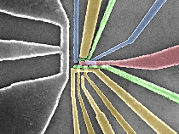
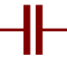
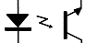

AWG
TTL trigger
AC
DC source
RF source
DC
Fast
Qubit
DC block
$$I_{SET}$$
LPF
Digitiser
V/I amp
V/V amp

