Slide 1
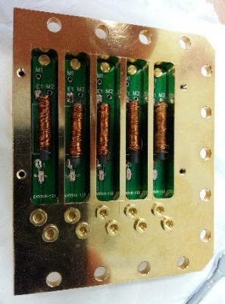
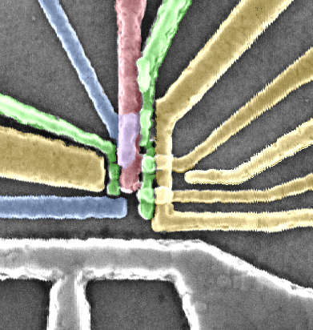
DC
AC
Fast <1GHz
Fast <18GHz
Fast
<40GHz
4 K
20dB
20dB
10dB
6dB
10dB
1 K
Base (mK)
20dB
40dB
3dB
Cavity filter
1GHz
80MHz
RC
20Hz
Bias - T
Diplexer
TLC
DG
RS
S
RB
RR
PL
RG
R
LB
BC
D
TG
MW antenna
GND

