Slide 1
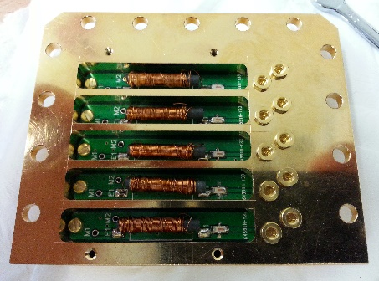
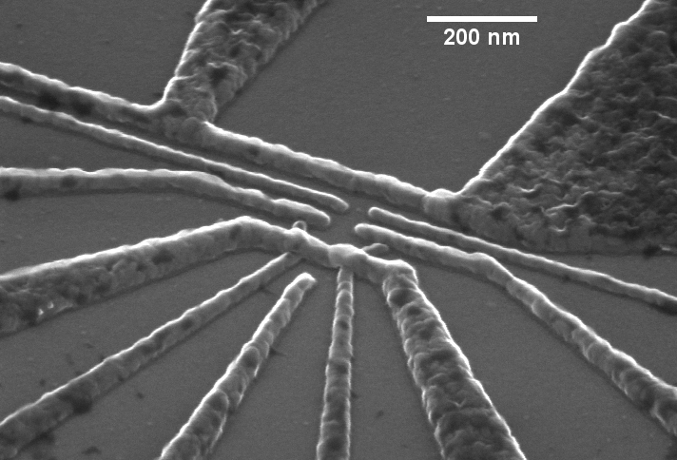
DC
AC
Fast
attenuation
Base (mK)
80MHz
RC
20Hz
MW antenna
DF1
GND
DS1
S
DF2
DS2
D
LB
TGAC
RB
TG

