Slide 1
Analyzing Walmart Sales Data: Insights and Visualizations
Power BI Dashboard Analysis
Yash Bhimrao Koli

Slide 2
Introduction
Objective: To provide insights into sales trends and performance across different categories and segments.
This presentation documents the process of analyzing Walmart sales data, including data fetching, processing, and visualization.

Slide 3
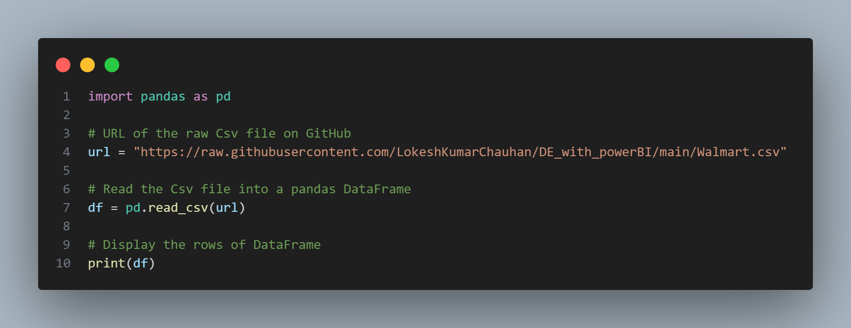
Data Fetching
Source: Data was fetched from a CSV file hosted on GitHub.
Method: Utilized Python and pandas to read the data into a DataFrame.

Slide 4
Data Processing
Handling Missing Values: Checked and handled missing values appropriately (no missing values in the dataset).
Removing Unnecessary Columns: Removed columns not used for visualization using Power Query in Power BI.

Slide 5
Key Metrics Overview
Visuals: Four cards indicating:
- Total Sales
- Total Profit
- Total Quantity
- Total Customers
Insights: Provides a snapshot of overall performance.

Slide 6
State-Level Analysis
State Slicer: Enables filtering sales data by state within a report.
Benefit: Allows detailed analysis of regional sales performance, identifying areas with higher or lower sales.

Slide 7
Profit Trends
Line Chart: Illustrates profit trends over time.(i.e. by year and quarter)
Insights: Highlights seasonal patterns and trends, crucial for planning marketing strategies and inventory management.

Slide 8
Category and Segment Analysis
Donut Chart: Shows profit by category (Furniture, Technology, Office Supplies).
Pie Chart: Shows profit by segment (Consumer, Corporate, Home Office).
Insights: Identifies the most profitable categories and segments.

Slide 9
Detailed Sales Insights
Map: Displays sales by state and segment.
Stacked Bar Chart: Shows profit by sub-category.
Matrix: Displays sales by sub-category and segment in a grid format.
Insights: Provides a geographical perspective on sales and detailed profit insights by sub-category.

Slide 10
Conclusion
- Key metrics offered a quick performance overview.
- State slicer provided regional insights.
- Line chart highlighted profit trends.
- Donut and pie charts identified profitable categories and segments.
- Map, stacked bar chart, and matrix provided detailed sales and profit insights.
Impact: These insights support informed decision-making, strategic improvements, and enhanced operational efficiency for Walmart.

