Slide 1
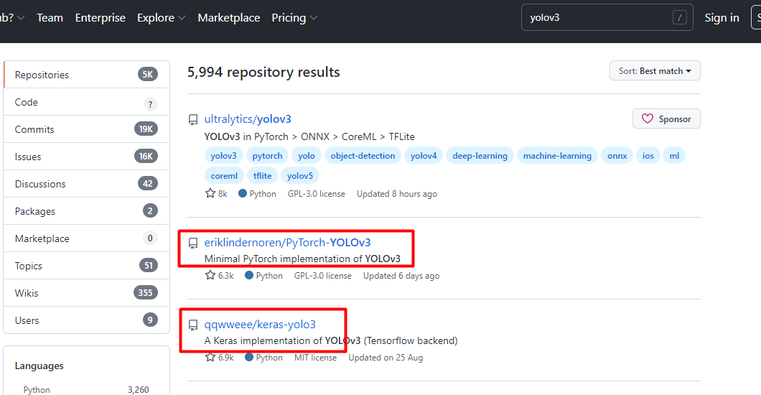



Slide 2
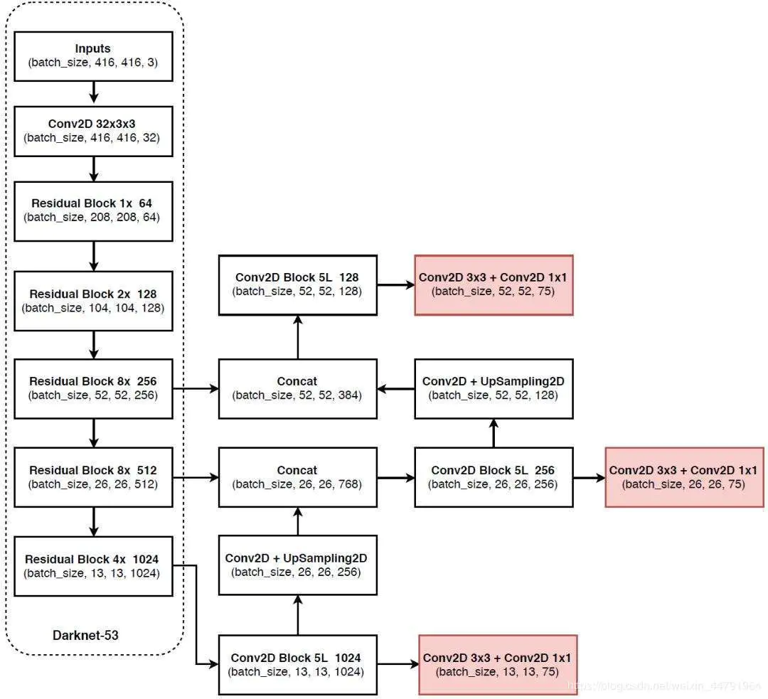
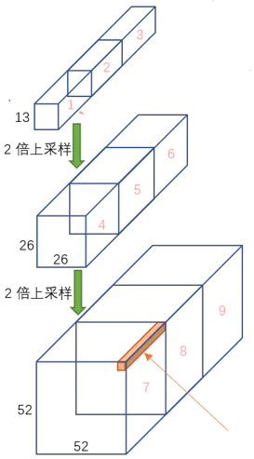
9个anchor,
每个输出特征层有3个anchor
真实值的编码
预测值的解码
损失函数实现
输出shape=(8,75,13,13)

Slide 3
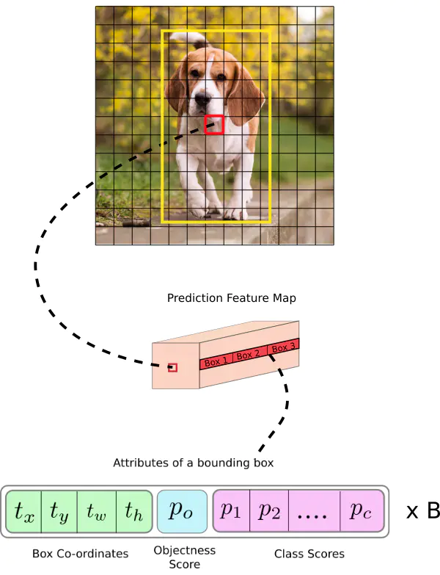
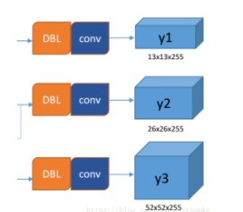
52x52
26x26
13x13
10,13, 16,30, 33,23, 30,61, 62,45, 59,119, 116,90, 156,198, 373,326
0
1
2
3
4
5
6
7
8
num_layers = len(anchors) // 3
anchor_mask = [[6, 7, 8], [3, 4, 5], [0, 1, 2]]
9个anchor,
每个输出特征层有3个anchor

Slide 4
(8,3,13,13,25)
13
...
26
52
空的全0矩阵, 待填充真实编码值

Slide 5
iou的计算
x,y,w,h
60,60
100,54
(0,0,60,60),(0,0,100,54)
y
30
50
30
27
x
30,30
50,27

Slide 6

best_iou=[8,2,4]

Slide 7
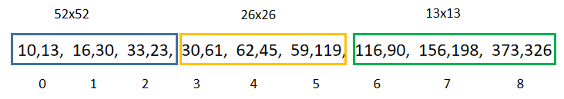
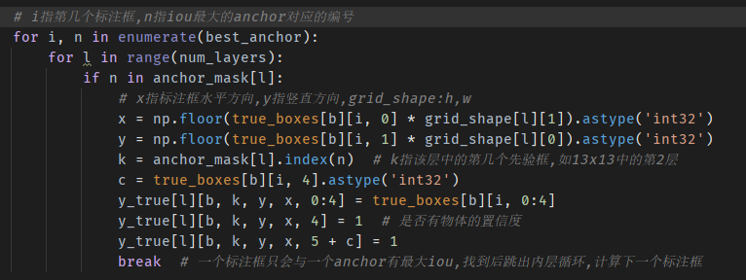
0,0
x
150
中心点归一化后
映射到13x13网格
300
(0.481,0.577)
(6.253,7.501)
(200,240)
宽高归一化后
0.361,0.865
416,416
0 | 0 | 0 | 0 | 0 | 0 | 0 | 0 | 0 | 0 | 0 | 0 | 0
0 | 0 | 0 | 0 | 0 | 0 | 0 | 0 | 0 | 0 | 0 | 0 | 0
0 | 0 | 0 | 0 | 0 | 0 | 0 | 0 | 0 | 0 | 0 | 0 | 0
0 | 0 | 0 | 0 | 0 | 0 | 0 | 0 | 0 | 0 | 0 | 0 | 0
0 | 0 | 0 | 0 | 0 | 0 | 0 | 0 | 0 | 0 | 0 | 0 | 0
0 | 0 | 0 | 0 | 0 | 0 | 0 | 0 | 0 | 0 | 0 | 0 | 0
0 | 0 | 0 | 0 | 0 | 1 | 0 | 0 | 0 | 0 | 0 | 0 | 0
0 | 0 | 0 | 0 | 0 | 0 | 0 | 0 | 0 | 0 | 0 | 0 | 0
0 | 0 | 0 | 0 | 0 | 0 | 0 | 0 | 0 | 0 | 0 | 0 | 0
0 | 0 | 0 | 0 | 0 | 0 | 0 | 0 | 0 | 0 | 0 | 0 | 0
0 | 0 | 0 | 0 | 0 | 0 | 0 | 0 | 0 | 0 | 0 | 0 | 0
0 | 0 | 0 | 0 | 0 | 0 | 0 | 0 | 0 | 0 | 0 | 0 | 0
0 | 0 | 0 | 0 | 0 | 0 | 0 | 0 | 0 | 0 | 0 | 0 | 0
y
anchor_mask = [[6, 7, 8], [3, 4, 5], [0, 1, 2]]

Slide 8
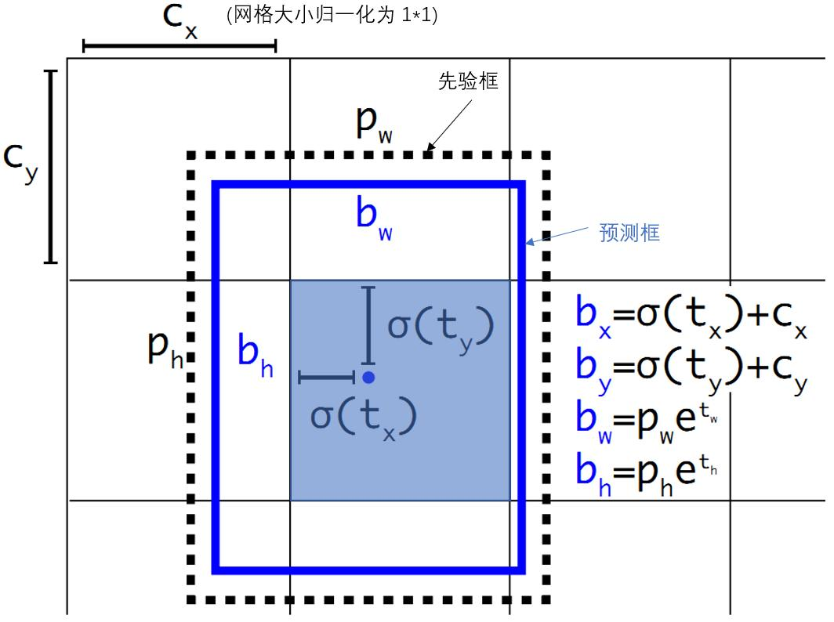
要获得真实框的中心和宽高, 预测值应该是什么?
true_x=bx-Cx
true_y=by-Cy
true_w=log(bw/Pw)
模型输出已做归一化处理, 上述值也要做
同样的处理
预测的是中心点相对于真实的偏移量
预测框宽高相对于真实框宽高的比例值

Slide 9

0
1
2
3
1
2
3

Slide 10

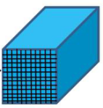
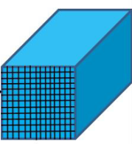
损失函数计算次序
shape=[8,3,13,13,25]
13x13
26x26
52x52
图片1
图片2
图片3
图片4
图片5
图片6
图片7
图片8
batch_size=8

Slide 11
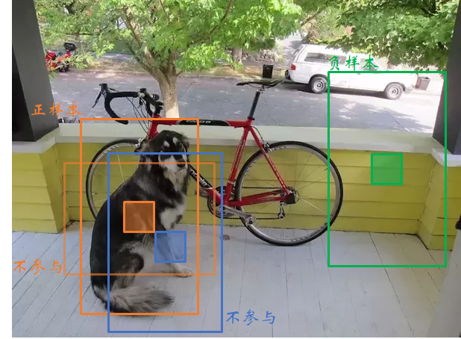
负样本选择

Slide 12
13x13

Slide 13
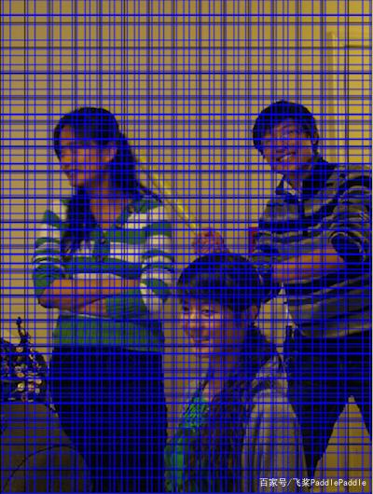
[8,3,13,13, 4:5]
1 | 1 | 1 | 1 | 1 | 1 | 1 | 1 | 1 | 1 | 1 | 1 | 1
1 | 1 | 1 | 1 | 1 | 1 | 1 | 1 | 1 | 1 | 1 | 1 | 1
1 | 1 | 1 | 1 | 1 | 1 | 1 | 1 | 1 | 1 | 1 | 1 | 1
1 | 1 | 1 | 1 | 1 | 1 | 1 | 1 | 1 | 1 | 1 | 1 | 1
1 | 1 | 1 | 1 | 1 | 1 | 1 | 1 | 1 | 1 | 1 | 1 | 1
1 | 1 | 1 | 1 | 1 | 1 | 1 | 1 | 1 | 1 | 1 | 1 | 1
1 | 1 | 1 | 1 | 1 | 1 | 1 | 1 | 1 | 1 | 0 | 0 | 0
1 | 1 | 1 | 1 | 1 | 1 | 1 | 1 | 1 | 1 | 1 | 0 | 1
1 | 1 | 0 | 1 | 1 | 1 | 1 | 0 | 1 | 0 | 1 | 1 | 1
1 | 1 | 0 | 0 | 1 | 1 | 1 | 1 | 0 | 1 | 1 | 1 | 1
1 | 1 | 1 | 1 | 1 | 1 | 1 | 1 | 1 | 1 | 1 | 1 | 1
1 | 1 | 1 | 1 | 1 | 1 | 1 | 1 | 1 | 1 | 1 | 1 | 1
1 | 1 | 1 | 1 | 1 | 1 | 1 | 1 | 1 | 1 | 1 | 1 | 1

Slide 14
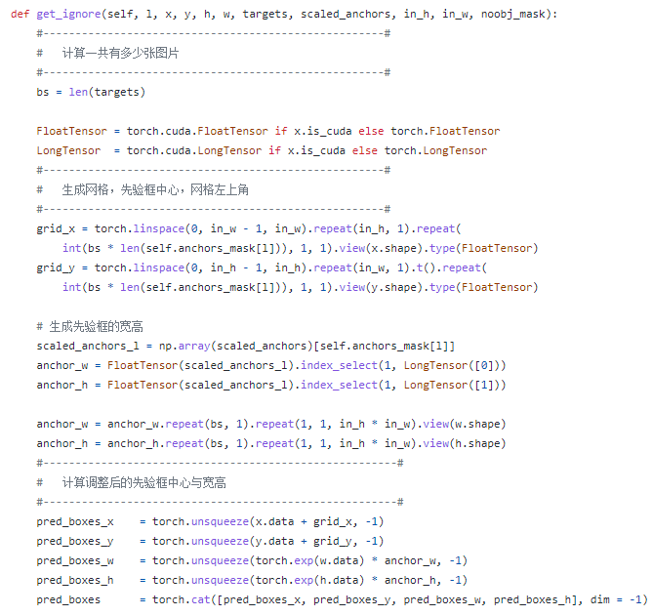
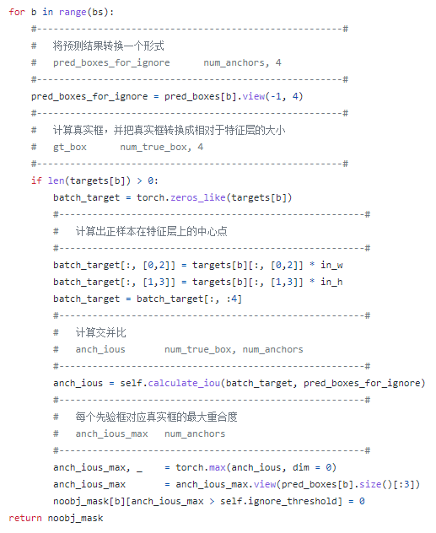

Slide 15
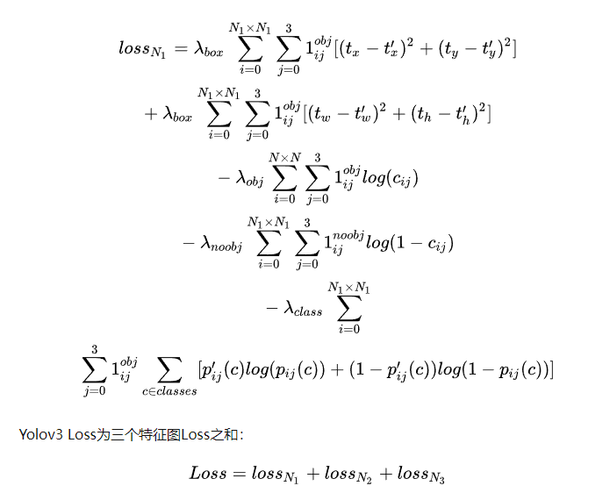

Slide 16
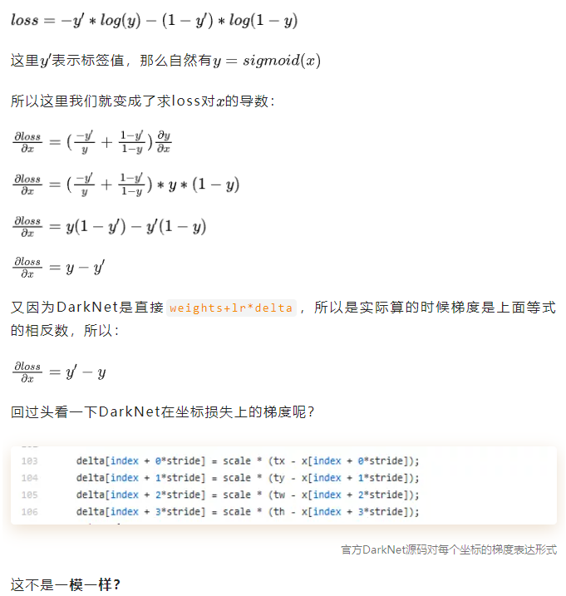
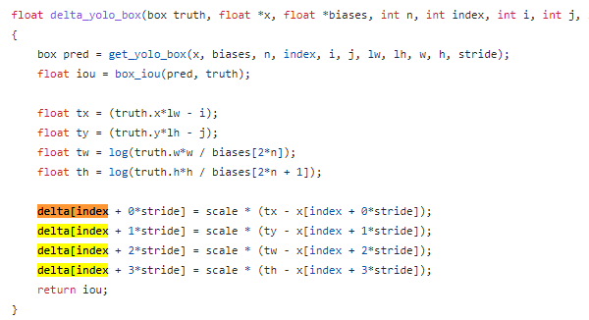
BCE loss求导过程

Slide 17
总结
1 我所做的工作有哪些?
对代码的重构,
部分模块的改进
2 对yolov3的后续改进.
与yolov4,5的关系
什么时候能跳出当前架构?

