Slide 1
N
E
W
D
A
Y
周报
屈原斌
20200109

Slide 2

0
上周所做的工作
1.看论文
2.跑代码

Slide 3
1
论文
Encoder-Agnostic Adaptation for Conditional Language Generation
Proposed Model: Pseudo-Self
-- trains a new full transformer decoder
Baseline1: Repr-Transformer
-- trains a new context attention layer
BASELINE 2: Context-Attn
-- modifies part of the self attention layer
-- injects learned encoder conditioning directly into the
-- pretrained self attention of the model.

Slide 4
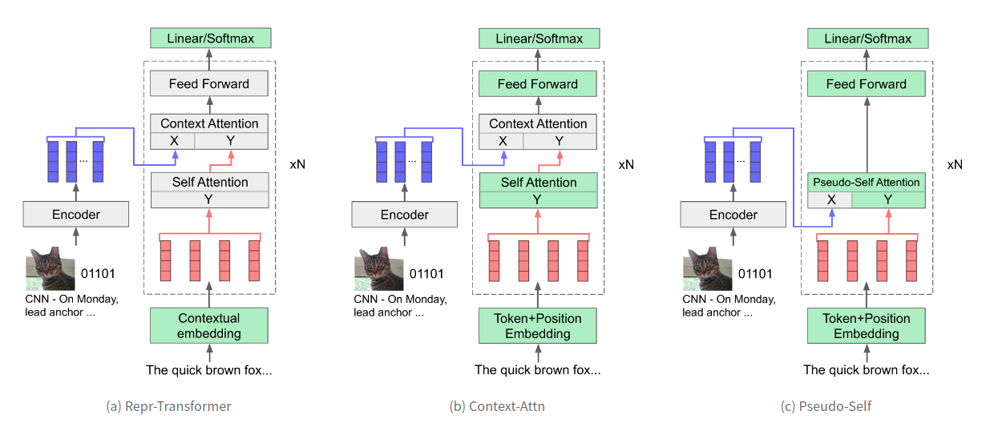
1
论文
green -- parameters are initilized with pretrained weights;
gray -- random initialization;
red vectors -- the target activations at each layer;
blue vectors -- the source features at the output of the encoder;
xN -- the section within the dotted lines is stacked N times.

Slide 5
1
论文
Class-conditional generation
document summarization
story generation
image paragraph captioning

Slide 6
2
本周要做的事
1.看论文
2.看源码，跑一下其他的任务

Slide 7
T
H
A
N
K
S
周报
屈原斌
20200109

