Slide 1

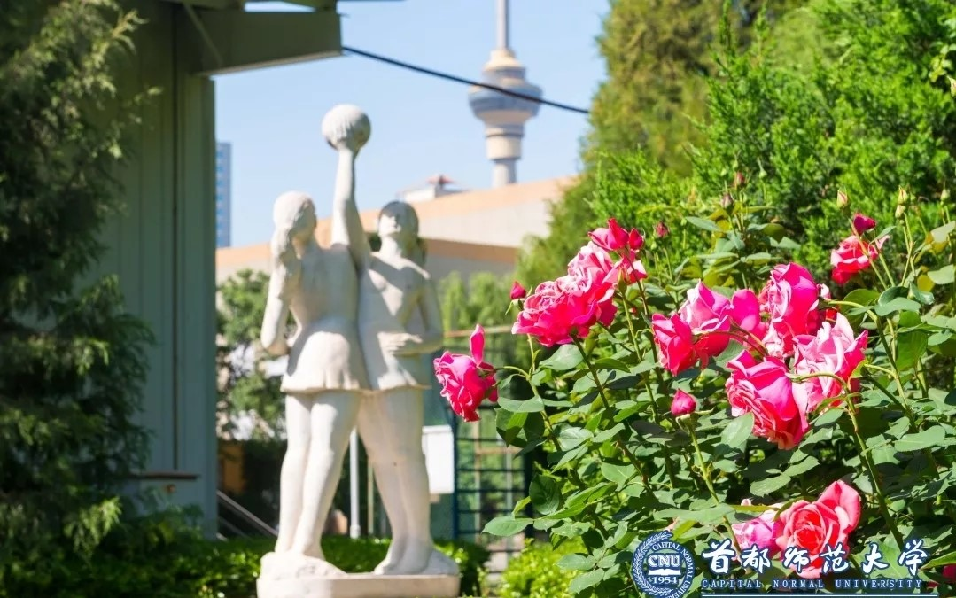
首都师范大学PPT模板
汇报人：小北

Slide 2
1
输入标题
The user can demonstrate on a projector or computer
Contents
2
输入标题
目 录
The user can demonstrate on a projector or computer
3
输入标题
The user can demonstrate on a projector or computer
4
输入标题
The user can demonstrate on a projector or computer

Slide 3
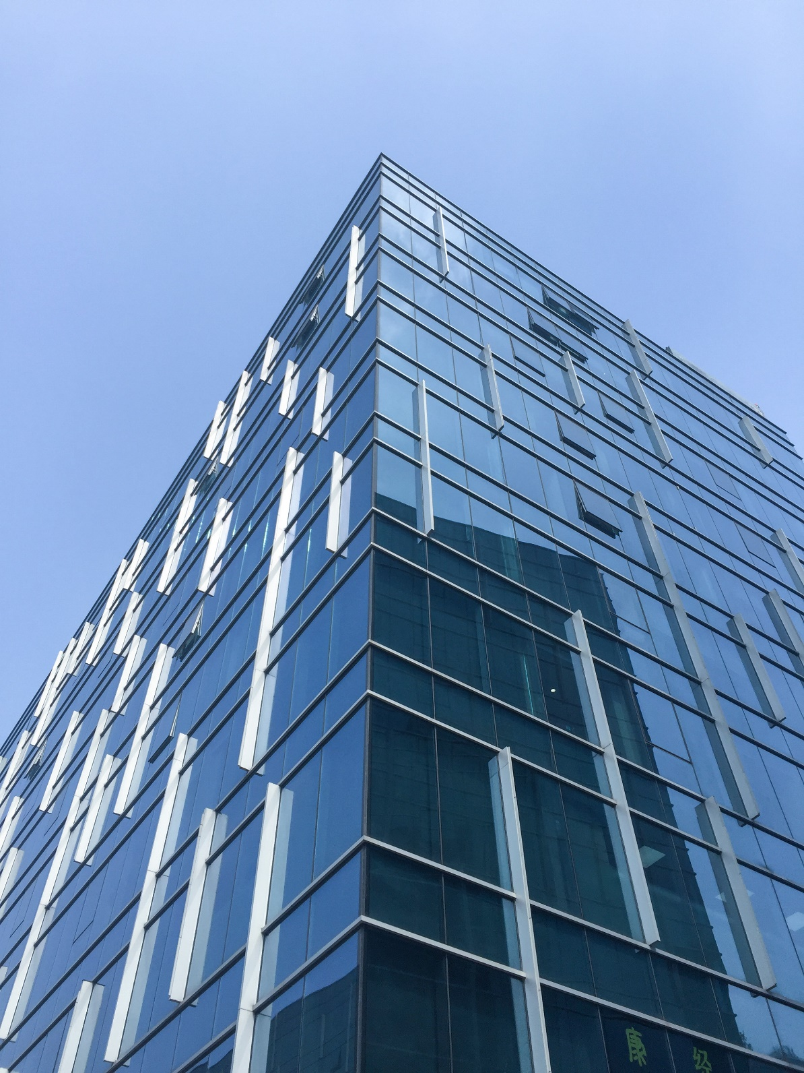

PART
01
输入标题
The user can demonstrate on a projector or computer, or print the presentation and make it into a film to be used
标题文字添加
标题文字添加
标题文字添加
标题文字添加

Slide 4

点击标题文字添加
The user can demonstrate on a projector or computer, or presentation and make it film to be used in a wider field
The user can demonstrate on a projector or computer, or presentation and make it film to be used in a wider field
The user can demonstrate on a projector or computer, or presentation and make it film to be used in a wider field
The user can demonstrate on a projector or computer, or presentation and make it film to be used in a wider field
The user can demonstrate on a projector or computer, or presentation and make it film to be used in a wider field

Slide 5
点击标题文字添加

Slide 6
点击标题文字添加
The user can demonstrate on a projector or computer, or presentation and make it film to be used in a wider field
The user can demonstrate on a projector or computer, or presentation and make it film to be used in a wider field
The user can demonstrate on a projector or computer, or presentation and make it film to be used in a wider field
The user can demonstrate on a projector or computer, or presentation and make it film to be used in a wider field
The user can demonstrate on a projector or computer, or presentation and make it film to be used in a wider field

Slide 7
点击标题文字添加

Slide 8
PART
02
输入标题
The user can demonstrate on a projector or computer, or print the presentation and make it into a film to be used
标题文字添加
标题文字添加
标题文字添加
标题文字添加

Slide 9
点击标题文字添加
The user can demonstrate on a projector or computer, or presentation and make it film to be used in a wider field
The user can demonstrate on a projector or computer, or presentation and make it film to be used in a wider field
The user can demonstrate on a projector or computer, or presentation and make it film to be used in a wider field
The user can demonstrate on a projector or computer, or presentation and make it film to be used in a wider field
The user can demonstrate on a projector or computer, or presentation and make it film to be used in a wider field

Slide 10
点击标题文字添加

Slide 11
点击标题文字添加
The user can demonstrate on a projector or computer, or presentation and make it film to be used in a wider field
The user can demonstrate on a projector or computer, or presentation and make it film to be used in a wider field
The user can demonstrate on a projector or computer, or presentation and make it film to be used in a wider field
The user can demonstrate on a projector or computer, or presentation and make it film to be used in a wider field
The user can demonstrate on a projector or computer, or presentation and make it film to be used in a wider field

Slide 12
PART
03
输入标题
The user can demonstrate on a projector or computer, or print the presentation and make it into a film to be used
标题文字添加
标题文字添加
标题文字添加
标题文字添加

Slide 13
点击标题文字添加
The user can demonstrate on a projector or computer, or presentation and make it film to be used in a wider field
The user can demonstrate on a projector or computer, or presentation and make it film to be used in a wider field
The user can demonstrate on a projector or computer, or presentation and make it film to be used in a wider field
The user can demonstrate on a projector or computer, or presentation and make it film to be used in a wider field
The user can demonstrate on a projector or computer, or presentation and make it film to be used in a wider field

Slide 14
点击标题文字添加

Slide 15
点击标题文字添加
The user can demonstrate on a projector or computer, or presentation and make it film to be used in a wider field
The user can demonstrate on a projector or computer, or presentation and make it film to be used in a wider field
The user can demonstrate on a projector or computer, or presentation and make it film to be used in a wider field
The user can demonstrate on a projector or computer, or presentation and make it film to be used in a wider field
The user can demonstrate on a projector or computer, or presentation and make it film to be used in a wider field

Slide 16
PART
04
输入标题
The user can demonstrate on a projector or computer, or print the presentation and make it into a film to be used
标题文字添加
标题文字添加
标题文字添加
标题文字添加

Slide 17
点击标题文字添加
The user can demonstrate on a projector or computer, or presentation and make it film to be used in a wider field
The user can demonstrate on a projector or computer, or presentation and make it film to be used in a wider field
The user can demonstrate on a projector or computer, or presentation and make it film to be used in a wider field
The user can demonstrate on a projector or computer, or presentation and make it film to be used in a wider field
The user can demonstrate on a projector or computer, or presentation and make it film to be used in a wider field

Slide 18
点击标题文字添加

Slide 19
点击标题文字添加
The user can demonstrate on a projector or computer, or presentation and make it film to be used in a wider field
The user can demonstrate on a projector or computer, or presentation and make it film to be used in a wider field
The user can demonstrate on a projector or computer, or presentation and make it film to be used in a wider field
The user can demonstrate on a projector or computer, or presentation and make it film to be used in a wider field
The user can demonstrate on a projector or computer, or presentation and make it film to be used in a wider field

Slide 20
首都师范大学PPT模板
汇报人：小北

