Slide 1
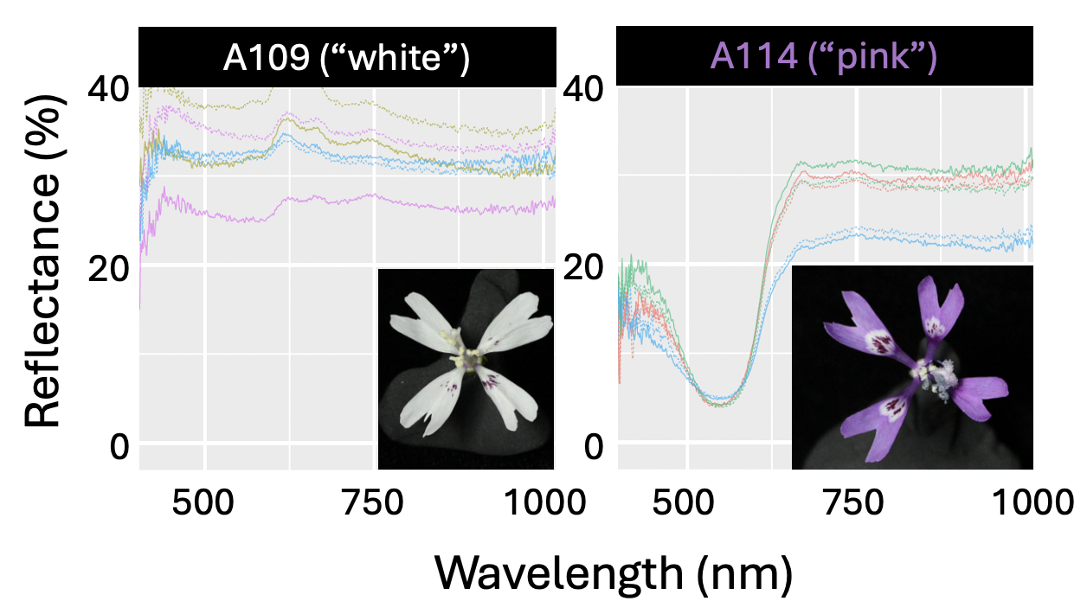

Slide 2
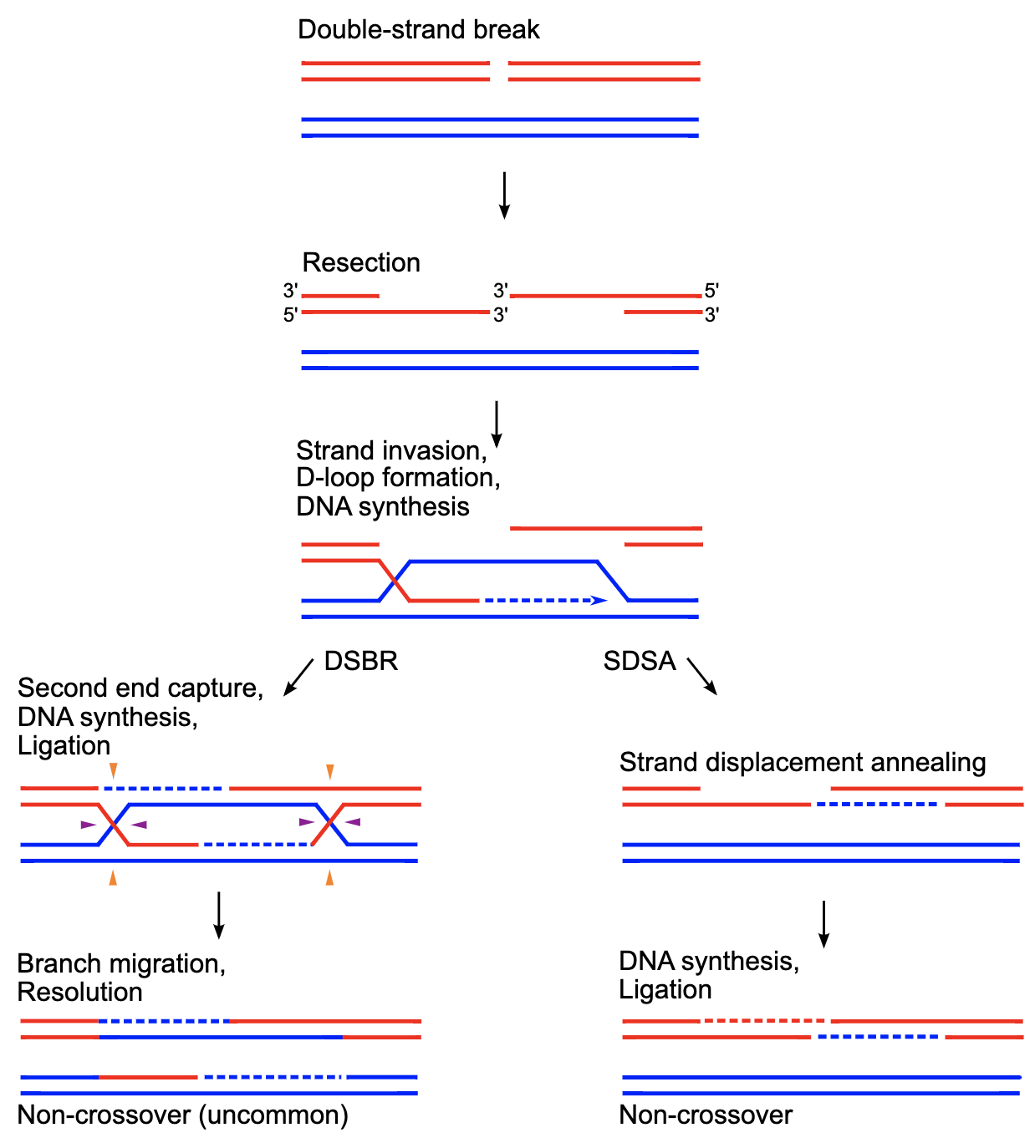
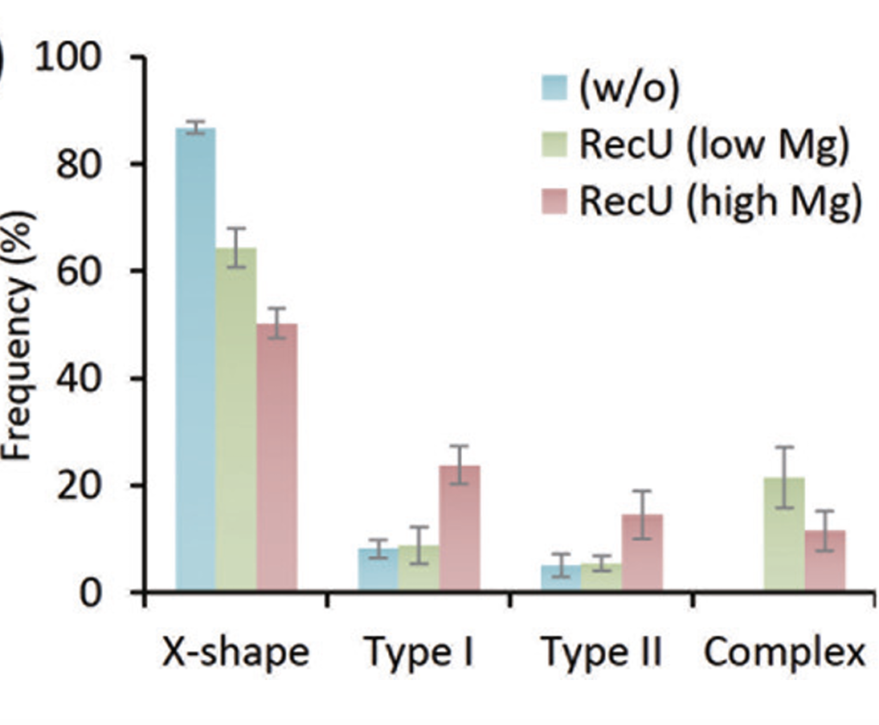
Double strand break
A) A scientific model
Resection
3′5′
3′3′
5′3′
Strand invasion
D-loop formation
DNA synthesis
Second end
capture
DNA synthesis Ligation
DSBR
SDSA
Strand
displacement annealing
DNA synthesis,
Ligation
Non-crossover (uncommon)
Non-crossover
B) A statistical model
Non-crossover
Branch migration,
Resolution

Slide 3
