Slide 1
Describing Data
Analysis of Biological Data
Chapter 3

Slide 2
Three common descriptions of data
Location (or central tendency)
Width (or spread)
Association (or correlation)

Slide 3
Samples and Populations
We do statistics to learn about the
World Out There (the population)
From
Data (the sample)

Slide 4
Estimates and Parameters
We almost never sample an entire population. So we can’t nail down parameters from populations.
But we can make educated guesses of parameters by making estimates from samples.

Slide 5
Measures of location
The mean, the median, and the mode.

Slide 6
Mean, Median, and Mode
Mean: The average value.
The weight of the data.
Median: A typical individual.
If I take an individual at random, this is the value we expect them to be closest to.
Mode: The most common individual.
The most common value for an individual

Slide 7
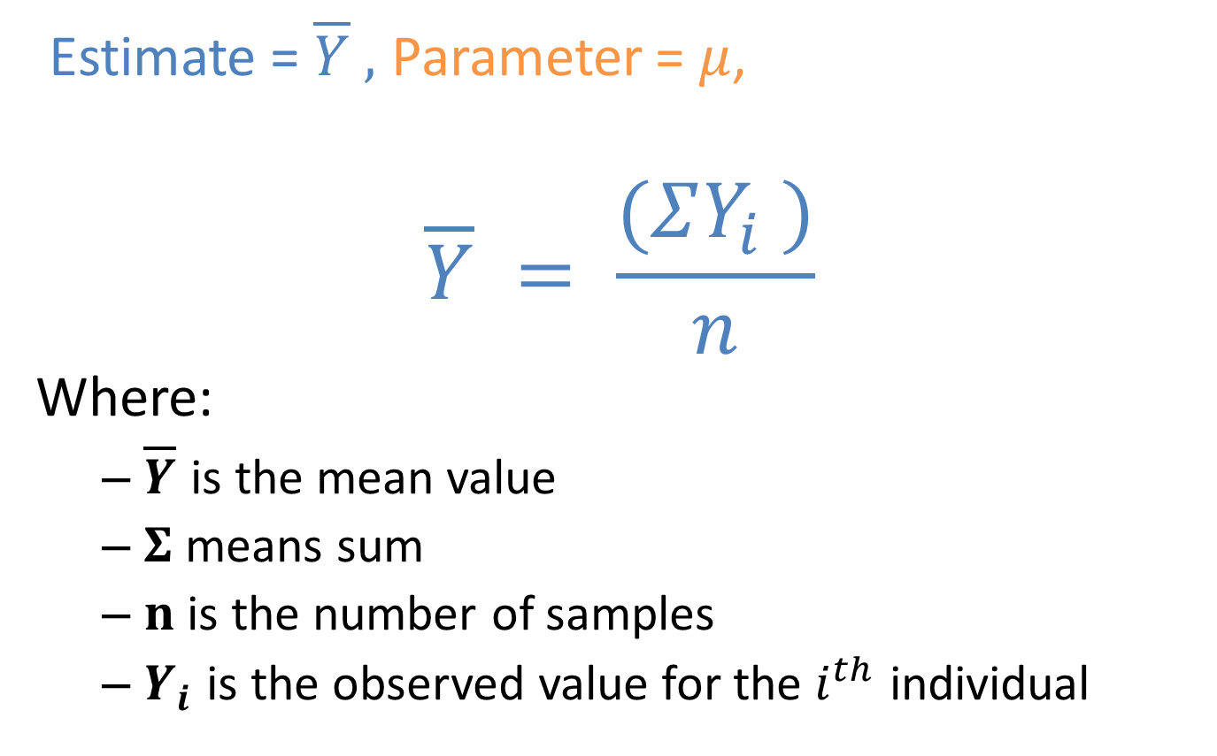
Mean
Estimate = $\overline{Y} ,$ Parameter = $μ$,
$$\overline{Y} = \frac{(ΣY_{i} )}{n}$$
Where:
$\overline{Y}$ is the mean value
$Σ$ means sum
$n$ is the number of samples
$Y_{i}$ is the observed value for the $i^{th}$ individual

Slide 8
Histograms reveal measures of center

Slide 9
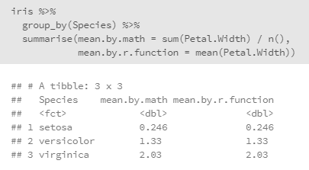
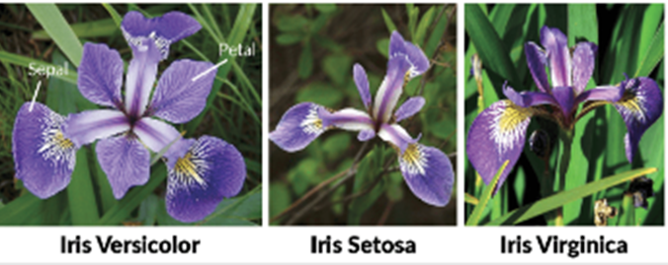
Mean: an example from R
Sum up all observations and divide by the sample size

Slide 10
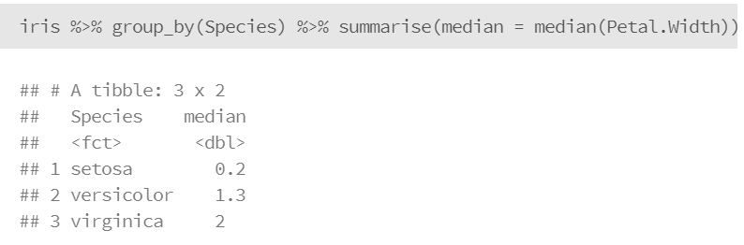

Median: an example from R
Sort your flowers in order of pedal width.
Go halfway down, and find the middle value.
The mean of the (n+1)/2th value for samples of odd sizes.
The mean of the n/2 and 1+n/2 values for even sizes.

Slide 11
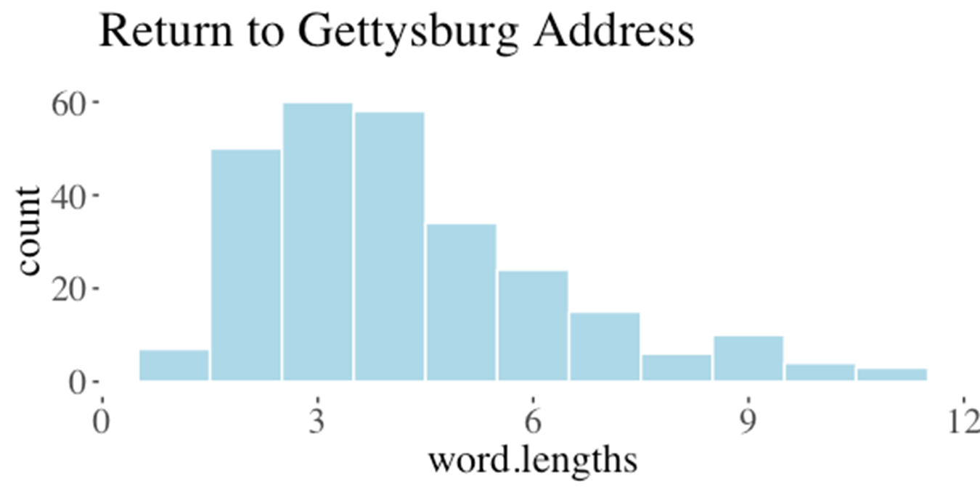

Mean from a frequency table (1/2)
$$\frac{\sum_{cat=1}^{n.cat}{{Number}_{i}}×{Value}_{i}}{n.total}$$

Slide 12
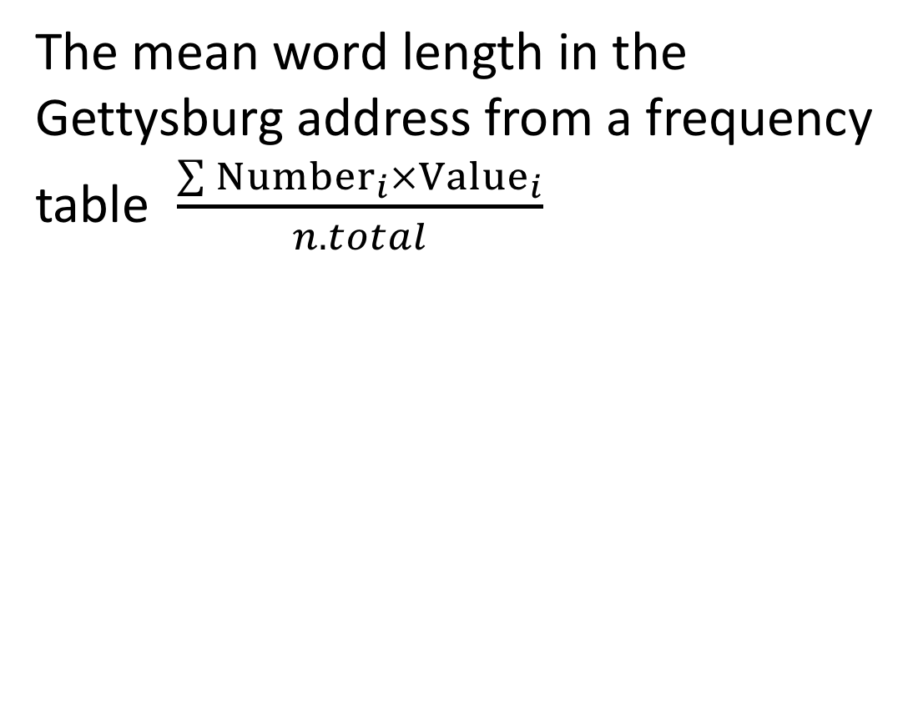
Mean from a frequency table (2/2)
Word Length | Count
1 | 7
2 | 50
3 | 60
4 | 58
5 | 34
6 | 24
7 | 15
8 | 6
9 | 10
10 | 4
11 | 2
The mean word length in the Gettysburg address from a frequency table $\frac{\sum{{Number}_{i}}×{Value}_{i}}{n.total}$
numerator = 1x7 + 2x50 + 3x60 + 4x58 +
5x34 + 6x24 +7x15 + 8x6 +
9x10 + 10x4 + 11x3 = 1149.
denominator = 7 + 50 + 60 + 58 + 34 + 24 + 15
+ 6+ 10 + 4 + 3 = 271
mean = 1149 / 271 = 4.24

Slide 13
The proportion is the mean
Coding categories as yes/no, and set yes=1, no=0
Example: What proportion of deaths (age 15-19 USA 1999) were homicides?
2093 of the 13778 deaths were homicides.
So 2093/13778 = 0.15 of deaths were by homicide.

Slide 14
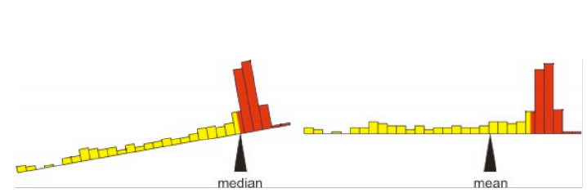
Mean or Median?
The mean is more convenient mathematically.
The median is a better descriptor for skewed populations.
The mean is the center of gravity. The median is the middle measurement.

Slide 15
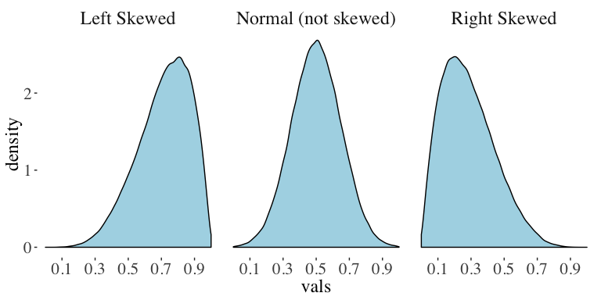
Skewedness

Slide 16
Width of the data
Range, Interquartile Range, Variance, Standard Deviation, Coefficient of Variation.
Analysis of Biological Data
Chapter 3

Slide 17
Measures of width.
The Range, The Interquartile Range, The Variance, The Standard Deviation, and The Coefficient of Variation

Slide 18
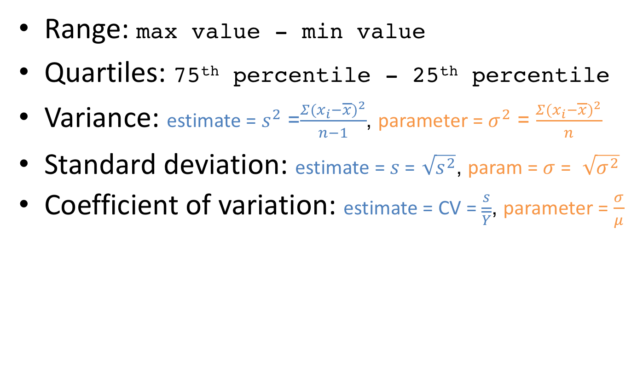
Measures of width
Range: max value - min value
Quartiles: 75th percentile - 25th percentile
Variance: estimate = $s^{2}$ =$\frac{Σ(x_{i}−\overline{x})^{2}}{n−1}$, parameter = $σ^{2}$ = $\frac{Σ(x_{i}−\overline{x})^{2}}{n}$
Standard deviation: estimate = $s$ =$\sqrt{s^{2}}$, param = $σ$ = $\sqrt{σ^{2}}$
Coefficient of variation: estimate = CV = $\frac{s}{\overline{Y}}$, parameter = $\frac{σ}{μ}$

Slide 19
Histograms reveal spread

Slide 20
Range
The difference between extreme values.
Small samples tend to give lower estimates of the range than large samples.
So, the sample range is a biased estimator of the true range of the population.
Largest Value
minus
Smallest Value

Slide 21
Quartiles
Imagine sorting your data.
The individual in the middle is the median
The first and last individuals mark the range
The other two quantiles are the individuals ¼ and ¾ the way into your sorted list of data
The difference between these is the interquartile range
This measure has less bias than the range.
75th percentile
minus
25th percentile

Slide 22
Boxplots reveal quartiles
Largest value
3rd quartile
Median
1st quartile
Smallest value

Slide 23
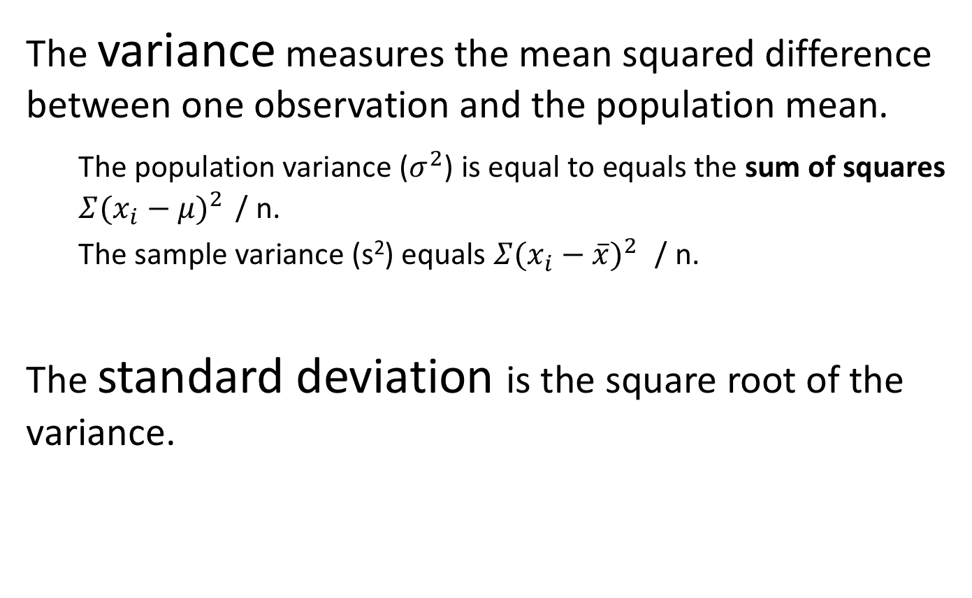
Variance and Standard Deviation
The variance measures the mean squared difference between one observation and the population mean.
The population variance ($σ^{2}$) is equal to equals the sum of squares $Σ(x_{i}−μ)^{2}$ / n.
The sample variance (s²) equals $Σ(x_{i}−\overline{x})^{2}$ / n.
The standard deviation is the square root of the variance.

Slide 24
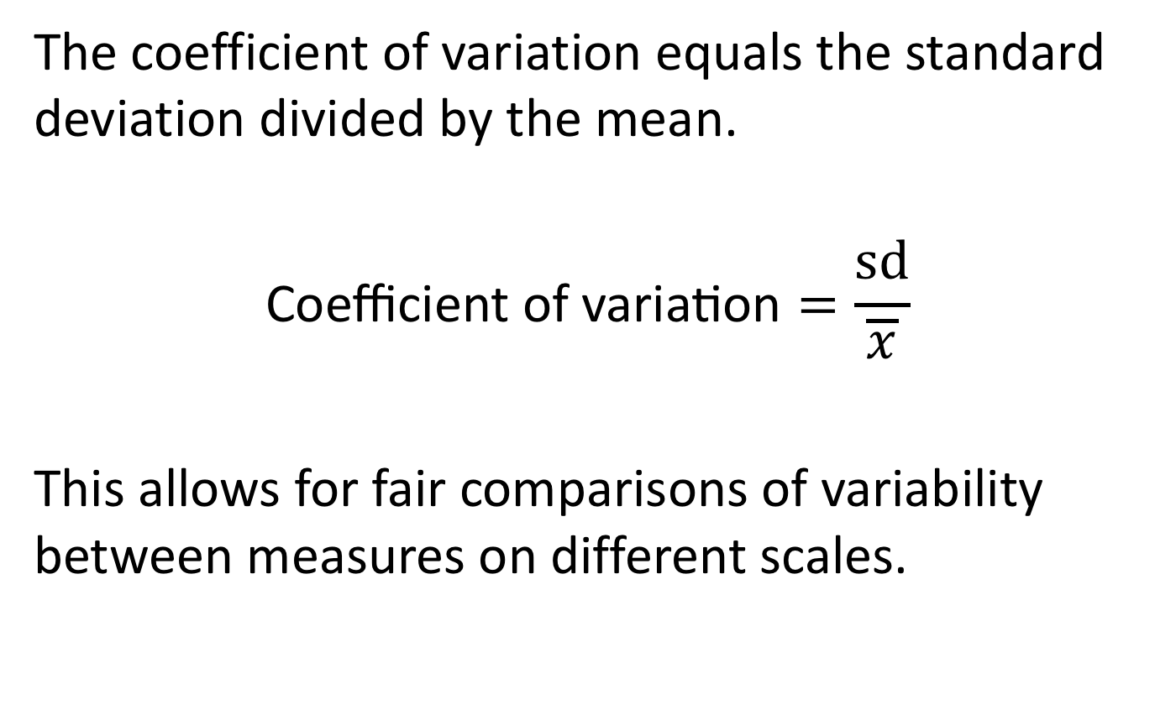
Coefficient of Variation
The coefficient of variation equals the standard deviation divided by the mean.
$$\text{Coefficient} \text{of} \text{variation}=\frac{sd}{\overline{x}}$$
This allows for fair comparisons of variability between measures on different scales.

Slide 25
How sample size influences estimates

Slide 26
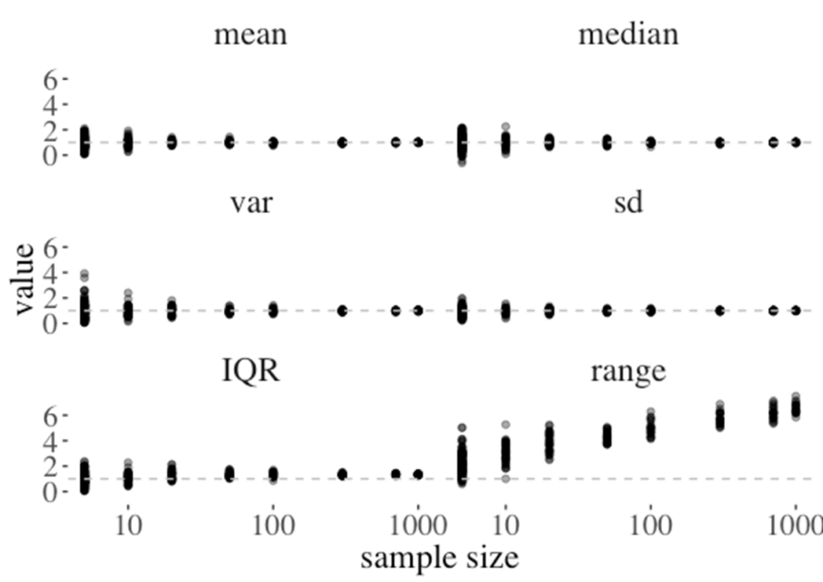
Most (good) estimators are unbiased
Unbiased estimators do not change reliably with sample size.
.

Slide 27
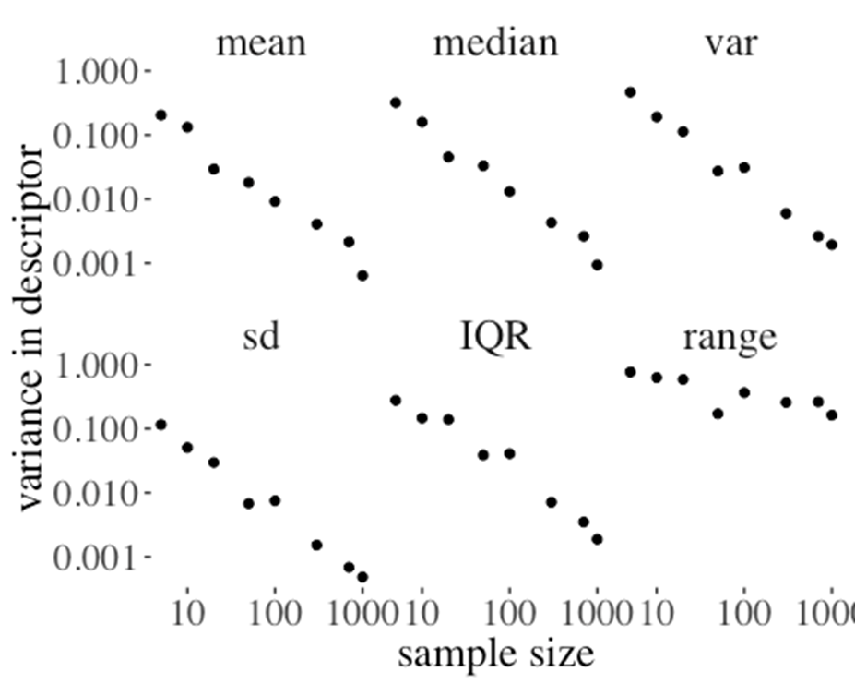
Sampling error decrease with sample size
Noise in estimates decrease with sample size. Thus increased sample size increases precision.

Slide 28
Review and Nomenclature
Analysis of Biological Data
Chapter 3

Slide 29
Review and Nomenclature

Slide 30
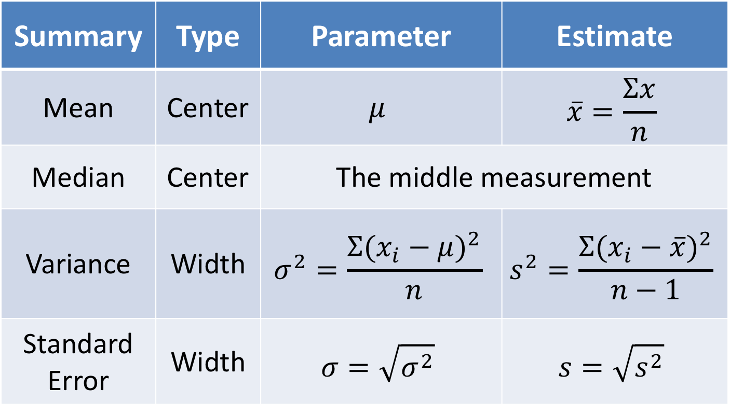
The Most Critical Summaries
Summary | Type | Parameter | Estimate
Mean | Center | $$μ$$ | $$\overline{x}=\frac{Σx}{n}$$
Median | Center | The middle measurement
Variance | Width | $$σ^{2}=\frac{Σ({x_{i}−μ)}^{2}}{n}$$ | $$s^{2}=\frac{Σ({x_{i}−\overline{x})}^{2}}{n−1}$$
Standard Error | Width | $$σ=\sqrt{σ^{2}}$$ | $$s=\sqrt{s^{2}}$$

