Slide 1
Statistics and Samples: What it’s all about
Analysis of Biological Data
Chapter 1

Slide 2
Key Learning Objectives
Understand the major goal of statistics.
Distinguish between a sample and a population.
Distinguish between an estimate and a parameter.
Identify why estimates from samples may deviate from parameters of populations.
Identify the properties of a good sample.

Slide 3
What’s the point of statistics?
Like what are we even doing here?

Slide 4
The Point of Statistics
Goal: We want to learn about the world.
Challenge: We can’t look at the whole world.
Solution: Take a sample and generalize outward.
New Challenge: Samples deviate from the populations by
bad luck (sampling error) or
unrepresentative sampling (sampling bias)

Slide 5
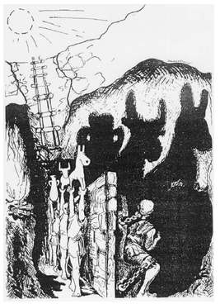
Statistics’ Fundamental Obsession
Question: How do we make inferences
about the WORLD from our finite
observations?
Answer: Make models to account for the
process of sampling & the
associated hazards.
Plato’s “Allegory of the Cave”, drawing by Markus Maurer. Veldkamp, Gabriele. Zukunftsorientierte Gestaltung informationstechnologischer Netzwerke im Hinblick auf die Handlungsfähigkeit des Menschen. Aachener Reihe Mensch und Technik, Band 15, Verlag der Augustinus Buchhandlung, Aachen 1996, Germany. From wikimedia commons

Slide 6
Populations & Samples

Slide 7
Populations and Samples
Parameters represent the world out there. AKA the truth.
Samples come from hard-won data that we collect.

Slide 8
Parameters versus Estimates [1/2]
Because we can’t sample an entire population, we usually don’t know parameters.
Parameters describe Populations
But we can get a good sense of the parameters from estimates we make from samples.
Estimates approximate parameters as inferred from Samples

Slide 9
Parameters versus Estimates [2/2]
Parameters are constants. This means that they are fixed. Parameters are the world. Parameters are the truth.
Estimates are random variables. This means estimates change from one random sample to the next from the same population.

Slide 10
Probability versus Frequency
Probability distribution
The proportion of the population with a given value (often approxi- mated with a function)
Frequency distribution
The number of times a value occurs in a sample.

Slide 11
Sampling, what could go wrong?
Sampling errors and sampling bias

Slide 12
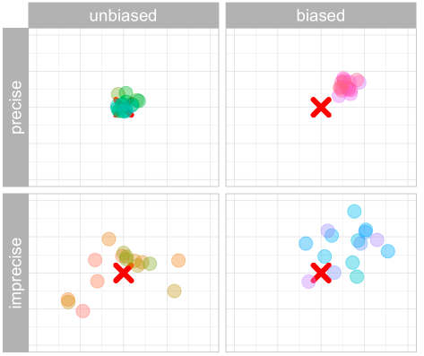
Sampling bias and sampling error
How sampling bias & sampling error alter estimates
Sampling bias:
Systematic difference between estimates & parameters.
Sampling error:
Undirected deviation of estimates away from parameters
Colored points are estimates from a sample. Red X is a true parameter.

Slide 13
Sampling bias: Systematic difference between parameters & estimates.
Case study: Polls in the 1936 US Election.

Slide 14
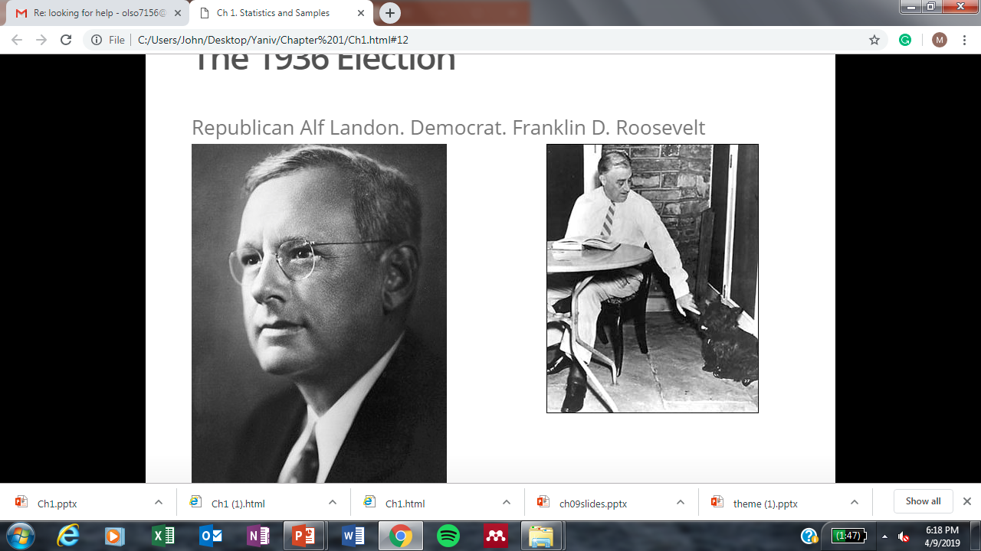
The 1936 Election
Republican Alf Landon Democrat Franklin Roosevelt
https://upload.wikimedia.org/wikipedia/commons/c/c6/Alf_Landon_closeupcrop.jpg https://upload.wikimedia.org/wikipedia/commons/3/37/FDR_and_Fala_at_table.jpg

Slide 15
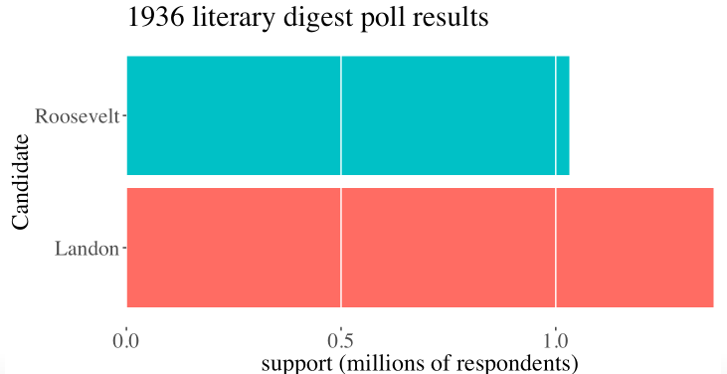
1936 Literary Digest poll
2.4 million responses to 10 million Questionnaires , sent to people from telephone books and club lists.

Slide 16
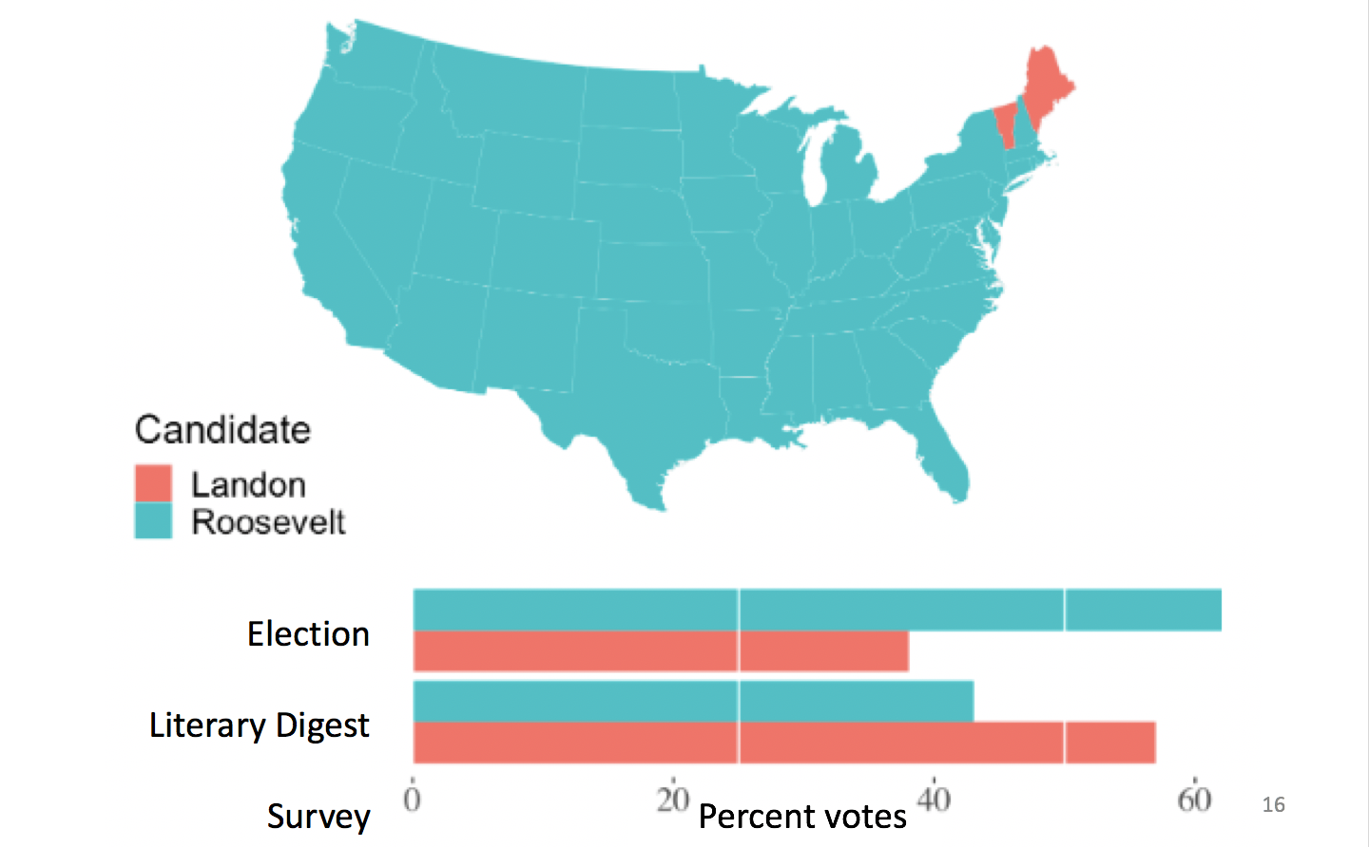
Election: Roosevelt in a Landslide

Slide 17
Sampling Bias in the 1936 Polls
Questionnaire was more likely to reach rich people (who could afford phones & attend book clubs) than those with fewer means.
Voting and party preference are correlated with wealth.
Poorer people (underrepresented in the poll) supported Roosevelt, carrying him to victory.

Slide 18
Volunteer bias
Volunteers for a study are likely to be different, on average, from the population.
For example:
Volunteers for sex studies are more likely to be open about sex.
Volunteers for medical studies may be sicker than the general population.
Animals that are caught may be slower or more docile than those that are not.
Taking random samples is hard and requires effort

Slide 19
Properties of a good sample
A good sample is made up of a Random and Independent selection of a sufficiently large number of individuals.
In a random sample, each member of a population has an equal and independent chance of being selected

Slide 20
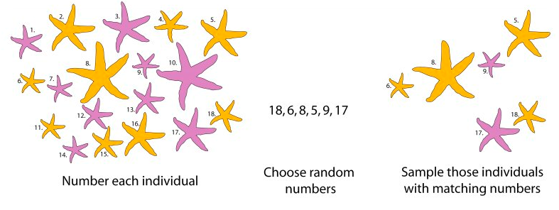
How to get a random sample
Carefully characterize a population and use computer code (e.g. the sample() function in R) to select participants randomly.

Slide 21
Sampling: Limits & Interpretations
Our analyses only directly related to the population we studied.
Be clear on what that population is and be honest about limits to generalization.

Slide 22
Sampling Error: Chance deviations between estimates and the truth
Even when you did NOTHING wrong.

Slide 23
Sampling error
Even if you sample perfectly, by the book, your estimates will differ from the true parameter.
Sampling error is the difference between the estimate and its true parameter value.

Slide 24
Estimates are random variables
Because an estimate is a random variable, the value of an estimate is influenced by chance.
Therefore estimates will differ among random samples from the same population.

Slide 25
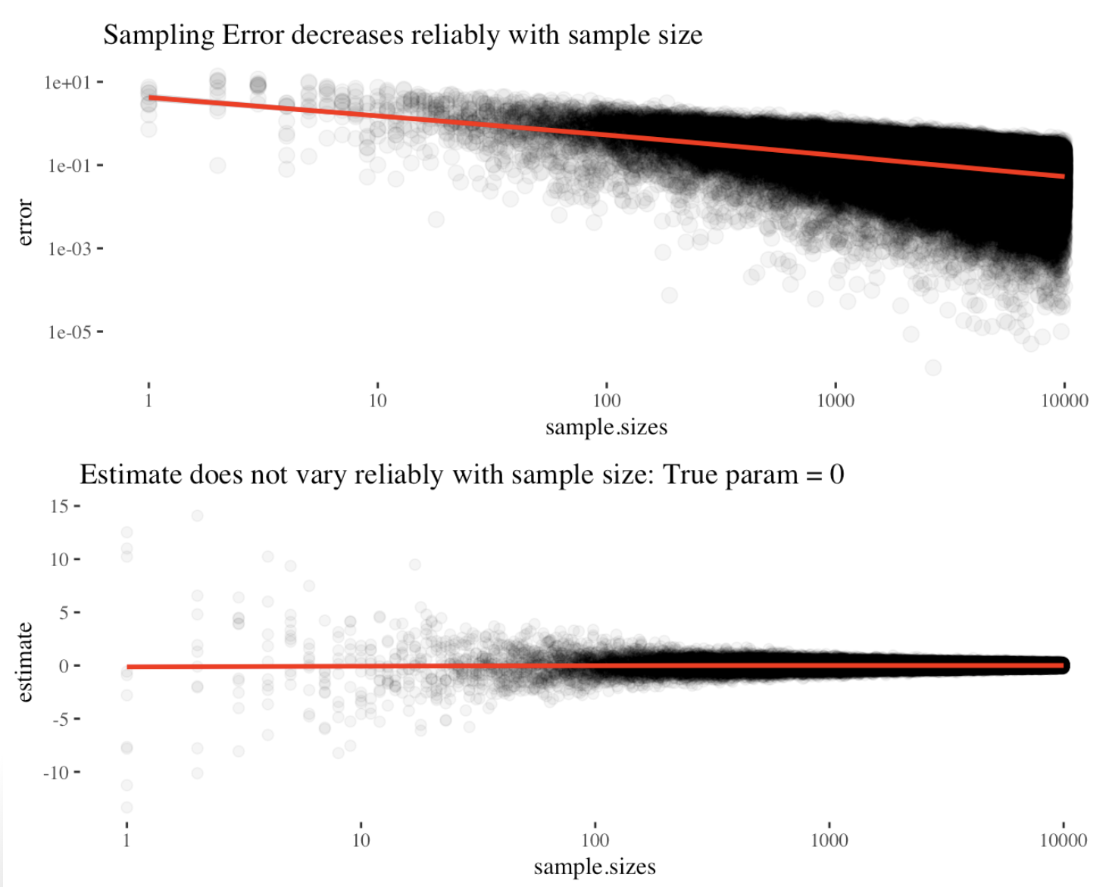
Sampling error declines with sample size

Slide 26
Types of variables
Variables come in different flavors
Numeric:
Discrete: can only take some values.
Continuous (can take any value).
Categorical:
Ordinal: can be ranked.
Nominal: cannot be ranked.

Slide 27
Another classification of variables
We predict the values of response variables from explanatory variables.

Slide 28
Types of variables: Why do we care?
Knowing what kind of variable we have drives our models of data analysis, and is therefore critical to the enterprise of statistics.

Slide 29
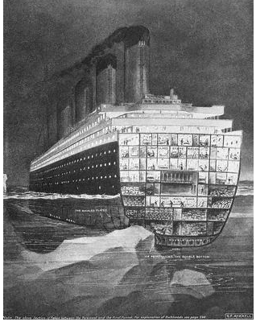
Case Study: surviving the Titanic
https://upload.wikimedia.org/wikipedia/commons/9/91/Titanic_struck_iceberg.jpg

Slide 30
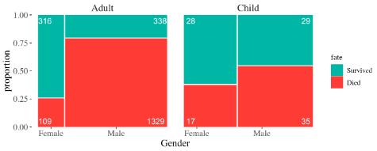
Case Study: surviving the Titanic
Identify the explanatory & response variables.
Identify each variable’s type.
Is this an experimental or observational study?
Describe the population this result came from… How far would you generalize from this to “Women & Children 1st?”

