Slide 1
Probability
Analysis of Biological Data
Chapter 5

Slide 2
Key Learning Objectives
Understand why probability theory is the foundation for statistical reasoning.
Think addition upon hearing “OR”.
Think multiplication upon hearing “AND”.
Calculate probabilities of complex events by using standard rules of probability theory.
Use Bayes’ theorem to translate between probabilistic statements.

Slide 3
Review

Slide 4
Samples and Populations
We do statistics to learn about the
World Out There (the population)
From
Data (the sample)

Slide 5
Why Sample?
We almost never sample an entire population. So we can’t nail down parameters from populations.
But we can make educated guesses of parameters by making estimates from samples.

Slide 6
Estimation with Uncertainty
We know that estimates will differ from parameters by chance.
So, we must incorporate uncertainty in our estimation.
How can we rigorously quantify this uncertainty?

Slide 7
Probability Theory: The foundation of statistical thinking

Slide 8
What is a Probability?
The probability of an event is its true relative frequency.
This is the proportion of times the event would occur if we repeated the same process over and over again.

Slide 9
Probability Theory & Statistics
We can use probability theory to connect sample estimates
Which we can obtain from data.
Which take their values by chance.
To Population Parameters:
Which we can almost never obtain.
With values free from chance.

Slide 10
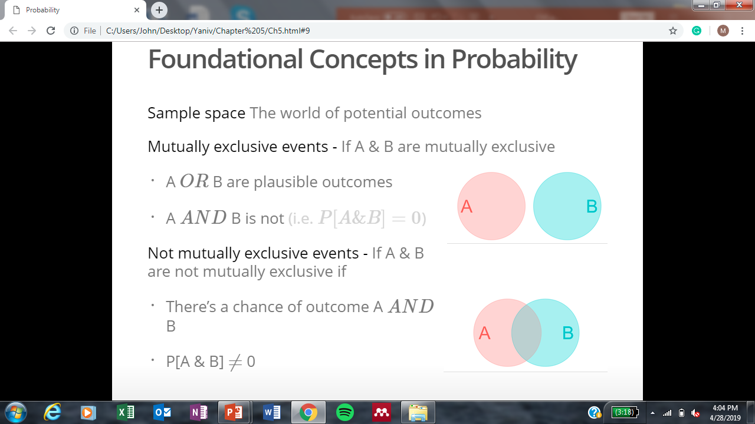
Foundational Concepts in Probability
Sample space
Mutually exclusive events
Non-exclusive events
The world of potential outcomes

Slide 11
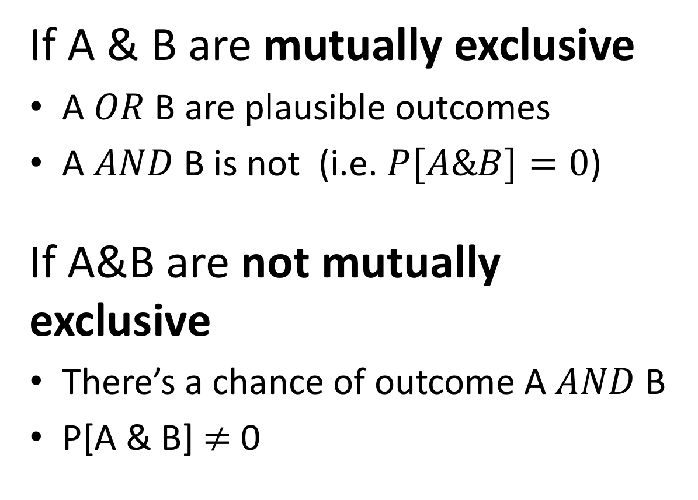
Mutually Exclusive vs Non-Exclusive Events
If A & B are mutually exclusive
A $OR$ B are plausible outcomes
A $AND$ B is not (i.e. $P[A\&B]=0$)
If A&B are not mutually exclusive
There’s a chance of outcome A $AND$ B
P[A & B] $≠$ 0

Slide 12
Probability Distributions

Slide 13
What is A Probability Distribution?
A probability distribution is the true relative frequency of all possible values of a random variable.

Slide 14
The Sampling Distribution
The sampling distribution is the distribution of the parameter estimate of interest from these samples.
The sampling distribution is among the most important probability distributions for statistics.

Slide 15
Probability: Distributions vs Densities
Probability distributions describe discrete variables.
All discrete outcomes have finite probabilities.
Probability distributions sum to 1.
Probability densities describe continuous variables.
The probability of any continuous outcome is infinitesimal.
Probability densities integrate to 1.

Slide 16
Probability Distribution: One Die 🎲

Slide 17
Prob. Distribution: Sum of Two Dice 🎲 + 🎲

Slide 18
Proportions

Slide 19
Proportion
The proportion is the number of times an event occurs divided by the number of tries.
We can think of a proportion as a realized sample from our probability distribution.

Slide 20
Proportion: Outcome of a Die 🎲

Slide 21
Compare Probability to Proportion 🎲

Slide 22
Proportion: Sum of Two Dice 🎲 + 🎲

Slide 23
Compare Probability to Proportion 🎲 + 🎲

Slide 24
Probability Rules

Slide 25
Probability Rules: The general addition principle (this or that)

Slide 26
General Addition Principle
P[A or B]= P[A] + P[B] - P[A and B]
i.e. The probability of A PLUS The probability of B MINUS The probability of A and B
Equals The probability of A or B

Slide 27
A Special Case of the Addition Principle
If A and B are mutually exclusive
P[A and B] = 0
So, if A and B are mutually exclusive,
P[A or B] = P[A] + P[B]

Slide 28

Example: Probability of a Range Slide 1/2
The probability the sum of two dice is between six and eight.
P[ 6 $≤$🎲 + 🎲$≤$ 8] = P[6] + P[7] + P[8]

Slide 29
Example: Probability of a Range Slide 2/2
The probability the sum of two dice is between six and eight.
P[ 6 $≤$🎲 + 🎲$≤$ 8] = P[6] + P[7] + P[8]

Slide 30

Example: Probability of Not
The probability the sum of two dice is not between six and eight.
$Σ$P[X] = 1 therefore P[not x] = 1 – P[X]

Slide 31
Example: General Addition Principle
Probability that the sum of two dice is odd or between 6 and 8.
Subtract P[P and B] to avoid double counting nonexclusive events.
P[A or B] = P[A] + P[B] - P[A and B]
Odd and Odd or
Between 6 & 8 Between 6 & 8
Between 6 & 8 Odd

Slide 32
Challenge: General Addition Principle
Use the general addition principle to find the proportion of animals that walk or fly.
See exceptions: walking bat, flying elephant

Slide 33
Solution: General Addition Principle
Use the general addition principle to find the proportion of animals that walk or fly.
Answer:
Walks (🐘 + 🐦) + Flies (🦇 + 🐦) - Walks and flies 🐦
= 🐘 + 2 🐦 + 🦇 - 🐦 = 🐘 + 🐦 + 🦇

Slide 34
Probability Rules: The general multiplication principle (this and that)

Slide 35
The General Multiplication Principle
P[A & B] = P[A] X P[B|A]
The probability of A and B equals
The probability of one event
Times the probability of the other, conditioned on the first.
Read “|” as “given”

Slide 36
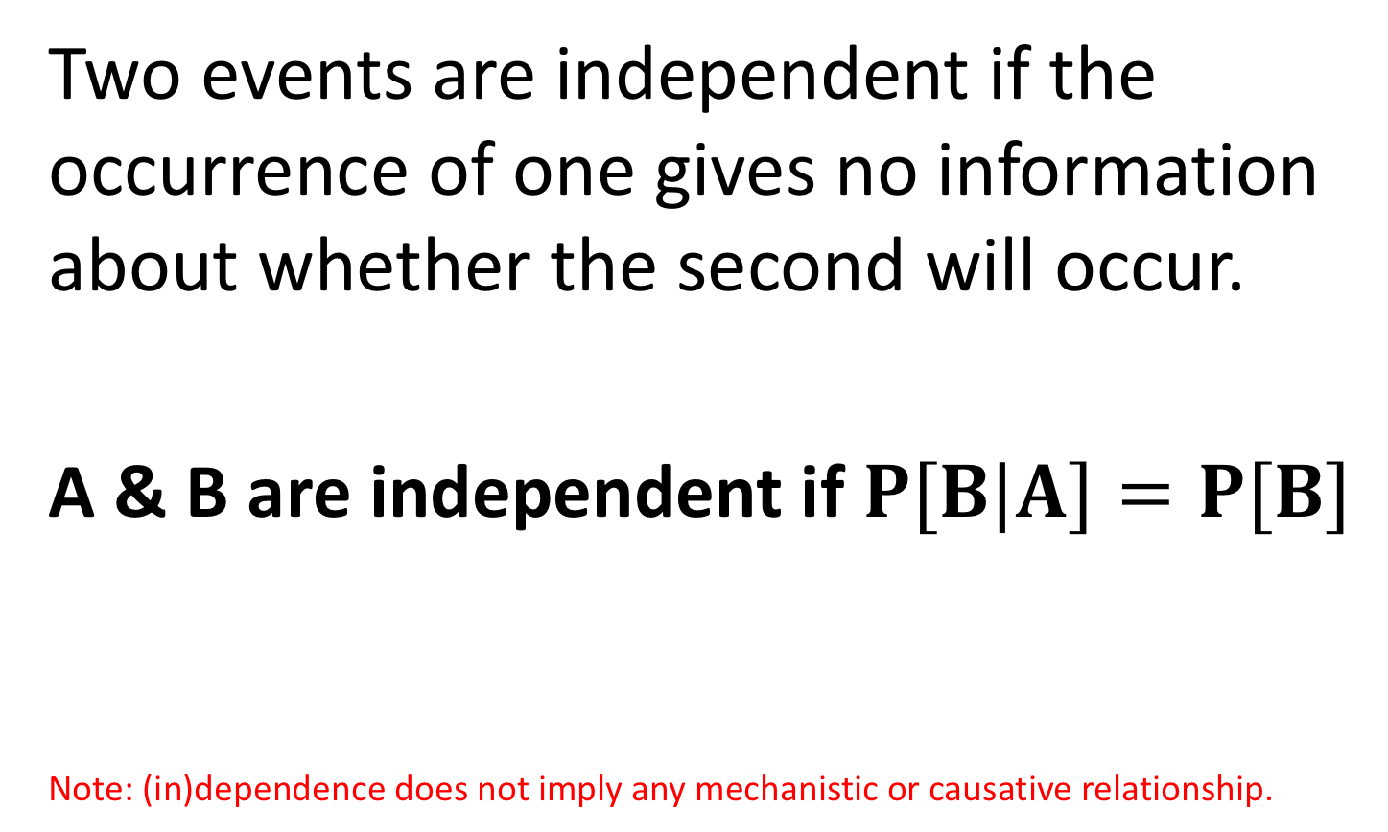
Independence
Two events are independent if the occurrence of one gives no information about whether the second will occur.
A & B are independent if $P[B|A]=P[B]$
Note: (in)dependence does not imply any mechanistic or causative relationship.

Slide 37
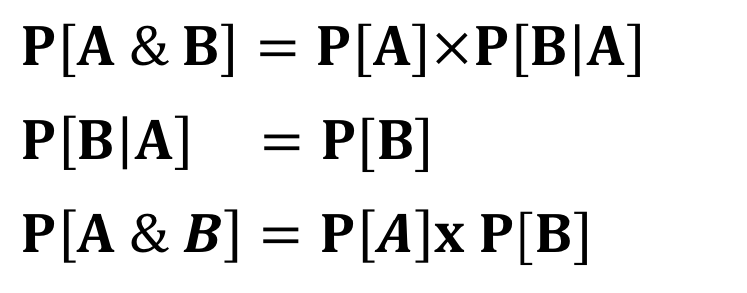
Probabilities for Independent Variables
The Multiplication Principle
A special case of the general multiplication principle
That is, if A & B are independent, the probability of A and B is the product of their probabilities.
General multiplication principle:
If A & B are independent:
If A & B are independent:
$$P[A \& B]=P[A]×P[B|A]$$
$P\left[B | A\right] =P[B]$
$$P\left[A \& B\right]=P\left[A\right]x P[B]$$

Slide 38
Example: Oguchi Disease
“Oguchi disease, also called congenital stationary night blindness, Oguchi type 1 or Oguchi disease 1, is an autosomal recessive form of congenital stationary night blindness associated with fundus discoloration and abnormally slow dark adaptation.” from wikipedia
Oguchi disease is autosomal recessive.
Therefore it is only expressed in people who inherit both mom’s AND dad’s mutant allele.

Slide 39
Question: Child of Two Oguchi Carriers
Question: If both parents have an affected chromosome but no disease, find the probability that a given child will have Oguchi disease?

Slide 40
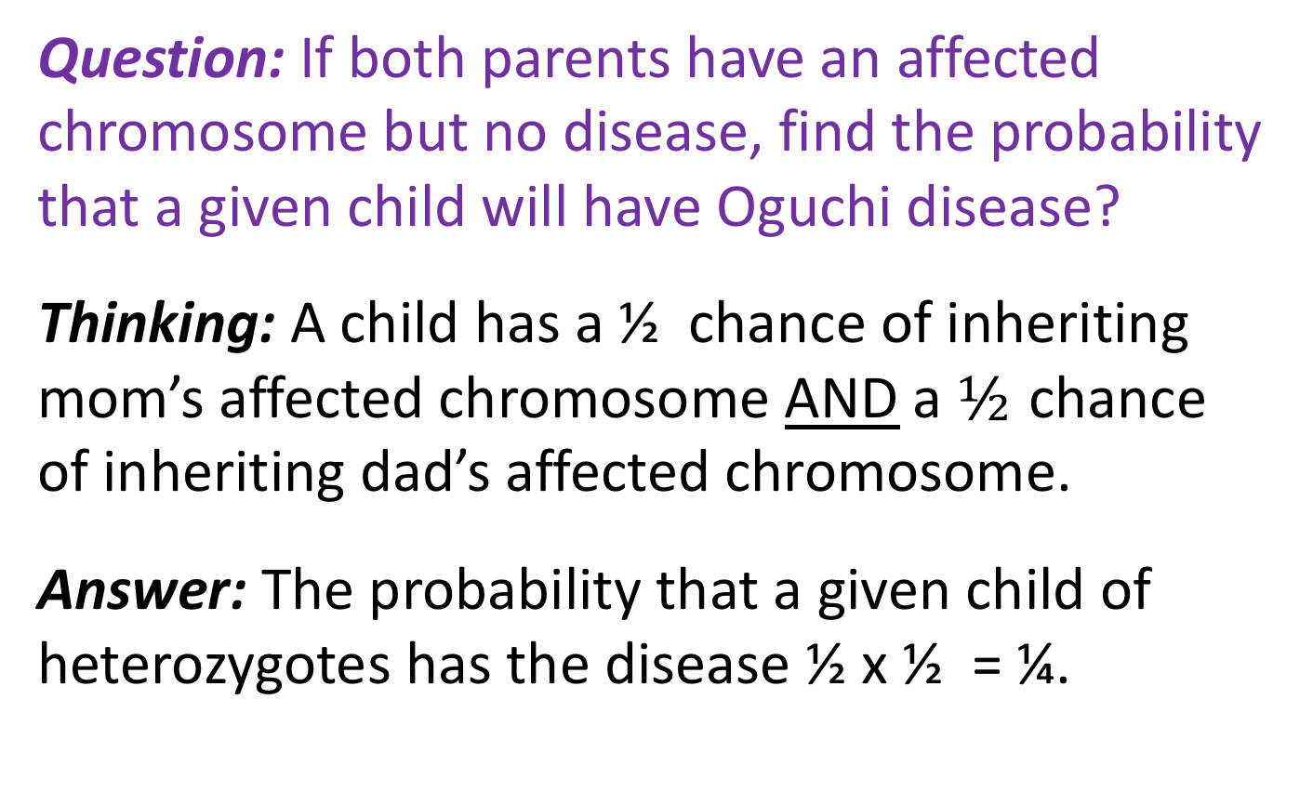
Answer: Child of Two Oguchi Carriers
Question: If both parents have an affected chromosome but no disease, find the probability that a given child will have Oguchi disease?
Thinking: A child has a ½ chance of inheriting mom’s affected chromosome AND a $½$ chance of inheriting dad’s affected chromosome.
Answer: The probability that a given child of heterozygotes has the disease ½ x ½ = ¼.

Slide 41
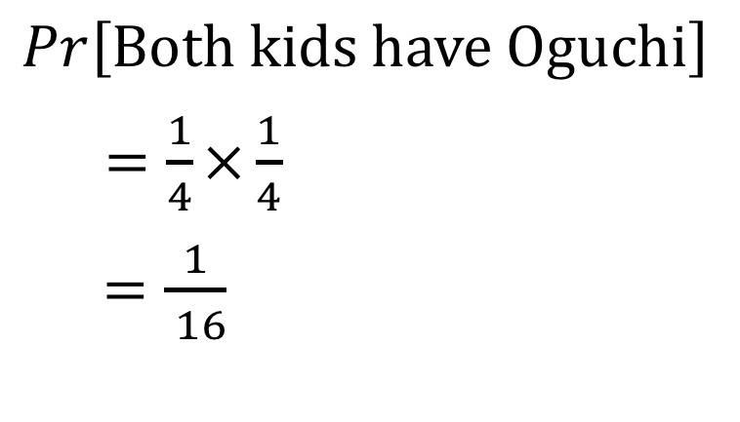
Visualization: Two Children of Oguchi Carriers
If both of parents have an affected chromosome but no disease, what’s the probability that both of their children will have Oguchi disease?
# Children With Oguchi disease
$$Pr\left[Both kids have Oguchi\right]$$
$=\frac{1}{4}×\frac{1}{4}$
$=\frac{1}{ 16}$
0
1
1
2
Does child one have Oguchi?
Yes No
No Yes
Does child two have Oguchi?

Slide 42
Probability Rules: Using probability trees

Slide 43
Probability Trees
Probability theory can be hard.
Being explicit about what you’re doing makes this easier.
Probability trees offer a simple way to follow accounting.

Slide 44
How to Make Probability Trees
Write down all possible outcomes for event one, two… etc. and connected them.
Write down the probability of each outcome, conditional on their path.
Multiply each value down a path to find the probability of that path.
Repeat for all paths.
Sum paths that lead to the same destination.
i.e. the same outcome.

Slide 45
Probability Trees Example: Children of Oguchi Carriers
If both of parents have an affected chromosome but no disease, what’s the probability that none, one or both of their children will have Oguchi disease?
Let’s revisit this question using probability trees!

Slide 46
Probability Trees: Children of Oguchi Carriers Step 1
1. Write down all possible outcomes for event one, two… etc. and connected them.
1st child
Affected
Unaffected
2nd child
Affected
Unaffected
Affected
Unaffected

Slide 47
Probability Trees: Children of Oguchi Carriers Step 2
2. Write down the probability of each outcome, conditional on their path.
Probability
1st child
1/4
3/4
1st child
Affected
Unaffected
Probability
2nd child
1/4
3/4
1/4
3/4
2nd child
Affected
Unaffected
Affected
Unaffected

Slide 48
Probability Trees: Children of Oguchi Carriers Step 3
3. Multiply each value down a path to find the probability of that path.
Probability
1st child
1/4
3/4
1st child
Affected
Unaffected
Probability
2nd child
1/4
3/4
1/4
3/4
2nd child
Affected
Unaffected
Affected
Unaffected
Probability of
the path
1/16
3/16
3/16
9/16

Slide 49
Probability Trees: Children of Oguchi Carriers Step 4
Sum paths that lead to the same destination.
P[2 Affected] = 1/16 P[1 Affected] = 6/16 P[0 Affected = 9/16]
Probability
1st child
1/4
3/4
1st child
Affected
Unaffected
Probability
2nd child
1/4
3/4
1/4
3/4
2nd child
Affected
Unaffected
Affected
Unaffected
Probability of
the path
1/16
3/16
3/16
9/16
# Children with
Oguchi disease
2
1
1
0

Slide 50
Probability Rules: Dependent events & Conditional Probabilities

Slide 51
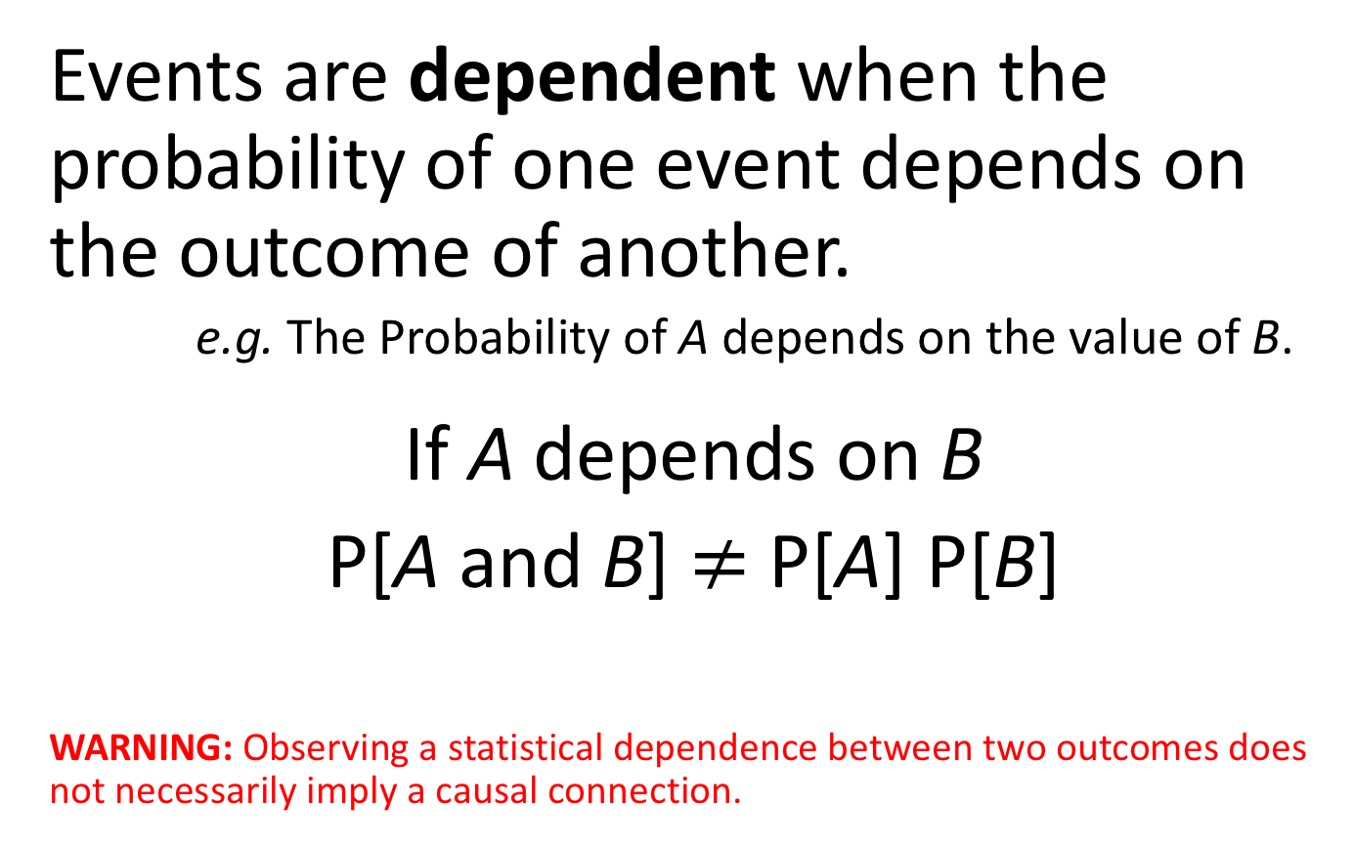
Dependent Events
Events are dependent when the probability of one event depends on the outcome of another.
e.g. The Probability of A depends on the value of B.
If A depends on B
P[A and B] $≠$ P[A] P[B]
WARNING: Observing a statistical dependence between two outcomes does not necessarily imply a causal connection.

Slide 52
Example: Surviving the Titanic
Of the 2092 Adults on the Titanic
319 [approx. 0.152] sat in 1st class.
654 [approx. 0.312] survived.
If survival and sitting in 1st class are independent:
We expect that around 0.152*0.312*2092 = 100 1st class adults would survive.
We expect that around 0.848*0.312*2092 = 554 other adults would survive.

Slide 53
Surviving the Titanic Depends on Class
More 1st class passengers survived than expected.
197 of the 319 people in 1st class survived.
This severely exceeds the 100 expected survivors.
Fewer other passengers survived than expected.
457 of the 1773 other passengers survived.
This is way less than the 554 expected survivors.

Slide 54
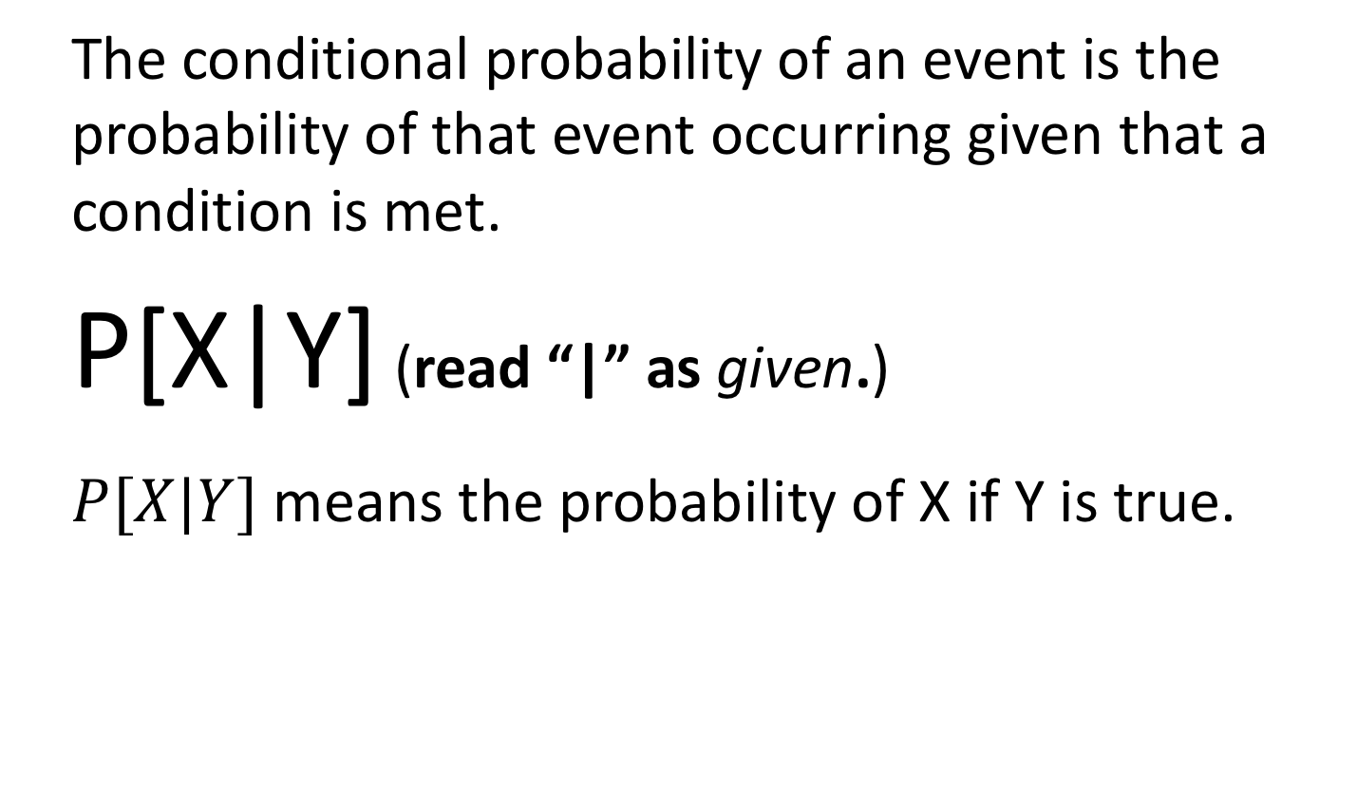
Conditional Probability
The conditional probability of an event is the probability of that event occurring given that a condition is met.
P[X|Y] (read “|” as given.)
$P[X|Y]$ means the probability of X if Y is true.

Slide 55

Surviving the Titanic Conditional on Class
P[Survive| Adult in 1st class] = $\frac{\text{197}}{\text{319}}=\text{0.62}$.
P[Survive| Adult not in 1st class] = $\frac{\text{457}}{\text{1773}}=\text{0.}\text{26}$.

Slide 56
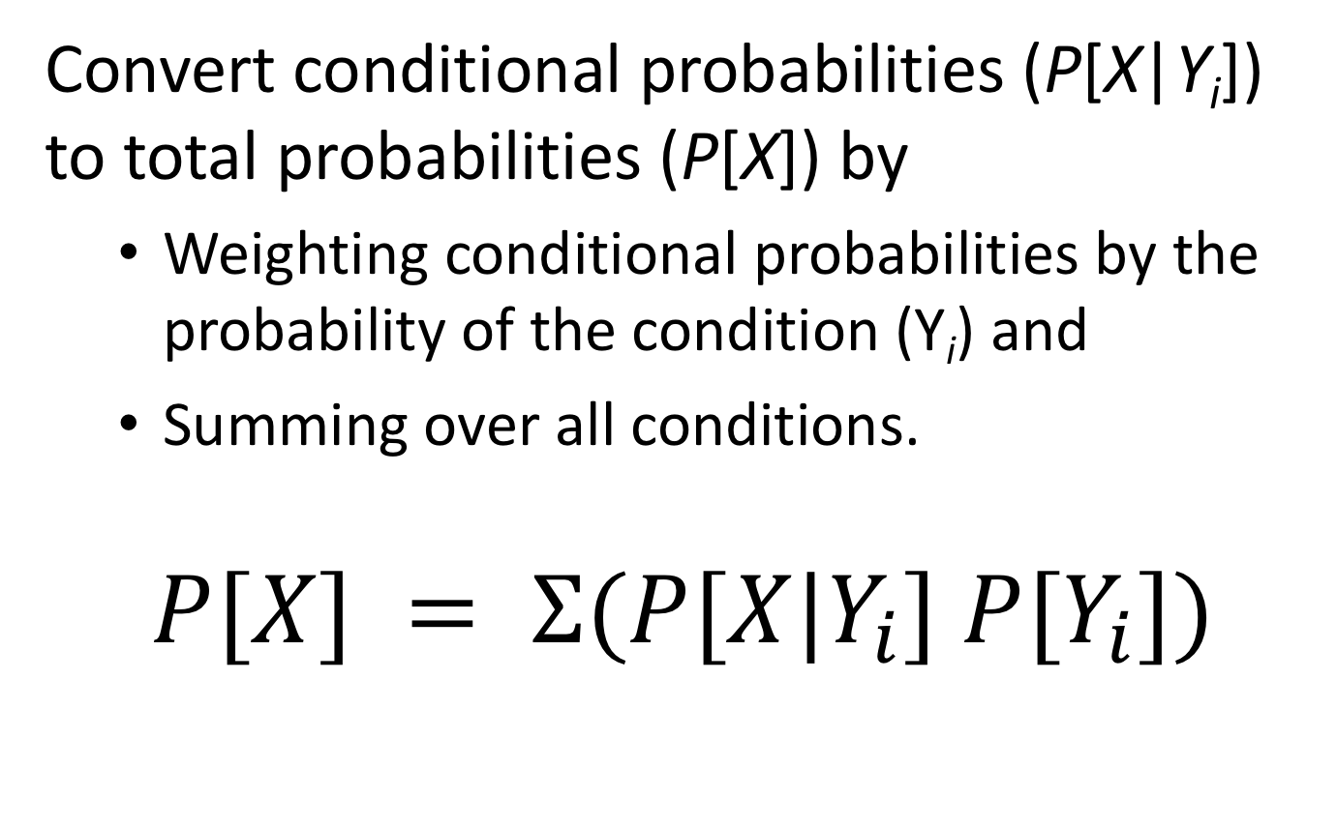
The Law of Total Probability
Convert conditional probabilities (P[X|Y_{i}]) to total probabilities (P[X]) by
Weighting conditional probabilities by the probability of the condition (Y_{i}) and
Summing over all conditions.
$$P[X] = Ʃ(P[X|Y_{i}] P[Y_{i}])$$

Slide 57
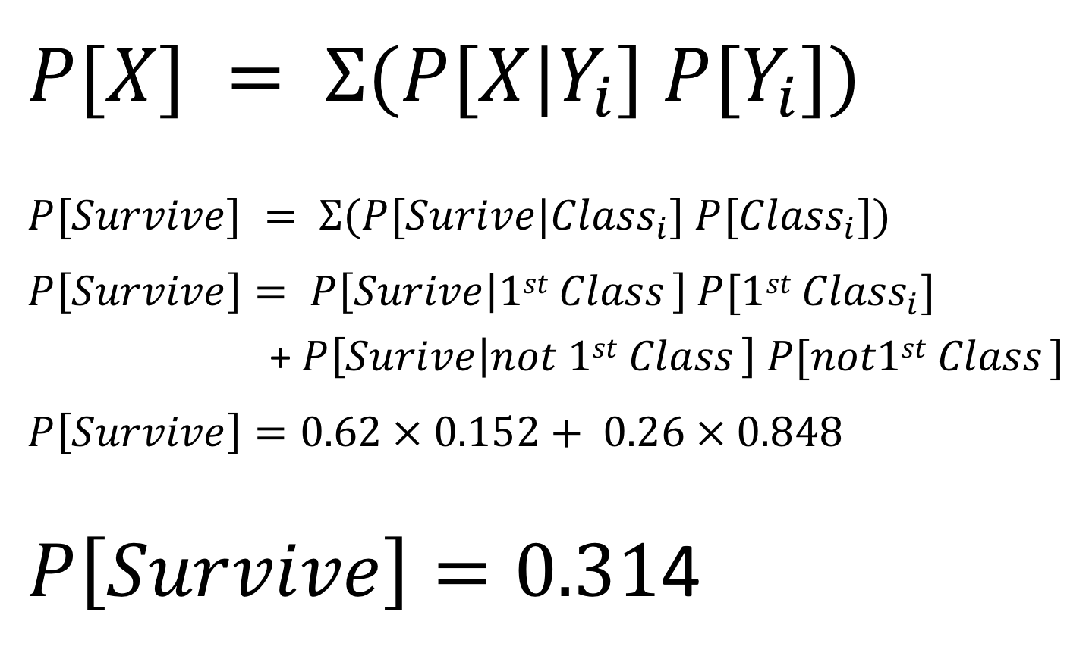
The Total Probability of Surviving the Titanic
$$P[X] = Ʃ(P[X|Y_{i}] P[Y_{i}])$$
$$P[Survive] = Ʃ(P[Surive|{Class}_{i}] P[{Class}_{i}])$$
$$P\left[Survive\right]= P\left[Surive | {1st Class}_{ }\right] P[1st {Class}_{i}]$$
+ $P\left[Surive | {not 1st Class}_{ }\right] P[not1st {Class}_{ }]$
$$P\left[Survive\right]=0.62 × 0.152+ 0.26 × 0.848$$
$P\left[Survive\right]=0.31$4

Slide 58

Probability Trees for Conditional Probabilities
We recover $P\left[Survive\right]=$0.094 + 0.220
= 0.314
Probability
1stclass
0.152
0.848
1st class
Yes
No
Probability
Of Fate
0.62
0.38
0.26
0.74
Survived
Yes
No
Yes
No
Probability of
the path
0.094
0.058
0.220
0.627
Survived
Yes
No
Yes
No

Slide 59
Probability Rules: Short summary of Addition and Multiplication Principles

Slide 60
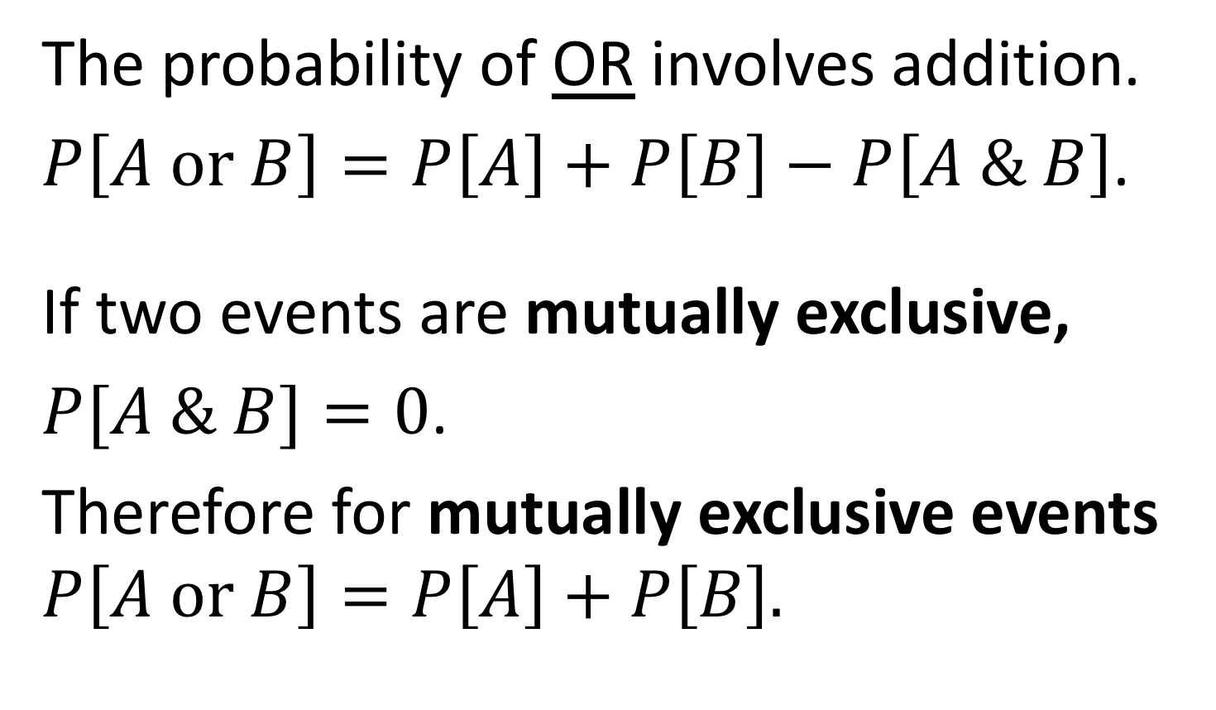
Short Summary: Addition Principle
The probability of OR involves addition.
$P\left[A or B\right]=P\left[A\right]+P\left[B\right]−P\left[A \& B\right]$.
If two events are mutually exclusive,
$P[A \& B]=0$.
Therefore for mutually exclusive events $P\left[A or B\right]=P\left[A\right]+P\left[B\right].$

Slide 61
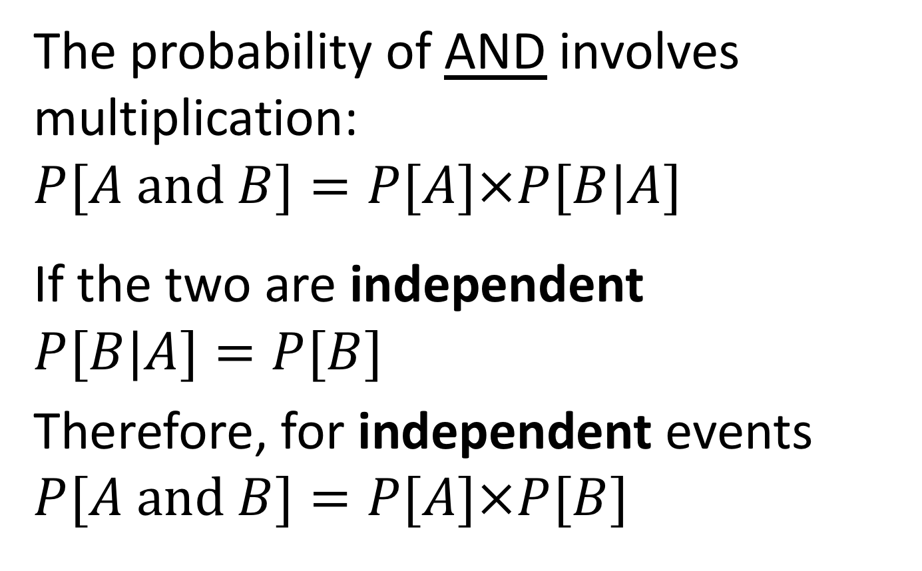
Short summary: Multiplication Principle
The probability of AND involves multiplication:
$$P[A and B]=P[A]×P[B|A]$$
If the two are independent
$$P[B|A]=P[B]$$
Therefore, for independent events $P[A and B]=P[A]×P[B]$

Slide 62
Bayes’ Theorem

Slide 63
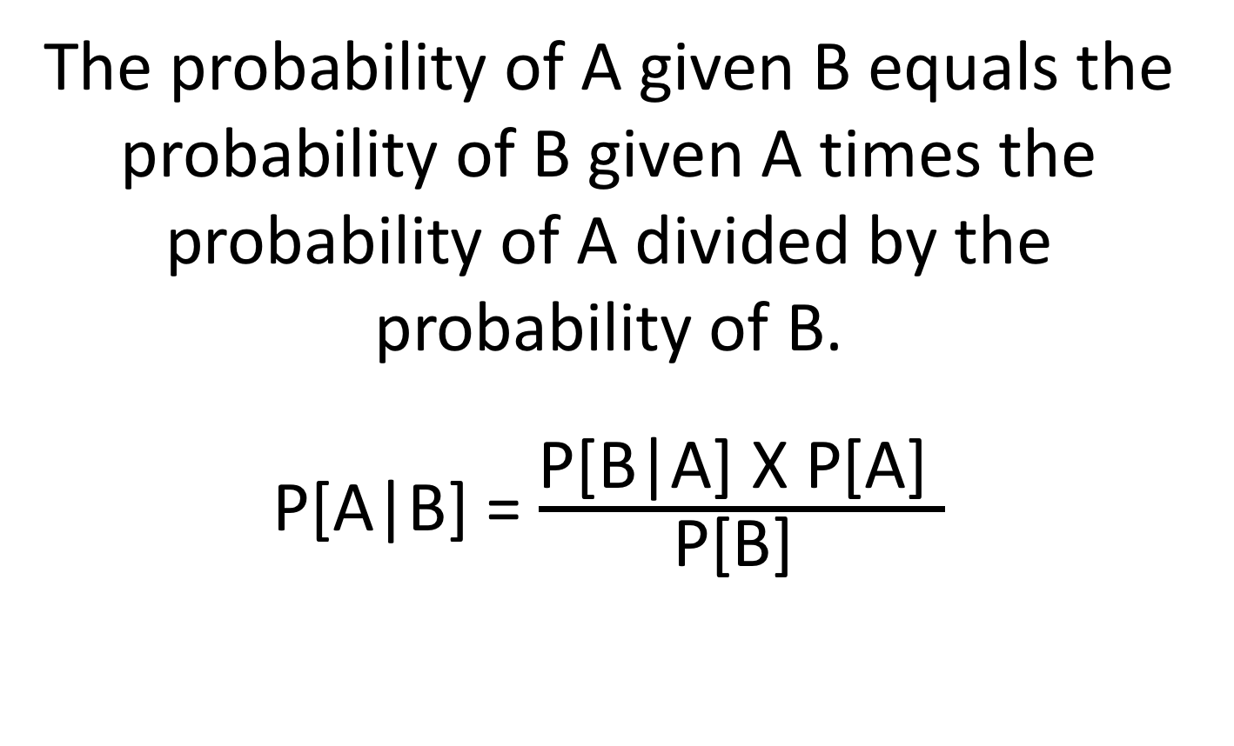
Bayes’ Theorem: Definition
The probability of A given B equals the probability of B given A times the probability of A divided by the probability of B.
P[A|B] = $\frac{\text{P}\text{[}\text{B}\text{|}\text{A}\text{] }\text{X} \text{P}\text{[}\text{A}\text{] }}{\text{P}\text{[}\text{B}\text{] }}$

Slide 64
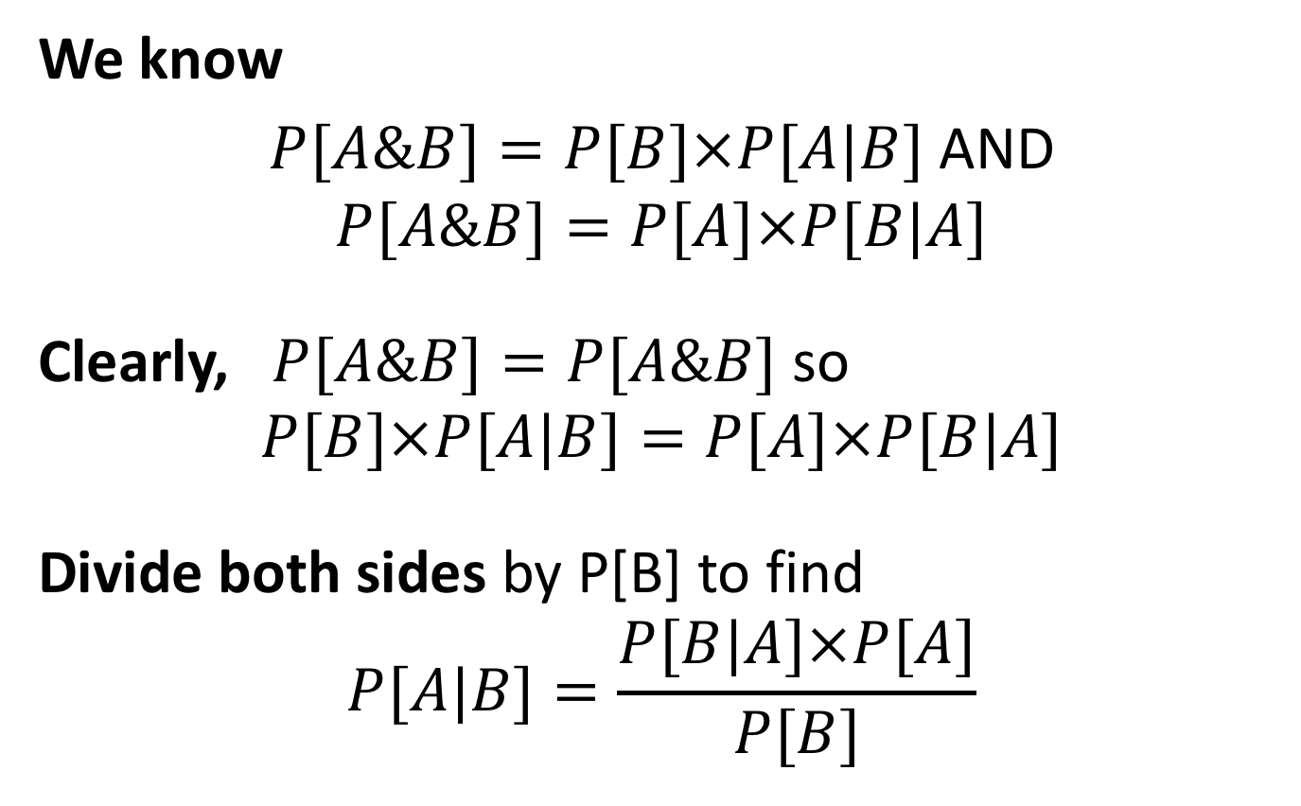
Bayes’ Theorem: Derivation
We know
$P[A\&B]=P[B]×P[A|B]$ AND
$$P[A\&B]=P[A]×P[B|A]$$
Clearly, $P[A\&B]=P[A\&B]$ so
$$P[B]×P[A|B]=P[A]×P[B|A]$$
Divide both sides by P[B] to find
$$P[A|B]=\frac{P[B|A]×P[A]}{P[B]}$$

Slide 65
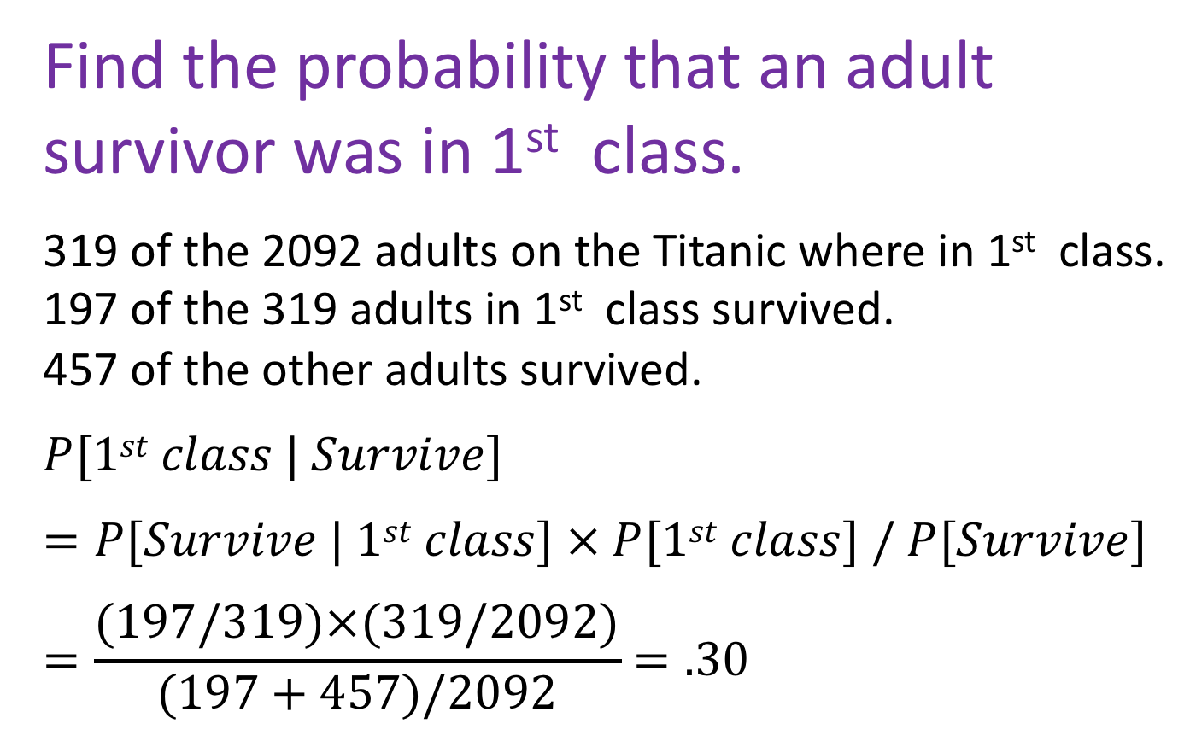
Bayes’ Theorem: Titanic Example
Find the probability that an adult survivor was in 1st class.
319 of the 2092 adults on the Titanic where in 1st class. 197 of the 319 adults in 1st class survived. 457 of the other adults survived.
$$P[1st class | Survive]$$
$$=P[Survive | 1st class] × P[1st class] / P[Survive]$$
$$=\frac{(197/319)×(319/2092)}{(197+457)/2092}=.30$$

Slide 66
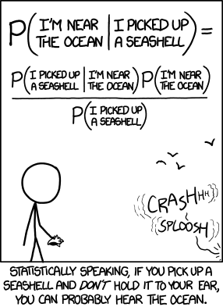
Bayes’ Theorem On the Beach
https://xkcd.com/1236/

Slide 67
Challenge: Rare Disease Diagnosis
What proportion of women (ages 40-49) whose 1st mammogram suggests they have breast cancer actually do have breast cancer whose mammogram suggested they have breast cancer.
About 3 in 1000 women (ages 40-49) have breast cancer.
A mammogram will reliably detect breast cancer in ~ 990 of every 1000 patients who truly have cancer.
A mammogram will incorrectly diagnose 121 of every 1000 cancer free patients as having cancer.

Slide 68
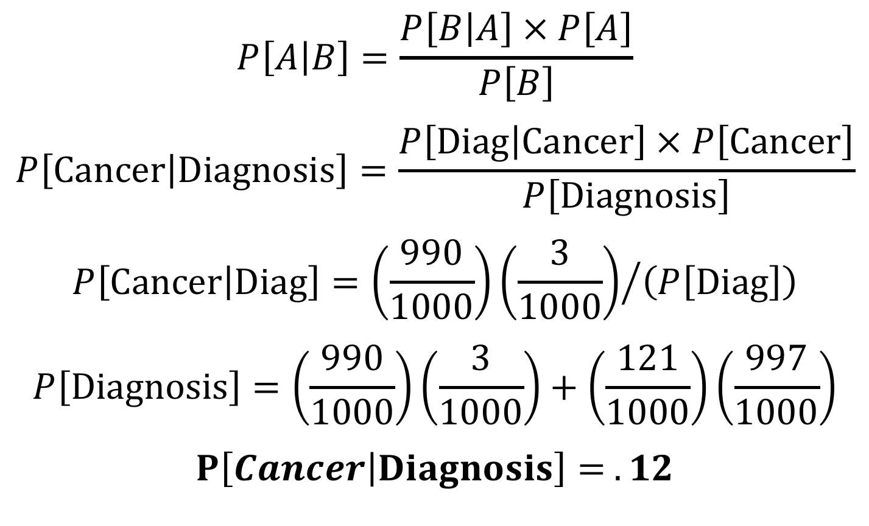
Answer: Rare Disease Diagnosis
$$P\left[A | B\right]=\frac{P\left[B | A\right] × P\left[A\right]}{P\left[B\right]}$$
$$P\left[Cancer | Diagnosis\right]=\frac{P\left[Diag | Cancer\right] × P\left[Cancer\right]}{P\left[Diagnosis\right]}$$
$$P\left[Cancer | Diag\right]={\left(\frac{990}{1000}\right)\left(\frac{3}{1000}\right)}/{\left(P\left[Diag\right]\right)}$$
$$P\left[Diagnosis\right]=\left(\frac{990}{1000}\right)\left(\frac{3}{1000}\right)+\left(\frac{121}{1000}\right)\left(\frac{997}{1000}\right)$$
$$P\left[Cancer | Diagnosis\right]= .12$$

Slide 69
Summary of Probability Theory

Slide 70
Probability Wrap Up
Probability theory provides a foundation for rigorous statistics.
Application of simple rules of probability facilitates the generation of more complex predictions.
We can use Bayes’ Theorem to translate between probabilistic statements

