Slide 1
Analyzing Proportions
Analysis of Biological Data
Chapter 7

Slide 2
Key Learning Objectives
Explain probabilities and proportions.
Which is the parameter? Which is the estimate?
Explain the binomial – when would you use it?
Understand the binomial distribution and connect it to simple probability rules.
Quantify the expected mean and variability of a binomial distribution.
Be able to appropriately conduct and interpret a binomial test.

Slide 3
Proportions

Slide 4
A Proportion
A proportion is the fraction of individuals having a particular attribute. i.e. # successes divided by # trials

Slide 5
Example: Murphy’s Law 🍞
Is the deck stacked against us?
Researchers found that 6101 of the 9821 slices of toast thrown in the air landed butter side down.
What proportion of slices landed butter side down?

Slide 6
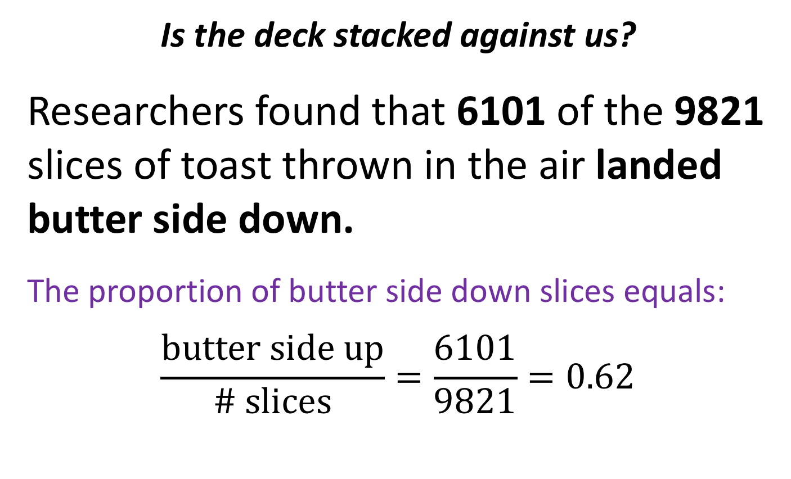
Answer: Murphy’s Law 🍞 🍞
Is the deck stacked against us?
Researchers found that 6101 of the 9821 slices of toast thrown in the air landed butter side down.
The proportion of butter side down slices equals:
$$\frac{butter side up}{\# slices}=\frac{6101}{9821}=0.62$$

Slide 7
From Proportions to the Binomial
Assume that the true probability that toast falls butter side down is 60%.
If three people drop their slice of toast, what is the probability that one falls butter side down and two fall butter side up?
HINT: Draw trees…

Slide 8
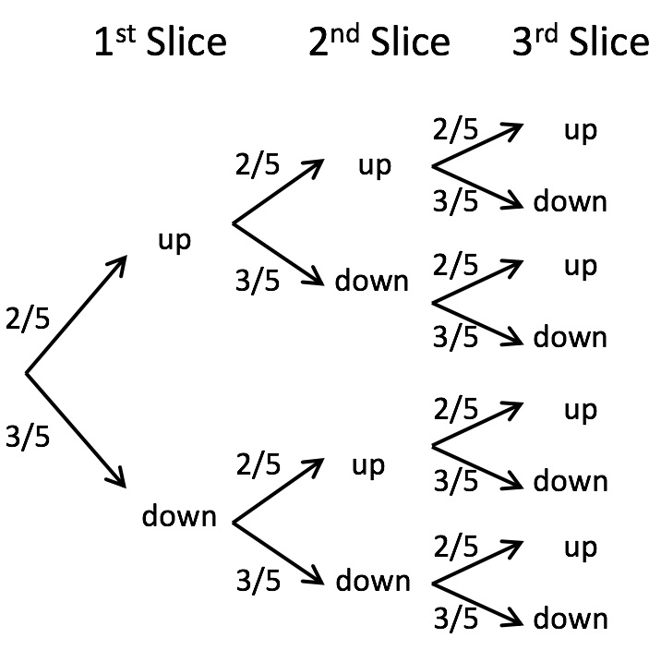
P[1 of 3 Slices Land Butter Side Down] slide 1/4
First, draw a tree

Slide 9
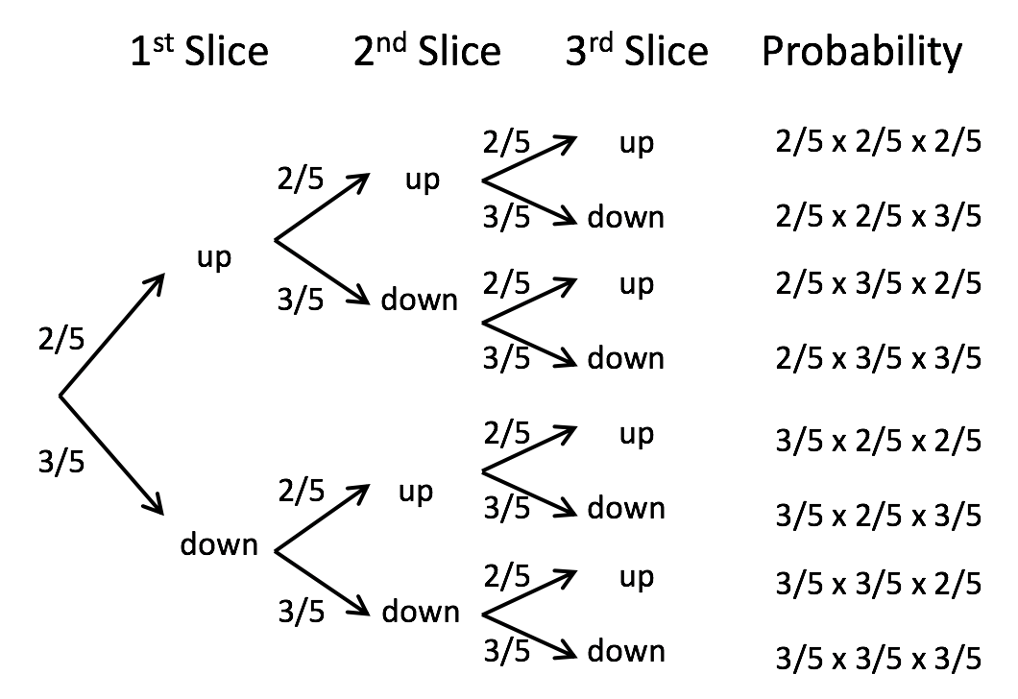
P[1 of 3 Slices Land Butter Side Down] slide 2/4
Then, work out probabilities

Slide 10
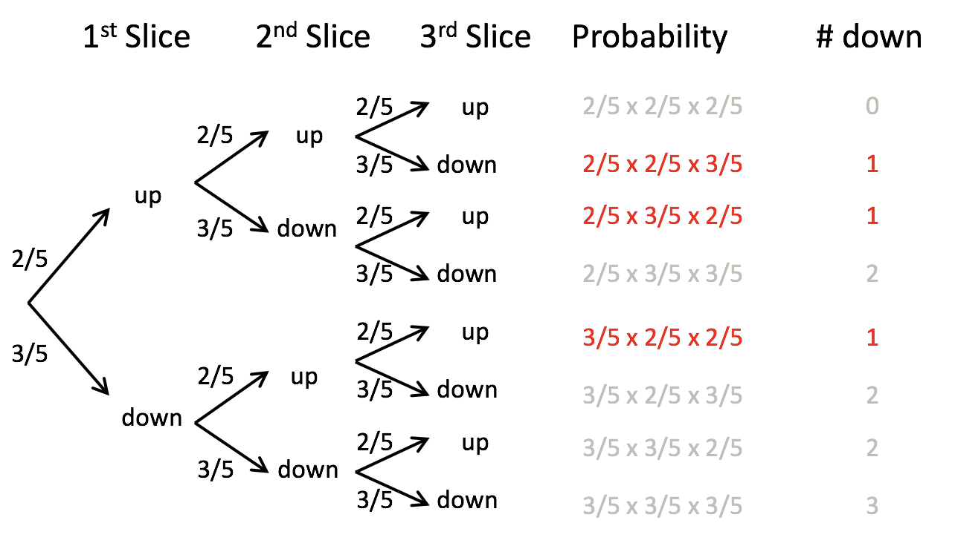
P[1 of 3 Slices Land Butter Side Down] slide 3/4
Finally, count the ways to get the desired outcome

Slide 11
P[1 of 3 Slices Land Butter Side Down] slide 4/4
Add up probabilities: 3 x (2/5 x 2/5 x 3/5) = 0.288

Slide 12
The Binomial Distribution

Slide 13
The Binomial Distribution: Idea💡
The probability of a given number (X) of “successes” from a fixed number of n independent trials.

Slide 14
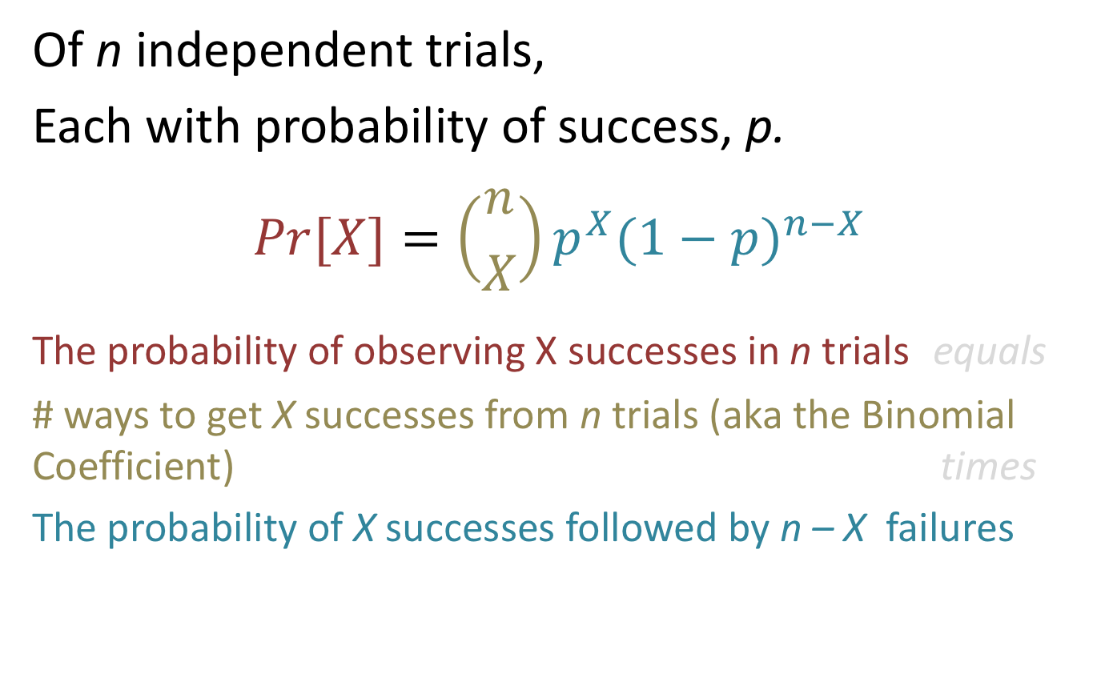
The Probability of X Successes
Of n independent trials,
Each with probability of success, p.
$$Pr[X]=\left({n \atop X}\right)p^{X}(1−p)^{n−X}$$
The probability of observing X successes in n trials equals
# ways to get X successes from n trials (aka the Binomial Coefficient) times
The probability of X successes followed by n – X failures

Slide 15
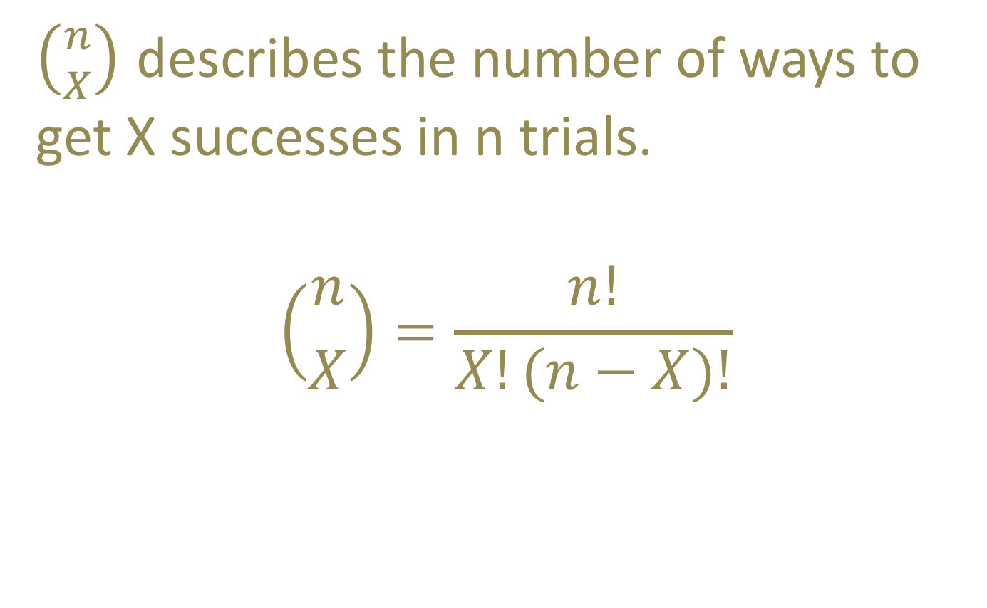
Looking into the Binomial Coefficient
$\left({n \atop X}\right)$ describes the number of ways to get X successes in n trials.
$$\left({n \atop X}\right)=\frac{n!}{X!(n−X)!}$$

Slide 16
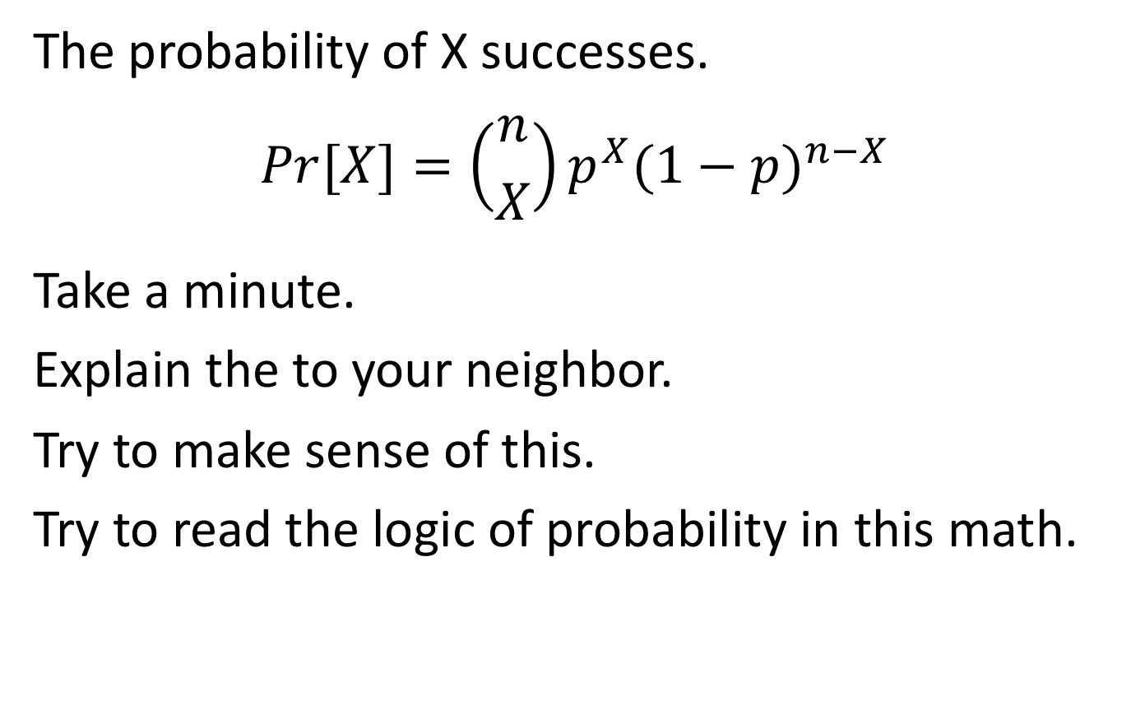
Revisiting the Binomial Distribution
The probability of X successes.
$$Pr[X]=\left({n \atop X}\right)p^{X}(1−p)^{n−X}$$
Take a minute.
Explain the to your neighbor.
Try to make sense of this.
Try to read the logic of probability in this math.

Slide 17
Expected # of Successes of n Trials
The expected number of successes is the number of trials times the probability of success.
μ = n x p
Probability Trivia: A binomial with n = 1 is called a Bernoulli process. You do not need to know this for class, but you might hear it some time.

Slide 18

Binomial Variability
For counts
Population variance
$$σ^{2}=n p \left(1−p\right)$$
Sample variance
$$s^{2} =\frac{n}{n−1} p (1−p)$$

Slide 19
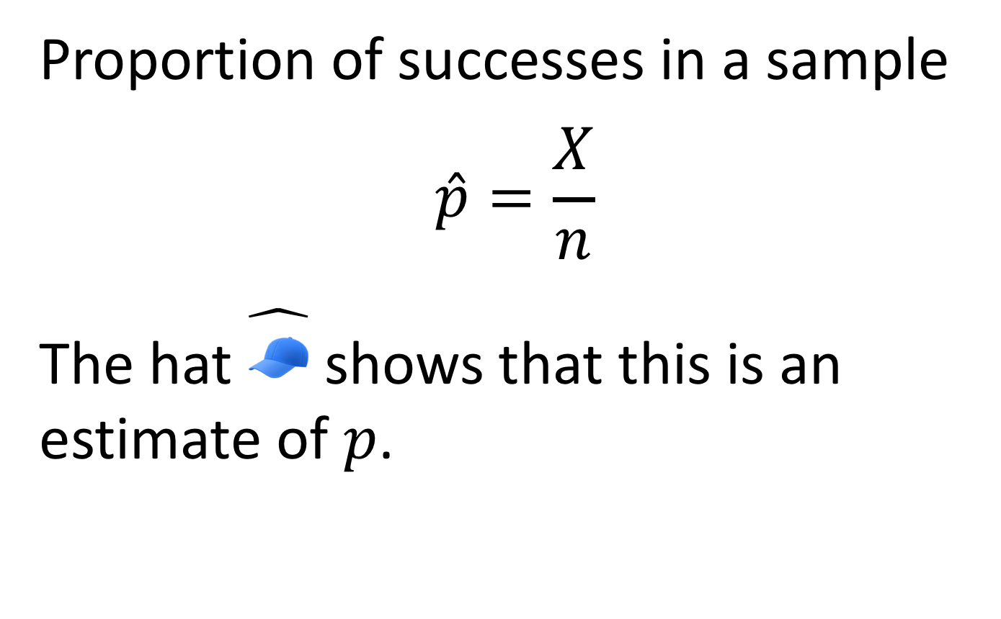
Properties of Proportions: Expectations
Proportion of successes in a sample
$$\hat{p}=\frac{X}{n}$$
The hat $\hat{🧢}$ shows that this is an estimate of $p$.

Slide 20
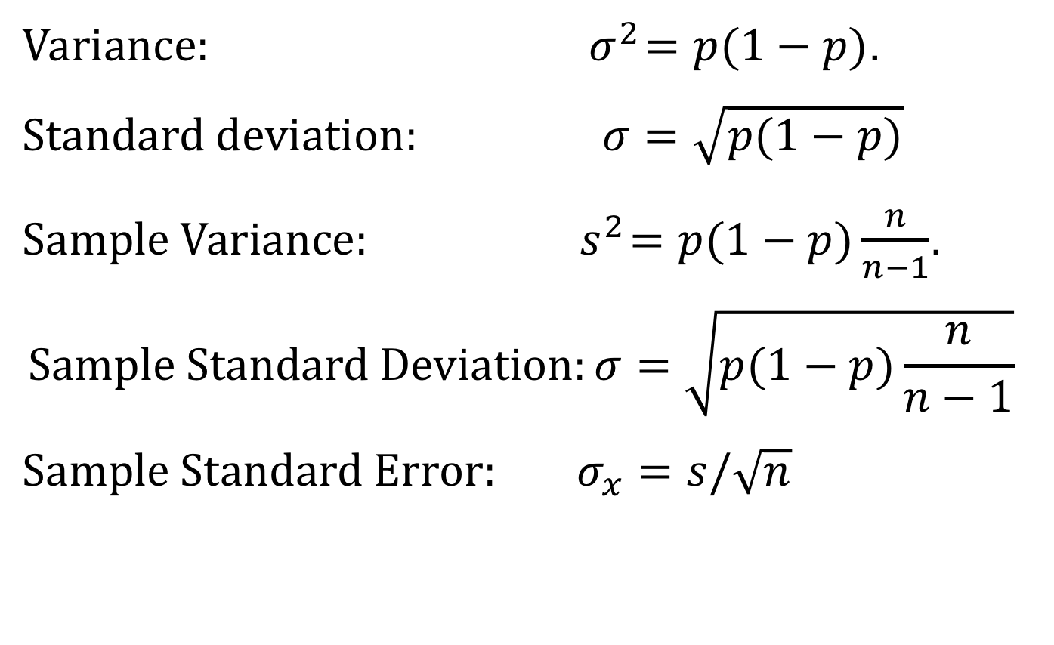
Properties of Proportions: Variability
$Variance: { σ}^{2}=p(1−p)$.
$$Standard deviation: σ=\sqrt[ ]{p(1−p)}$$
$Sample Variance:{ s}^{2}=p(1−p)\frac{n}{n−1}$.
$$Sample Standard Deviation:σ=\sqrt[ ]{p(1−p)\frac{n}{n−1}}$$
$$Sample Standard Error: σ_{x}=s/\sqrt[ ]{n}$$

Slide 21

The Binomial Test Testing 𝐻₀ that $\hat{p}$ comes from a population with proportion 𝑝

Slide 22

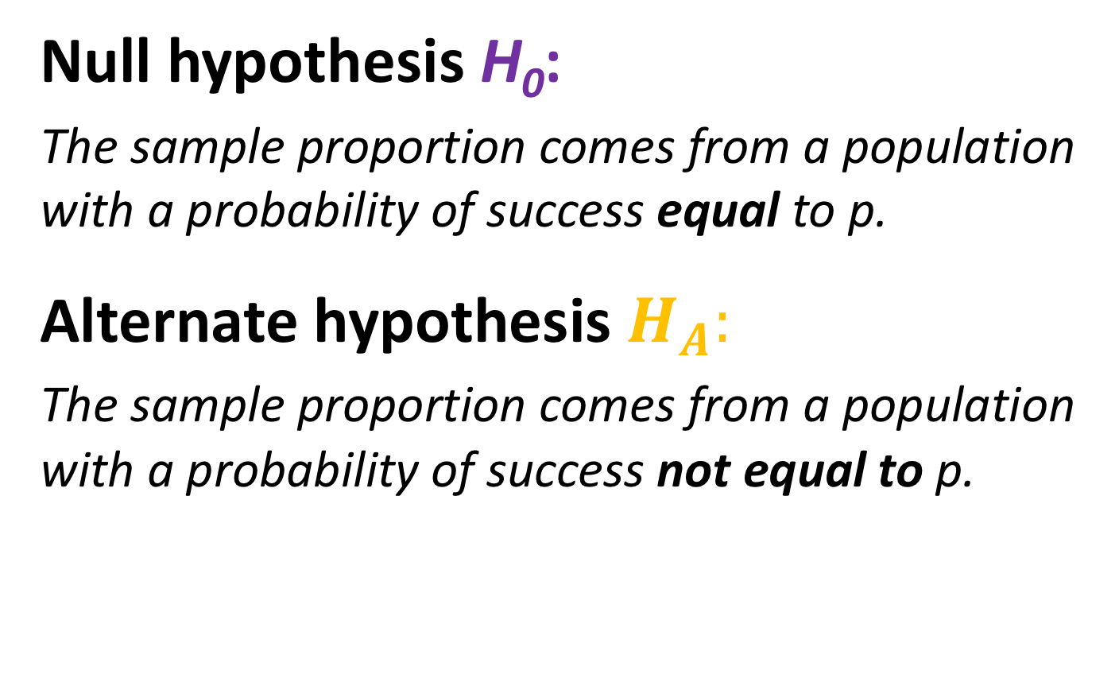
The Binomial Test: $H_{0}$ and $H_{A}$
Null hypothesis H₀:
The sample proportion comes from a population with a probability of success equal to p.
Alternate hypothesis $H_{A}:$
The sample proportion comes from a population with a probability of success not equal to p.

Slide 23
Binomial Test Example 🍞 slide 1/3
Is the deck stacked against us?
Researchers found that 6101 of the 9821 slices of toast thrown in the air landed butter side down.
What is the probability that we would see a result this or more extreme if toast has a fifty-fifty chance of landing butter side down?

Slide 24
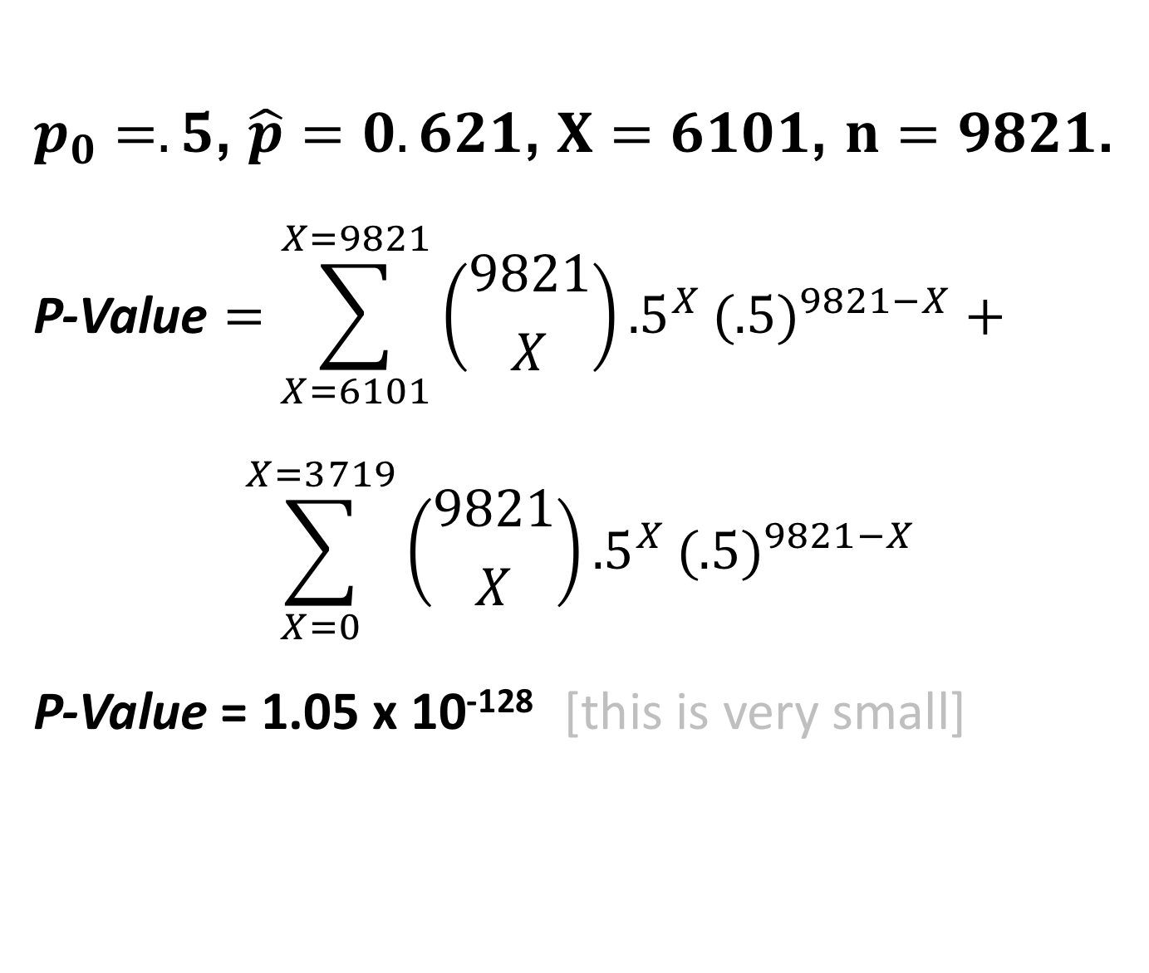
Binomial Test Example 🍞 slide 2/3
$p_{0}=.5$, $\hat{p}=0.621$, $X=6101$, $n=9821$.
$$\text{P}\text{-}\text{V}\text{alue}=\sum_{X=6101}^{X=9821}{\left({9821 \atop X}\right)}{.5}^{X}(.5)^{9821−X}+$$
$$\sum_{X=0}^{X=3719}{\left({9821 \atop X}\right)}{.5}^{X}(.5)^{9821−X}$$
P-Value = 1.05 x 10⁻¹²⁸ [this is very small]

Slide 25
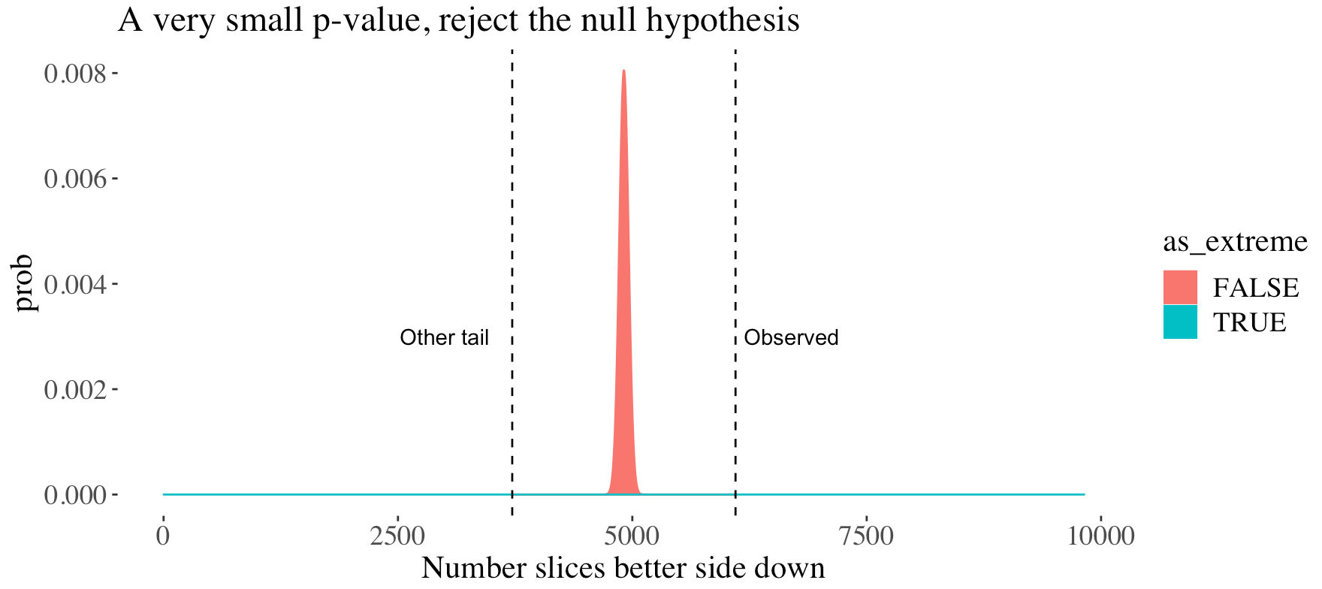
Binomial Test Example 🍞 slide 3/3
We reject H₀ & conclude that toast is more likely to land butter side down than not.

Slide 26
We Conducted a Binomial Test!
👏 Congrats 👏 You conducted a hypothesis test!
R can make this even easier.
binom.test(x = 6010, n = 9821, p = .5)
## Exact binomial test ## number of successes = 6101,
## number of trials = 9821,
## p-value: < 2.2e-16 ## 95 percent CI: 0.6115 – 0.6308 ## probability success: 0.6212

Slide 27
Confidence Interval of a Proportion It’s not normal

Slide 28
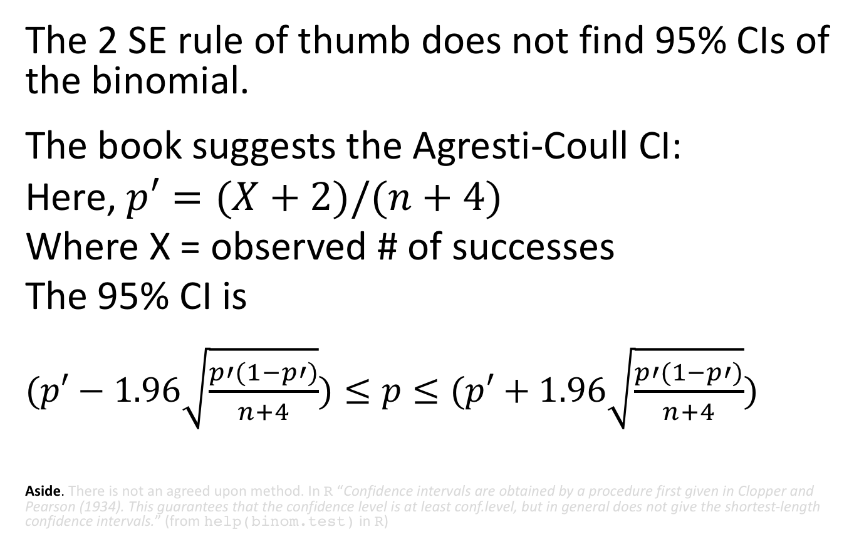
An Aside: 95% CIs for the Binomial
The 2 SE rule of thumb does not find 95% CIs of the binomial.
The book suggests the Agresti-Coull CI:
Here, $p′=(X+2)/(n+4)$
Where X = observed # of successes
The 95% CI is
$(p′−1.96\sqrt[ ]{\frac{p′(1−p′)}{n+4}})$ $≤p≤$ $(p′+1.96\sqrt[ ]{\frac{p′(1−p′)}{n+4}})$
Aside. There is not an agreed upon method. In R “Confidence intervals are obtained by a procedure first given in Clopper and Pearson (1934). This guarantees that the confidence level is at least conf.level, but in general does not give the shortest-length confidence intervals.” (from help(binom.test) in R)

Slide 29
Analyzing Proportion Summary

Slide 30
Key Points
A proportion is an estimate of a probability.
The binomial distribution provides a clear example of building up from simple probability logic to mathematical models of probability.
The binomial test tests the null hypothesis that an estimated proportion comes from a population with a specified probability.
We can quantify the uncertainty in our estimate of the probability.

Slide 31
Biology & Statistics

Slide 32
Biology and Statistics Go Together
Many biology questions concern scenarios that are a mix of predictable effects and chance.
As such, much innovation in statistics came from biologists and was applied to biological questions.

Slide 33
Pearson, Galton, and Fisher
Pioneers in statistics include the biologists RA Fisher, Francis Galton & Karl Pearson.
These researchers also made many critical mistakes in interpreting statistics and their deep biases and commitment to unscientific ideas (e.g. eugenics) highlight how statistics are easily misused, misinterpreted and misapplied.

