Slide 1
The normal distribution

Slide 2
Key Learning Goals
Recognize that the normal distribution is common in nature (and why).
Know how to parameterize a normal distribution.
Know how to use the standard normal table & conduct a Z-transformation.
Find the probability that a sample mean is within a given range.
Explain the central limit theorem and its significance.

Slide 3
Get to know the normal distribution
The normal distribution (aka the “bell curve”, aka the Gaussian) is incredibly common in the world!
It is also mathematically convenient.
Therefore, much of statistics is based off of the normal distribution.

Slide 4
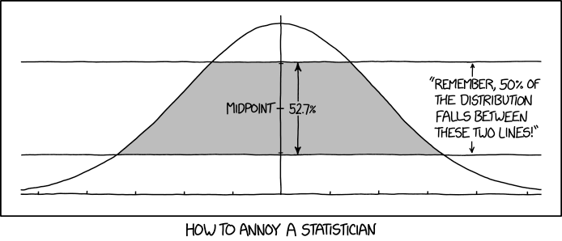

Slide 5
Sums are Normally Distributed
Because most quantitative variables are sums (or averages) of a bunch of things, the normal distribution is incredibly common!
For example:
Human height is realized as the addition of lot of genetic effects and a lot of environmental factors.
The distance a seed moves is the sum of a lot of wind currents.

Slide 6
Examples: The normal distribution in nature

Slide 7
Human Birth Weight
Birth weight is (roughly) normally distributed

Slide 8
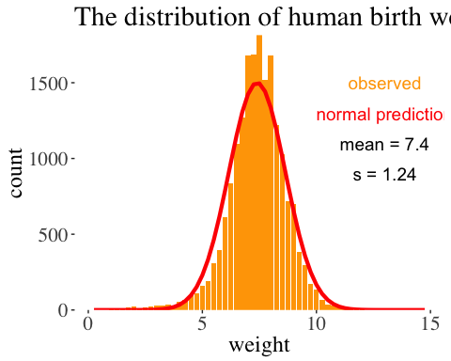

Slide 9
Data from Pethybridge, Ashford, and Fryer 1974

Slide 10
Human Body Temp
Body temp is (roughly) normally distributed

Slide 11
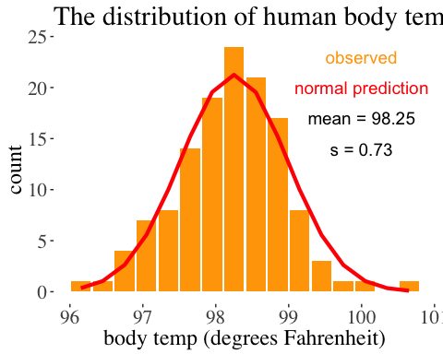

Slide 12
Data from Shoemaker 1996

Slide 13
Drosophila Egg Number
Drosophila egg number is (roughly) normally distributed

Slide 14
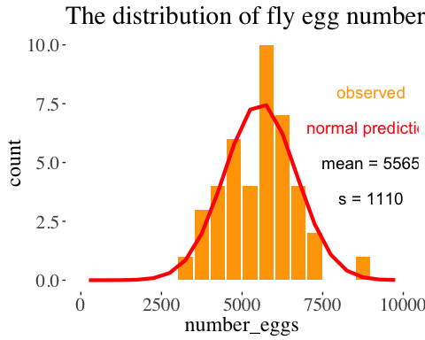

Slide 15
Data from Paaby, Bergland, Behrman and Schmidt 2014, data link

Slide 16
The Normal Distribution: Definitions and Properties

Slide 17
The Normal Probability Density
Unlike discrete distributions, the probability of a specific value for a continuous value is infinitesimally small.
We therefore work with probability densities.
The probability density of a given value X, $P[X]=\frac{1}{\sqrt{2πσ^{2}}}e^{−\frac{(x−μ)^{2}}{2σ^{2}}}=1$
Across sample space, probability densities integrate to 1. $\int_{−∞}^{μ+σ}{\frac{1}{\sqrt{2πσ^{2}}}}e^{−\frac{(x−μ)^{2}}{2σ^{2}}}=1$

Slide 18
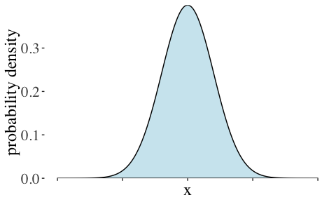
Visualizing Probability Densities

Slide 19
Parameters of the Normal: $μ$ & $σ$
$N(μ,σ)$ – These parameters fully specify a normal distribution

Slide 20
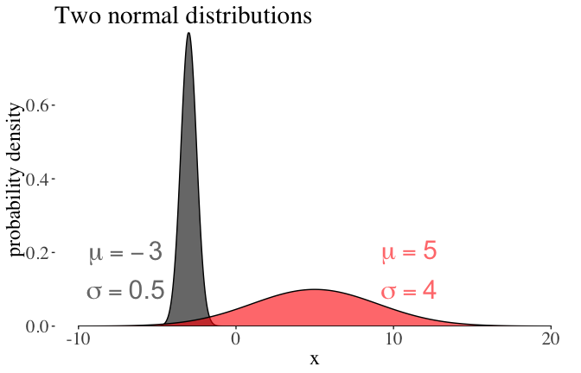

Slide 21
Concept Check in
This normal distribution has points with a probability density > 1.
We know that probabilities cannot be greater than 1, so how can this be the case?
Bonus: Does this mean probability densities can be negative?

Slide 22
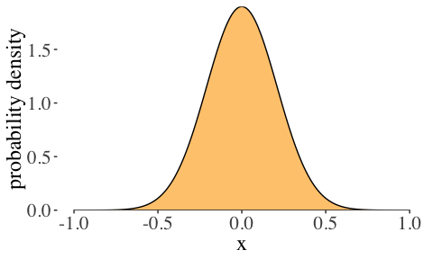

Slide 23
A Normal Distribution is Symmetric
A normal distribution is symmetric & centered around its mean.

Slide 24
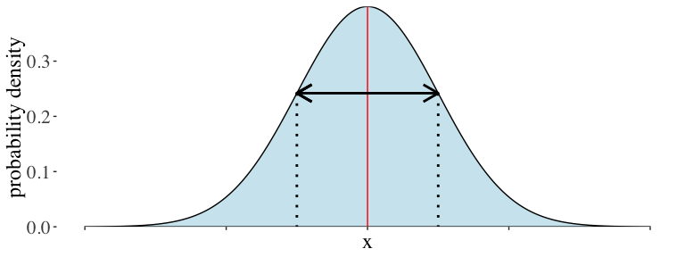

Slide 25
Probability that X falls in a range
The probability that x lies between two values, $a$ and $b$ is
$$P[a<X<b]=\int_{a}^{b}{\frac{1}{\sqrt{2πσ^{2}}}}e^{−\frac{(x−μ)^{2}}{2σ^{2}}}dx$$
Some helpful (approximate) ranges:

Slide 26
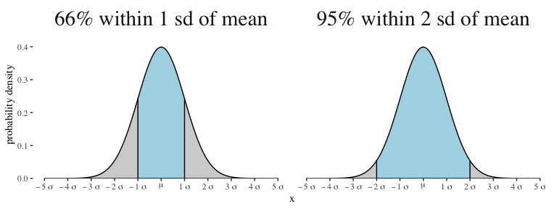

Slide 27
The Standard Normal Distribution

Slide 28
One Normal Distribution To Rule Them
Of the infinite normal distributions, the “standard normal distribution”, $N(μ=0,σ=1)$ is particularly useful.
By Z-transformation, we can turn any normal distribution into the standard normal distribution (coming soon).

Slide 29
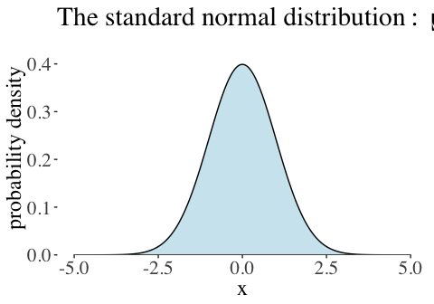

Slide 30
Visualizing the Z-distribution
The Z-distribution gives the probability that a random draw from the standard normal is greater than a given value.

Slide 31
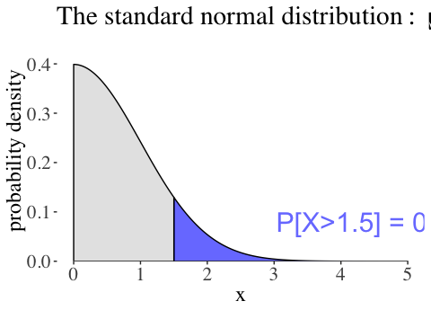

Slide 32
In R pnorm(x = 1.5, lower.tail = FALSE) = 0.067

Slide 33
The Standard Normal Table
The Z-distribution is available as a table in the back of the text. - Rows contain the first two digits of X, columns contain the third digit, and the entry reflects the probability that a random draw from the standard normal is $>X$. - Note that the entry for 1.5 equals 0.067.
0
0.01
0.02
0.03
0.04
0.05
0.06
0.07
0.08
0.09
1
0.159
0.156
0.154
0.152
0.149
0.147
0.145
0.142
0.140
0.138
1.1
0.136
0.133
0.131
0.129
0.127
0.125
0.123
0.121
0.119
0.117
1.2
0.115
0.113
0.111
0.109
0.107
0.106
0.104
0.102
0.100
0.099
1.3
0.097
0.095
0.093
0.092
0.090
0.089
0.087
0.085
0.084
0.082
1.4
0.081
0.079
0.078
0.076
0.075
0.074
0.072
0.071
0.069
0.068
1.5
0.067
0.066
0.064
0.063
0.062
0.061
0.059
0.058
0.057
0.056
1.6
0.055
0.054
0.053
0.052
0.051
0.049
0.048
0.047
0.046
0.046

Slide 34
Using the Z-distribution
Because the standard normal is symmetric about zero, $Pr[Z<−X]=Pr[Z>X]$. That is, the probability that a random sample is less than $−X$ equals the probability that a random sample is greater than X.
Because the normal integrates to one, $Pr[Z<X]=1−Pr[Z>X]$. That is, the probability that a random sample is less than $X$ equals one minusthe probability that a random sample is greater than X.

Slide 35
Other Normal Distributions

Slide 36
What About Other Normals?
Normal distributions can have distint values of $μ$ and $σ$ but must have the same shape.
Any normal distribution can be converted to a standard normal distribution, by a Z-transformation
$Z=\frac{Y−μ}{σ}$
Z is called a “standard normal deviate”

Slide 37
Z = Distance Between Y & $μ$ (in $σ$ units)
$$Z=\frac{Y−μ}{σ}$$
The probability of getting a value greater than Y is the same as the probability of getting a value greater than Z from a standard normal distribution.

Slide 38

Example: British Spies
Bond heights

Slide 39
MI5 says a man has to be shorter than 180.3 cm tall to be a spy.
Mean height of British men is 177.0cm, with standard deviation 7.1cm, with a normal distribution.
What proportion of British men are excluded from a career as a spy by this height criteria?

Slide 40
Answer: British Spies
$P[X>180.3|N(μ=177,σ=7.1)]$
Step 1. Z-transform
$$Z=\frac{180.3−177.0}{7.1}=0.46$$
Step 2. Look this up in the standard normal table or with pnorm() in R.
0
0.01
0.02
0.03
0.04
0.05
0.06
0.07
0.08
0.09
0.3
0.382
0.378
0.374
0.371
0.367
0.363
0.359
0.356
0.352
0.348
0.4
0.345
0.341
0.337
0.334
0.330
0.326
0.323
0.319
0.316
0.312
0.5
0.309
0.305
0.302
0.298
0.295
0.291
0.288
0.284
0.281
0.278
Step 3. Conclude that $≈32.3\%$ of British men are too tall to spy.

Slide 41
Ths Sampling Distribution of Samples from a Normal Distribution

Slide 42
Sample means: $N(μ=\overline{Y},sigma_{\overline{Y}}=\frac{σ}{\sqrt{n}})$
Means of normally distributed variables are normally distributed
The mean of the sample means is $μ$
The standard deviation of the sample means is the standard error, and equals $σ_{\overline{Y}}=\frac{σ}{\sqrt{n}}$

Slide 43
Law of Large Numbers
Larger samples make for tighter distributions & smaller standard errors

Slide 44
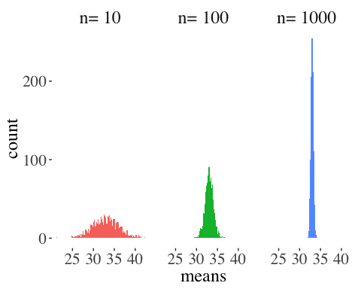

Slide 45
Central limit theorem

Slide 46
Central limit theorem
The sum or mean of a large number of measurements randomly sampled from ANY population is approximately normally distributed.

Slide 47
Button Pushing Example [1/3]
Imagine that 20000 people are asked to press a button.

Slide 49
Button Pushing Example [2/3]
Imagine that 20000 people are asked to press a button.
Half are anxious & do this quickly $N(10,1)$
Half are not & do this slowly $N(70,15)$
This is not normally distributed

Slide 50
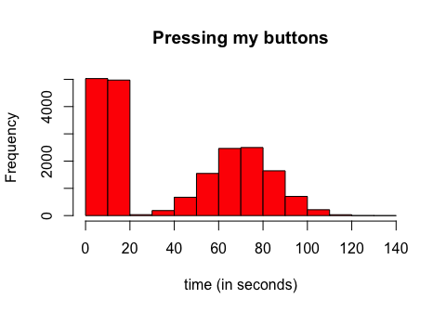

Slide 51
Button Pushing Example [3/3]
The sampling distribution becomes normal as n gets large.

Slide 52
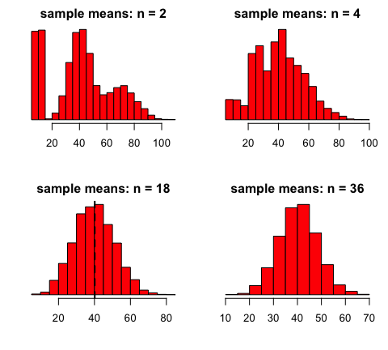

Slide 53
Utility of the Central Limit Theorem ✨
The Central Limit Theorem explains why so much in the world is normally distributed!!!
It also means that (with large sample sizes) many statistical tests that assume data are normal still work ok, if data are not totally normal.
Finally, we can use the Central Limit Theorem to speed up tedious calculations for large samples from non-normal distributions.

Slide 54
Example: Approximating the Binomial
When number of trials (n) is large and probability of success (p) is not too close to 0 or 1.
We can approximate the binomial by a normal distribution with$μ=np$ and $σ=\sqrt{np(1−p)}$
NOTE: The sampling distribution of the binomial looks normal for large samples.

Slide 55
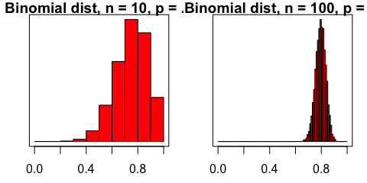

Slide 56
Takeaways

Slide 57
Major messages
The normal distribution is common in nature.
A normal distribution is fully characterized by its mean and standard deviation.
The distribution of sample means from a normal is normal distributed with mean = $μ$ and standard deviation = $σ/\sqrt{n}$.
Any normal distribution can be transformed into the standard normal.
The central limit theorem implies that with sufficiently large sample sizes, the sampling distribution of non-normally distributed populations is normal.

