Slide 1
STAT 685: Distracted Driving
Committee: Dr. Derya Akleman, Dr. Samiran Sinha, Dr. Ergun Akleman Bryan Yu | bryanyu@tamu.edu

Slide 2
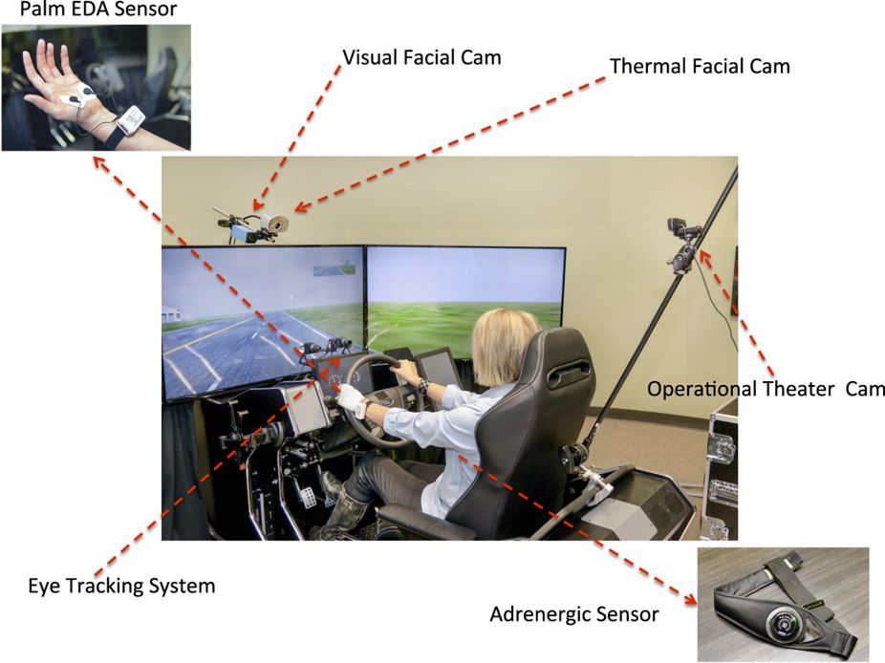
Experiment
Controlled simulated driving experiment¹ to asses driving behavior
Multiple different stressors: cognitive, emotional, sensorimotor (texting)
Sensors captured vehicle information and driver outputs
Subject variables: age, gender, personality
Drive variables: Speed, brake, lane position
Biological variables: eye gaze, heart rate, breathing rate, etc

Slide 3
Objective
Model variance of lane positioning to undertand texting effect
Bayesian modelling
Time series analysis
Stan MCMC Programming: Sampling with Hamiltonian Monte Carlo
“Modern Statistical Workflow”²: Capture simulated data before fitting observations
Explore population level effects on variance

Slide 4
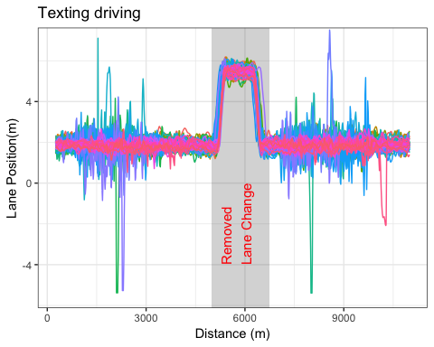
Preliminary Analysis: All drivers
Each color is a separate driver (N=68)
Data resampled at 390 data points and missing data filtered
Prior to lane change: 200
After lane change: 190
Focused on first half (prior to lane change)
Some drivers exhibit extremely long tails in their lane positioning
Univariate (T021) data is stationary according to Dickey-Fuller test
Accounting for texting vs normal driving state

Slide 5
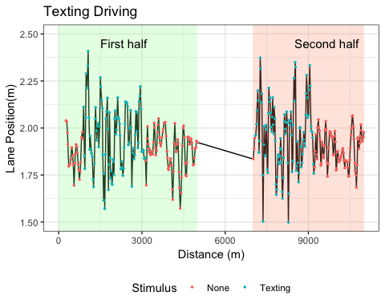
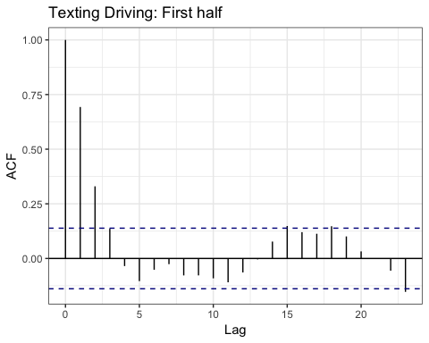
Preliminary Analysis: T021 Driver

Slide 6
Modelling
Univariate model (T021 driver)
Autoregressive (AR) models
Stochastic Volatility (SV) models³
Multivariate model (all drivers)
Hierarchical model: Regularization

Slide 7
AR(1) Setup
Conceptual Analysis
Single driver staying in the middle of a lane (3.65m wide). Should expect that as the driver moves out of the middle of lane to correct by reducing lane position back to middle (~1.825m). Would expect that mean and variance is constant in each state of driving (normal vs texting)
Define observations
$$N:Number of observations$$
$$y_{n}:Lane Position (meters)$$
$$x_{n}:Texting indicator$$
Summary Statistic
Correlogram of $y_{t}$
Likelihood and priors
$$y_{n}∼N(α+ρ_{n−1},σ_{texting})$$
$$ρ∼Beta(1.5,1.5)$$
$$σ_{texting}∼H(0,1)$$
$$α∼N(1.825,0.25)$$

Slide 8
Backup slides

Slide 9
References
Taamneh, S. et al. A multimodal dataset for various forms of distracted driving. Sci. Data 4:170110 doi: 10.1038/sdata.2017.110 (2017).
Betancourt, Michael. 2018. “A Principled Bayesian Workflow” June 2018
Kim, Shephard, Chib (1998) “Stochastic Volatility: Likelihood Inference and Comparison with ARCH Models” The Review of Economic Studies Vol. 65, No. 3

Slide 10
Future steps
Incorporate bayesian methods for dealing with missing data
Incorporate “change-point” model to account of lane changes

