Slide 1
STAT 685: Distracted Driving
Committee: Dr. Derya Akleman, Dr. Samiran Sinha, Dr. Ergun Akleman Bryan Yu | bryanyu@tamu.edu

Slide 2
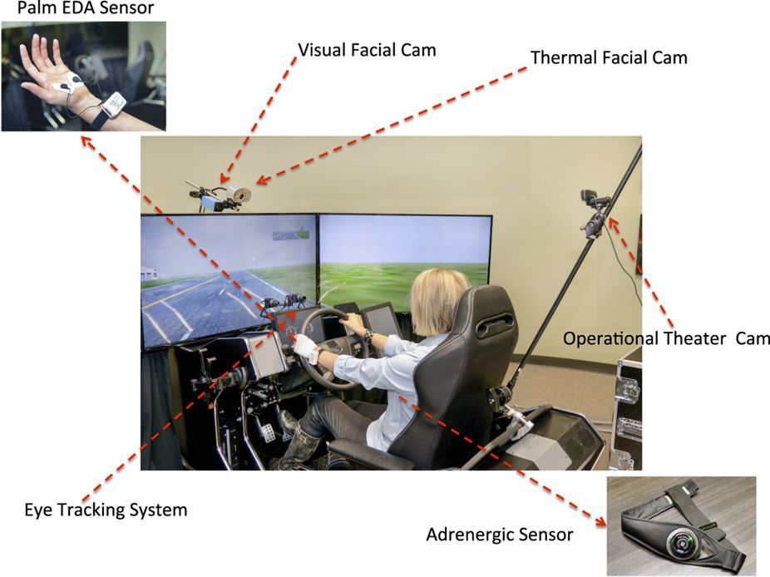
Experiment
Controlled simulated driving experiment¹ to asses driving behavior
Multiple different stressors: cognitive, emotional, sensorimotor (texting)
Sensors captured vehicle information and driver outputs
Subject variables: age, gender, personality
Drive variables: Speed, distance, lane position, etc
Biological variables: eye gaze, heart rate, breathing, etc

Slide 3
Objective
Model variance of lane positioning to understand texting effect
Bayesian modelling
Time series analysis
Stan MCMC Programming: Sampling with Hamiltonian Monte Carlo
“Modern Statistical Workflow”²: Capture simulated data before fitting observations
Explore population level effects on variance

Slide 4
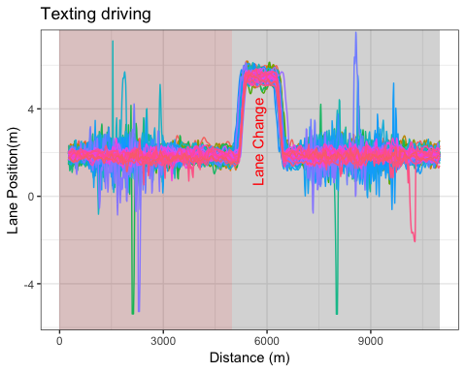
Preliminary Analysis: All drivers
Each color is a separate driver (N=68)
Data resampled at 390 data points and missing data filtered
Prior to lane change: 200
After lane change: 190
Focused on first half (red area)
Some drivers exhibit extremely long tails in their lane positioning
Univariate (T021) data is stationary according to Dickey-Fuller test
Accounting for texting vs normal driving state

Slide 5
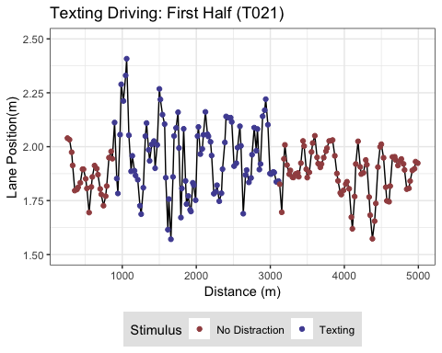
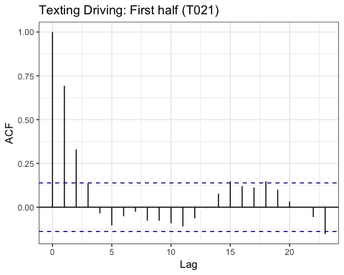
Preliminary Analysis: T021 Driver

Slide 6
Modelling
Univariate model (T021 driver)
Autoregressive (AR) model
Stochastic Volatility (SV) models³
Multivariate model (all drivers)
Independent drivers model
Hierarchical model: Regularization

Slide 7
AR(1) Setup
Conceptual Analysis
Single driver staying in the middle of a lane (3.65m wide). Should expect that as the driver moves out of the middle of lane to correct by reducing lane position back to middle (~1.825m). Would expect that mean and variance is constant in each state of driving (normal vs texting)
Define observations
$$N:Number of observations$$
$$N_{texting}:Number of texting states (j)$$
$$y_{n}:Lane Position (meters)$$
$$x_{n}:Texting indicator (1: ND, 2: MD)$$
Summary Statistic
Correlogram of $y_{t}$
Likelihood and priors
$$y_{n}∼N(α+ρy_{n−1},σ_{j})$$
$$ρ∼Beta(1.5,1.5)$$
$$σ_{i}∼H(0,1)$$
$$α∼N(1.825,0.1)$$

Slide 8
AR(1) Prior Predictive Analysis

Slide 9
Stochastic Volatility Setup
Conceptual Analysis
Mean of lane positioning is constant but with changing volatility. The SV model has additional parameters to deal with the structure of this data. Latent variables and generative nature of model allows for additional complexity.
Define observations
$$N:Number of observations$$
$$N_{texting}:Number of texting states (j)$$
$$y_{n}:Lane Position (meters), mean corrected$$
$$x_{n}:Texting indicator (1: ND, 2: MD)$$
Likelihood and priors
$$y_{n}∼N(0,exp(h_{n}/2))$$
$$h_{n}∼N(μ+δ+ϕ(h_{n}−μ),σ)$$
$$h_{1}∼N(μ,\frac{σ}{\sqrt{1−ϕ^{2}}})$$
$$μ∼N(0,1):Mean log volatility$$
$$ϕ∼Uniform(−1,1):Persistence of volatility$$
$$σ∼N(0,1):White noise shock$$
$$δ∼N(0,0.05):Texting effect$$

Slide 10
Multivariate (SV Model) Setup
Conceptual Analysis
All the drivers!
Define observations
$$N_{texting}:Number of texting states (j)$$
$$N_{drivers}:Number of drivers (i)$$
$$N:Number of observations, N_{drivers}*N_{obs/driver}$$
$$y_{n}:Lane Position (meters), mean corrected$$
$$x_{n}:Texting indicator (1: ND, 2: MD)$$
Likelihood and priors
$$y_{n}∼N(0,exp(h_{n}/2))$$
$$h_{n}∼N(μ+μ_{i}+δ+δ_{i}+ϕ(h_{n}−μ),σ)$$
$$h_{1}∼N(μ,\frac{σ}{\sqrt{1−ϕ^{2}}})$$

Slide 11
Conclusions

Slide 12
Backup slides

Slide 13
References
Taamneh, S. et al. A multimodal dataset for various forms of distracted driving. Sci. Data 4:170110 doi: 10.1038/sdata.2017.110 (2017).
Betancourt, Michael. 2018. “A Principled Bayesian Workflow” June 2018
Kim, Shephard, Chib (1998) “Stochastic Volatility: Likelihood Inference and Comparison with ARCH Models” The Review of Economic Studies Vol. 65, No. 3
Stan Development Team. “Stan Modeling Language User’s Guide and Reference Manual” Version 2.17.0, Sept 2017

Slide 14
Computing Cluster Setup (AWS)
Prior Predictive Modelling
Each prior predictive model ran 1000 simulations from the generative model
Fitting 1000 simulations is a time consuming process on local machine
Stan runs 4 markov chains in parallel and aggregates (4 cores)
1000 * 4 = 4000 CPU’s to run fit observations for one model!
Created a docker container with RStan and submitted jobs to AWS Batch service

Slide 15
Future steps
Incorporate bayesian methods for dealing with missing data
Incorporate “change-point” model to account of lane changes

