Slide 1
STAT 685: Distracted Driving
Committee: Dr. Derya Akleman, Dr. Samiran Sinha, Dr. Ergun Akleman Bryan Yu | bryanyu@tamu.edu

Slide 2
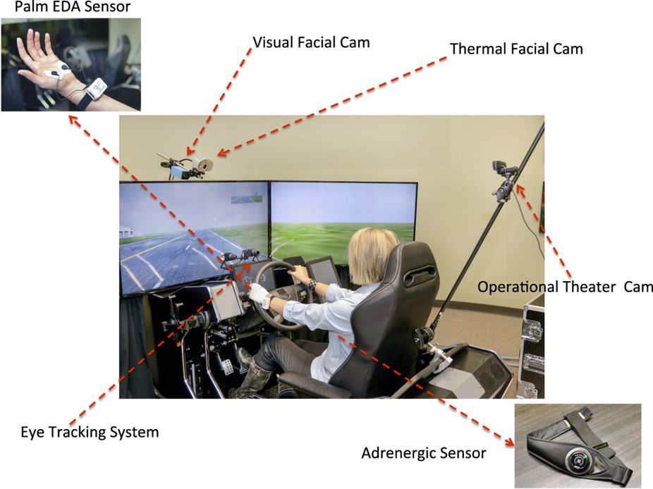
Experiment
Controlled simulated driving experiment¹ to asses driving behavior
Multiple different stressors: cognitive, emotional, sensorimotor (texting)
Sensors captured vehicle information and driver outputs
Subject variables: age, gender, personality
Drive variables: Speed, brake, lane position
Biological variables: eye gaze, heart rate, breathing rate, etc

Slide 3
Objective
Model variance of lane positioning/offset to understand texting effect
Bayesian modelling
Time series analysis
Stan MCMC Programming: Sampling with Hamiltonian Monte Carlo
“Modern Statistical Workflow”²: Capture simulated data before fitting observations
Explore population level effects on variance

Slide 4
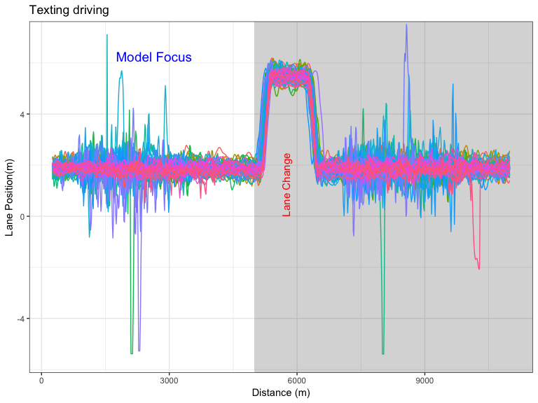
Preliminary Analysis: All drivers
Each color is a separate driver (N=68)
Data resampled at 390 data points and missing data filtered
Prior to lane change: 200
After lane change: 190
Focused on first half (prior to lane change)
Some drivers exhibit extremely long tails in their lane positioning
Univariate (T021) data is stationary according to Dickey-Fuller test
Accounting for texting vs normal driving state

Slide 5
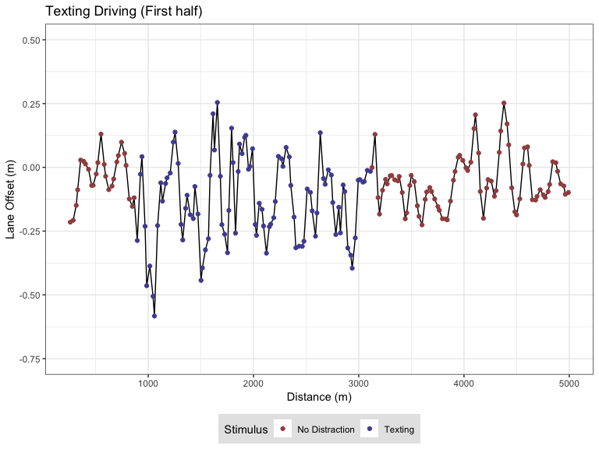
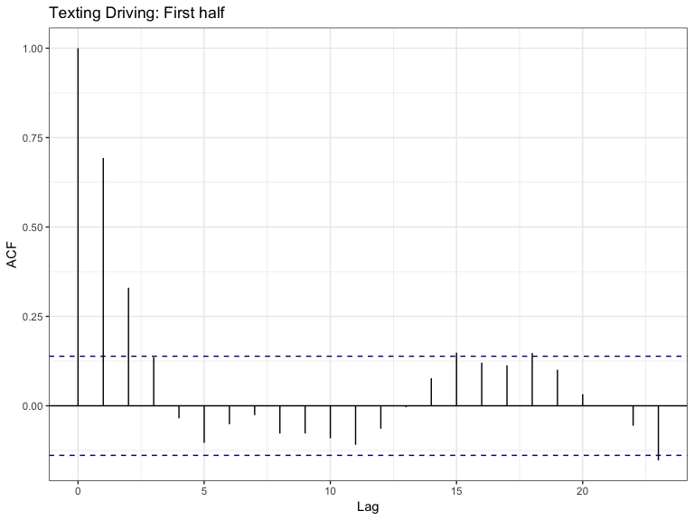
Preliminary Analysis: T021 Driver

Slide 6
Modelling
Univariate model (T021 driver)
Autoregressive (AR) model
Multivariate model (all drivers)
Independent drivers model
Hierarchical model: Regularization

Slide 7
AR(1): Setup
Conceptual Analysis
Single driver staying in the middle of a lane. Should expect that as the driver moves out of the middle of lane to correct by reducing lane position back to middle (LaneOffset = 0). Would expect that mean and variance is constant in each state of driving (normal vs texting)
Define observations
$$T:Number of observations$$
$$N_{texting}:Number of texting states (j)$$
$$y_{t}:Lane Offset (meters)$$
$$x_{t}:Texting indicator (1: ND, 2: MD)$$
Summary Statistic
Posterior Predictive mean of each $y_{t+1}$
Likelihood and priors
$$y_{t}∼N(α+ρy_{t−1},σ+δ_{j})$$
$$ρ∼Uniform(0,1)$$
$$σ_{i}∼H(0,1)$$
$$α∼N(0,1)$$
$$δ_{j}∼H(0,1)$$

Slide 8
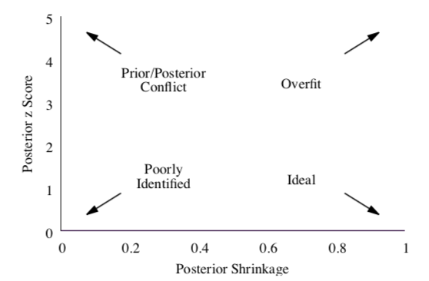
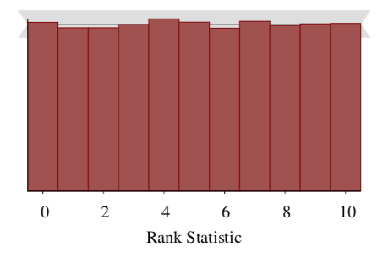
Prior Predictive Fit Tests

Slide 9
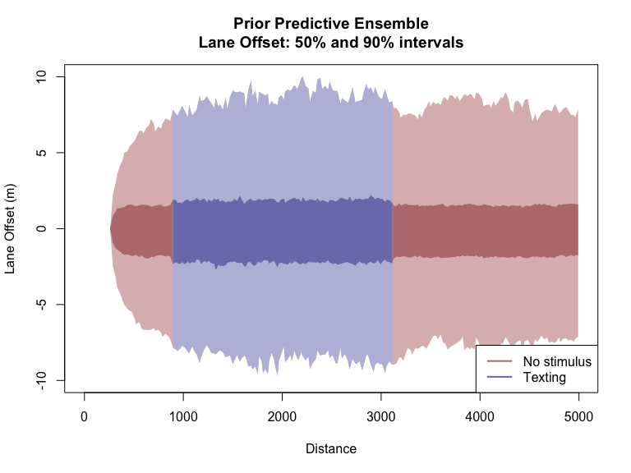
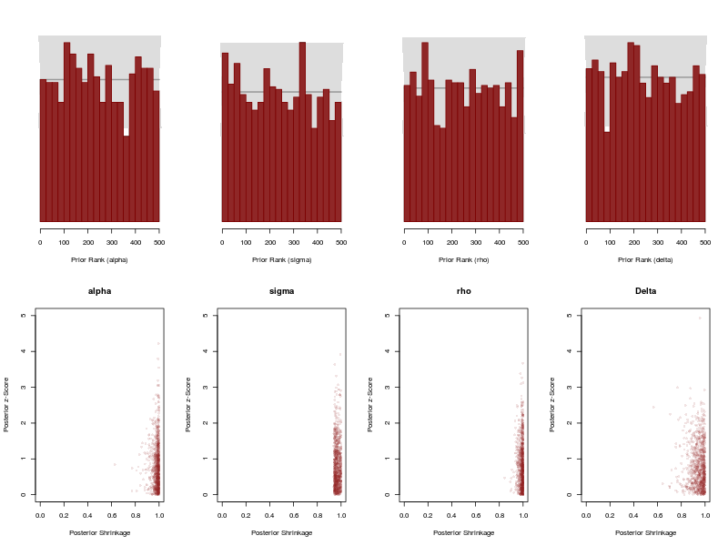
AR(1): Prior Predictive Analysis

Slide 10
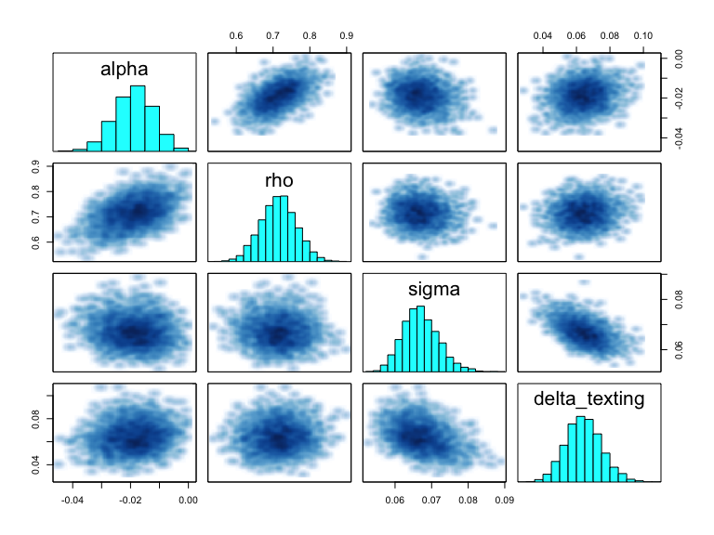
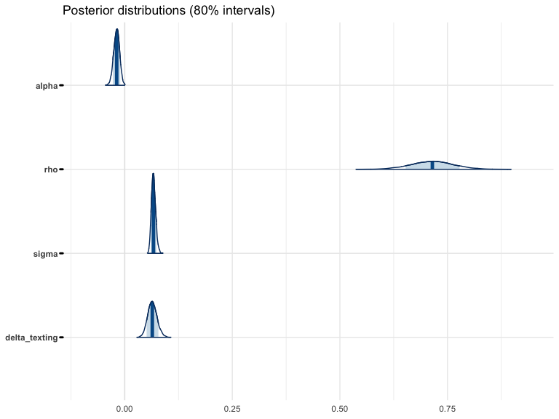
AR(1): Fit observations

Slide 11
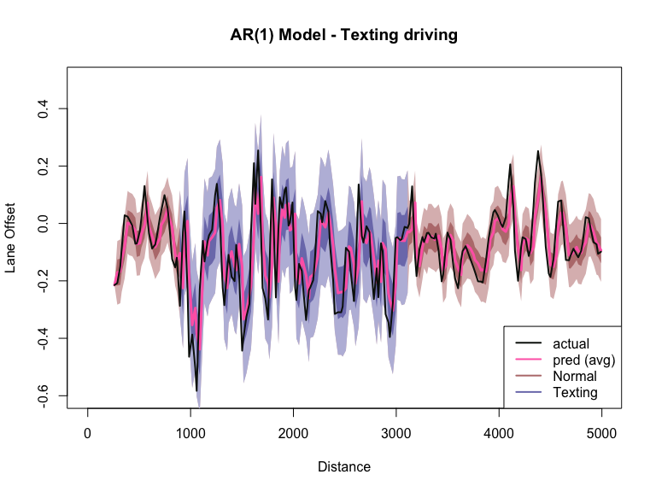
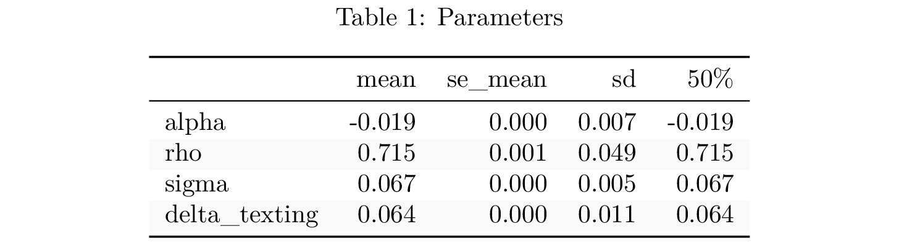
AR(1): Posterior Predictive Check

Slide 12
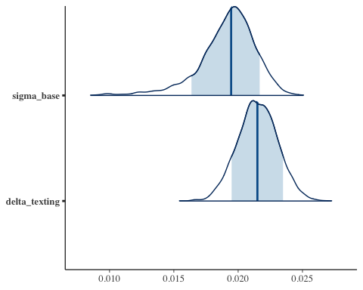
AR(1): Multivariate drivers
Likelihood and priors
$$y_{i,t}∼N(α+ρy_{i,t−1},σ_{base}+σ_{i}+δ_{base}+δ_{i})$$
$$σ_{i}∼N(0,0.1)$$
$$δ_{i}∼N(0,0.1)$$

Slide 13
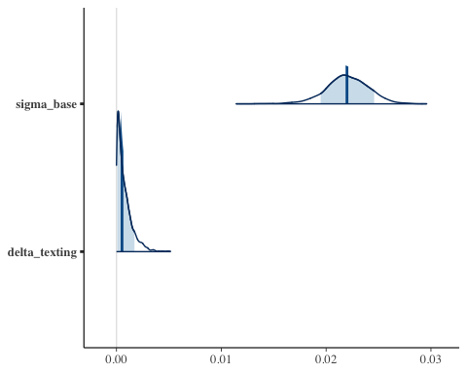
AR(1): Hierarchical multivariate model
Likelihood and priors
$$y_{i,t}∼N(α+ρy_{i,t−1},σ_{base}+σ_{i}+δ_{base}+δ_{i})$$
$$σ_{i}∼N(0,σ_{γ})$$
$$σ_{γ}∼N(0,0.01)$$
$$δ_{i}∼N(0,δ_{γ})$$
$$δ_{γ}∼N(0,0.01)$$

Slide 14
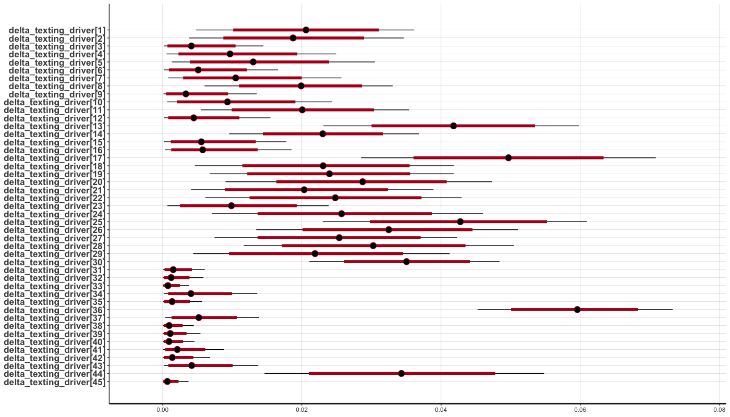
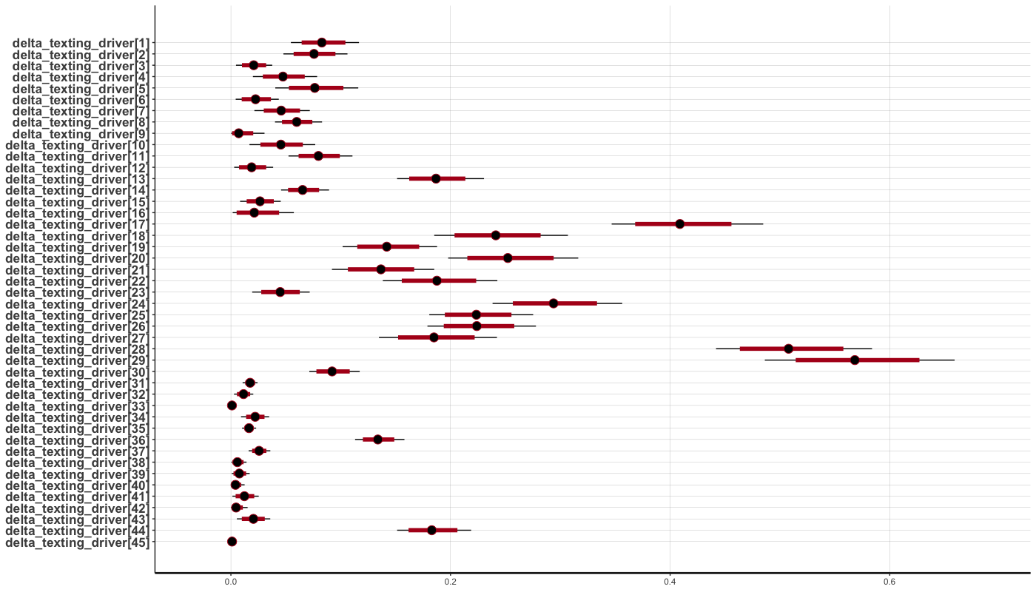
AR(1): Texting effect: Regularization by driver

Slide 15
Backup slides

Slide 16
References
Taamneh, S. et al. A multimodal dataset for various forms of distracted driving. Sci. Data 4:170110 doi: 10.1038/sdata.2017.110 (2017).
Betancourt, Michael. 2018. “A Principled Bayesian Workflow” June 2018
Kim, Shephard, Chib (1998) “Stochastic Volatility: Likelihood Inference and Comparison with ARCH Models” The Review of Economic Studies Vol. 65, No. 3
Stan Development Team. “Stan Modeling Language User’s Guide and Reference Manual” Version 2.17.0, Sept 2017

Slide 17
Computing Cluster Setup (Amazon Web Services)
Prior Predictive Modelling
Each prior predictive model runs 1000 simulations from the generative model
Fitting 1000 simulations is a time consuming process on local machine
Stan runs 4 markov chains in parallel and aggregates (4 cores)
1000 * 4 = 4000 CPU’s to run fit observations for one model!
Created a docker container with RStan and submitted jobs to AWS Batch service

Slide 18
Future steps
Incorporate bayesian methods for dealing with missing data
Incorporate “change-point” model to account of lane changes
Determine better methods for posterior predictive checking for time series data
Correlogram & Variogram

Slide 19
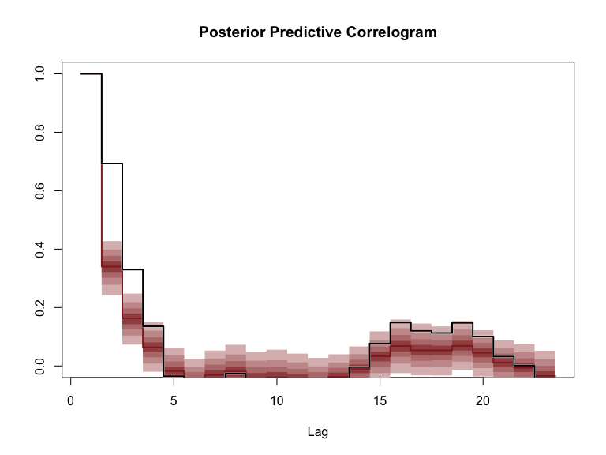
AR(1): Posterior Predictive Check - Correlogram

Slide 20
Stochastic Volatility: Setup
Conceptual Analysis
Mean of lane offset is constant but with changing volatility. The SV model has additional parameters to deal with the structure of this data. Latent variables and generative nature of model allows for additional complexity.
Define observations
$$T:Number of observations$$
$$N_{texting}:Number of texting states (j)$$
$$y_{t}:Lane Offset (meters), mean corrected$$
$$x_{t}:Texting indicator (1: ND, 2: MD)$$
Likelihood and priors
$$y_{t}∼N(0,exp(h_{t}/2))$$
$$h_{t}∼N(μ+δ+ϕ(h_{t}−μ),σ)$$
$$h_{1}∼N(μ,\frac{σ}{\sqrt{1−ϕ^{2}}})$$
$$μ∼N(0,1):Mean log volatility$$
$$ϕ∼Uniform(−1,1):Persistence of volatility$$
$$σ∼N(0,1)$$
$$δ∼N(0,0.05):Texting effect$$

Slide 21
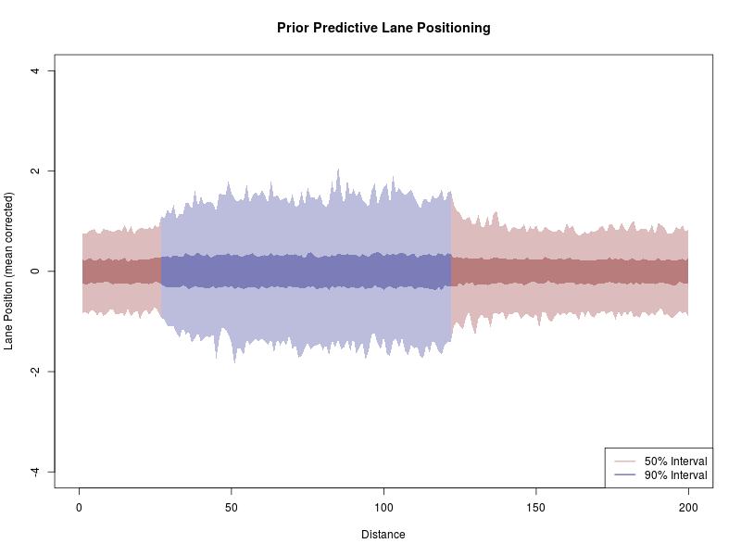
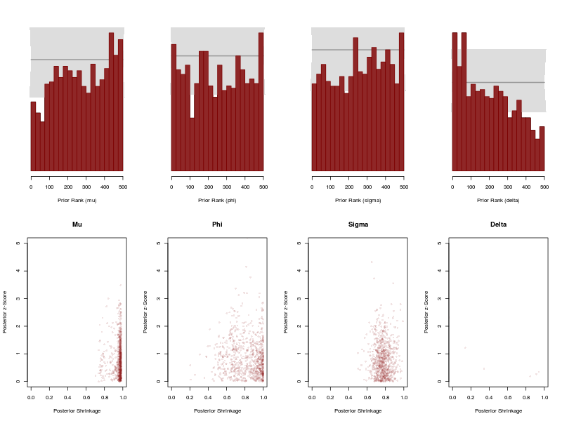
Stochastic Volatility: Prior Predictive Analysis

Slide 22
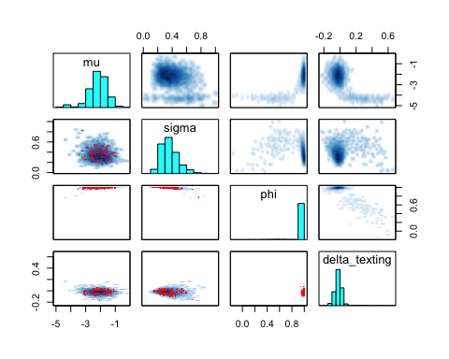
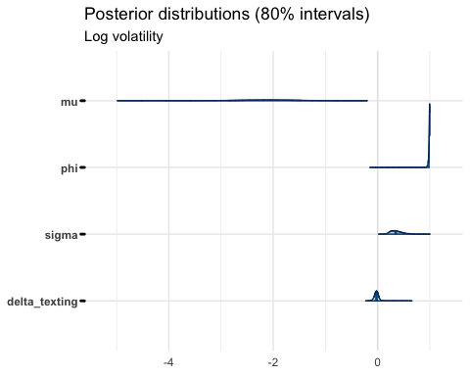
Stochastic Volatility: Fit Observations

Slide 23
Assignment 8 Summary
Since last time …
Reverted back to AR(1) model, fit with $δ_{j}$ term
Fit multivariate model
Fit hierarchical multivariate model
Stopped progress on stochastic volatility model
Couldn’t fix non-stationarity in $phi$ term
Future work
Hierarchical AR model texting effect is too dampened
Population effects
Try SV model again?

