Slide 1
STAT 685: Distracted Driving
Committee: Dr. Derya Akleman, Dr. Samiran Sinha, Dr. Ergun Akleman Bryan Yu | bryanyu@tamu.edu

Slide 2
Summary (Assignment 7)
Created cloud computing infrastructure to run MCMC samples more effectively
16 hour run time for one model on laptop
1 hour with concurrent docker containers
Updated stochastic volatility model with less complexity
Lots of divergences with phi suspect (non-stationarity)
Created stochastic volatility model for all drivers

Slide 3
Computing Cluster Setup (Amazon Web Services)
Prior Predictive Modelling
Each prior predictive model runs 1K simulations from generative model
Fitting 1000 simulations is a time consuming process on local machine
Stan runs 4 markov chains in parallel and aggregates (4 cores)
1000 * 4 = 4000 CPU’s to run fit observations for one model!
Created a Stan docker container with job submissions to cluster (128 cores)

Slide 4
Stochastic Volatility: Setup
Conceptual Analysis
Mean of lane positioning is constant but with changing volatility. The SV model has additional parameters to deal with the structure of this data. Latent variables and generative nature of model allows for additional complexity.
Define observations
$$T:Number of observations$$
$$N_{texting}:Number of texting states (j)$$
$$y_{t}:Lane Position (meters), mean corrected$$
$$x_{t}:Texting indicator (1: ND, 2: MD)$$
Likelihood and priors
$$y_{t}∼𝒩(0,exp(h_{t}/2))$$
$$h_{t}∼𝒩(μ+δ+φ(h_{t}−μ),σ)$$
$$h_{1}∼𝒩(μ,\frac{σ}{\sqrt{1−φ^{2}}})$$
$$μ∼𝒩(0,1):Mean log volatility$$
$$φ∼Uniform(−1,1):Persistence of volatility$$
$$σ∼𝒩(0,1)$$
$$δ∼𝒩(0,0.05):Texting effect$$

Slide 5
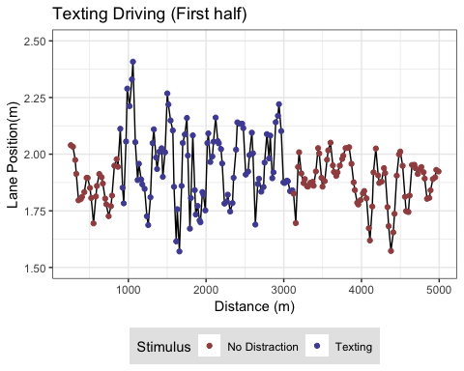
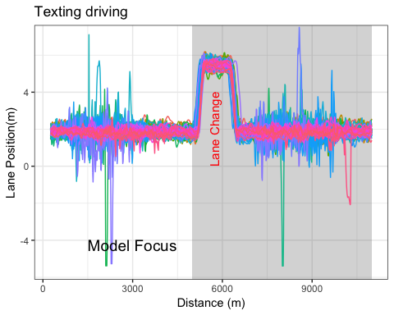
T021 Driver

Slide 6
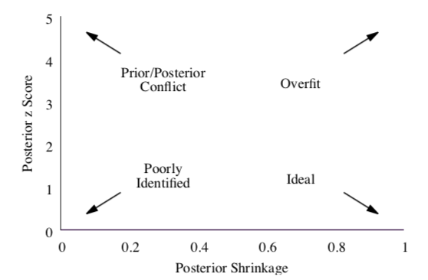
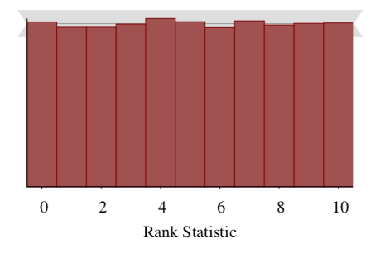
Prior Predictive Fit Tests

Slide 7
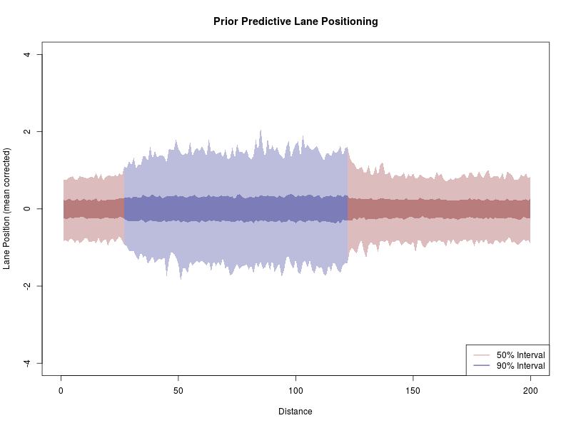
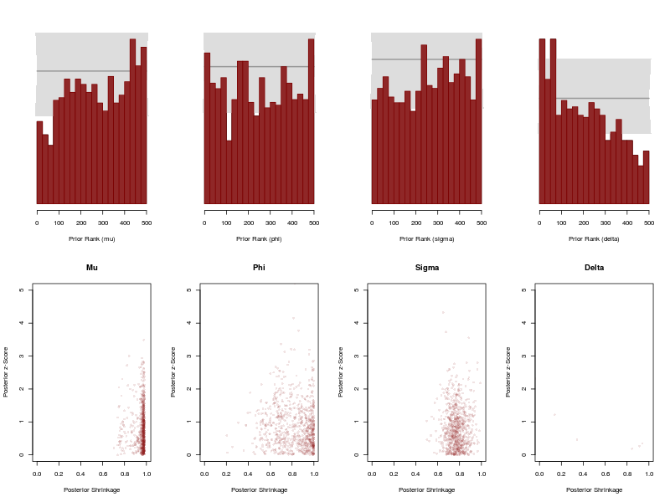
Stochastic Volatility: Prior Predictive Fits

Slide 8
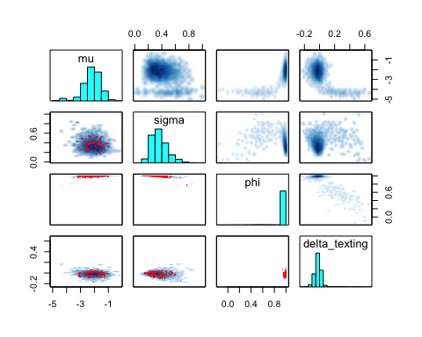
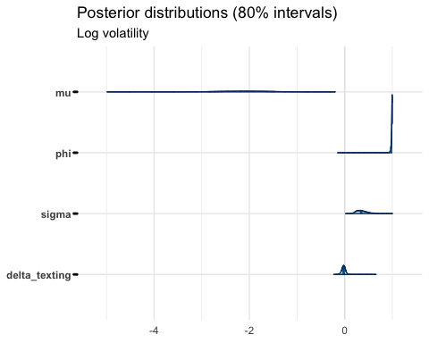
Stochastic Volatility: Output

Slide 9
References
Taamneh, S. et al. A multimodal dataset for various forms of distracted driving. Sci. Data 4:170110 doi: 10.1038/sdata.2017.110 (2017).
Betancourt, Michael. 2018. “A Principled Bayesian Workflow” June 2018
Kim, Shephard, Chib (1998) “Stochastic Volatility: Likelihood Inference and Comparison with ARCH Models” The Review of Economic Studies Vol. 65, No. 3
Stan Development Team. “Stan Modeling Language User’s Guide and Reference Manual” Version 2.17.0, Sept 2017
Betancourt, Michael. “Calibrating Model-Based Inferences and Decisions” March 2018
Sean Talts, Michael Betancourt, Daniel Simpson, Aki Vehtari, Andrew Gelman “Validating Bayesian Inference Algorithms with Simulation-Based Calibration” April 2018

Slide 10
Future steps
Fix divergences
Run all drivers model

