Slide 1
Campus Helper Bot
COMP 7940 Group Project
Yang Bowei (25428179)
Ji Xinyu (25423797)

Slide 2
01.
Project Overview
02.
System Design and Technical Implementation
03.
Resources and Costs
04.
Project Verification and Demonstration

Slide 3
01
Project Overview

Slide 4
Project Scenario
Course Q&A Function
Scenario
Telegram campus assistant chatbot for university campus scenarios.
Schedule Reminder Function
Personalized Recommendation Function

Slide 5
Responsibility
Name / No. | Role | Responsibility
Yang Bowei (25428179) | Leader | system architecture design, cloud deployment, containerization, and CI/CD pipeline construction
Ji Xinyu (25423797) | Group member | Telegram bot development, LLM API integration, database configuration, monitoring, and report writing

Slide 6
System Design and Technical Implementation
02

Slide 7









System Architecture
User access layer
Gateway access layer
Core application layer
Service Support Layer
AI model layer
Redis Cache
Historical context/status
End User
Bot API
AWS EC2
Intelligent reasoning core
Telegram App initiates command interaction
Real time message forwarding
HKBU LLM API remote call
CloudWatch
Python / Docker
log collection

Slide 8
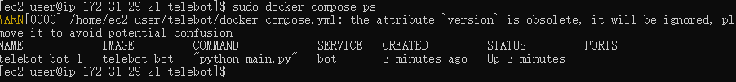
Empowering the standardized container ecosystem
With the mature container ecosystem of Docker and AWS cloud services, we can easily achieve rapid iteration and delivery of applications, as well as elastic scaling and expansion.
This is the result of executing the docker compose ps command on an EC2 server. As you can see, the status of the service named bot-1 is displayed as Up, indicating that our robot application has successfully started and is running stably in the Docker container.

Slide 9
03
Resources and Costs

Slide 10
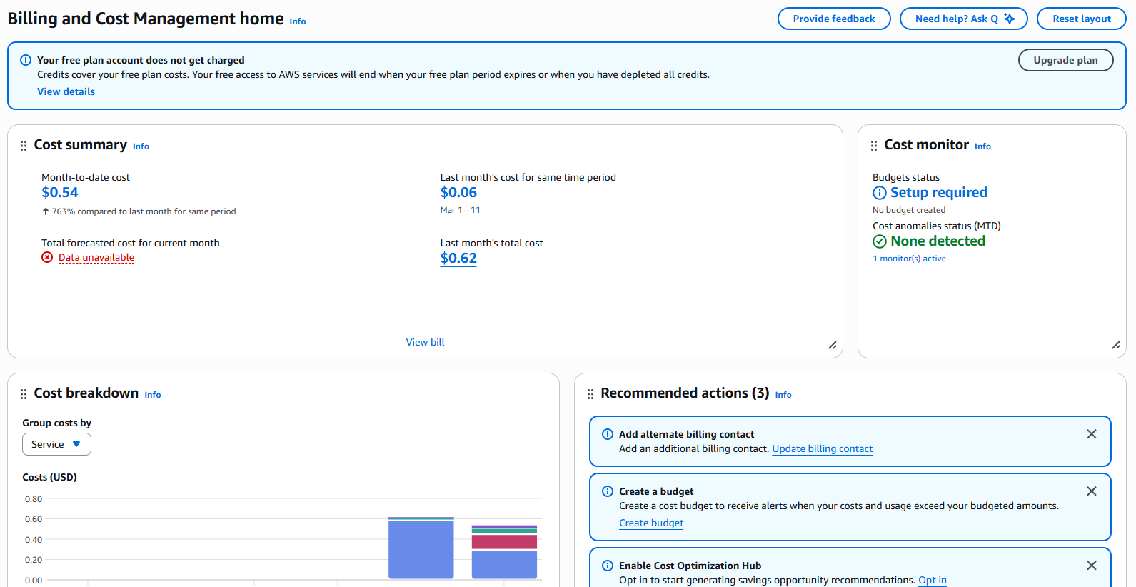

Cost Overview
The entire project is built on an AWS Free Tier account, where most basic cloud resources are covered by free credits, resulting in extremely low actual costs throughout the project cycle.

Slide 11
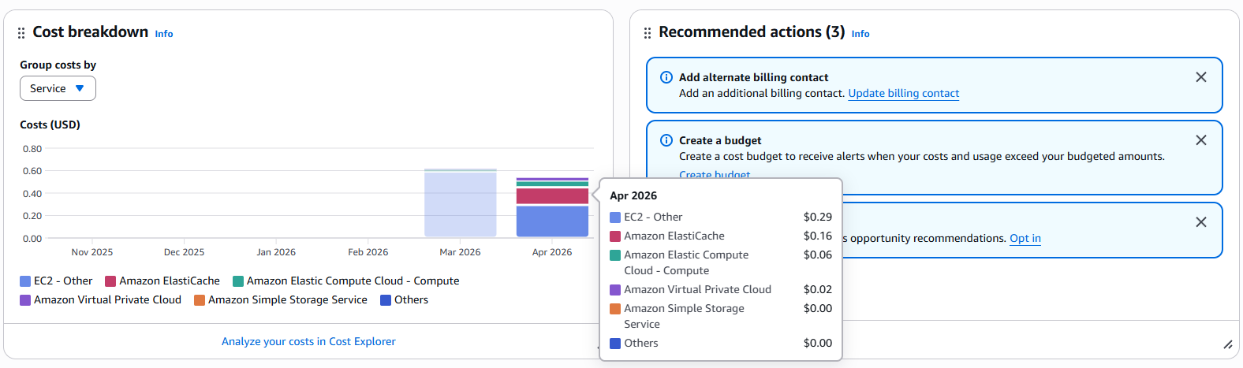

Cost Structure
The project’s breakdown of service costs reveals the majority of expenses come from EC2-related resources

Slide 12
Project Verification and Demonstration
04

Slide 13
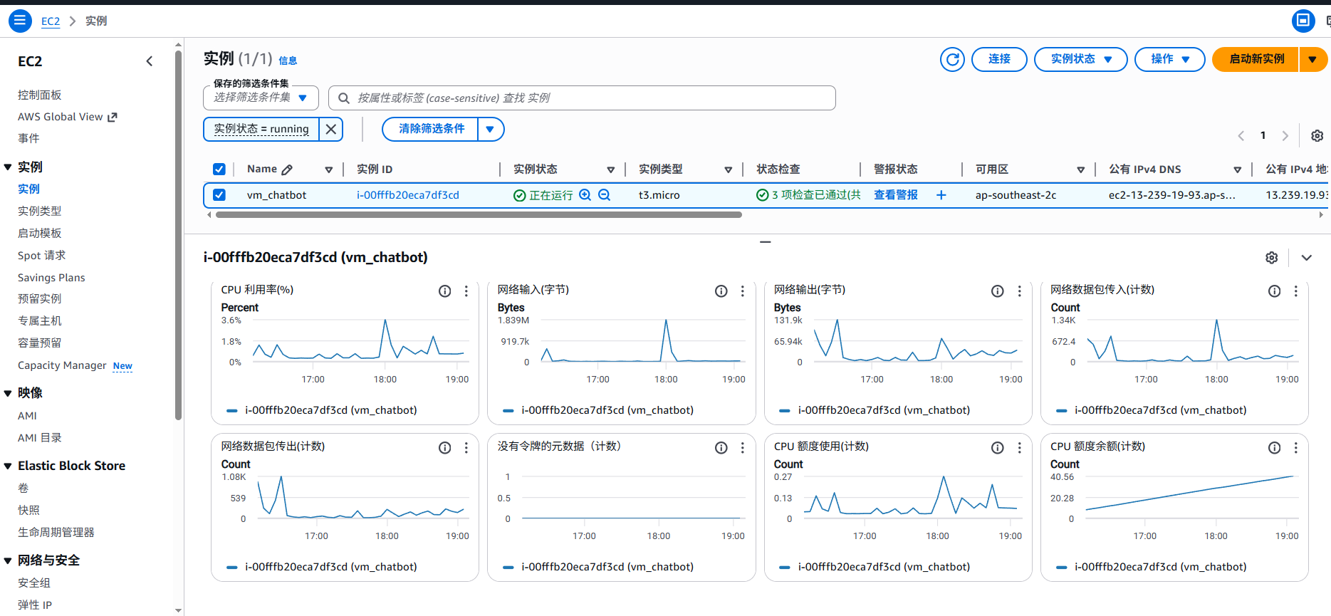
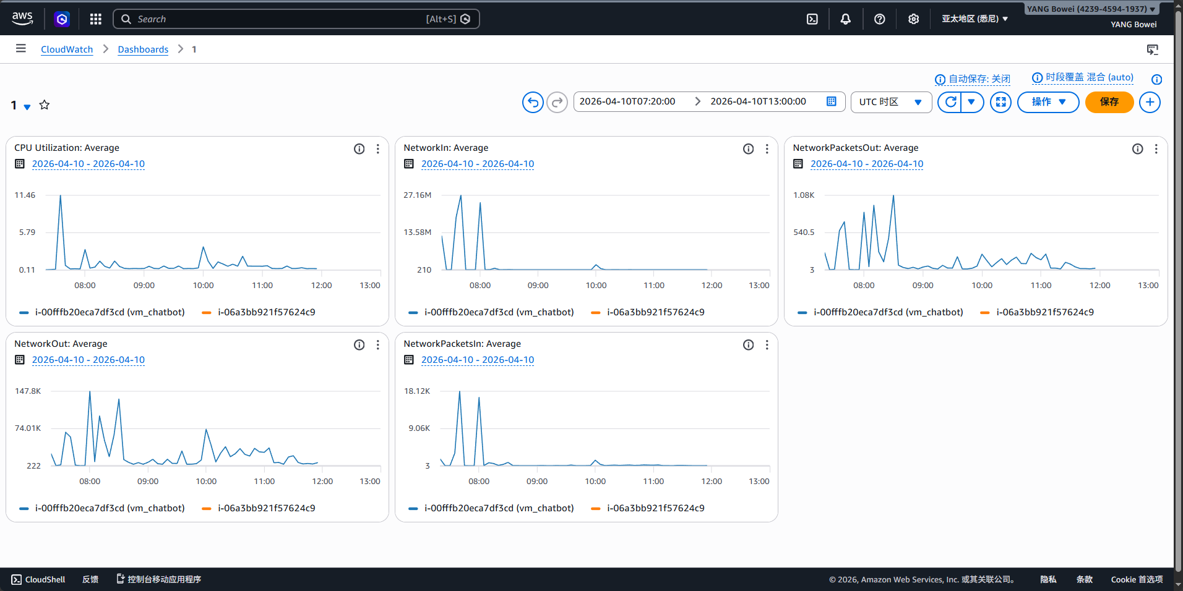
Project Verification
EC2 instance runs properly
Stable CPU usage and network traffic
low and steady resource consumption

Slide 14
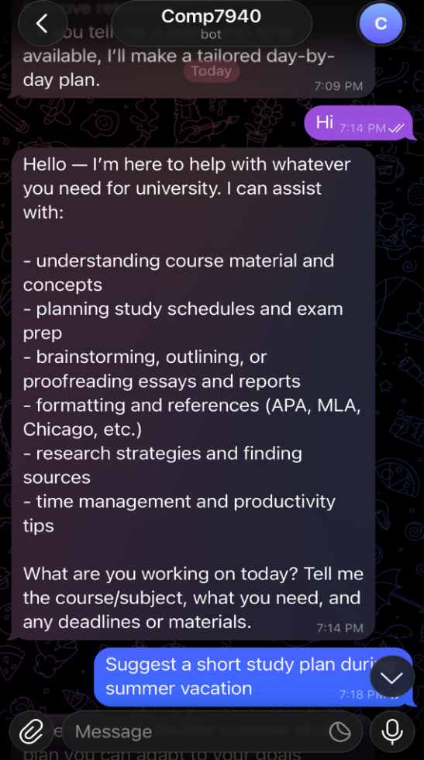
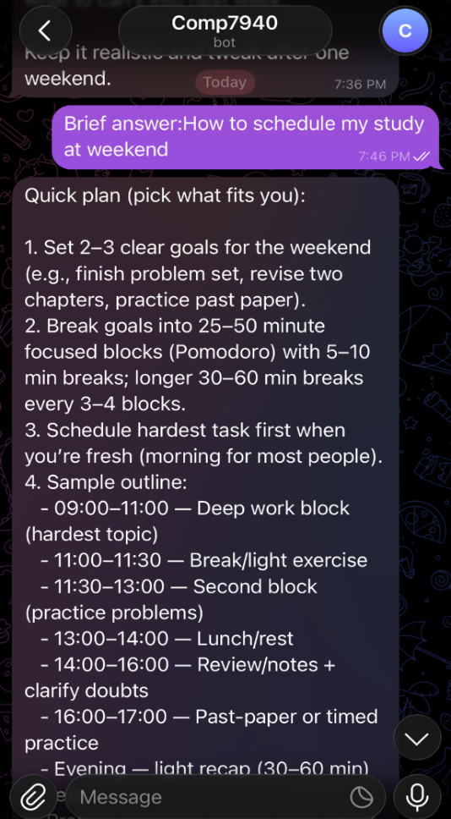
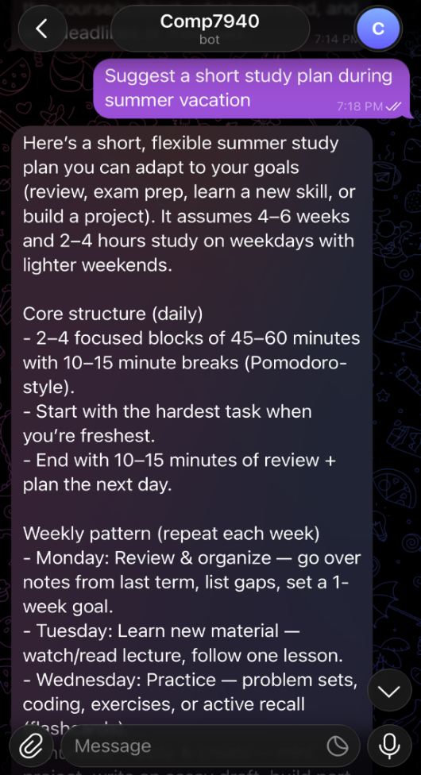
Demonstration

Slide 15
LOGO
Thanks for Listening

