Slide 1
Cancer Metastases Detection Based on Fully Convolutional Networks
Project for COMS 4995 Applied Deep Learning
Name: Boyu Yang
UNI: by2267

Slide 2
Introduction
Cancer metastases detection is an important and difficult problem in biology and medicine science area.
High requirement for doctors: knowledge and experience
Low accuracy
Deep learning: A sufficient method to help doctors

Slide 3
Dataset
CAMELYON16
400 whole slide images, each contains several levels of images
Higher level images is the downsample images of lower level images

Slide 4
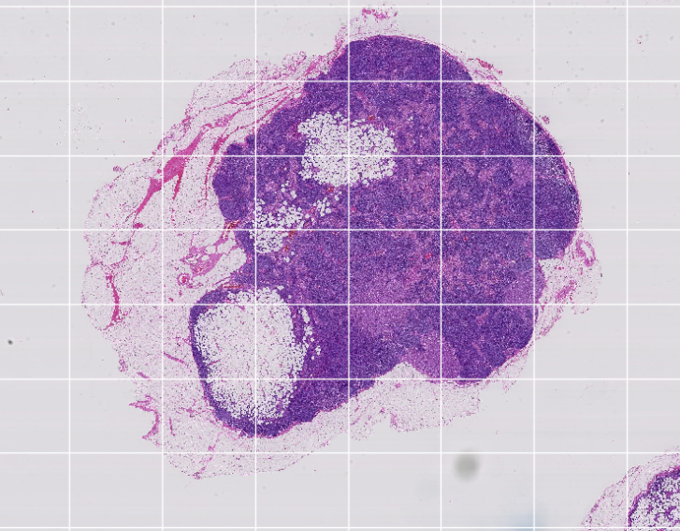
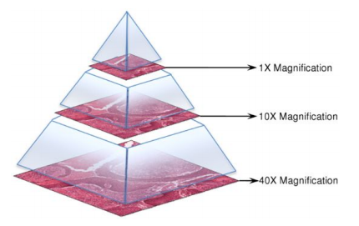

Slide 5
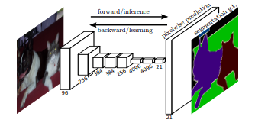
Methods
FCN: Fully Convolutional Networks
Add upsampling layer after a Convolutional Neural Network
Generate pixel level predictions

Slide 6
Methods
Divide the image with high resolution into small pieces
Choose the pieces which contain tissue cells as training data
Choose the masks as labels
Train a FCN network to predict every pixels in an image piece
For every image piece, if there exists tumor pixels, judge the corresponding pixel in the higher level downsample image as tumor pixel
Generate the prediction of tumor mask for the higher level downsample image

Slide 7
Experiment Results and Evaluation
Slide selection: tumor_064.tif
The number of training data: 27500
The number of validation data: 9139
Model validation accuracy: 95.24%

Slide 8
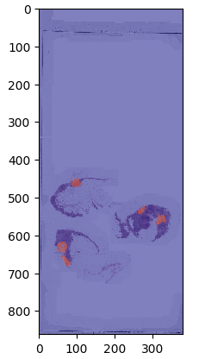
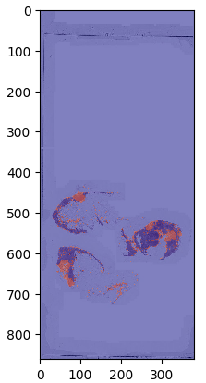
Cancers are correctly detected
Wrongly detect more normal pixels as cancer pixels
This fault is better than missing the cancers and can be corrected by human doctors in the following steps.

Slide 9
Experiment Results and Evaluation
Evaluation matrix:
Model intends to judge more normal cells as tumor cells, which means that it is hard to miss any part of cancers.
That is helpful for doctors to use the model to roughly detect cancers in the very first step.
 | real_normal | real_tumor
pred_normal | 322724 | 14
pred_tumor | 4522 | 2024

Slide 10
Further Works
More training data
Higher resolution prediction

Slide 11
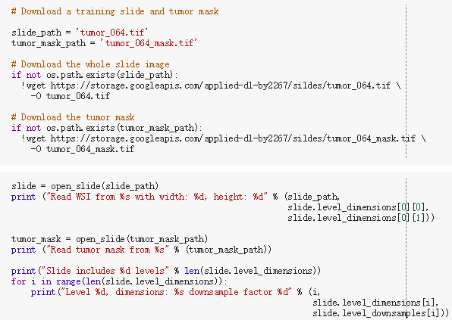
Code Walkthrough
Download and open slide

Slide 12
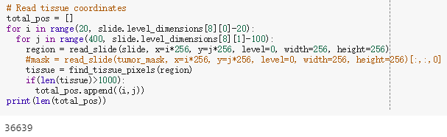
Code Walkthrough
Read tissue coordinates

Slide 13
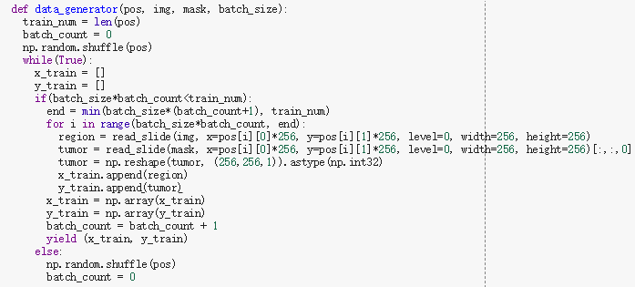
Code Walkthrough
Generate training data and labels

Slide 14
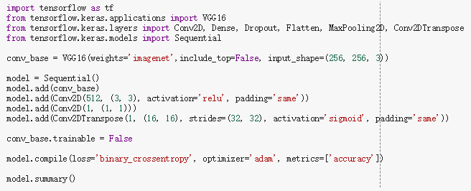
Code Walkthrough
Define the model

Slide 15
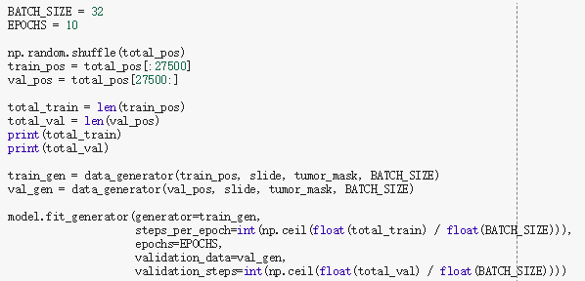
Code Walkthrough
Train the model

Slide 16
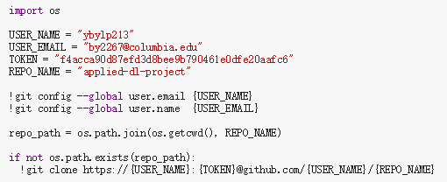
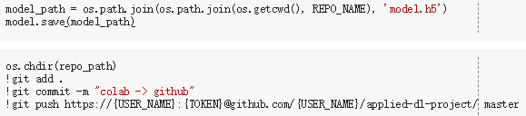
Code Walkthrough
Save the model to GitHub

Slide 17
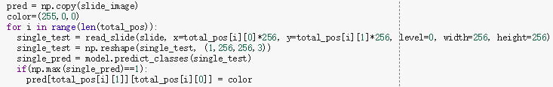
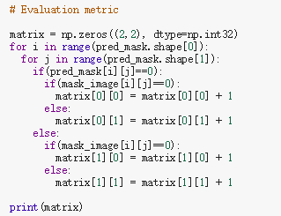
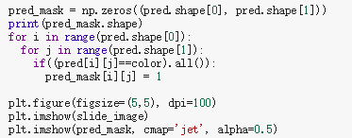
Code Walkthrough
Model evaluation

Slide 18
Thanks!
GitHub link: https://github.com/ybylp213/applied-dl-project

