Slide 1
NGWN-P2
2023/11/20 羅文熠

Slide 2
Outline
Instructions
Introduction
Project goal
Project hints

Slide 3
Instructions
In this project, you need to
Write server and client programs to practice TCP socket programming.
Demo your project to TA group.
Name the zip file “studentID.zip” and upload it to the Moodle system
Mail to network6459@gmail.com if you have any question about this project.

Slide 4
Introduction
This project aims to implement an application for transmitting real-time video streaming between the client and the server.
A camera positioned on the server captures real-time images. Once the server reads the live image, it is showcased on the screen and transmitted to the client.
The client receives the video stream from the server and displays it on the screen. Additionally, the client needs to provide the screenshot function.

Slide 5
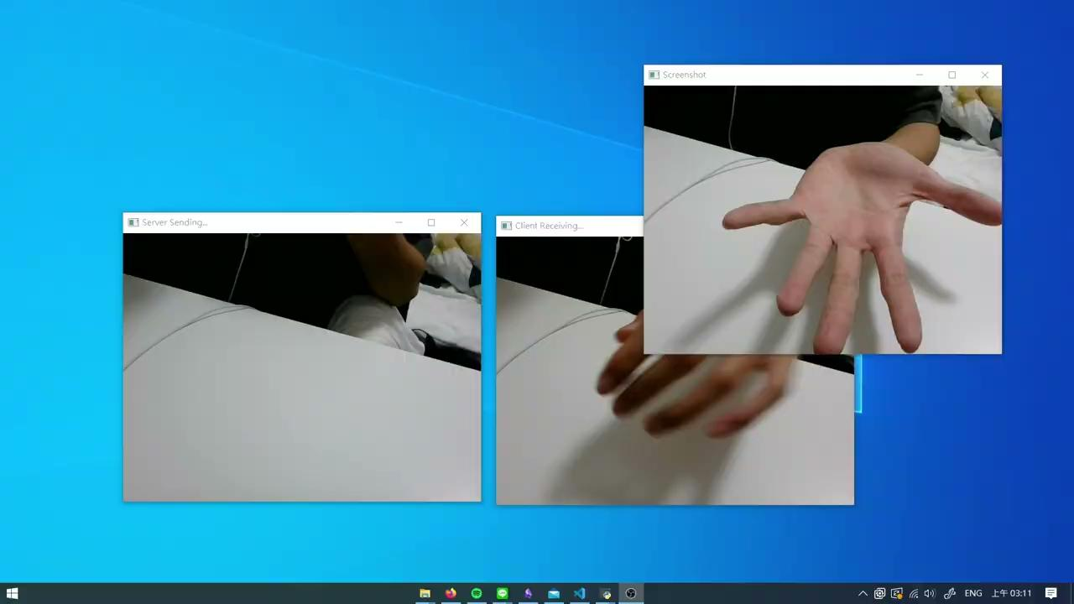
Goal

Slide 6
Goal
Construct a TCP connection between the server and the client.
Server side displays **camera** screen.
Client-side displays **camera** screen and screenshots the received video.

Slide 7
Server (only one server)
Construct a TCP connection with the connected client.
Open a TCP socket.
Wait for the client.
Read live video from the camera and display it on the screen.
Transmit the live video to the client.
Close the TCP connection when the client finishes the task.

Slide 8
Client (only one client)
Build a TCP connection with its target server.
Open a TCP socket.
Connect to the server.
Receive live video from the server and display it.
If the client presses the “space” key, it will take a screenshot and save it on disks.
Finish the TCP connection(ctrl+c or “ESC” key).

Slide 9
Project Requirement
Submission deadline: 12/17 23:59
Pack your jpg files and source codes into a compressed file and upload it to the Moodle system. Finally, name the zip files as BXXXXXXXX.zip.
Part 1 (40%) image about TA and You (Demo: 12/14, 12/15) => screenshot_1.jpg
Part 2 (60%)
your client code
your server code

Slide 10


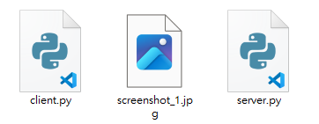
Submission Items
Format: B10803040.zip
Unzip your file to output the following folder containing your source codes and jpg files.

Slide 11
Project Requirement
Source Code in .c/.cpp/.py => C/ C++/ Python
Plagiarism is prohibited and will get a minus score if you do so
In this project, we’ll use source code plagiarism detection tool for plagiarism detection

Slide 12
Demo
Demo dates: 12/14(19:00~21:00) or 12/15 (19:00~21:00)
Generate the jpg file required for “Part 1 (40%) img about TA and You => screenshot_1.jpg” during the demo.
Please bring your computer during the demo and test in advance whether it can successfully operate and run the program.
Please fill the demo order sheet below before 12/1(Fri.) 23:59
12/14:Link
12/15:Link

Slide 13
Project hints
Use python package: socket, cv2,pickle,struct,numpy
Use TCP, ipv4, ip=127.0.0.1, port: any (8080,whatever)
Remember to implement the function of the screenshot key.

