Slide 1
Med Safe
Before adding
a new medicine
Confirm the label. Understand selected warnings.
Bring a clear question to the pharmacist.
Hong Kong medicine data · Cantonese access · Sources beside the warning
Med Safe / HacKU 2026 / Prototype · 3 October 2026
01
Notes:
Primary proposed scenario: a Hong Kong older adult or caregiver wants to add an over-the-counter medicine while already taking other medicines. The prototype confirms identity, shows selected source-backed warnings, and produces a pharmacist question card. This is not an evaluated clinical service. Team and repository: https://github.com/yc-eagle/med-safe .

Slide 2
The Hong Kong use case
A common decision point
“I already take these medicines.
Can I add this cold medicine?”
The user has
The app prepares
A pharmacy bag, medicine packs,
and instructions that may differ
from general packaging.
Confirmed product identities,
selected warnings, and questions
for a professional to resolve.
Med Safe / HacKU 2026 / Prototype · 3 October 2026
02
Notes:
A proposed workflow, not a validated demographic finding: older adults and caregivers compare a medicine bag or existing packs before adding an OTC cold or pain product. Hong Kong registration identifiers and the official catalogue support local identity matching. Medicine bag instructions are individual dispensing instructions and must not be replaced with a guessed box dose. Catalogue source: https://data.gov.hk/en-data/dataset/hk-dh-dh_do-hk-dh-do-pharmaceutical-product . HK general medicine advice: https://www.drugoffice.gov.hk/eps/do/en/consumer/news_informations/knowledge_on_medicines/general_use_on_medicine.html .

Slide 3
Data scope is visible
14,269
23,835
product–ingredient rows
Hong Kong registered products
Official snapshot: 25 September 2026
2,081
original ingredient strings
14 ingredient profiles · 14 rule drafts · 22 lexicon entries
Catalogue size and ingredient mapping do not establish clinical coverage.
All clinical rules still await professional review.
Med Safe / HacKU 2026 / Prototype · 3 October 2026
03
Notes:
Audited inventory: data/data_inventory.json, snapshot 2026-09-25. 14,269 unique HK registration numbers; 23,835 product-ingredient rows; 2,081 distinct original ingredient strings; 14 ingredient profiles with 13 educational source documents; 14 clinical rule drafts from 5 source documents; 13 illustrative formulations; 22 lexicon entries. 1,431 products have at least one mapped prepared ingredient; 674 have all listed ingredients mapped. Mapping is not clinical coverage. Clinically approved rules: zero. All rule and profile wording awaits professional review. Official source: https://data.gov.hk/en-data/dataset/hk-dh-dh_do-hk-dh-do-pharmaceutical-product .

Slide 4
How a medicine check works
01
Confirm identity and route
A candidate from OCR or a name is not a confirmed medicine.
02
Map ingredients explicitly
Unmapped ingredients stay visible; no guessed equivalence.
03
Check every distinct pair
Up to 12 medicines, 66 pairs. Rules retain their sources.
04
Show warnings and unresolved items
A missing rule cannot establish that a combination is safe.
Personal doses and the combined effect of three or more medicines are outside this check.
Med Safe / HacKU 2026 / Prototype · 3 October 2026
04
Notes:
Implementation sources in this repository: app/engine.js, app/medicine-info.js, app/patient.js, data-pack/data/demo_rules.json. Up to 12 products yields up to 66 distinct product pairs. User confirms identity and route. Exact explicit ingredient aliases map known ingredients; unmapped ingredients remain missing. The engine enumerates product pairs and ingredient combinations, evaluates prepared rule applicability, retains source/jurisdiction and clinical-review status, and separately reports pending routes, unknowns and unmatched pairs. It does not infer a safety clearance, personal dose or higher-order interactions from pairwise results.

Slide 5
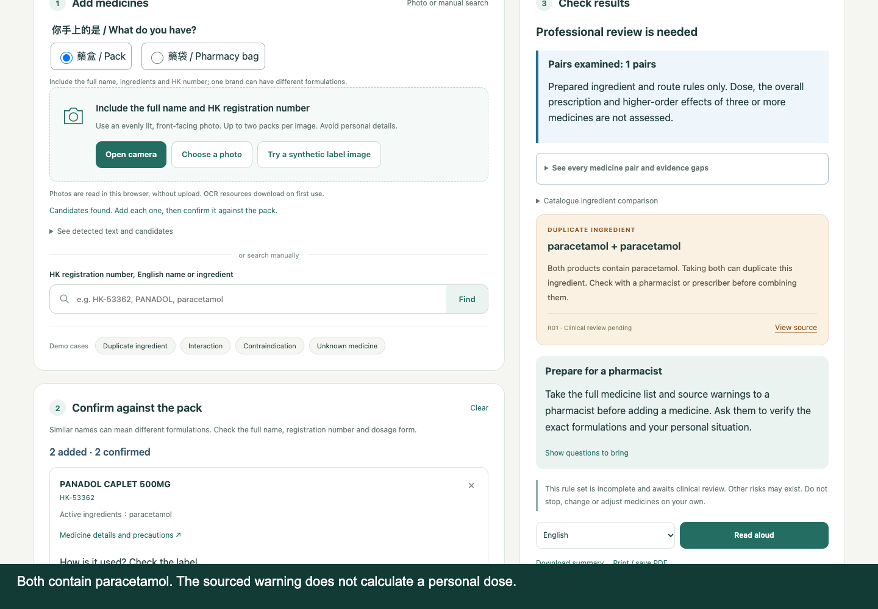
A warning with a source
Two products can
share an ingredient
The warning keeps
its source and
review status visible.
Synthetic labels
Actual browser output
Med Safe / HacKU 2026 / Prototype · 3 October 2026
05
Notes:
Actual browser screenshot captured on 3 October 2026 during automated interactions with synthetic labels. HK-53362 PANADOL CAPLET 500MG and HK-53319 PANADOL COLD & COUGH TAB both list paracetamol in the HK catalogue. R01 links to HK Drug Office paracetamol information: https://www.drugoffice.gov.hk/eps/do/en/consumer/news_informations/knowledge_on_medicines/paracetamol.html . The application does not calculate actual total dose or determine the user overdose risk. Synthetic UI demonstration, not a real patient or clinical validation.

Slide 6
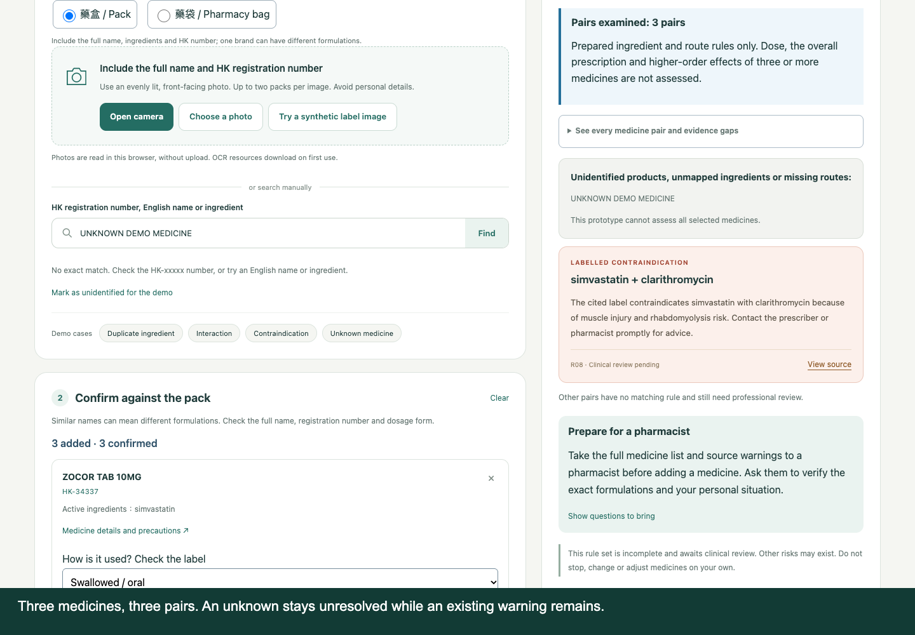
Unknowns do not erase a warning
A third medicine
cannot be identified
The check remains
incomplete. Existing
warnings stay visible.
Synthetic scenario
Professional review pending
Med Safe / HacKU 2026 / Prototype · 3 October 2026
06
Notes:
Actual browser screenshot captured from the current app. Selected medicines in this scenario include a sourced simvastatin/clarithromycin warning and an unidentified third medicine. The engine keeps the known warning while reporting an incomplete check and unresolved product pairs. The warning source is a US DailyMed clarithromycin label: https://dailymed.nlm.nih.gov/dailymed/drugInfo.cfm?setid=d22bd12c-737b-4aab-e053-2995a90aff60 . Local applicability requires professional review. No patient outcome or manual-baseline improvement is claimed.

Slide 7
Phone access and offline boundaries
Phone browser
Offline use
Photo recognition on the device
Search, details and rule checks
Large text and a pharmacist card
Download app assets first.
Check offline readiness before use.
Original source links need internet.
Voice has a separate boundary
Phone recognition may use the browser provider after consent.
The optional Mac model can transcribe locally. Device voices vary.
Med Safe / HacKU 2026 / Prototype · 3 October 2026
07
Notes:
Current browser implementation uses bundled Tesseract JS with English and Traditional Chinese assets. Photos are processed in the browser, with user confirmation before checks. Offline assets require an initial download and readiness check; physical iPhone/Android testing is still pending at media production time. Browser SpeechRecognition can send audio to a browser provider and asks for consent. The optional Apple Silicon local Mac package uses Qwen3-ASR-0.6B-4bit with downloaded weights for local Cantonese transcription. Speech synthesis depends on installed browser/device voices. No claim that all phone voice input works offline.

Slide 8
Evidence and the next review
Demonstrated in software
Evidence still needed
Label OCR with synthetic input
Confirmation and source gates
Pair enumeration and unknowns
Readable mobile layouts
Real medicine packs and devices
Professional and Cantonese review
Timed manual-method comparison
Observed user errors and recovery
Working prototype, with limits available to the reviewer
github.com/yc-eagle/med-safe
Med Safe / HacKU 2026 / Prototype · 3 October 2026
08
Notes:
Engineering tests exercise exact identity gates, multi-medicine pairs, unknown propagation, source-linked output, browser OCR on synthetic labels, microphone/camera consent fallbacks and mobile widths. Test logs are in qa/. These tests are not clinical approval, a real-pack benchmark, physical-device testing or a human usability study. Next evidence: Ella/pharmacist review of selected actual product labels and all corresponding rule wording; native Cantonese listening; consenting real users completing current manual lookup versus the prototype, recording completion, mistakes, time and remaining uncertainty. No fabricated results. Raccoon usage evidence is handled separately by Ella and is not presented as verified in this deck.

