Slide 1
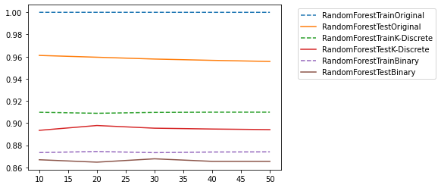
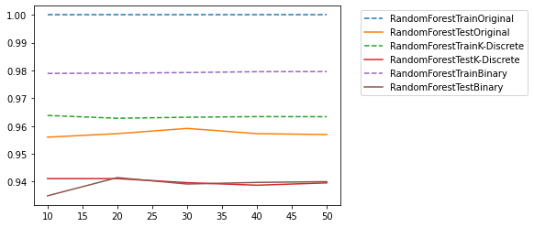
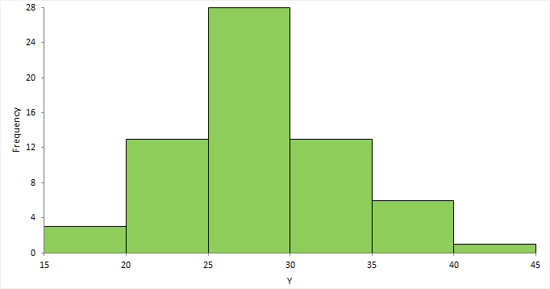
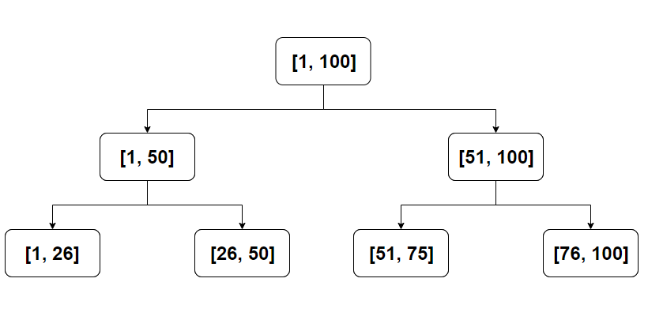
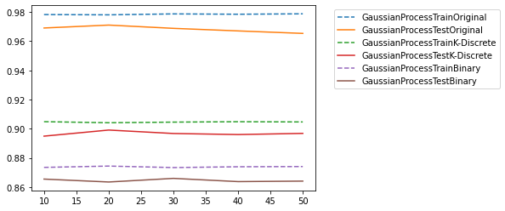
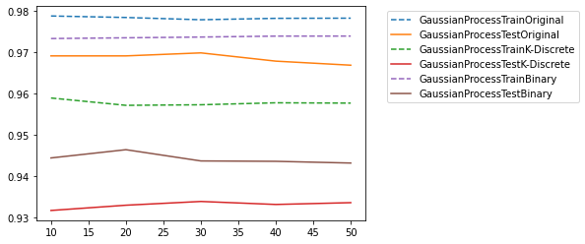
Feature Transformation in ML Discretization & Binarization
Ex: “27” = 01, “67”=10, “88”=11
Yijie (Ejay) Guo
Yu Chen

Slide 2
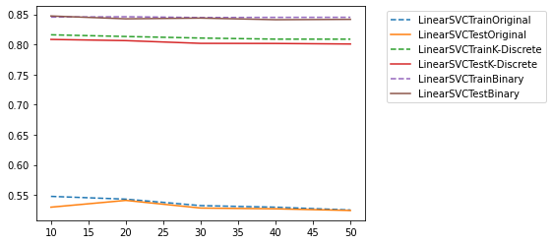
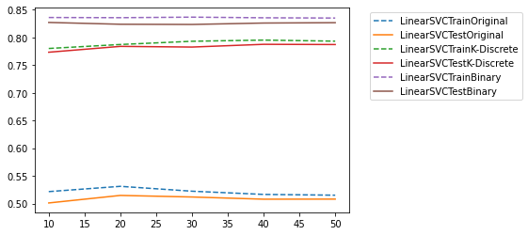
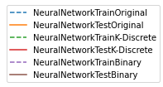
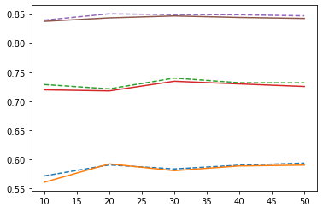
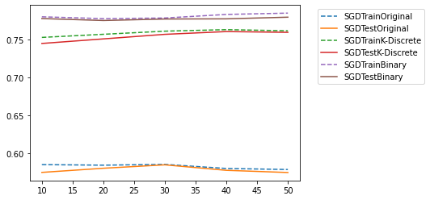
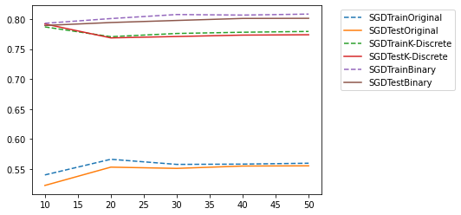
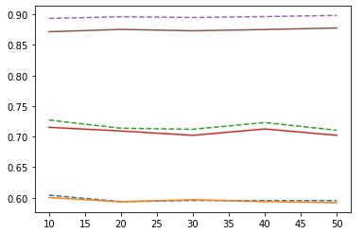
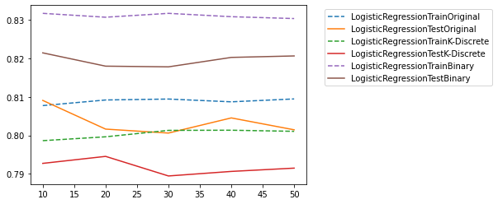
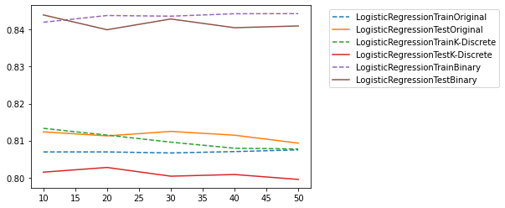

Slide 3
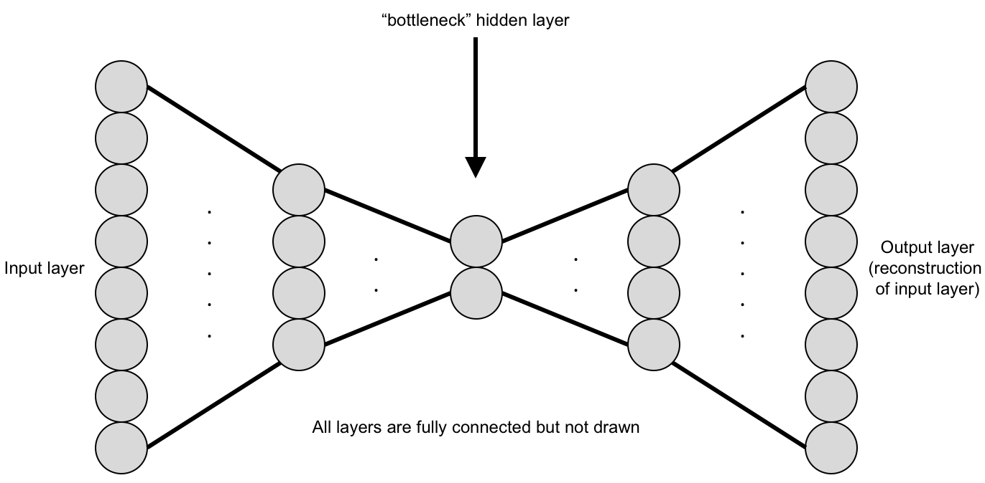


Noise Reduction
[1] Linear Models are more sensitive towards out layers, noises and fluctuates in the data. The discretization and binarization improve signal-to-noise ratio and smooth out the noises.
[2] Non-linear models are not so sensitive towards the noises and very likely to be more overfitting.
Quantization
[1] More Model Choices
[2] Memory and Computation Reduction
[3] Compressing the floating point input/output values in DNN to a fixed point representation, like 8-bit or 16-bit integers.
Information Bottleneck
Binary Neural Network
Inputs, outputs and weights are all binary values. By binary here, we mean Bipolar Binary, i.e. +1 & -1 values.

