Slide 1
Baba Is us
Team BabaIsUs presentation

Slide 2
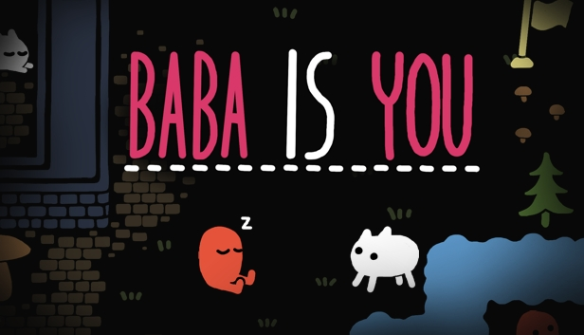
overview & background
Baba is You:
A single-player puzzle game on Steam
“Out of the box” and challenging, yet can be implemented
Goal: Understand more about design patterns, JavaFX, OOD
Baba is Us:
Nguyen Nguyen: Product Owner
Yuhan Chen: Scrum Master
Christiaan Smith: Ethics Leader
Anh Tran: Developer
An illustration of BABA IS YOU

Slide 3
Designing & implementing
the game

Slide 4
Important user stories
As a game player, I want to…
Start the game and see the game menu ✔️
Move around the board and interact with objects ✔️
Determine if I have won the game ✔️
Move to the next level when finish the current level ✔️
Have an in-game menu to restart, customize,... ✔️
Customize the board to accommodate people ❌
Have confetti when we win the game ❌
➝ We needed a Menu, a Gameboard, and a GUI manager

Slide 5
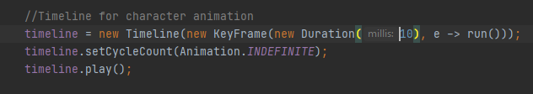
OUR APPROACH(ES) for the gameboard
Approach 1: The simple version
Every object is in the Model of the board
The Controller controls the interactions between the objects and the board and everything else (and make sure the game runs while continually updating the state).

Slide 6
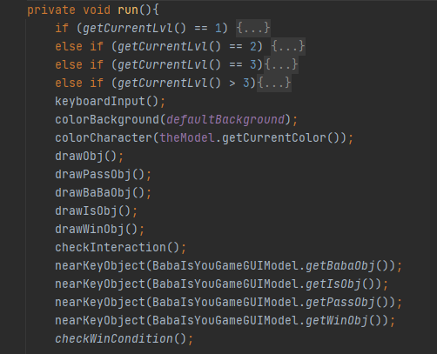
OUR APPROACH(ES) for the gameboard

Slide 7
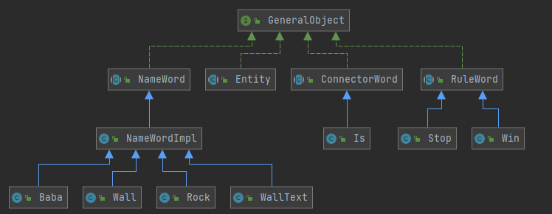
OUR APPROACH(ES) for the gameboard
Approach 2: The complete game - Developed from the GeneralObject interface - Every object is created on its own for more flexibility

Slide 8
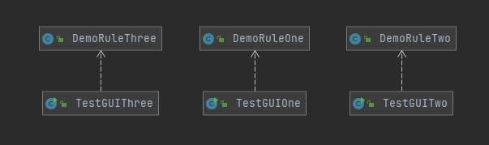
OUR APPROACH(ES) for the gameboard
Every object is then added to their own level GUI
The DemoRule controls the interactions, while the test GUIs display everything on each level.

Slide 9
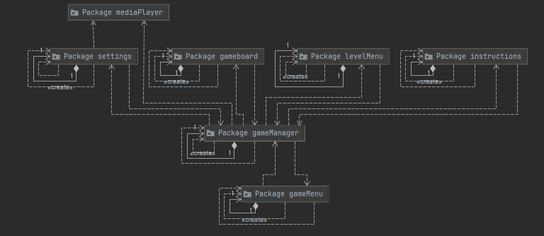
other design choices
GUIs are put into different packages
Utilizing the MVC design pattern extensively to lower coupling and increase cohesion
Have a gameManager that overlooks the scene transition

Slide 10
other design choices
Uses CSS for GUI style and font for multiple themes
Allowing for the creation of multiple themes without the need to repeat the code every time
Make the code cleaner, and better for maintenance or changing the code

Slide 11
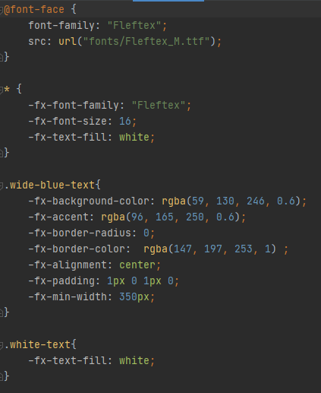
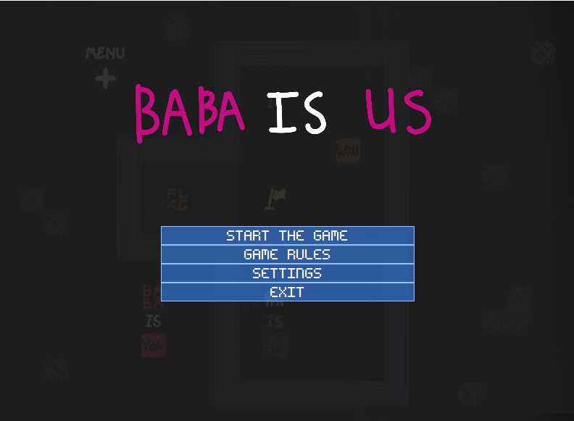
other design choices

Slide 12
User Interface & CLASS DEMO

Slide 13

Video Demo

Slide 14
SCRUM
(sprints, planning, and execution)

Slide 15
ROLE Assignments
menu, GUI management & customization: Anh Tran
gameboard, approach 1: Nguyen Nguyen
Rules, objects, approach 2:
Object and Rule design: Christiaan Smith
Further object and Level design: Yuhan Chen

Slide 16
The sprints
4 main sprints (with sprint 5 adding unfinished stuffs):
basic GUIs,board generation,basic object skeleton
Sprint 1
Sprint 2
Sprint 3
Sprint 4
game mechanics, detailed object implementation, 2 approaches, customization
1st approach levels, scene transition, objects for 2nd approach
design levels 1st and 2nd approaches,add additional game & GUI features, connect the GUIS

Slide 17
Strengths and Weaknesses
Strengths
Strong commitment between members, good engagement ✔️
Good programming management, no conflicts in the code ✔️
➝ Created a back-up version 🏆
Weaknesses
Weak communication between members due time difference ❌
➝ Causes misunderstanding ❗
Uneven work progress between members ❌
➝ Slowed the workflow ❗

Slide 18
Reflection on the experience
What we learned
Communication
Work distribution
Scrum process
What we would change
Follow Scrum better
Better communication
Divide work more logically and more evenly among members
Better workflow
Version 2.0
Better level design
More objects and more interactions
Better visual
Cleaner code
Take feedback from the players

Slide 19
THANK YOU!!!

