Slide 1
Modeling the Sequential Response Time with Item Position and Total Time Limits
Yi Chen, Yi Yang, Sizheng Zhu, Young-Sun Lee
Teachers College, Columbia University

Slide 2
Background
Similar to ability, the construct of speed has a long history in both the psychology of individual differences and educational measurement (e.g., Gulliksen, 1950; Kelley, 1927; Thorndike et al., 1926). Researchers can now automate the recording of examinees' reaction times (RTs) on items via the use of computer-based assessments.
However, an implicit assumption of the most RT studies is that the item parameters remain constant during the assessment. This assumption is not realistic when the item parameter related to RT (e.g., item time intensity) is affected by the item position. For example, when there is a practice effect or time pressure items at later position tends to be less time consuming.
Meanwhile, the natural upper bound of time limits also need to be controlled (van der Linden, 2005). However, time limits at the test-level have not been a great focus of measurement research and practice. With total time limits, this assumption may not be reasonable since the remaining times for examinees on each item depend on how much RTs they spend on the previous items.

Slide 3
Research Questions
How to extend the conventional RT modeling so that the impact of total time limitation could be taken into account?
How to model the potential effect of item position on item parameters related to RT?

Slide 4
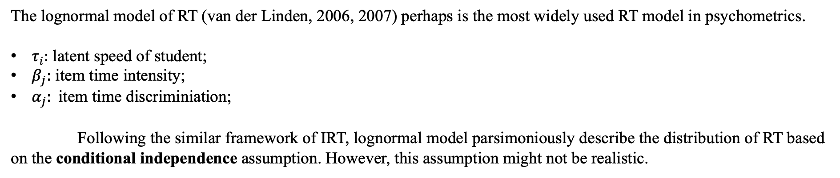

Method: Lognormal Model for RT
$$f\left(T_{ij};τ_{i},α_{j},β_{j}\right)=\frac{α_{j}}{\sqrt{2π}}\exp\left\{−\frac{1}{2}\left[α_{j}\left(lnT_{ij}−{\left(β_{j}−τ_{i}\right)}^{2}\right)\right]\right\}$$
The lognormal model of RT (van der Linden, 2006, 2007) perhaps is the most widely used RT model in psychometrics.
$τ_{i}:$ latent speed of student;
$β_{j}:$ item time intensity;
$α_{j}: \text{item} \text{time} \text{discriminiation}\text{;}$
Following the similar framework of IRT, lognormal model parsimoniously describe the distribution of RT based on the conditional independence assumption. However, this assumption might not be realistic.

Slide 5
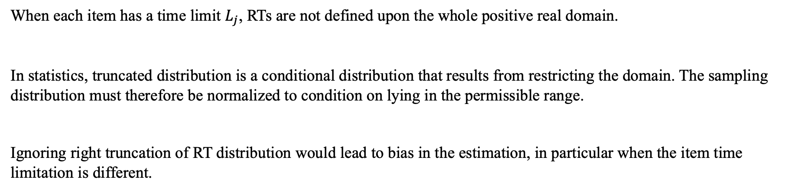

Method Design 1: Adaptive Truncation
$$f\left(t_{ij};τ_{i},α_{j},β_{j}, t_{ij}<L_{j}\right)=\frac{f\left(t_{ij};τ_{i},α_{j},β_{j}\right)I(t_{ij}<L_{j})}{F(L_{j})}∝f\left(t_{ij};τ_{i},α_{j},β_{j}\right)I\left(t_{ij}<L_{j}\right)$$
When each item has a time limit $L_{j}$, RTs are not defined upon the whole positive real domain.
In statistics, truncated distribution is a conditional distribution that results from restricting the domain. The sampling distribution must therefore be normalized to condition on lying in the permissible range.
Ignoring right truncation of RT distribution would lead to bias in the estimation, in particular when the item time limitation is different.

Slide 6
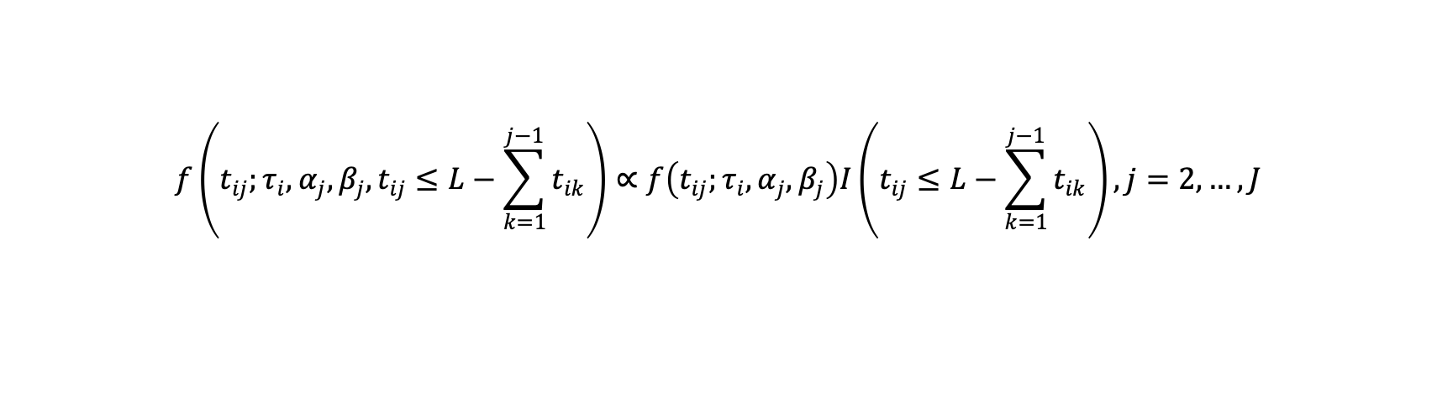
Method Design 1: Adaptive Truncation
$$f\left(t_{ij};τ_{i},α_{j},β_{j}, t_{ij}≤L−\sum_{k=1}^{j−1}{t_{ik}}\right)∝f\left(t_{ij};τ_{i},α_{j},β_{j}\right)I\left(t_{ij}≤L−\sum_{k=1}^{j−1}{t_{ik}}\right), j=2,…,J$$
For the case when only total time limits (𝐿) is restricted, examinees need to find the best distribute of RTs over all items.
For the first item, the domain of distribution has biggest range.
Starting from the second item, the domain becoming smaller and the natural upper bound is the RT remaining.
When the time limit is very large or the students’ motivation is low, the impact of time limit is ignorable. However, when students have the potential to be short of time or in a speed test, ignoring time limit is risky.

Slide 7
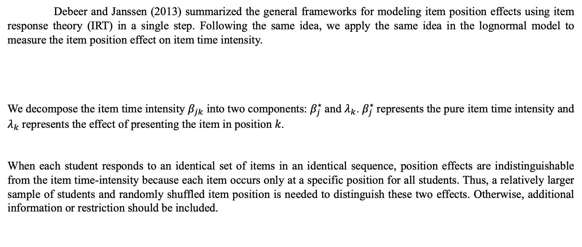
Method Design 2: Modeling of Item Position Effect
Debeer and Janssen (2013) summarized the general frameworks for modeling item position effects using item response theory (IRT) in a single step. Following the same idea, we apply the same idea in the lognormal model to measure the item position effect on item time intensity.
We decompose the item time intensity $β_{jk}$ into two components: $β_{j}^{∗}$and $λ_{k}$. $β_{j}^{∗}$represents the pure item time intensity and $λ_{k}$represents the effect of presenting the item in position 𝑘.
When each student responds to an identical set of items in an identical sequence, position effects are indistinguishable from the item time-intensity because each item occurs only at a specific position for all students. Thus, a relatively larger sample of students and randomly shuffled item position is needed to distinguish these two effects. Otherwise, additional information or restriction should be included.
$$f\left(t_{ijk};τ_{i},α_{j},β_{jk}\right)=\frac{α_{ j}}{\sqrt{2π}}\exp\left\{−\frac{1}{2}\left[α_{j}\left(lnt_{ij}−{\left(β_{ jk}−τ_{i}\right)}^{2}\right)\right]\right\}, β_{ jk}=β_{j}^{∗}+λ_{k}$$

Slide 8
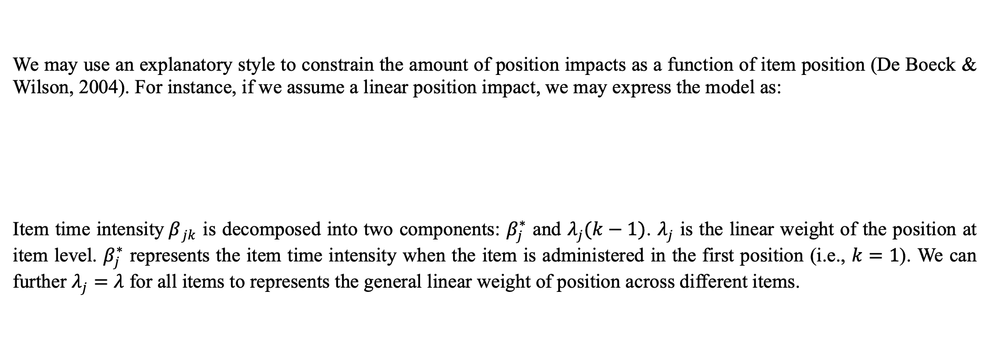
Method Design 2: Modeling of Item Position Effect
We may use an explanatory style to constrain the amount of position impacts as a function of item position (De Boeck & Wilson, 2004). For instance, if we assume a linear position impact, we may express the model as:
Item time intensity$β_{ jk}$ is decomposed into two components: $β_{j}^{∗}$ and $λ_{j}(k−1)$. $λ_{j}$ is the linear weight of the position at item level. $β_{j}^{∗}$ represents the item time intensity when the item is administered in the first position (i.e., $k=1$). We can further $λ_{j}=λ$ for all items to represents the general linear weight of position across different items.
$$β_{ jk}=β_{j}^{∗}+λ_{j}(k−1)$$

Slide 9
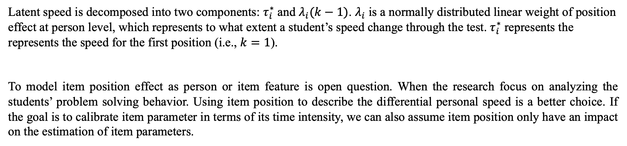
Method Design 2: Modeling of Item Position Effect
Alternatively, Fox and Marianti (2016) model the impact of item position as differential personal speed using latent curve analysis. For example,
$$τ_{ik}=λ_{i}\left(k−1\right)−τ_{i}^{∗}$$
Latent speed is decomposed into two components: $τ_{i}^{∗}$ and $λ_{i}(k−1)$. $λ_{i}$ is a normally distributed linear weight of position effect at person level, which represents to what extent a student’s speed change through the test. $τ_{i}^{∗}$ represents the represents the speed for the first position (i.e., $k=1$).
To model item position effect as person or item feature is open question. When the research focus on analyzing the students’ problem solving behavior. Using item position to describe the differential personal speed is a better choice. If the goal is to calibrate item parameter in terms of its time intensity, we can also assume item position only have an impact on the estimation of item parameters.

Slide 10
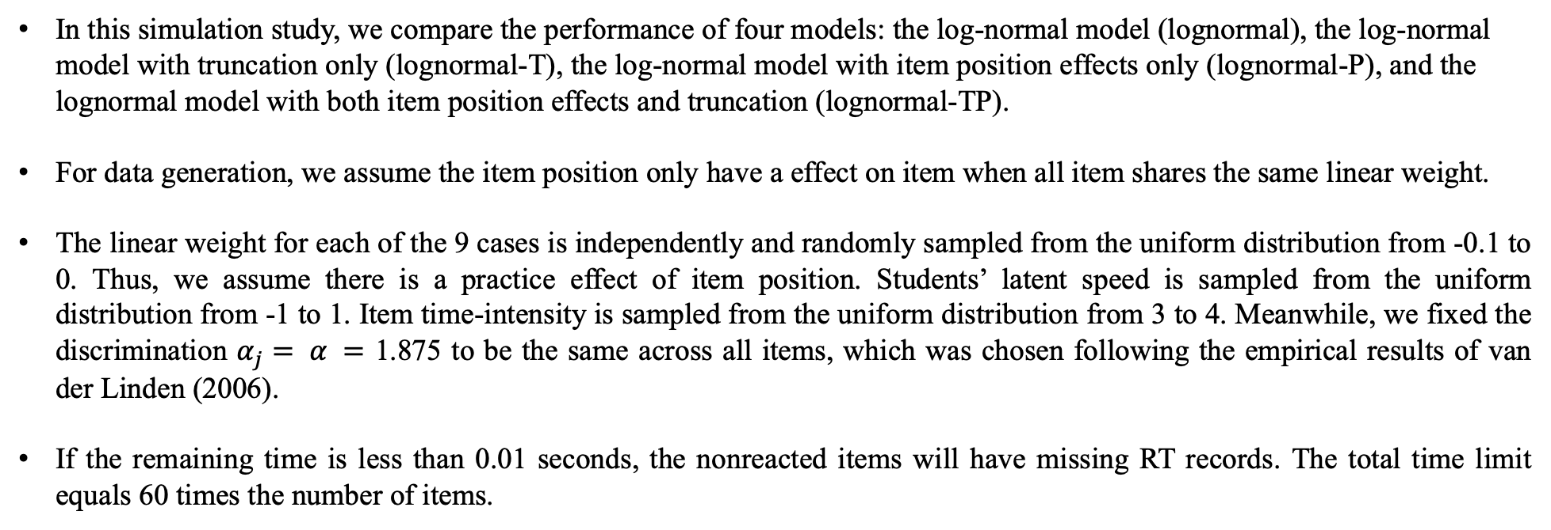
Simulation Studies
In this simulation study, we compare the performance of four models: the log-normal model (lognormal), the log-normal model with truncation only (lognormal-T), the log-normal model with item position effects only (lognormal-P), and the lognormal model with both item position effects and truncation (lognormal-TP).
For data generation, we assume the item position only have a effect on item when all item shares the same linear weight.
The linear weight for each of the 9 cases is independently and randomly sampled from the uniform distribution from -0.1 to 0. Thus, we assume there is a practice effect of item position. Students’ latent speed is sampled from the uniform distribution from -1 to 1. Item time-intensity is sampled from the uniform distribution from 3 to 4. Meanwhile, we fixed the discrimination $α_{j}= α =$ 1.875 to be the same across all items, which was chosen following the empirical results of van der Linden (2006).
If the remaining time is less than 0.01 seconds, the nonreacted items will have missing RT records. The total time limit equals 60 times the number of items.

Slide 11
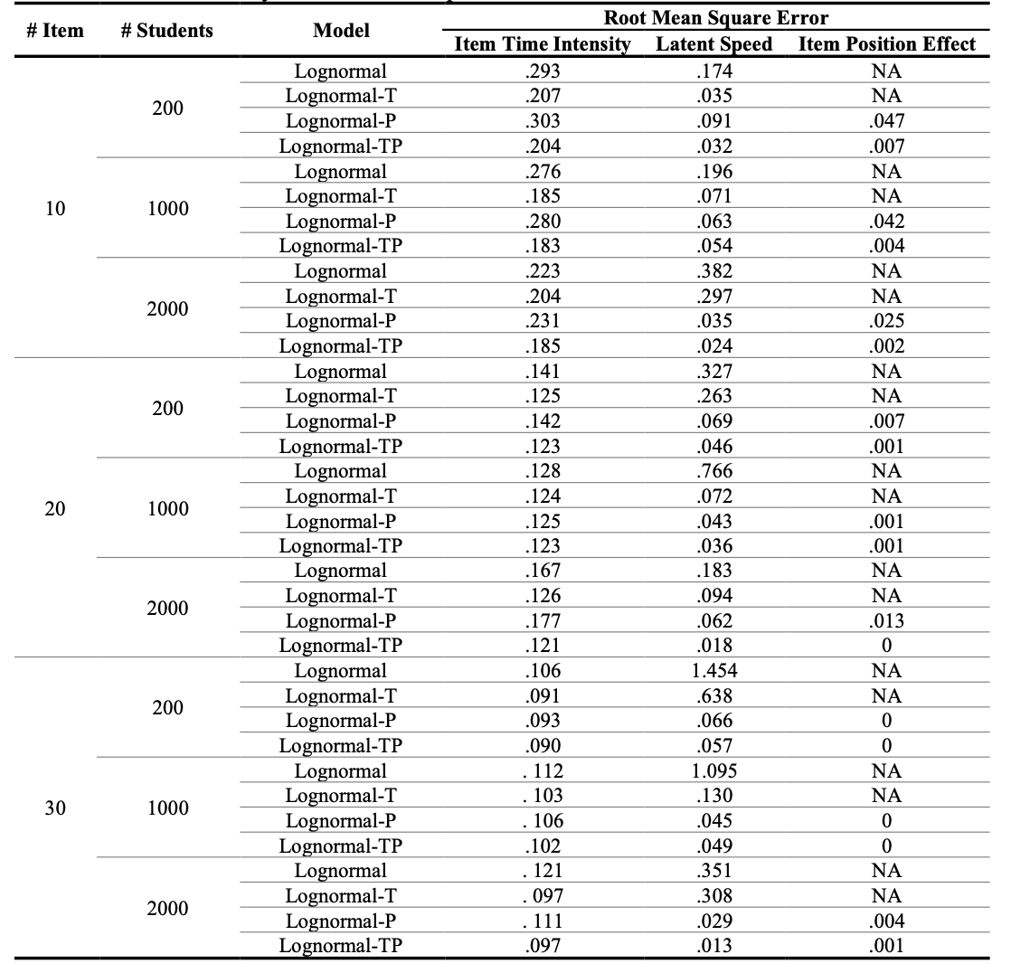
Simulation Studies
Notes:
Table 1 summarized the performance of parameter recovery. For estimation bias, we calculate the root mean square errors (RMSE) for item time intensity, person speed, and item position effect. As expected, the lognormal-PT model has the best estimation performance for item and person parameters, while the lognormal model performs worst. The estimation performance of lognormal-PT tends to be better when more students or items are included. Compared with other models, the advantage of lognormal-PT is more obvious when the number of students and items is large. In most cases, adding adaptive truncation significantly improves the performance of parameter recovery, compared with the conventional lognormal model. In this simulation, we assume the item time-intensity change linearly and match the specification of lognormal-P. We expect to see the performance of lognormal-P becomes worse if the item position effect does not change in a linear format.

Slide 12
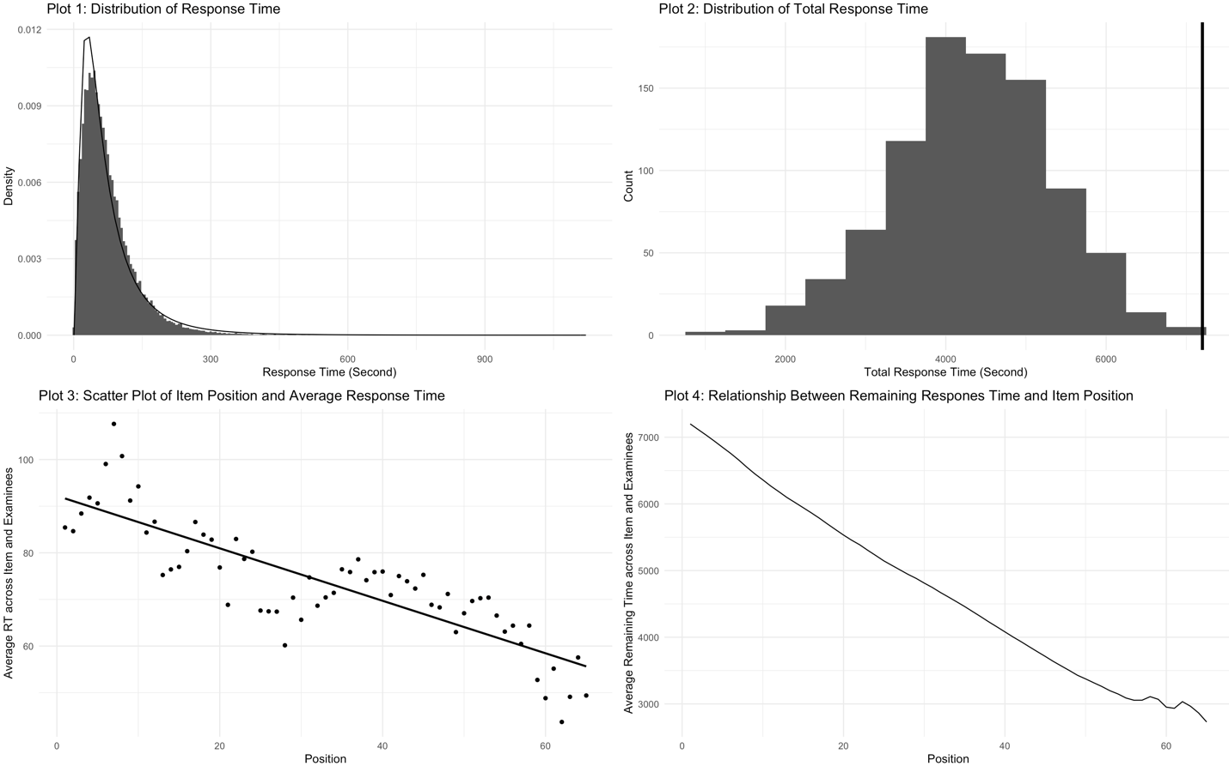
Real Data Analysis
We used one specific sample of the United States drawn from the computer-based assessment (CBA) Program for International Student Assessment (PISA) 2015 computer-based items. Without loss of generality, we focus on the students who took a survey about scientific and reading literacy (i.e., test forms from 31 to 66), which made up approximately 96% of the participants. Each student received a form that consisted of four 30-minute clusters assembled from two domains: science and reading.
To ensure the true response sequence match the designed response sequence of PISA, we remove the records if the student revisits any item. After listwise delectation of missing or invalid records of RTs, there are 904 students and 184 unique items from the science domain.
Notes:
The density line in the first plot is the lognormal distribution with the empirical mean and standard deviation of observed log RTs. In general, lognormal distribution matches the histogram well. The second plot is the distribution of total response time across students. The vertical line (intercept = 7,200 seconds) is the total time limit. It may be because PISA is a low-stake assessment, most students did not make full use of the testing time. For the third plot, we calculate the median response time for each item position across items and students. Based on the evidence of the linear regression line, we expect to see a smaller median response time for later items. The last plot represents the relationship between the item position and median remaining RTs across items and students. As expected, the remaining RTs decrease smoothly as the position increase.

Slide 13
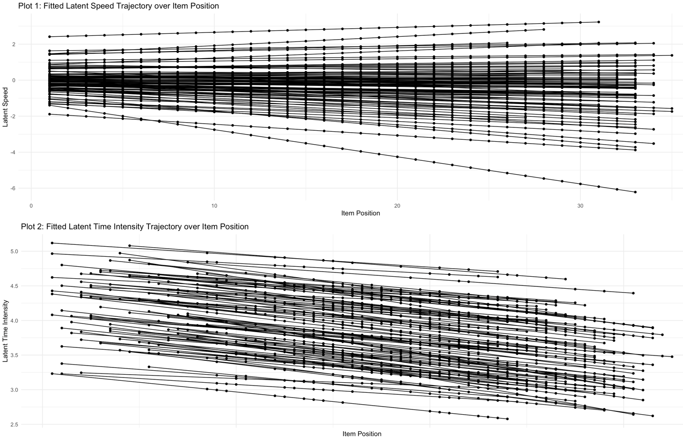
Real Data Analysis
76.65% of a person's linear weight of the position and 100% of the item's linear weight of position is negative.
Notes:
overall

Slide 14
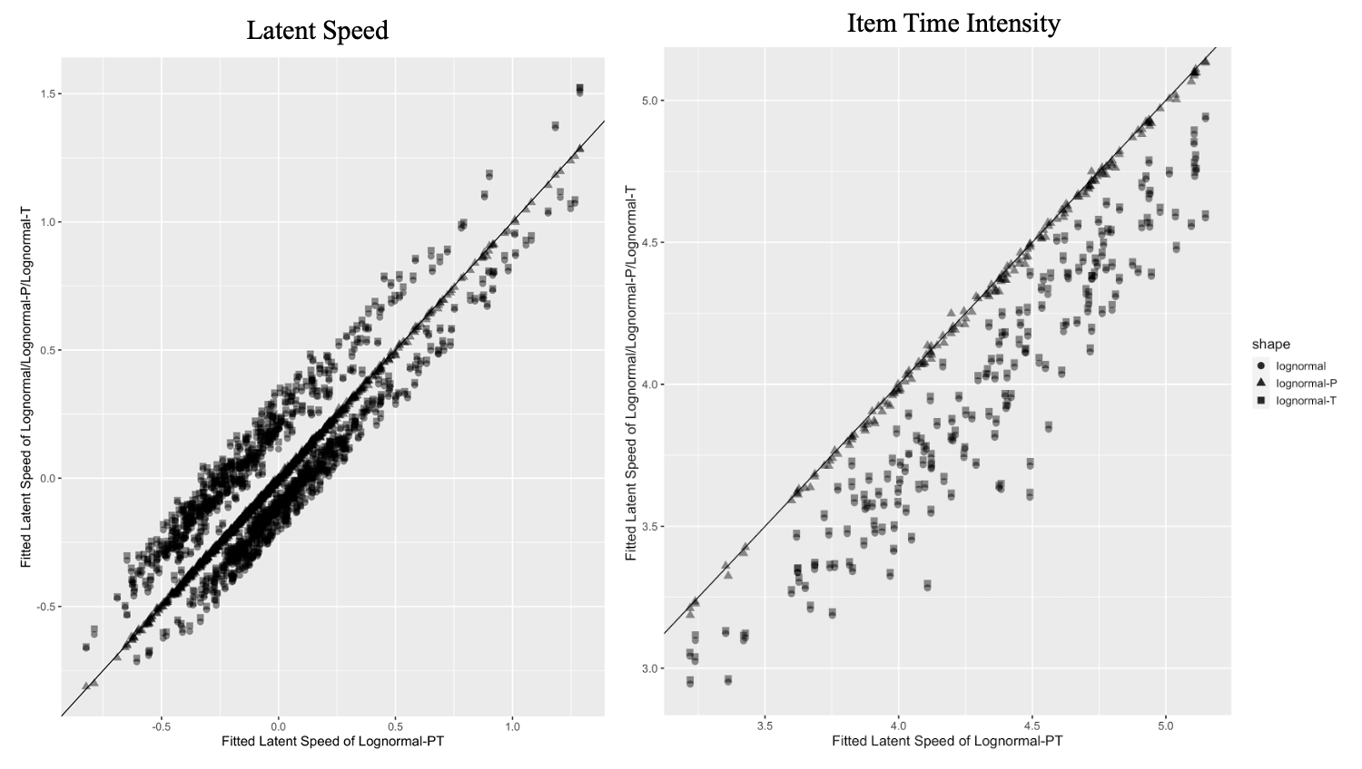
Real Data Analysis
The x-axis in indicates the fitted latent speed for the lognormal-PT model, while the y-axis represents the fitted latent speed for the lognormal, lognormal-P, and lognormal-T models distinguished by respective point shapes.
The estimates from models with and without truncation almost exactly overlap in both plots, regardless of whether the item position effect is included. This pattern may well be explained in part by the fact that the majority of students do not reach time limit.
The item position effect is unignorable for this real data since it led to significant effects in the estimation of both item and person parameters.
Notes:
overall

Slide 15
Conclusion
We presented a general framework for modeling sequential RTs with total time restraints in this paper. According to evidence from both simulation studies and real-world data analysis, incorporating truncation and item position effects has the potential to enhance model fit and violate the stationarity of latent parameters and local independence assumptions associated with standard RT treatment.
In contrast to item position parameters, adaptive truncation makes no assumptions about the total item time-possible intensity's variation between positions. However, when students are not under time constraints owing to low motivation or high time constraints, the effect of adaptive truncation on both item and person parameter estimates may be minimal.
This paper establishes a general framework for modeling the effects of item position on item parameters in RT, which may be utilized to enhance linking and equating. Additional factor may need to be explored in future research to adequately understand the sequential process of RTs. For instance, students may choose to solve the easier problems first and then go on to the more difficult ones after reading the item. How much time RTs spend on revisiting items and if this increases RAs remain unknown. The time limit, the sequence of visits, and the RTs all provide information on the various testing procedures.

Slide 16
Thank you
If you have any questions or suggestions:
Email: yc3356@columbia.edu (Yi Chen)

