Slide 1
General Cognitive Diagnosis Model for Response Time
Yi Chen, Yi Yang, Sizheng Zhu, Young-Sun Lee
Teachers College, Columbia University

Slide 2
Background
Cognitive diagnosis models (CDMs) were developed to provide educators and researchers a useful psychometric framework for describing how underlying cognitive processes relate to performance on educational tasks.
Most applications of CDMs developments have been focused on the response accuracy (RAs) rather than other process information during the assessments. RTs probably is the most widely discussed process information in research and practice. Cognitive diagnosis utilizing the RT information might helps to provide deeper understanding about students’ problem solving behavior.

Slide 3
Research Questions
How to modeling RT using the framework of CDM under different model assumptions?
How to interpret the findings of CDM for RT?
What are the relationship between attribute profiles from CDM for RA and RT?

Slide 4
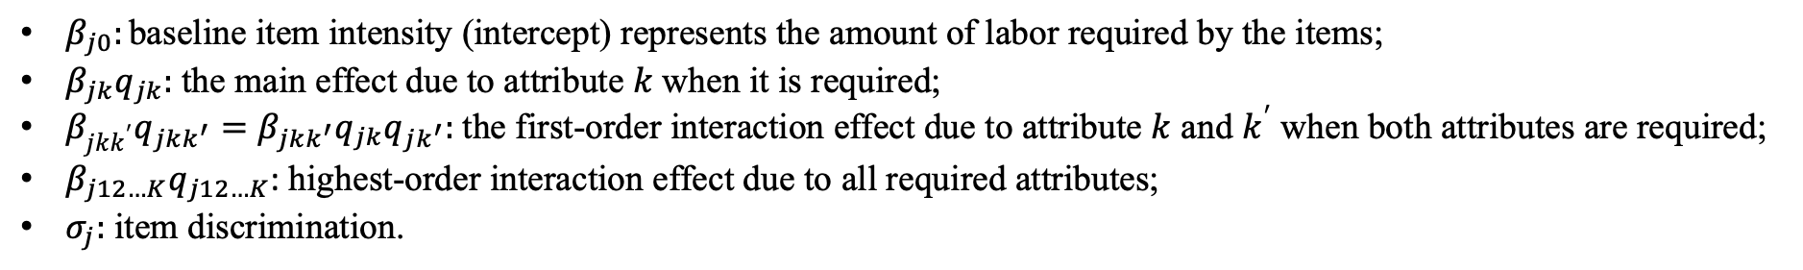
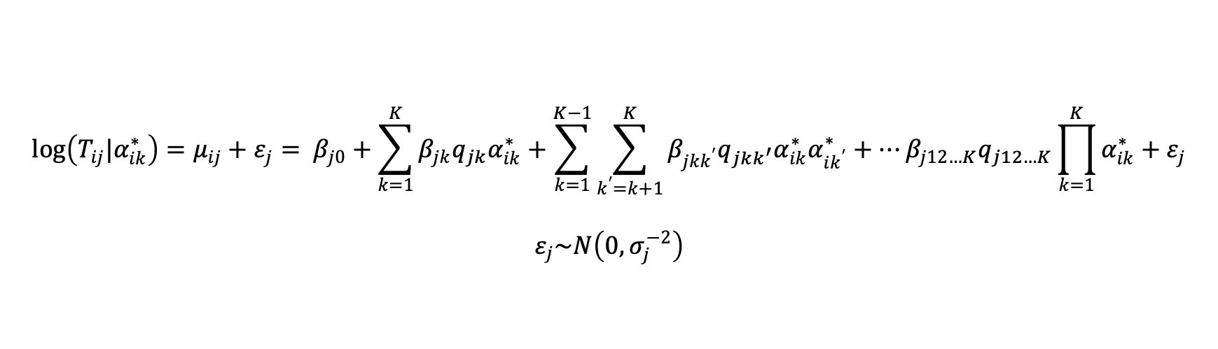
Method Design: CDM-RT
$$\log\left(T_{ij}|α_{ik}^{∗}\right)=μ_{ij}+ε_{j}= β_{j0}+\sum_{k=1}^{K}{β_{jk}q_{jk}α_{ik}^{∗}}+\sum_{k=1}^{K−1}{\sum_{k^{′}=k+1}^{K}{β_{jkk^{′}}{q_{jkk^{′}}α}_{ik}^{∗}α_{ik^{′}}^{∗}+…β_{j12…K}q_{j12…K}\prod_{k=1}^{K}{α_{ik}^{∗}}}}+ε_{j}$$
$$ε_{j}\sim N\left(0,σ_{j}^{−2}\right)$$
$β_{j0}:\text{baseline} \text{item} \text{intensity}\text{ (}\text{intercept}\text{) }\text{represents} \text{the} \text{amount} \text{of} \text{labor} \text{required} \text{by} \text{the} \text{items}\text{;}$
$β_{jk}q_{jk}:$the main effect due to attribute $k$ when it is required;
$β_{jkk^{′}}q_{jkk^{′}}=β_{jkk^{′}}q_{jk}q_{jk^{′}}:$the first-order interaction effect due to attribute $k$ and $k^{′}$ when both attributes are required;
$β_{j12…K}q_{j12…K}$: highest-order interaction effect due to all required attributes;
$σ_{j}:$ item discrimination.

Slide 5
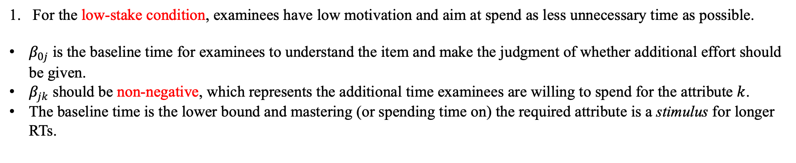
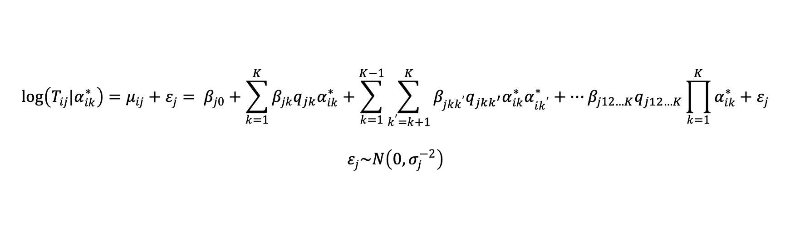
Model Constraints and Its Relationship with Motivation
$$\log\left(T_{ij}|α_{ik}^{∗}\right)=μ_{ij}+ε_{j}= β_{j0}+\sum_{k=1}^{K}{β_{jk}q_{jk}α_{ik}^{∗}}+\sum_{k=1}^{K−1}{\sum_{k^{′}=k+1}^{K}{β_{jkk^{′}}{q_{jkk^{′}}α}_{ik}^{∗}α_{ik^{′}}^{∗}+…β_{j12…K}q_{j12…K}\prod_{k=1}^{K}{α_{ik}^{∗}}}}+ε_{j}$$
$$ε_{j}\sim N\left(0,σ_{j}^{−2}\right)$$
For the low-stake condition, examinees have low motivation and aim at spend as less unnecessary time as possible.
$β_{0j}$ is the baseline time for examinees to understand the item and make the judgment of whether additional effort should be given.
$β_{jk}$ should be non-negative, which represents the additional time examinees are willing to spend for the attribute $k$.
The baseline time is the lower bound and mastering (or spending time on) the required attribute is a stimulus for longer RTs.

Slide 6
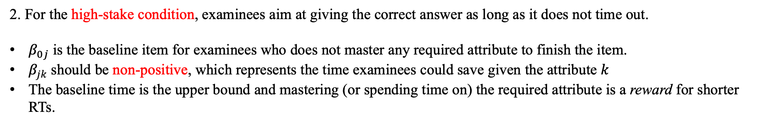
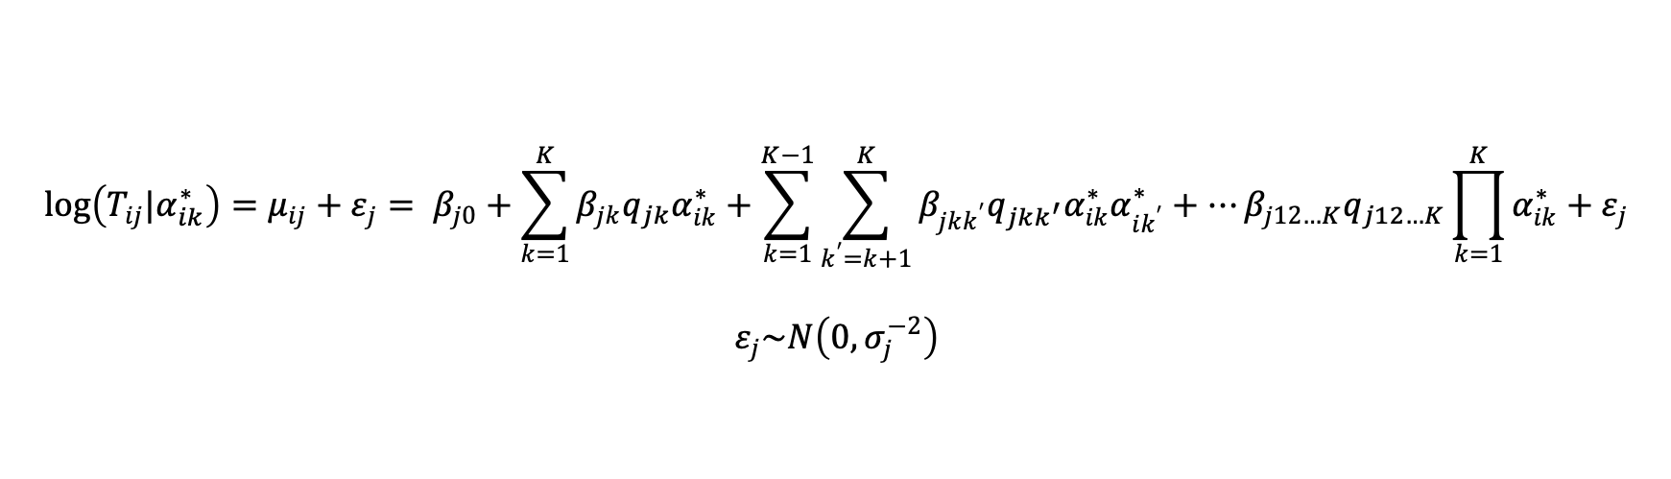
Model Constraints and Its Relationship with Motivation
$$\log\left(T_{ij}|α_{ik}^{∗}\right)=μ_{ij}+ε_{j}= β_{j0}+\sum_{k=1}^{K}{β_{jk}q_{jk}α_{ik}^{∗}}+\sum_{k=1}^{K−1}{\sum_{k^{′}=k+1}^{K}{β_{jkk^{′}}{q_{jkk^{′}}α}_{ik}^{∗}α_{ik^{′}}^{∗}+…β_{j12…K}q_{j12…K}\prod_{k=1}^{K}{α_{ik}^{∗}}}}+ε_{j}$$
$$ε_{j}\sim N\left(0,σ_{j}^{−2}\right)$$
2. For the high-stake condition, examinees aim at giving the correct answer as long as it does not time out.
$β_{0j}$ is the baseline item for examinees who does not master any required attribute to finish the item.
$β_{jk}$ should be non-positive, which represents the time examinees could save given the attribute $k$
The baseline time is the upper bound and mastering (or spending time on) the required attribute is a reward for shorter RTs.

Slide 7
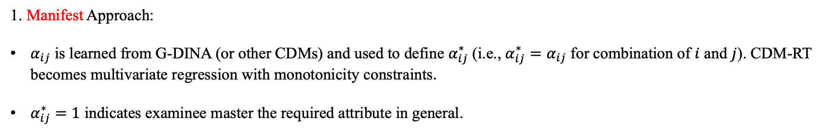
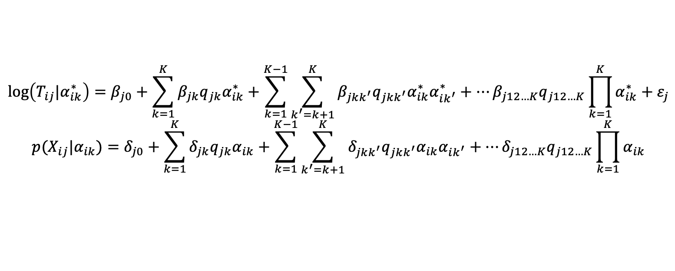
Two Treatment of Attribute Profile
$$\log\left(T_{ij}|α_{ik}^{∗}\right)=β_{j0}+\sum_{k=1}^{K}{β_{jk}q_{jk}α_{ik}^{∗}}+\sum_{k=1}^{K−1}{\sum_{k^{′}=k+1}^{K}{β_{jkk^{′}}{q_{jkk^{′}}α}_{ik}^{∗}α_{ik^{′}}^{∗}+…β_{j12…K}q_{j12…K}\prod_{k=1}^{K}{α_{ik}^{∗}}}}+ε_{j}$$
$${p(X}_{ij}|α_{ik})=δ_{j0}+\sum_{k=1}^{K}{δ_{jk}q_{jk}α_{ik}}+\sum_{k=1}^{K−1}{\sum_{k^{′}=k+1}^{K}{δ_{jkk^{′}}{q_{jkk^{′}}α}_{ik}α_{ik^{′}}+…δ_{j12…K}q_{j12…K}\prod_{k=1}^{K}{α_{ik}}}}$$
CDM-RT:
G-DINA:
1. Manifest Approach:
$α_{ij}$ is learned from G-DINA (or other CDMs) and used to define $α_{ij}^{∗}$ (i.e., $α_{ij}^{∗}=α_{ij}$ for combination of $i$ and $j$). CDM-RT becomes multivariate regression with monotonicity constraints.
$α_{ij}^{∗}=1$ indicates examinee master the required attribute in general.

Slide 8
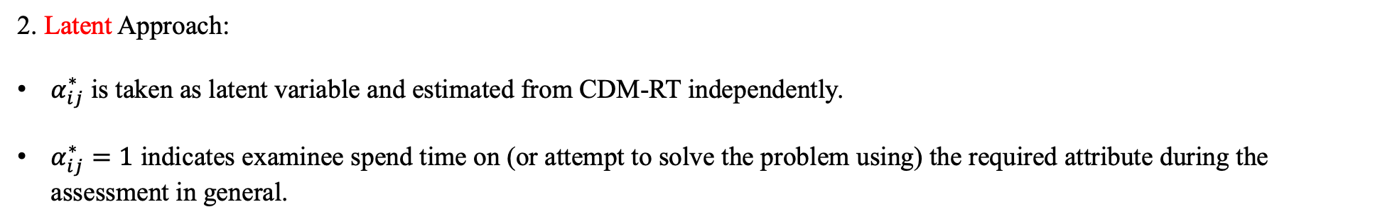
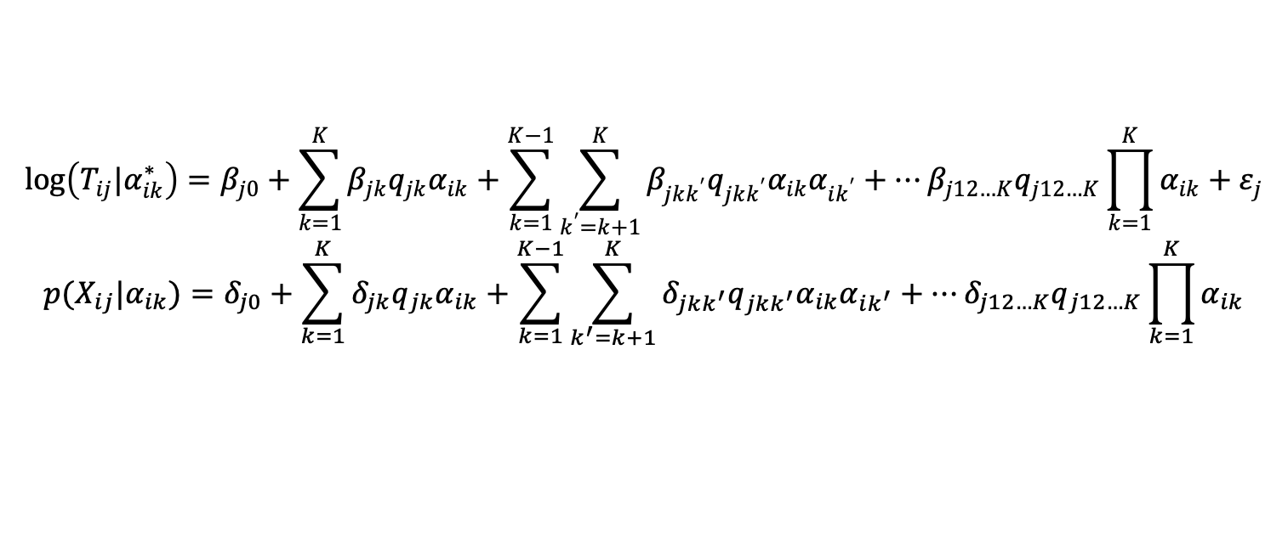
Two Treatment of Attribute Profile
$$\log\left(T_{ij}|α_{ik}^{∗}\right)=β_{j0}+\sum_{k=1}^{K}{β_{jk}q_{jk}α_{ik}}+\sum_{k=1}^{K−1}{\sum_{k^{′}=k+1}^{K}{β_{jkk^{′}}{q_{jkk^{′}}α}_{ik}α_{ik^{′}}+…β_{j12…K}q_{j12…K}\prod_{k=1}^{K}{α_{ik}}}}+ε_{j}$$
$${p(X}_{ij}|α_{ik})=δ_{j0}+\sum_{k=1}^{K}{δ_{jk}q_{jk}α_{ik}}+\sum_{k=1}^{K−1}{\sum_{k^{′}=k+1}^{K}{δ_{jkk^{′}}{q_{jkk^{′}}α}_{ik}α_{ik^{′}}+…δ_{j12…K}q_{j12…K}\prod_{k=1}^{K}{α_{ik}}}}$$
CDM-RT:
G-DINA:
2. Latent Approach:
$α_{ij}^{∗}$ is taken as latent variable and estimated from CDM-RT independently.
$α_{ij}^{∗}=1$ indicates examinee spend time on (or attempt to solve the problem using) the required attribute during the assessment in general.

Slide 9
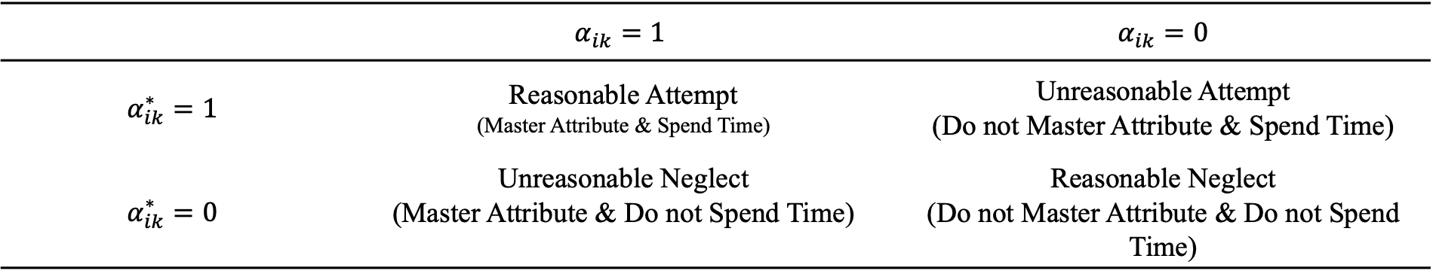
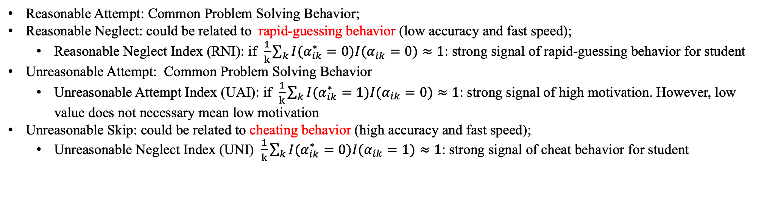
Matching of two Attribute Profiles
 | $$α_{ik}=1$$ | $α_{ik}=0$
$$α_{ik}^{∗}=1$$ | Reasonable Attempt (Master Attribute & Spend Time) | Unreasonable Attempt (Do not Master Attribute & Spend Time)
$$α_{ik}^{∗}=0$$ | Unreasonable Neglect (Master Attribute & Do not Spend Time) | Reasonable Neglect (Do not Master Attribute & Do not Spend Time)
Reasonable Attempt: Common Problem Solving Behavior;
Reasonable Neglect: could be related to rapid-guessing behavior (low accuracy and fast speed);
Reasonable Neglect Index (RNI): if $\frac{1}{k}\sum_{k}{I(α_{ik}^{∗}=0)I(α_{ik}=0)}≈1$: strong signal of rapid-guessing behavior for student
Unreasonable Attempt: Common Problem Solving Behavior
Unreasonable Attempt Index (UAI): if $\frac{1}{k}\sum_{k}{I(α_{ik}^{∗}=1)I(α_{ik}=0)}≈1$: strong signal of high motivation. However, low value does not necessary mean low motivation
Unreasonable Skip: could be related to cheating behavior (high accuracy and fast speed);
Unreasonable Neglect Index (UNI) $\frac{1}{k}\sum_{k}{I(α_{ik}^{∗}=0)I(α_{ik}=1)}≈1$: strong signal of cheat behavior for student

Slide 10
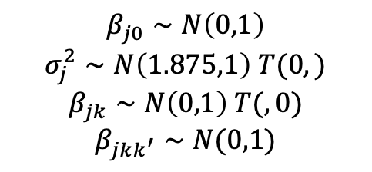
Simulation Studies: Manifest Attribute Profile
Robustness of item parameter estimations for CDM-RT with manifest attribute profile.
We randomly select 5%, 20%, and 50% elements of the attribute profile matrix and change their values.
These random errors represent the chance of examinees either spend time on the attribute they do not master or do not spend the time on the attribute they master.
A high-stack condition is assumed. The number of attributes is assumed to be 3.
# of Examinees | Random Error % | Item Time Intensity | Main Time Effects | Two-way Interactive Effect | Three-way Interactive Effects | Item Discrimination
100 | 5% | 0.139 | 0.198 | 0.326 | 0.417 | 0.165
 | 20% | 0.341 | 0.421 | 0.588 | 0.849 | 0.303
 | 50% | 0.739 | 0.716 | 1.028 | 0.803 | 0.427
500 | 5% | 0.109 | 0.135 | 0.200 | 0.284 | 0.174
 | 20% | 0.359 | 0.411 | 0.516 | 0.601 | 0.26
 | 50% | 0.833 | 0.863 | 0.873 | 0.780 | 0.398
1000 | 5% | 0.101 | 0.130 | 0.189 | 0.247 | 0.183
 | 20% | 0.368 | 0.412 | 0.521 | 0.609 | 0.301
 | 50% | 0.821 | 0.918 | 0.799 | 0.609 | 0.369
$$β_{j0}∼N\left(0,1\right)$$
$$σ_{j}^{2}∼N\left(1.875,1\right) T(0,)$$
$$β_{jk}∼N\left(0,1\right) T(,0)$$
$$β_{jkk^{′}}∼N(0,1)$$
Notes:
In general, the biases under all conditions are unignorable compare with the original scale of true parameters. As expected, the biases for all item parameters tends to be bigger with higher level of random error. The estimators of item time intensity and main time effects are more robust than interactive time effects and item discrimination. Meanwhile, increasing the number of examinees reduce the bias for all item parameters. This result indicates that CDM-RT with manifest attribute profile may bring unignorable biases in item parameter estimation if the mastery attempt matching assumption is not satisfied.

Slide 11
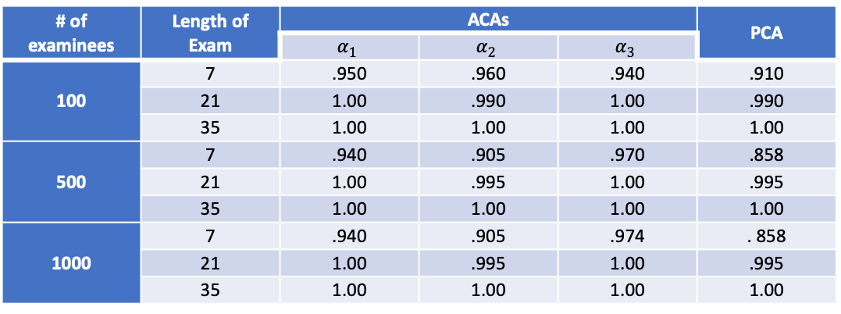
Simulation Studies: Latent Attribute Profile
Parameter Recovery Performance of Latent Attribute Profile under Different Conditions.
Two different factors are considered: number of examinees and length of exam.
A high-stack condition is assumed. The number of attributes is assumed to be 3.
# of examinees | Length of Exam | ACAs |  |  | PCA
 |  | $$α_{1}$$ | $$α_{2}$$ | $$α_{3}$$
100 | 7 | .950 | .960 | .940 | .910
 | 21 | 1.00 | .990 | 1.00 | .990
 | 35 | 1.00 | 1.00 | 1.00 | 1.00
500 | 7 | .940 | .905 | .970 | .858
 | 21 | 1.00 | .995 | 1.00 | .995
 | 35 | 1.00 | 1.00 | 1.00 | 1.00
1000 | 7 | .940 | .905 | .974 | . 858
 | 21 | 1.00 | .995 | 1.00 | .995
 | 35 | 1.00 | 1.00 | 1.00 | 1.00
$$β_{j0}∼N\left(0,1\right)$$
$$σ_{j}^{2}∼N\left(1.875,1\right) T(0,)$$
$$β_{jk}∼N\left(0,1\right) T(,0)$$
$$β_{jkk^{′}}∼N(0,1)$$
Notes:
In general, the biases under all conditions are unignorable compare with the original scale of true parameters. As expected, the biases for all item parameters tends to be bigger with higher level of random error. The estimators of item time intensity and main time effects are more robust than interactive time effects and item discrimination. Meanwhile, increasing the number of examinees reduce the bias for all item parameters. This result indicates that CDM-RT with manifest attribute profile may bring unignorable biases in item parameter estimation if the mastery attempt matching assumption is not satisfied.

Slide 12
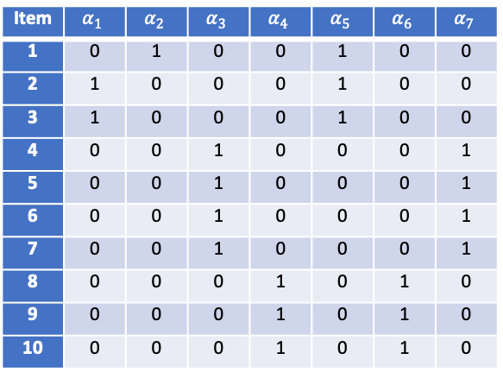
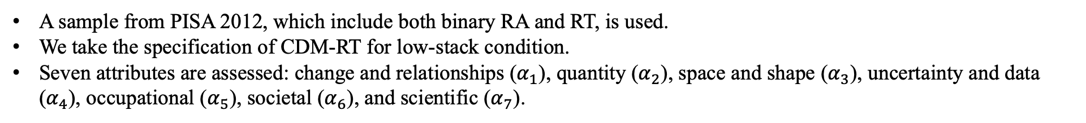
Real Data Analysis
A sample from PISA 2012, which include both binary RA and RT, is used.
We take the specification of CDM-RT for low-stack condition.
Seven attributes are assessed: change and relationships ($α_{1}$), quantity ($α_{2}$), space and shape ($α_{3}$), uncertainty and data ($α_{4}$), occupational ($α_{5}$), societal ($α_{6}$), and scientific ($α_{7}$).
Item | $$α_{1}$$ | $$α_{2}$$ | $$α_{3}$$ | $$α_{4}$$ | $$α_{5}$$ | $$α_{6}$$ | $$α_{7}$$
1 | 0 | 1 | 0 | 0 | 1 | 0 | 0
2 | 1 | 0 | 0 | 0 | 1 | 0 | 0
3 | 1 | 0 | 0 | 0 | 1 | 0 | 0
4 | 0 | 0 | 1 | 0 | 0 | 0 | 1
5 | 0 | 0 | 1 | 0 | 0 | 0 | 1
6 | 0 | 0 | 1 | 0 | 0 | 0 | 1
7 | 0 | 0 | 1 | 0 | 0 | 0 | 1
8 | 0 | 0 | 0 | 1 | 0 | 1 | 0
9 | 0 | 0 | 0 | 1 | 0 | 1 | 0
10 | 0 | 0 | 0 | 1 | 0 | 1 | 0
R package GDINA (Ma & de la Torre, 2020) is used to estimate the attribute profile based on the saturate format of G-DINA model.
CDM-RT is estimated based on Gibbs sampling with R package rjags.

Slide 13
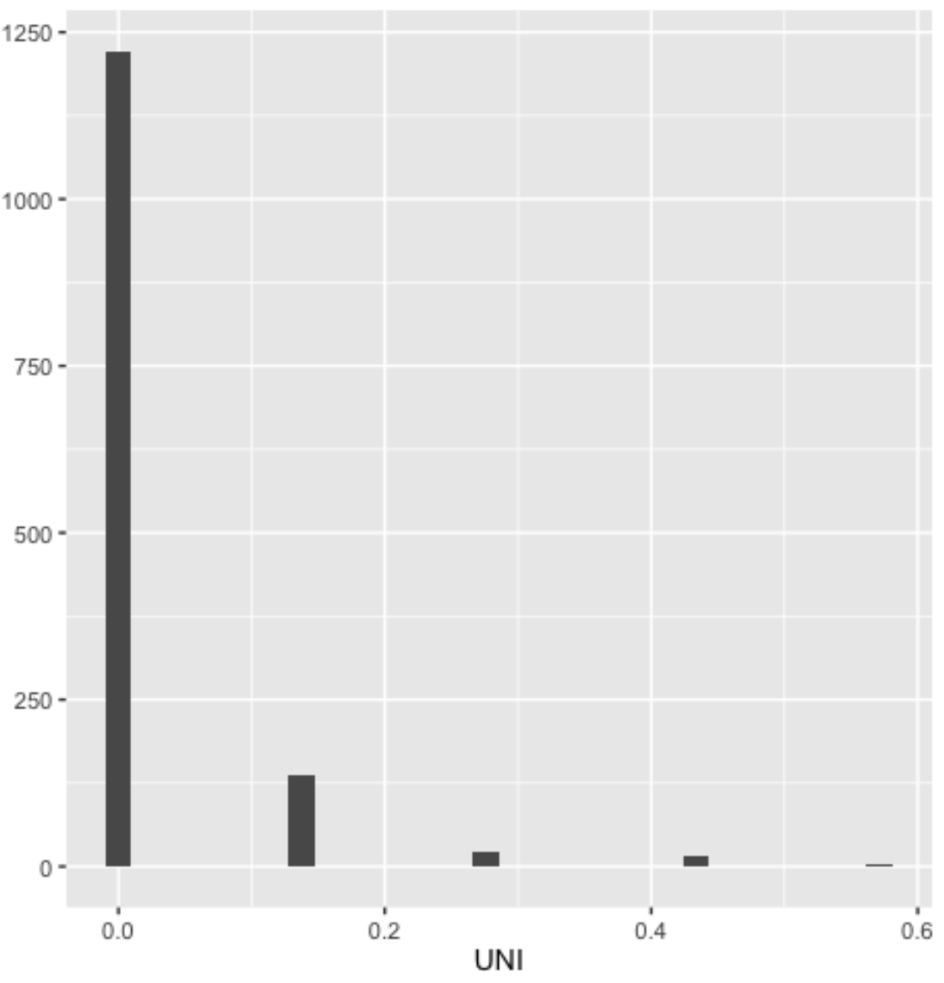
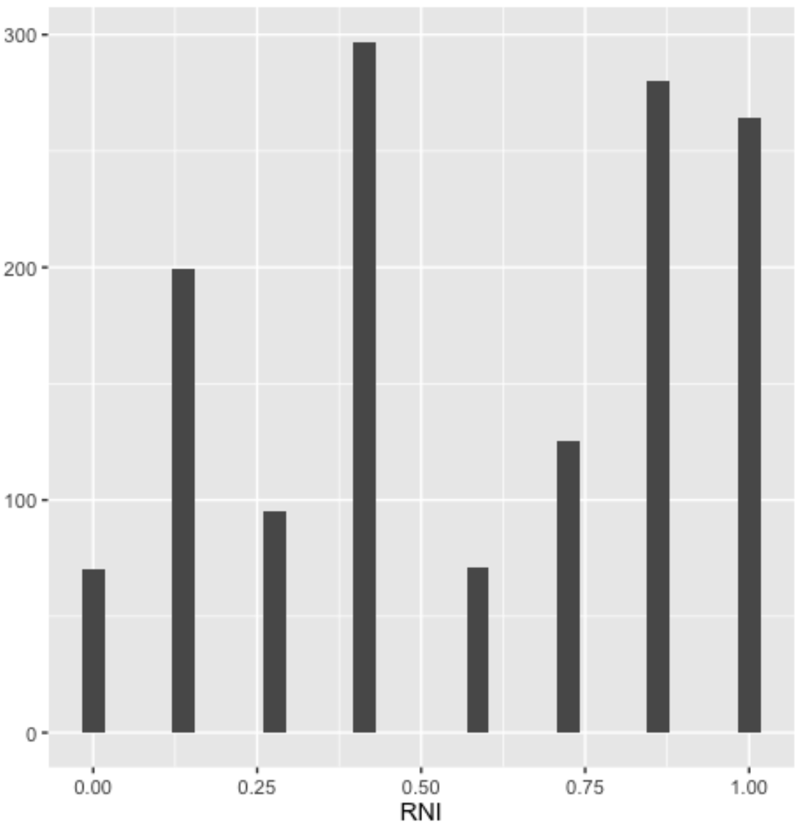
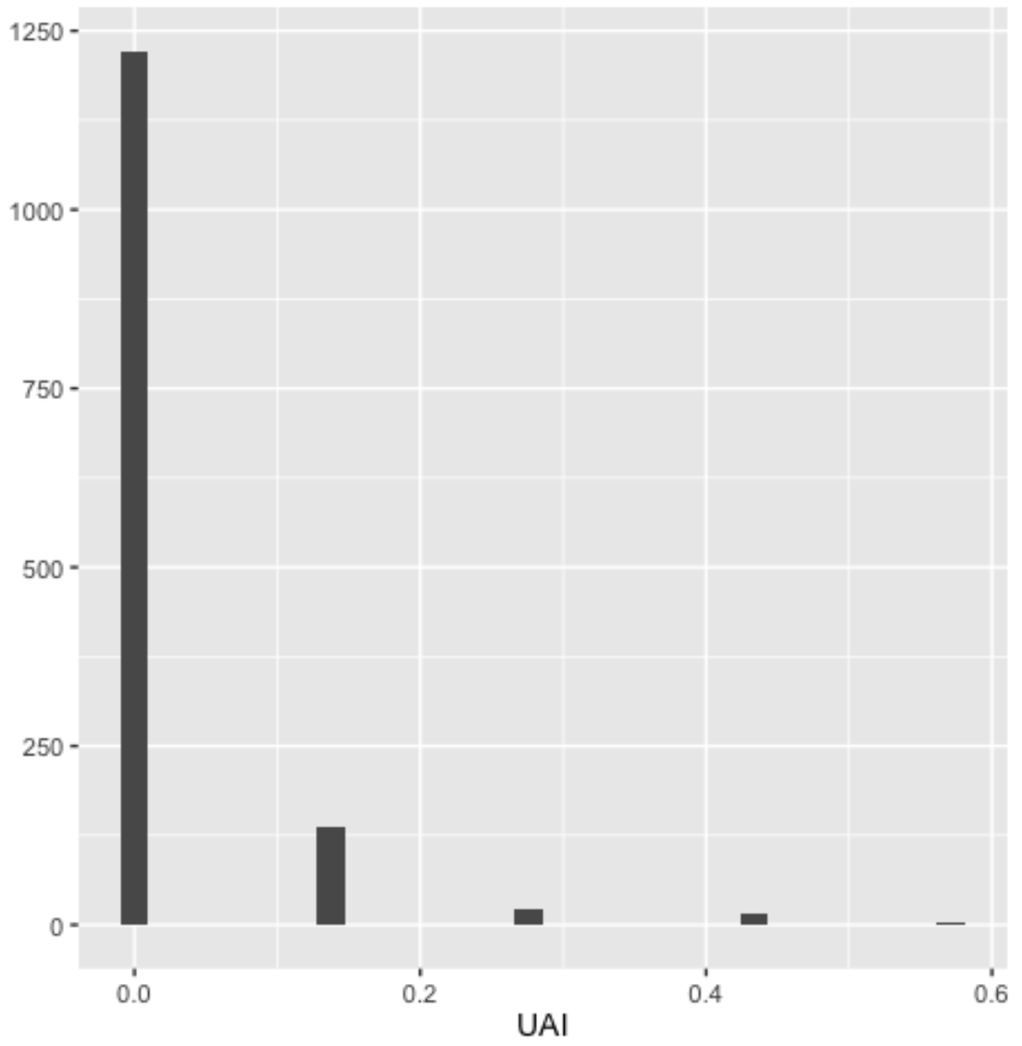
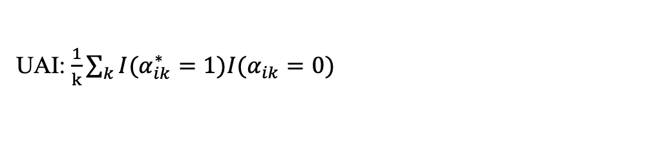
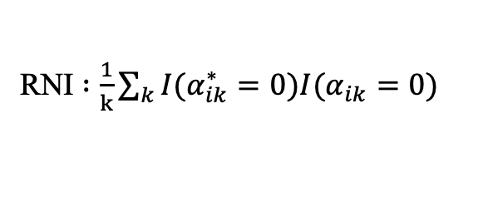
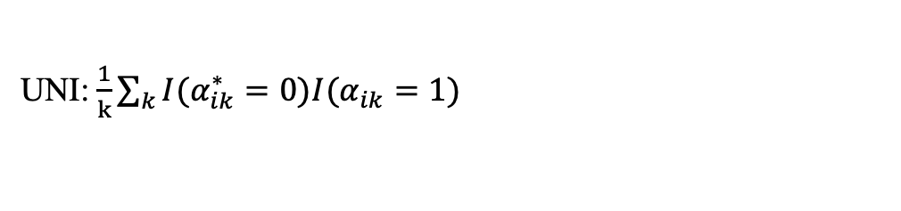
Real Data Analysis
RNI $:\frac{1}{k}\sum_{k}{I(α_{ik}^{∗}=0)I(α_{ik}=0)}$
UAI: $\frac{1}{k}\sum_{k}{I(α_{ik}^{∗}=1)I(α_{ik}=0)}$
UNI: $\frac{1}{k}\sum_{k}{I(α_{ik}^{∗}=0)I(α_{ik}=1)}$
Notes:
overall

Slide 14
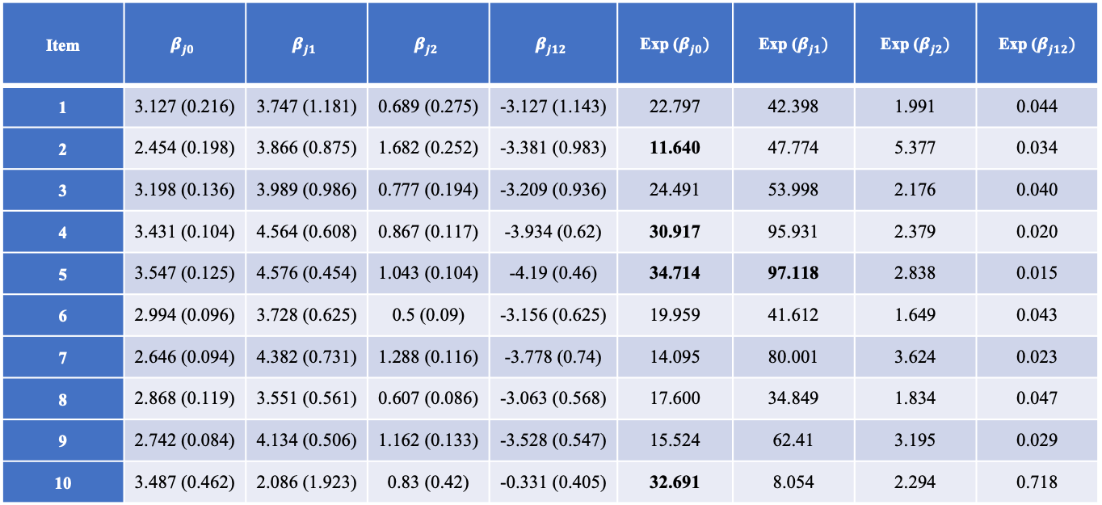
Real Data Analysis
With Latent Attribute Profile: how much more RT when student attempts to apply the attribute
Item | $$β_{j0}$$ | $$β_{j1}$$ | $$β_{j2}$$ | $$β_{j12}$$ | Exp ($β_{j0})$ | Exp ($β_{j1})$ | Exp ($β_{j2})$ | Exp ($β_{j12})$
1 | 3.127 (0.216) | 3.747 (1.181) | 0.689 (0.275) | -3.127 (1.143) | 22.797 | 42.398 | 1.991 | 0.044
2 | 2.454 (0.198) | 3.866 (0.875) | 1.682 (0.252) | -3.381 (0.983) | 11.640 | 47.774 | 5.377 | 0.034
3 | 3.198 (0.136) | 3.989 (0.986) | 0.777 (0.194) | -3.209 (0.936) | 24.491 | 53.998 | 2.176 | 0.040
4 | 3.431 (0.104) | 4.564 (0.608) | 0.867 (0.117) | -3.934 (0.62) | 30.917 | 95.931 | 2.379 | 0.020
5 | 3.547 (0.125) | 4.576 (0.454) | 1.043 (0.104) | -4.19 (0.46) | 34.714 | 97.118 | 2.838 | 0.015
6 | 2.994 (0.096) | 3.728 (0.625) | 0.5 (0.09) | -3.156 (0.625) | 19.959 | 41.612 | 1.649 | 0.043
7 | 2.646 (0.094) | 4.382 (0.731) | 1.288 (0.116) | -3.778 (0.74) | 14.095 | 80.001 | 3.624 | 0.023
8 | 2.868 (0.119) | 3.551 (0.561) | 0.607 (0.086) | -3.063 (0.568) | 17.600 | 34.849 | 1.834 | 0.047
9 | 2.742 (0.084) | 4.134 (0.506) | 1.162 (0.133) | -3.528 (0.547) | 15.524 | 62.41 | 3.195 | 0.029
10 | 3.487 (0.462) | 2.086 (1.923) | 0.83 (0.42) | -0.331 (0.405) | 32.691 | 8.054 | 2.294 | 0.718

Slide 15
Conclusion
This paper proposes the general cognitive diagnosis model for RTs (CDM-RT). As a general model, CDM-RT is an interpretable model and many alternative formulations can be generated with different assumptions. We assume that how much time examinees spend on each item conditionally dependents on to what extent their attribute profile matches the requirement of item. Thus, examinees with the same attribute profile are expected to have the same RTs across the items. Meanwhile, we assume that the attribute profile and the motivation condition of student is consistent during the entire assessment.
Assumption of high- or low-stack condition determine the model constraint of main effects.
Two different treatment of attribute profile determine how the results of CDMs for RA and RT could be related.
By investigate how attribute profiles from CDMs of RA and RT match with each other, we could have a deeper understanding of students’ behavior during test as well.
Other joint modeling of RT and RA under CDMs is also possible. Examples includes the general CDM for continuous responses proposed by Minchen & de la Torre (2018).

Slide 16
Thank you
If you have any questions or suggestions:
Email: yc3356@columbia.edu (Yi Chen)

