Slide 1
海棠经纬——面向数字制造的参数化竹编扇生成系统
Haitang Jingwei: A Parametric Bamboo-Fan Generator for Digital Fabrication
汪俏黎
WANG QIALI
个人项目
Individual project
Notes:
About 10 seconds: say your name and the project title, and move on.
The rules: five slides, three minutes, then two minutes of questions. Do not add slides, and do not make the text smaller to fit more in — cut words instead.
Each slide comes from your idea evaluation or your literature check. If a slide is hard to fill, that part of your idea evaluation needs work.

Slide 2
问题 / The problem
在海棠形非凸硬边框内生成连续编织：压一挑一、两端进框、没有悬空碎线。
Generate a continuous weave inside a non-convex haitang frame: over-under, ends in the rim, no dangling fragments.
生成时就要满足桌面 3D 打印的最小线宽、间隙和悬垂，而不是先出漂亮网格再在切片器里失败。
Print constraints (width, clearance, overhang) belong in generation, not after a pretty mesh fails in the slicer.
收进非专业用户能拖滑块的网页系统，导出可进入切片软件的网格。
A non-expert web tool with sliders, exporting a mesh that can go to the slicer.
新或旧？ / New or old?
旧问题。Ren/Panetta、Wu 的织机折返、Weavecraft、Muslimin 语法、Wang 的机器人竹亭都做过编织。
An old problem. Computational weaving already exists in those five works.
它们都不处理这把扇的闭合硬框，加上桌面 3D 打印必须一次打出的刚性几何。
None of them handle this closed rigid frame plus one-shot desktop 3D-print geometry.
Notes:
About 45 seconds.
Read your three sentences as written. If you need more than three sentences, the problem is not narrow enough yet.
Then say whether it is a new problem or an old one. If new, why it matters. If old, what has been tried and why that is not good enough.

Slide 3
缺口 / The gap
Ren, Panetta 等，2021：弯曲弹性条带能铺曲面，但不处理闭合硬框，也不能实时、不能直接 3D 打印。
Ren, Panetta et al. 2021: curved elastic ribbons on freeform surfaces — no closed rigid frame, not real-time, not a printable solid.
Wu 等，2020 织机浮雕：矩形布边折返保证连续，迁不到海棠形硬框。
Wu et al. 2020 woven relief: continuous return on a rectangular loom edge — it does not transfer to a haitang rim.
Weavecraft，2020：非专家仿真界面成熟，没有带框的可打印实体。
Weavecraft 2020: a mature simulation UI, not a framed, printable object.
缺口，以及改了什么 / The gap, and what changed
现有计算编织缺少面向非凸封闭边界的几何锚定，无法实时生成无碎线、有起伏、且匹配 3D 打印约束的连续竹编。
Current computational weaving lacks geometric anchoring to a non-convex closed boundary, so it cannot live-generate a continuous bamboo weave with no fragments, real relief, and print constraints.
因此：废弃布尔裁剪；把间隙和悬垂写进生成；只声称几何转译；本学期不做用户实验。
So: drop Boolean trim; put clearance and overhang in the generator; claim geometric translation only; no user study this term.
Notes:
About 45 seconds. This slide comes from your literature check (my_work/literature_verification.md).
Name the three works closest to yours — only works you have opened and checked yourself — and what each does not do.
Then say the gap in one sentence, and what you changed in your project because of the check — if anything.

Slide 4
贡献 / The contribution
类型：方法贡献
Type: method contribution
1 边界碎线 → 求交、去短线、端点嵌入边框 → 瓣角仍连续可打印
1 Fragments at the rim → intersect, drop shorts, embed ends → the petals stay continuous and printable.
2 过密即穿模 → 压挑、间隙、悬垂锁死 → 导出与打印机公差一致
2 Density causes collisions → over-under, clearance, overhang locks → export matches printer tolerance.
3 工具停在仿真 → 网页滑块到 STL（辅助证据，不是主贡献）
3 Tools stop at simulation → sliders to STL (supporting evidence, not the main claim).
必要性测试 / Necessity test
不做：布尔断头能不能打印，只有打印件能证明。现在还没有打印。
Without making: only prints can show whether Boolean stubs fail. Nothing has been printed yet.
不在这里：去掉海棠硬框和桌面打印，就只剩别人已经做过的计算编织。
Without this site: remove the haitang rim and desktop printing, and only prior computational weaving remains.
Notes:
About 45 seconds. Sections 4, 5 and 7 of your idea evaluation.
Say your contribution type, and how the gap points to it. Then your contributions — each one names the problem, your method and what is gained, not just what you did.
Finish with the necessity test: take away the making, then the site. Both should break the project; say why.

Slide 5
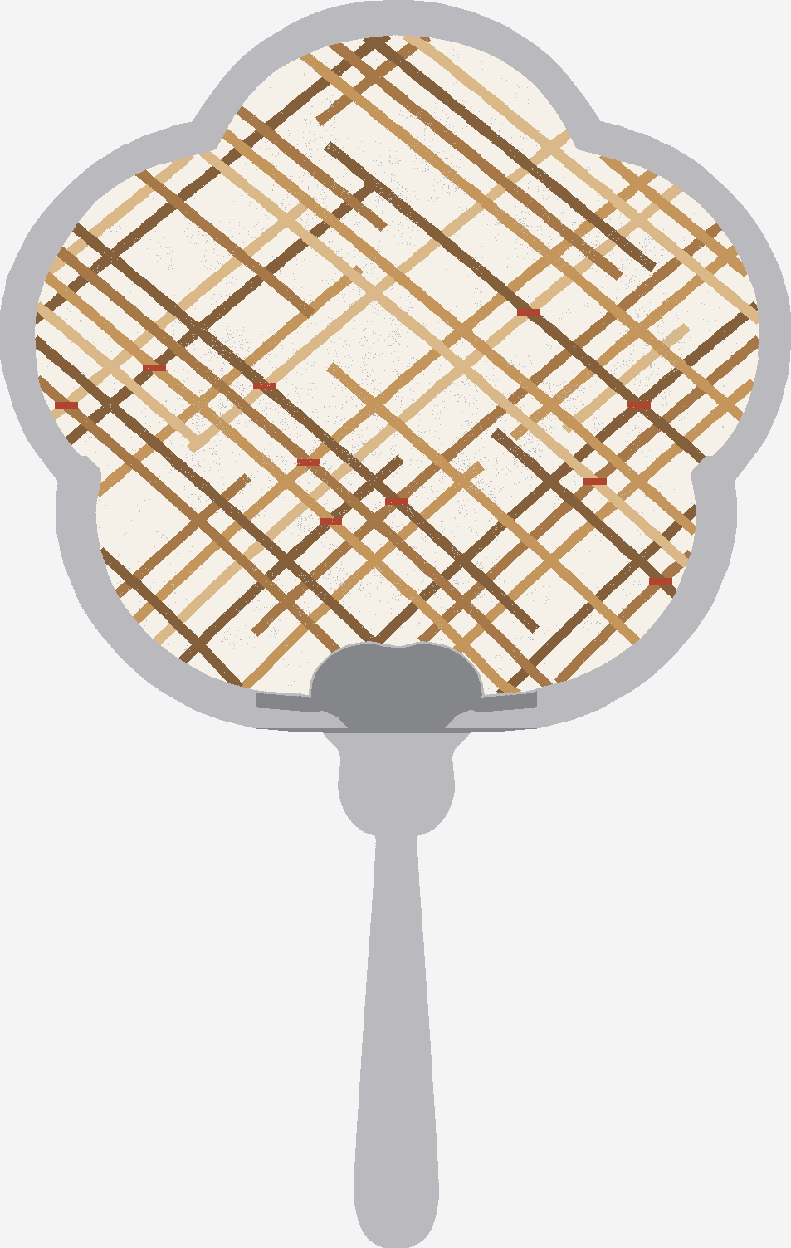
投哪里，以及我要做什么 / Where it goes, and what I will make
主投：ACM DIS 2027 · Papers · 约 7,000–8,000 词
Primary: ACM DIS 2027 · Papers · about 7,000–8,000 words
摘要 2027年1月11日 AoE；全文 1月18日 AoE
Abstract 11 Jan 2027 AoE; full paper 18 Jan 2027 AoE
审稿问：对 DIS/HCI 的贡献是否说清，文献是否站在 HCI，对交互设计的含义是什么。
Reviewers ask: is the DIS/HCI contribution clear, is it situated in HCI, are implications for interaction design stated?
备份：ACM C&C 2027 Papers · 摘要 1月19日 / 全文 1月25日 AoE
Backup: ACM C&C 2027 Papers · abstract 19 Jan / full paper 25 Jan 2027 AoE
到 11 月 25 日 / By 25 November
物件：参数化海棠刚性手扇（不是折扇）。
Object: a parametric haitang rigid hand-fan, not a folding fan.
机器：FDS DZ 13-103，细密用树脂，迭代用 FDM P2S。预约未做。
Machine: FDS DZ 13-103; resin for fine weave, FDM P2S to iterate. Not yet booked.
Notes:
About 45 seconds.
Name your primary venue and track, the format and the deadline, and one thing its review form rewards. Give your backup.
Then the made thing: what it is, which machine or material, and whether it is booked. One image if you have one.
Stop. Questions follow.

