Slide 1

SigPath
Deal Go –
Scam Towed
Every deal compared. Every deal checked.
sigpath.vercel.app

Slide 2
1 in 8
German online shoppers fell for a fake shop in the last two years.
And the risk rises with every big sale: Black Friday, Cyber Monday, Christmas.
Sources: vzbv / Forsa survey of 1,503 people, September 2025; Verbraucherzentrale Niedersachsen, 5 December 2024

Slide 3
SOUTHEAST ASIA
Mega-sales raise the scam risk too
11.11
12.12
+37%
Year-end mega-sale
Year-end mega-sale
more online purchase fraud cases in Malaysia, early 2025 vs 2024. Over RM19 million lost.
As the shopping frenzy peaks, “so does the risk of scams and frauds.”
Sources: Microsoft Malaysia, 8 November 2024; Royal Malaysia Police figures for 1 January to 24 March, via SAYS, 28 March 2025

Slide 4
SIGPATH
Search. Check. Protect.
⌕
✓
€
Compare
Check
Protect
Every deal in one search
One verdict on every listing
Money held until it ships

Slide 5
ON PEAK DAYS
Buyers rush. SigPath doesn't.
!
✓
★
€
Warns every visitor
Checks every deal
Shows who's real
Holds the money
A sale-day alert on every page. Live now.
The full check, even in the rush: 0 false flags on 800 listings
Verified sellers and EU-registered businesses
Paid when it ships, refunded if it doesn't
Germany first: Black Week, 23–30 November. Southeast Asia next: 11.11 and 12.12.
Sale-day alert live on sigpath.vercel.app; 800 live eBay listings tested 9 October 2026; escrow on Solana devnet

Slide 6
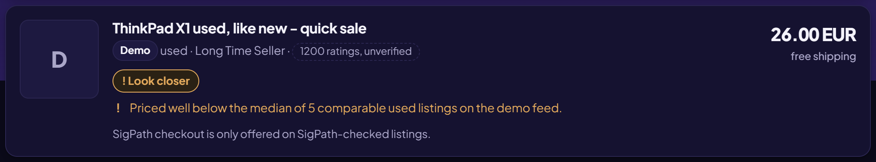
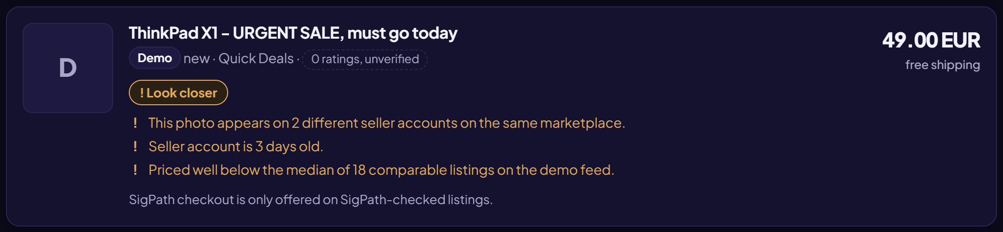
LOOK CLOSER
The bait gets flagged, not promoted
€26 laptop: far below identical ones
Copied photo, 3-day-old account
SigPath's demo feed, scams planted on purpose to show the checks. The live site shows only real listings.

Slide 7
TESTED ON LIVE EBAY
800 real listings
0
386
400
525
false scam flags
priced against identical listings
photos checked for copying
automated tests passing
First run: 14 false flags. Found, fixed, re-tested: zero.
16 searches × 50 listings on eBay.de through sigpath.vercel.app, 9 October 2026

Slide 8
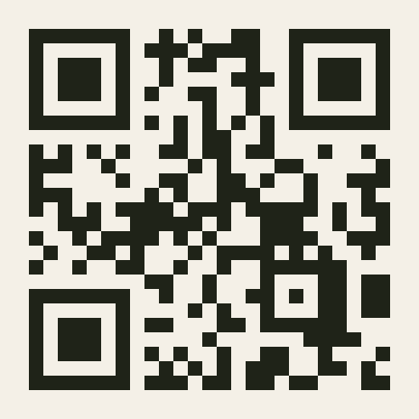
Try it now
sigpath.vercel.app
Deal Go – Scam Towed
Built on Solana only · devnet today, mainnet next
Yu Chuan, founder · @YC82628 on X and Telegram

