Slide 1
COVID Simplistic Model
Work in Progress
April 22nd 2020 – v0.2
https://github.com/ycaseau/KnomeeQuest/blob/master/Coronavirus.xlsx
Yves Caseau

Slide 2
Outline
Simplistic COVID Model
Sociology and Age Groups
Assumptions
Tuning Protocol
Sources
France Simulation
Disclaimer:
« All model are wrong but some models are useful ». Georges Box
This is a false model operating with false data. The only purpose of the model is to break false intuitions
Explore exponential growth with R = 4
Understand delays (COVID incubation and development)
« It Ain’t What You Don’t Know That Gets You Into Trouble. It’s What You Know for Sure That Just Ain’t So ». Mark Twain (attr.)

Slide 3
Simplistic COVID Model
Crude model based on 3 1-week phases
Variation on the SEIR model
(durations are simplistic, the graph is similar to
many « serious » models)
Sick at home
1 week
EHPAD
flow
Hospital to death
1 week
deaths
Symptomatic
1 week
Susceptible
population
Incubation
1 week
Hospital cure
1 week
(length does not matter)
Contagion from Phase 1 + un-isolated Phase 2
Asymptomatic
1 week
Cured
Phase 0
Phase 1
Phase 2
Notes:
innovation digitale / lean startup / agile / lean SW Factory Cloud Computing MapReduce & massive parallel Big Data

Slide 4
Sociology and Age Groups
This is the only original part of this naive model ☺ Country population is divided into three age groups.
This is the same principle as Pasteur’s model
https://hal-pasteur.archives-ouvertes.fr/pasteur-02548181/document,
… in a simplistic version (no regions, 3 age groups, and fixed duration for the steps (previous slide)
Sociology hypothesis: Elderly Social Distancing
(e.g. 3 generations under the same roof)
Lots of data available
Distribution is known and varies by country
65%
below 60 years old
Below 60 years old
Below 60 years old
Contact rates
by age
Hospitalization
rates
by age
Death
rates
by age
29%
60-80 years old
Below 60 years old
Below 60 years old
deaths
6%
Over 80 years old
Over 80 years old
Over 80 years old
Incubated + Phase1
Hospital+
Sick @ home

Slide 5
Assumptions
Humans bodies are the same everywhere in Europe.
The contagion and death rates are constants
When no overload is present, European hospital should do a similar job at curing the sick
The combination of the two says that dM/dC₋₆ should be more-or-less the same (without hospital congestion)
Testing, when largely available, should detect all phase2 patients (Germany)
Propagation follows a SEIR model : infections is the product of the susceptible population, the contagious rate, the frequency of contact and the virality factor
Confinement reduces the number of contacts
Google data gives a sense of what is achievable
Hospital death rise when hospitals are too crowded (congestion factor)
This is quite visible on M/C₋₆ data
EHPAD deaths come from a fraction of the “sick at home” population
There is not enough data to create a proper model.
Notes:
innovation digitale / lean startup / agile / lean SW Factory Cloud Computing MapReduce & massive parallel Big Data

Slide 6
Tuning Protocol
First step (no confinement, no virality)
create the seed population for the first week
classical retro-propagation computation assuming constant exponential rate
exponential rate is adjusted to reflect the case history of first 3 weeks
Second step: adjust virality factor
Adjust to reflect case growth before confinement effect
Third step: adjust confinement factor
Adjust to reflect observed case growth.
Fourth Step: adjust death model parameter
Hospital deaths: Congestion should be adjusted to reflect death tolls.
EHPAD deaths: same, when EHPAD death data is available
Notes:
innovation digitale / lean startup / agile / lean SW Factory Cloud Computing MapReduce & massive parallel Big Data

Slide 7
Main Sources (more on the Google doc)
Data (Cases & Deaths) is captured from Wikepedia, with additional sources
https://www.worldometers.info/coronavirus/country/italy/
https://www.worldometers.info/coronavirus/country/germany/
Testing rates: https://www.ft.com/content/6a8d66a4-5862-4937-8d53-b2d10794e795
Sociology of contacts: https://www.aa.com.tr/en/europe/what-s-behind-germanys-low-coronavirus-death-rate/1786296 https://www.lesechos.fr/monde/enjeux-internationaux/italie-les-raisons-dun-aussi-lourd-tribut-a-lepidemie-1188000?fbclid=IwAR2LIPwvzJICrOLdoi2Fi1AzCPZOCpL_KDd3V98RKZHKikdp2KsQ0gFF1Is
Case repartition by age: https://www.statista.com/statistics/1105465/coronavirus-covid-19-cases-age-group-germany/
Death repartition by age: https://www.worldometers.info/coronavirus/coronavirus-age-sex-demographics/ https://www.statista.com/statistics/1105512/coronavirus-covid-19-deaths-by-gender-germany/
Asymptomatic rate (50%): https://edition.cnn.com/2020/04/01/europe/iceland-testing-coronavirus-intl/index.html?fbclid=IwAR1W_E_wuewOPRptrCPdiogW00Y14AIGY0dH1lj_EEg0VG3s6syIHFwRgVM
Reduction of contacts due to Confinement: https://www.google.com/covid19/mobility/
To go further, read the Pasteur paper about their model :
https://hal-pasteur.archives-ouvertes.fr/pasteur-02548181/document
Same overall principles
Lots of relevant data (Markov chain probabilities by age group)
Much more realistic modelling of step duration (for instance, Poisson distribution versus fixed length)
Notes:
innovation digitale / lean startup / agile / lean SW Factory Cloud Computing MapReduce & massive parallel Big Data

Slide 8
Country-specific Tuning
France
Confinement : 14% of previous social contacts
R is adjusted from 4 to 0.5
Hospital congestion reflects what was seen in the D/C-6 mortality rate
Italy
The age-dependent probability of contagion is adjusted to reflect what we know from sociology (cf. previous slide & appendix)
There is no need to differentiate anything else (considering the age distribution) to retrofit the data (no hypothesis is made that Italy healthcare is less efficient)
Germany
Same about age-dependent probability adjustment
Assume that all sick cases are tested (approx. 5 times more cases detected for the same sick population) – explains most of Case/Death ratio discrepancy
Less hospital congestion
Test & Isolation : Patients that are tested positive are assumed to be isolated. It does not make much difference during the growth phase (exponential) but it helps when COVID contagion slows down.
USA
The initial population reflects the very high growth that was observed in March
Adjusting the confinement factor yields a congestion at 20% which is definitely lower than France

Slide 9
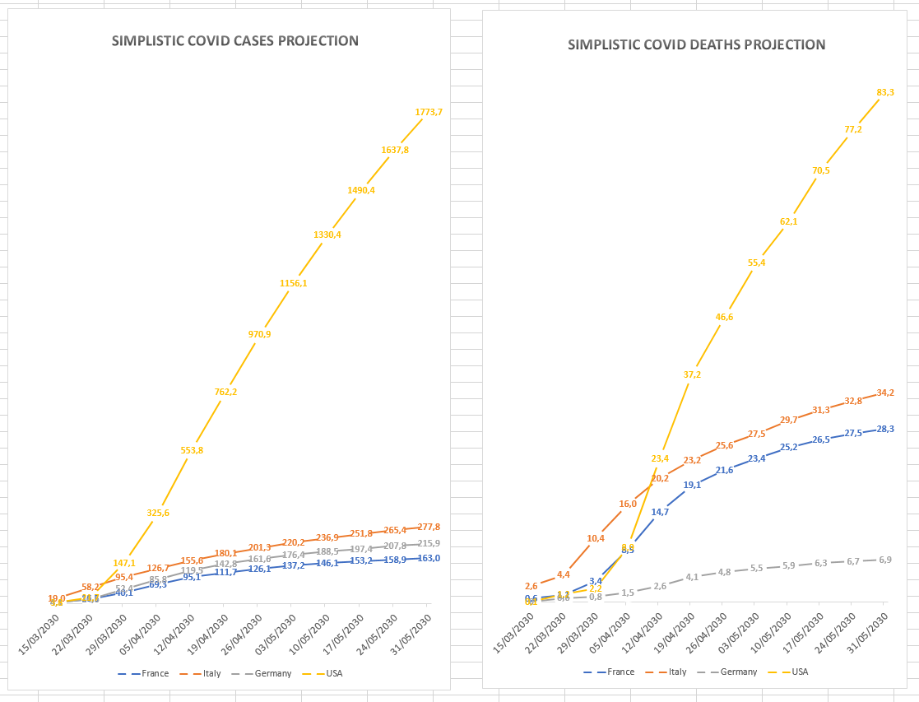
Simplistic Results
Weekly extract to tune the France model on observables
 | 08/03/2020 | 15/03/2020 | 22/03/2020 | 29/03/2020 | 05/04/2020 | 12/04/2020 | 19/04/2020 | 26/04/2020 | 03/05/2020 | 10/05/2020 | 17/05/2020 | 24/05/2020 | 31/05/2020
Observed cases | 1,1 | 5,4 | 16 | 44,5 | 70,4 | 96 | 112 | 140
cummul hostpital |  | 0,4 | 9 | 27 | 46 | 58 | 69
Real death |  | 0,1 | 0,6 | 3 | 8 | 14 | 18,2
Model cases |  | 4,1 | 16,5 | 40,1 | 69,3 | 95,1 | 111,733 | 126,1 | 137,2 | 146,1 | 153,2 | 158,9 | 163,0
Model hopital |  | 2,2 | 10,2 | 24,3 | 41,5 | 56,6 | 66,0 | 74,1 | 80,2 | 85,0 | 88,8 | 91,8 | 93,9
Model deaths |  | 0,583 | 1,088 | 3,366 | 8,535 | 14,667 | 19,067 | 21,558 | 23,430 | 25,249 | 26,513 | 27,505 | 28,296
EHPAD deaths |  |  |  |  | 0,000 | 5,117 | 7,116 | 8,241 | 9,087
Notes:
innovation digitale / lean startup / agile / lean SW Factory Cloud Computing MapReduce & massive parallel Big Data

Slide 10
Concluding Thoughts
The model tells nothing or says nothing.
However, « playing » the model has led me to develop the following ideas:
“Oxford’s hypothesis” (high ratio of already infected people) does not hold scrutiny.
With 50% asymptomatic rate, I get 2% of France population exposure to COVID on April 19th (less than Pasteur’s results)
Germany difference with France is mostly due to the testing policy. It accounts for a ratio of 5 in COVID cases.
Sociology of contacts, differentiated by age, is enough to explain the difference between France, Germany and Italy.
Test & isolation has small effects when the pandemic is growing, but it helps to decrease (ratio of tested/untested infectious)
As usual, the delays between phases and the non-linear behavior makes intuition a poor help.
The sensitivity to confinement parameters is such that there is absolutely no forecasting capability with such a model.
The sensitivity to initial conditions (such as the existence of clusters) is very high.
Quick decisive actions are necessary: simulation of starting confinement in France on March 11th reduces the number of death one month later by 4000.
Notes:
innovation digitale / lean startup / agile / lean SW Factory Cloud Computing MapReduce & massive parallel Big Data

Slide 11
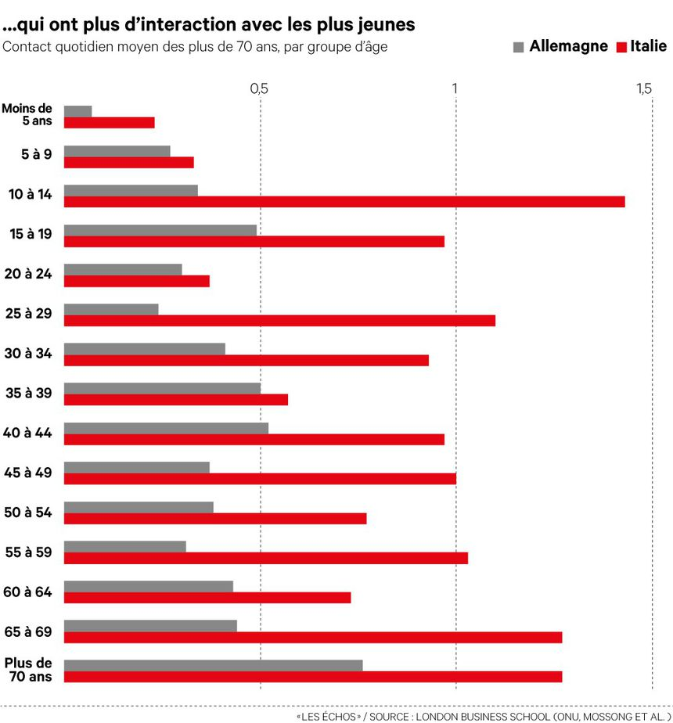
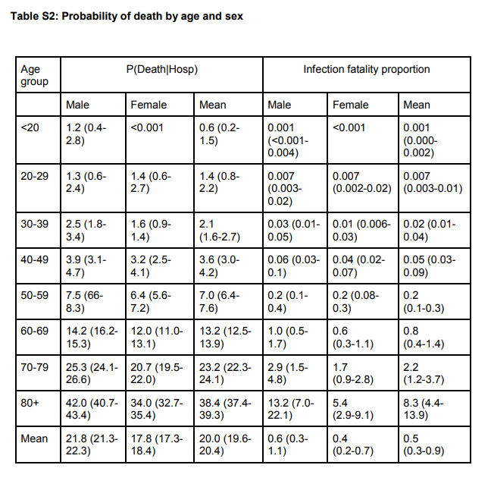
Key graphs that have influenced this model
Social Distance is a Culture Matter
Modeling needs to take age groups into account

