Slide 1
1. Build/Train
2. Web App
3. Deploy App
End to End
Face Recognition App

Slide 2
End to End “Face Recognition App”
Face Recognition Application
Develop Face Recognition Model
Web App
► Data Analysis
► Data Pre-processing
► Train Machine Learning Model
► Create Pipeline Model
► Create Face Recognition Web App in Flask (API)
► Deploy Flask app into production

Slide 3
End to End “Face Recognition App”
In this section we will focus our journey on Developing Face Recognition Model
Face Recognition Application
Develop Face Recognition Model
Web App
► Data Analysis
► Data Pre-processing
► Train Machine Learning Model
► Create Pipeline Model
► Create Face Recognition Web App in Flask (API)
► Deploy Flask app into production

Slide 4
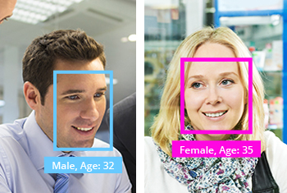
End to End “Face Recognition App”
For general purpose we are consider Gender app. The main purpose of the app is to identify gender from face (male/female)
Note: One can use same approach explained in the course to do
► Age Prediction from face
► Person Name / Identity
► Facial Emotion Recognition (Happy, Sad, Boredom etc)
many more …

Slide 5
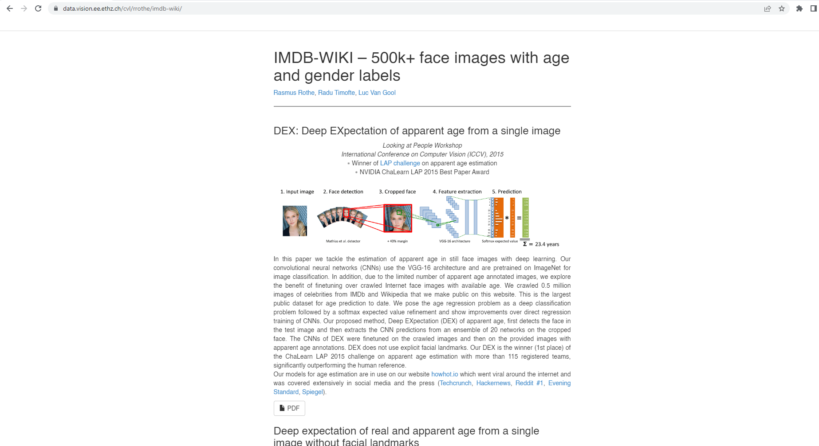
Dataset: IMDB WIKI 500K+ face images
URL: https://data.vision.ee.ethz.ch/cvl/rrothe/imdb-wiki/
The dataset downloaded directly from website given required some pre-processing steps as per instruction.
► Download Pre-processed data in Resources.

Slide 6
Activity
Lets look into data

Slide 7
Face Recognition Training Flow Diagram

Slide 8


Training Flow
Data Pre-processing
Images Data
Train
Machine Learning Model
Save ML model
Detect Face
Structure Images
& Labelling
Extract Features
► Detect Faces using
Haar Cascade Classifier
► Crop Faces from Images
► Label Each Image
► Unstructured dimension of cropped images to structured image dimension
► OpenCV resize module to make structure
► Eigen Faces
► Use PCA to extract features from Faces.

Slide 9
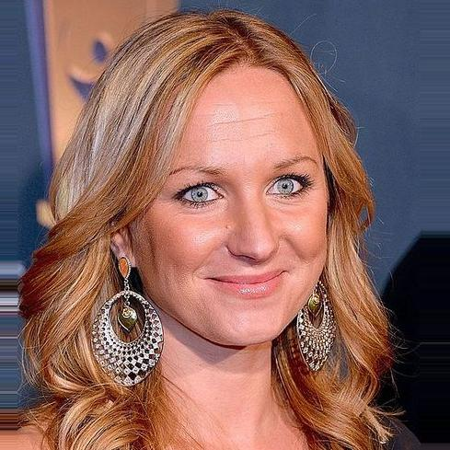
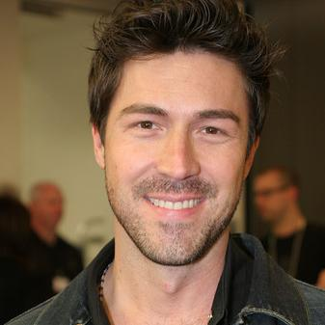
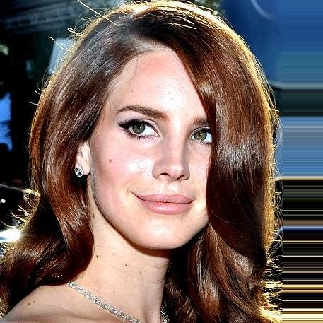
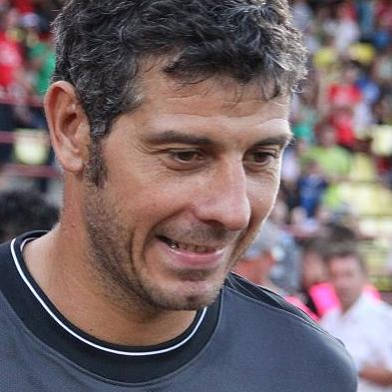
Training Flow
Data Pre-processing
Images Data
Train
Machine Learning Model
Save ML model
Detect Face
Structure Images
& Labelling
Extract Features
► Detect Faces using
Haar Cascade Classifier
► Crop Faces from Images
► Label Each Image
► Unstructured dimension of cropped images to structured image dimension
► OpenCV resize module to make structure
► Eigen Faces
► Use PCA to extract features from Faces.

Slide 10
Training Flow
Data Pre-processing
Images Data
Train
Machine Learning Model
Save ML model
Detect Face
Structure Images
& Labelling
Extract Features
► Detect Faces using
Haar Cascade Classifier
► Crop Faces from Images
► Label Each Image
► Unstructured dimension of cropped images to structured image dimension
► OpenCV resize module to make structure
► Eigen Faces
► Use PCA to extract features from Faces.

Slide 11
Training Flow
Data Pre-processing
Images Data
Train
Machine Learning Model
Save ML model
Detect Face
Structure Images
& Labelling
Extract Features
► Detect Faces using
Haar Cascade Classifier
► Crop Faces from Images
► Label Each Image
► Unstructured dimension of cropped images to structured image dimension
► OpenCV resize module to make structure
► Eigen Faces
► Use PCA to extract features from Faces.

Slide 12
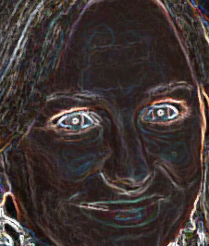
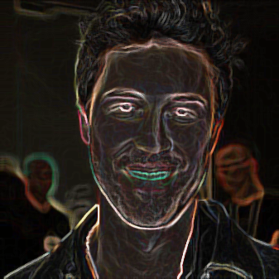
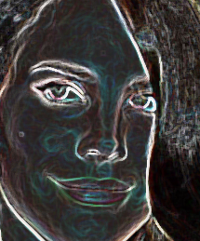
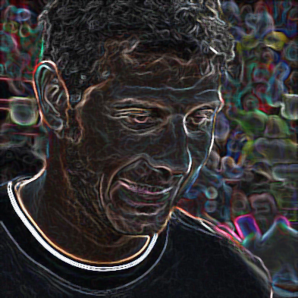
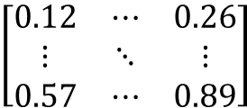
Training Flow
Data Pre-processing
Images Data
Train
Machine Learning Model
Save ML model
Detect Face
Structure Images
& Labelling
Extract Features
► Detect Faces using
Haar Cascade Classifier
► Crop Faces from Images
► Label Each Image
► Unstructured dimension of cropped images to structured image dimension
► OpenCV resize module to make structure
► Eigen Faces
► Use PCA to extract features from Faces.
$$\left[\begin{matrix}0.12 & ⋯ & 0.26 \\ ⋮ & ⋱ & ⋮ \\ 0.57 & ⋯ & 0.89\end{matrix}\right]$$

Slide 13


Training Flow
Data Pre-processing
Images Data
Train
Machine Learning Model
Save ML model
Detect Face
Structure Images
& Labelling
Extract Features
► Detect Faces using
Haar Cascade Classifier
► Crop Faces from Images
► Label Each Image
► Unstructured dimension of cropped images to structured image dimension
► OpenCV resize module to make structure
► Eigen Faces
► Use PCA to extract features from Faces.
$$\left[\begin{matrix}0.12 & ⋯ & 0.26 \\ ⋮ & ⋱ & ⋮ \\ 0.57 & ⋯ & 0.89\end{matrix}\right]$$

Slide 14
Data Preprocessing

Slide 15
Training Flow
Data Pre-processing
Images Data
Train
Machine Learning Model
Save ML model
Detect Face
Structure Images
& Labelling
Extract Features
► Detect Faces using
Haar Cascade Classifier
► Crop Faces from Images
► Label Each Image
► Unstructured dimension of cropped images to structured image dimension
► OpenCV resize module to make structure
► Eigen Faces
► Use PCA to extract features from Faces.

Slide 16
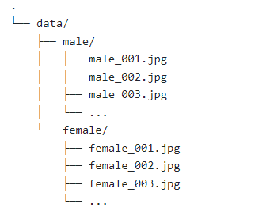
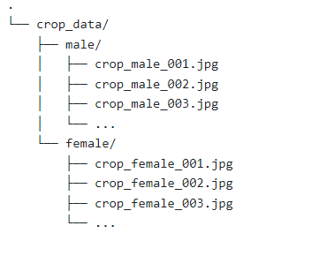
Detect & Crop Face from Image
Original Data
Cropped Faces Data
Images Data
Detect Face
► Detect Faces using
Haar Cascade Classifier
► Crop Faces from Images
► Label Each Image

Slide 17
Structuring Images
Images Data
Detect Face
Structure Images
& Labelling
Idea is to convert all images into same size
► Detect Faces using
Haar Cascade Classifier
► Crop Faces from Images
► Label Each Image
► Unstructured dimension of cropped images to structured image dimension
► OpenCV resize module to make structure

Slide 18
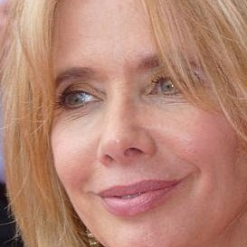
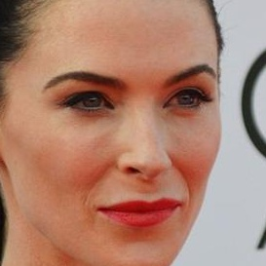
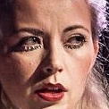

















Structuring Images
$$w_{1}$$
$$w_{2}$$
$$w$$
$$w$$
$$h_{1}$$
$$h_{2}$$
$$h$$
$$h$$
$$w$$
$$w$$
$$w$$
$$w_{3}$$
$$w_{4}$$
$$w_{5}$$
$$h$$
$$h$$
$$h$$
$$h_{4}$$
$$h_{5}$$
$$h_{3}$$
What is “w” and “h” we need to resize ?

Slide 19
Exploratory Data Analysis
Distribution of Male and Female
Bar Chart
Pie Chart
What Distribution of size of all Images
Histogram
Box Plot
Split by “Gender”
Make the decision of width & height to resize using above chart.
Remove the few images that are having very less size

Slide 20
Extract Features
Images Data
Detect Face
Structure Images
& Labelling
Extract Features
► Detect Faces using
Haar Cascade Classifier
► Crop Faces from Images
► Label Each Image
► Unstructured dimension of cropped images to structured image dimension
► OpenCV resize module to make structure
► Eigen Faces
► Use PCA to extract features from Faces.

Slide 21
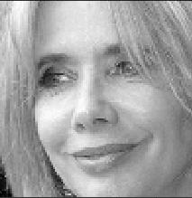
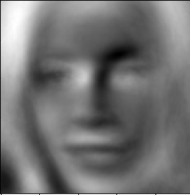
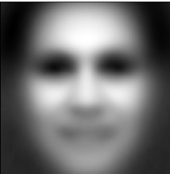
Feature Extraction with Eigen Face
Reference: https://web.stanford.edu/class/ee368/Handouts/Lectures/2019_Winter/10-EigenImages.pdf
New Face
Eigen Face
Principal Component Analysis
Normalize
+
-
Mean Face

Slide 22
Training Flow
Data Pre-processing
Images Data
Train
Machine Learning Model
Save ML model
Detect Face
Structure Images
& Labelling
Extract Features
► Detect Faces using
Haar Cascade Classifier
► Crop Faces from Images
► Label Each Image
► Unstructured dimension of cropped images to structured image dimension
► OpenCV resize module to make structure
► Eigen Faces
► Use PCA to extract features from Faces.

