Slide 1
Develop Web Application with Flask

Slide 2

Components
There are two components
1. Develop Web Application
► HTML
► Bootstrap
► Flask
2. Deploy Web App in Cloud
► GitHub
► Heroku

Slide 3
Develop Web Application
3 Pages
Page -1 : Home Page
Page -2: Application Page
Page -3: Gender App Page

Slide 4
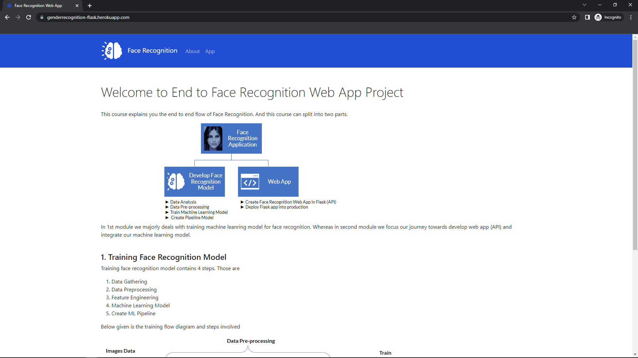
Web App
Page-1

Slide 5
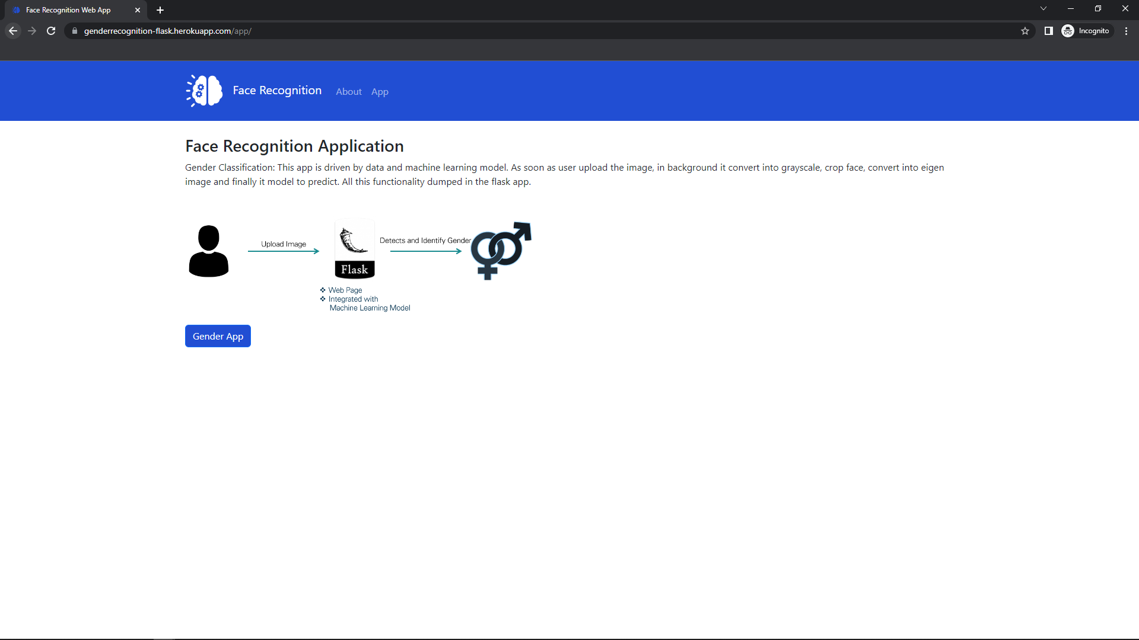
Web App
Page-2

Slide 6
Web App
Page-3

Slide 7
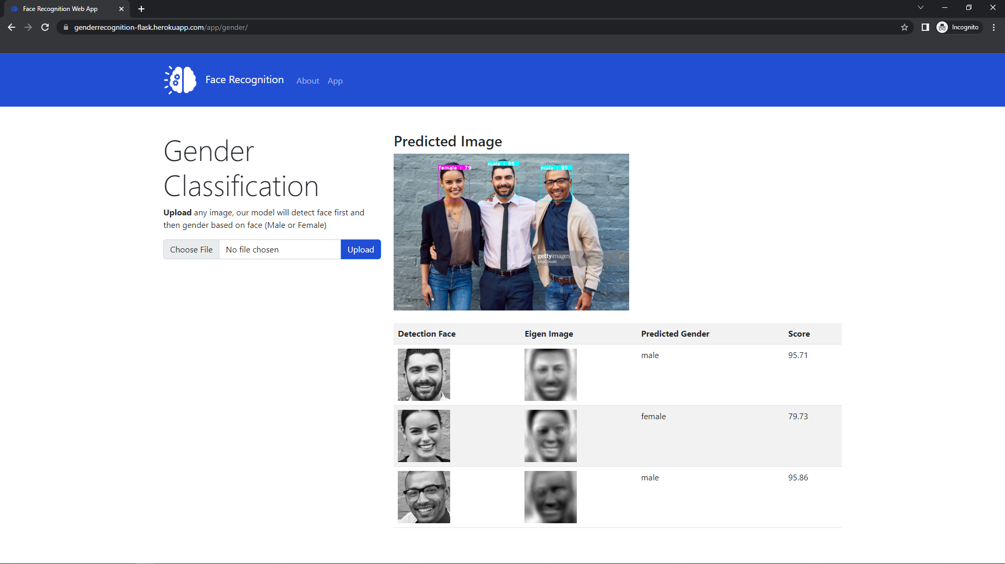
Web App
Page-3

Slide 8
Let's get started

Slide 9
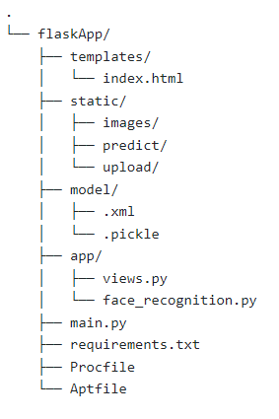
Folder Structure

Slide 10
Folder Structure
Create all html files
Create all static files like css, js, images, etc
Place all machine learning models
Python modules
Main flask file
Required python packages to run the app
Heroku files

