Slide 1
LLM- Based Black- Box Dynamic Testing of RESTful APIs Software Testing Course Project
Software Testing 2026
Members : Chengcheng Yin, Qingyi Lu,Yining Sun Instructor : Kaifeng Huang
2026- 04- 23

Slide 2
1
Project Overview
2
Experimental Procedure
Content
3
Result Analysis
4
AI capability analysis
5
Conclusion

Slide 3

01
Project Overview

Slide 4
Project Overview
Background
manual EP,BVA,test- case design is slow.
cross- field rules, auth, and edge cases are easy to miss.
Goal
use large language model(LLM) to design black- box tests for a documented REST API.
run and evaluate them in Interface testing tools(Apifox).
Project Work
Generating black- box test cases using LLM and iteratively optimizing the generation quality.
Executing test cases using the Apifox tool and recording results.
Analyzing equivalence class partitioning(EP), boundary value coverage(BVA),etc.
Evaluating the advantages and limitations of LLM in test case generation.

Slide 5
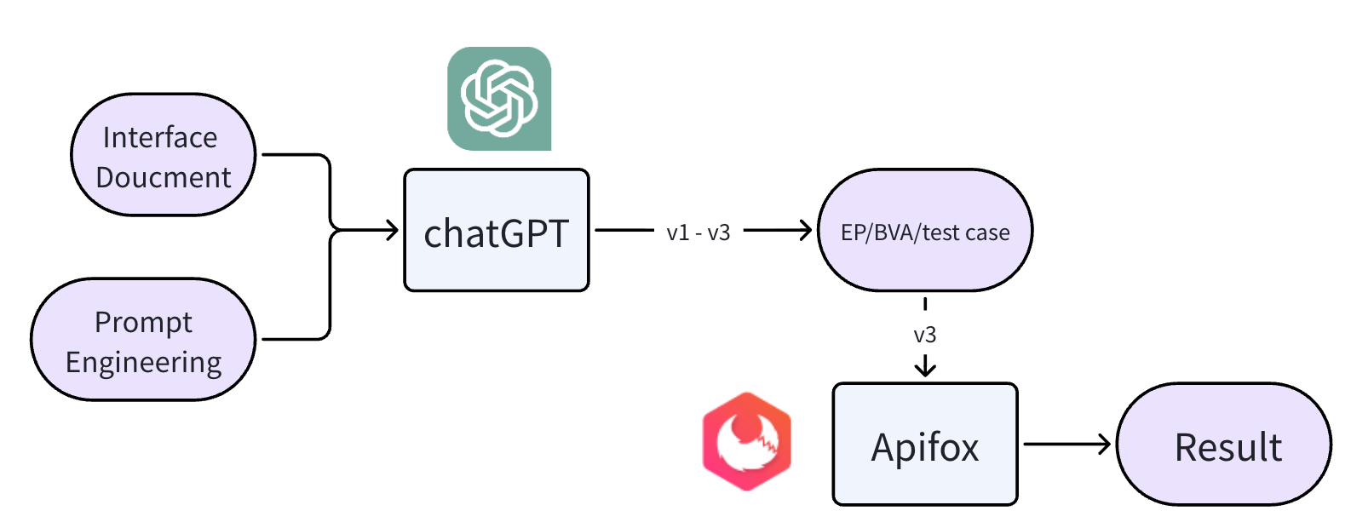
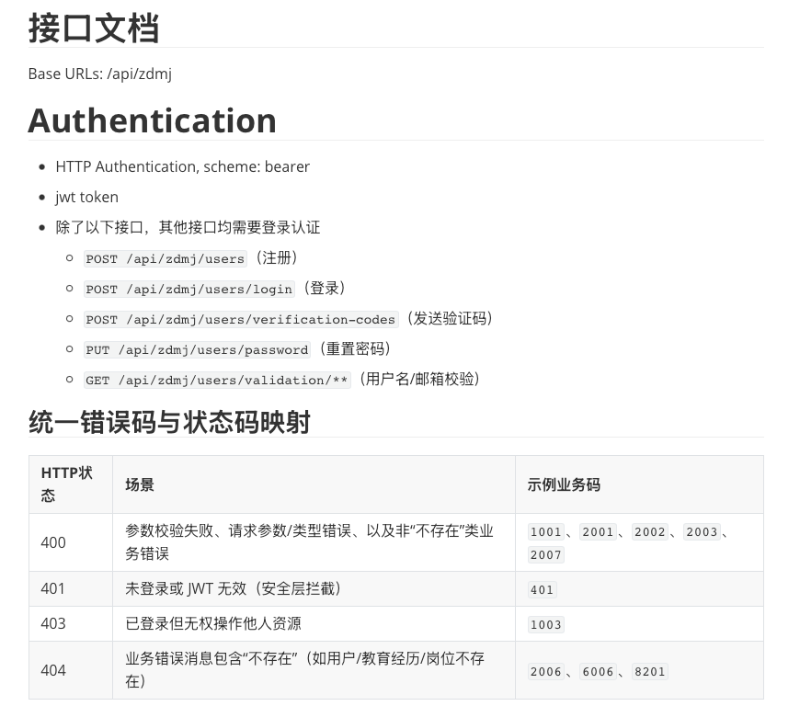
Experiment Design
Input
RESTful API Interface Document
Prompt
Tools
GPT- 5.3:Produces EP/BVA tables and numbered test cases from natural- language requirements.
Apifox:Execute test cases, record test results (HTTP status codes, business codes) , comparing them with the expected results generated by LLM.
Output
EP/ BVA
Simple test case
Combination Input test case
State transition test case

Slide 6
02
Experimental Produce

Slide 7
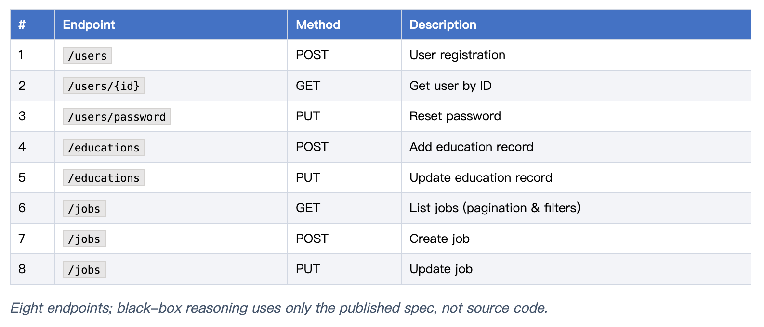
Experimental Produce
This experiment selected 8 interfaces from the interface documentation as input.
The information of these interfaces is as follows:

Slide 8


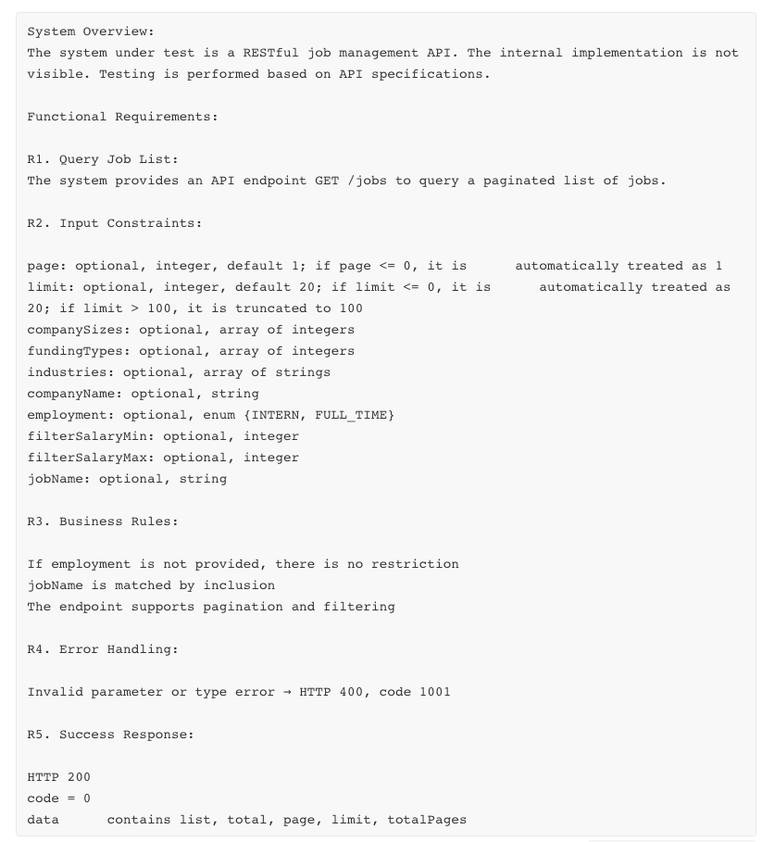
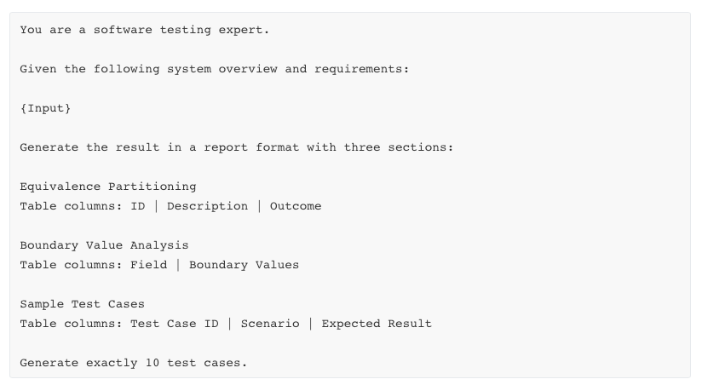
Prompt Design
Taking the interface GET / jobs API as an example:
same requirements excerpt is pasted into each round; only the instructions after {Input} change.
Goal of each round: EP table + BVA table + exactly 10 sample test cases, tabular format.
v4 adds a dedicated input-combination case set on top of v3-style coverage.
Prompt Design (v1)

Slide 9
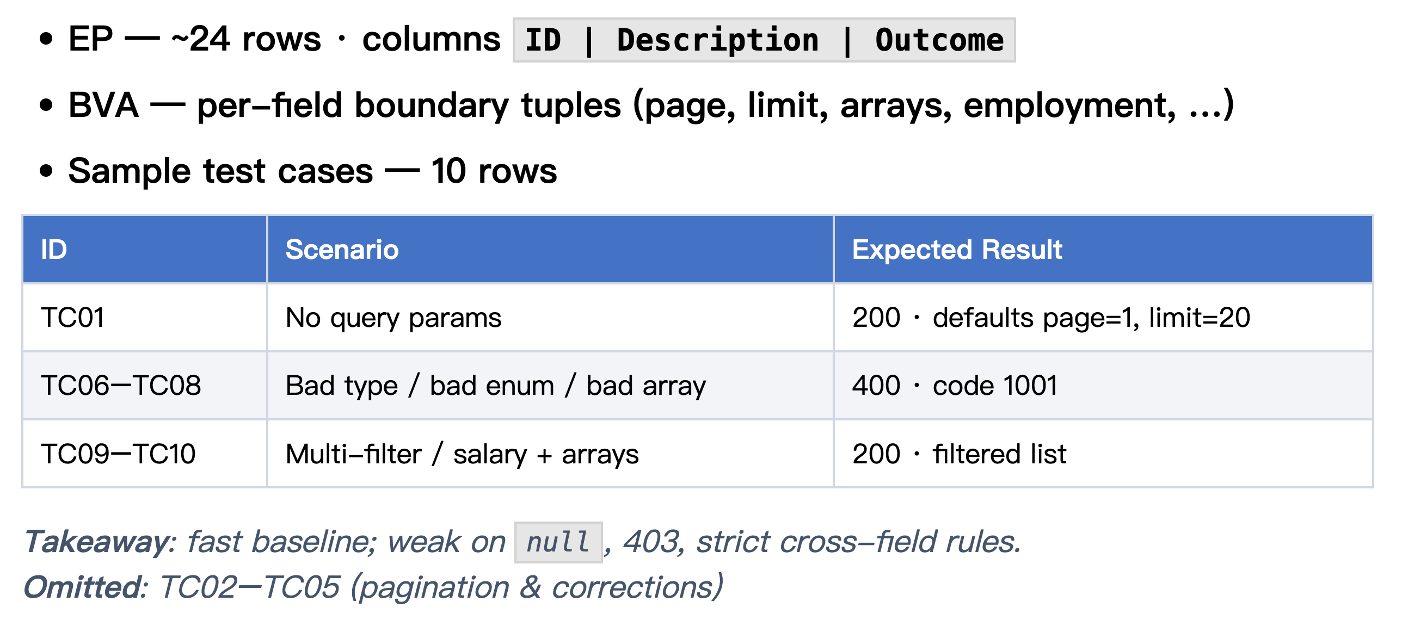
LLM Output (v1)

Slide 10
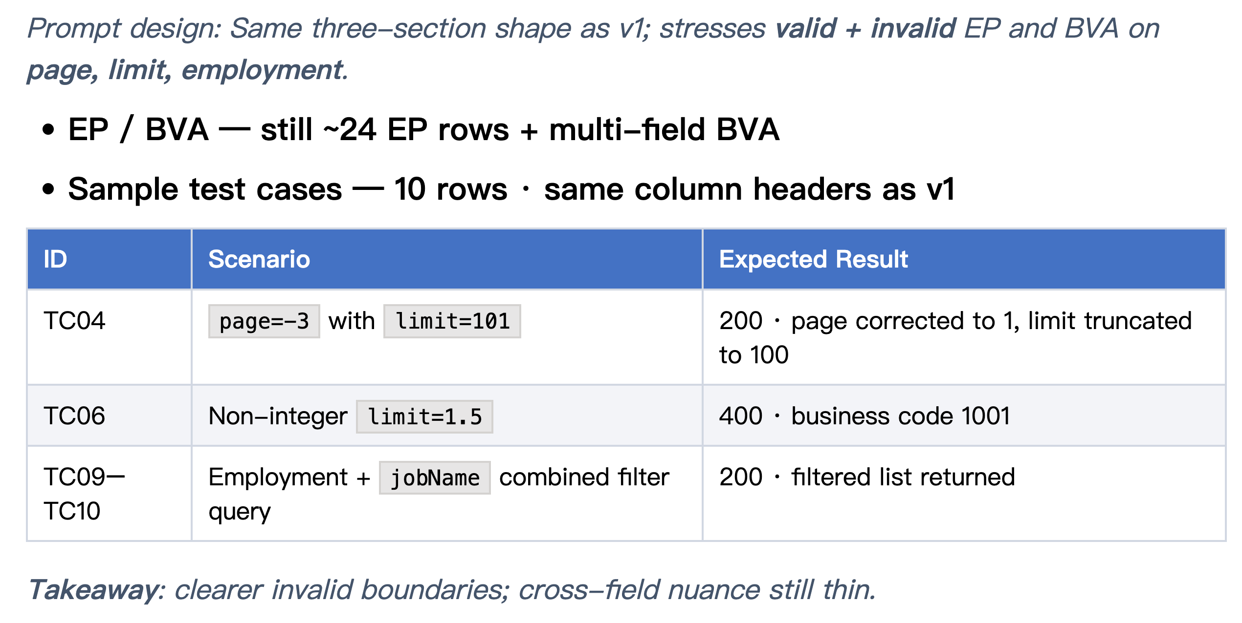
LLM Output (v2)

Slide 11
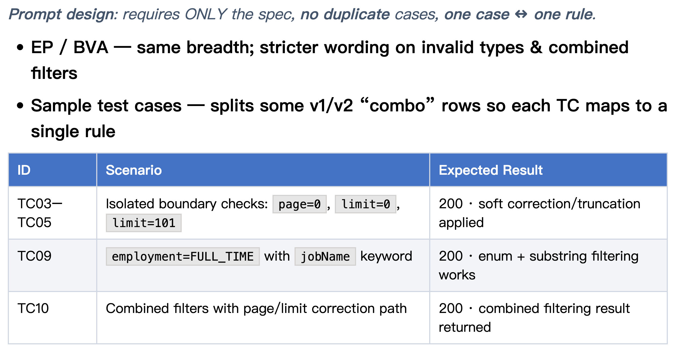
LLM Output (v3)

Slide 12
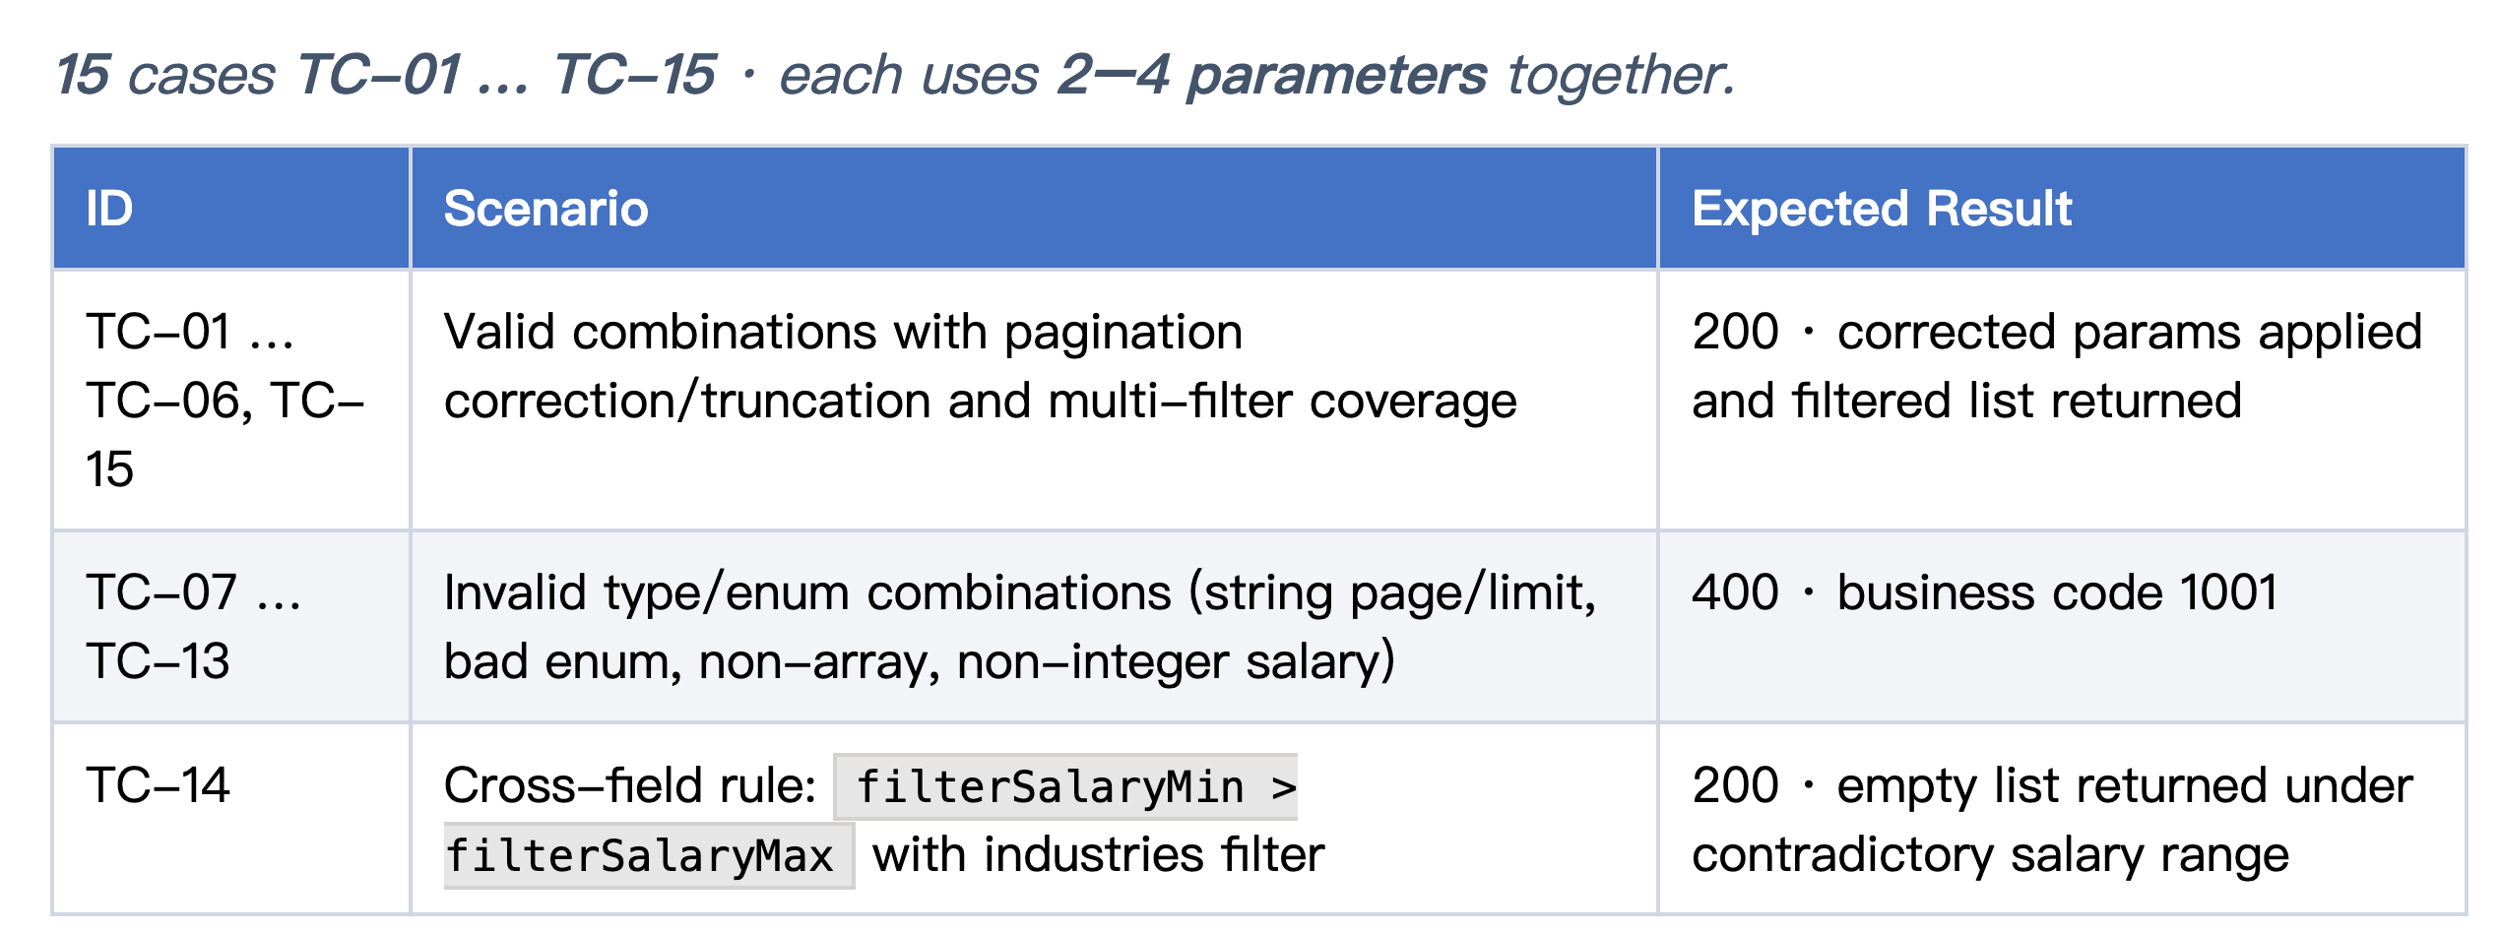
Combination Input test ( )

Slide 13
Combination Input test ( )

Slide 14
03
Result Analysis

Slide 15

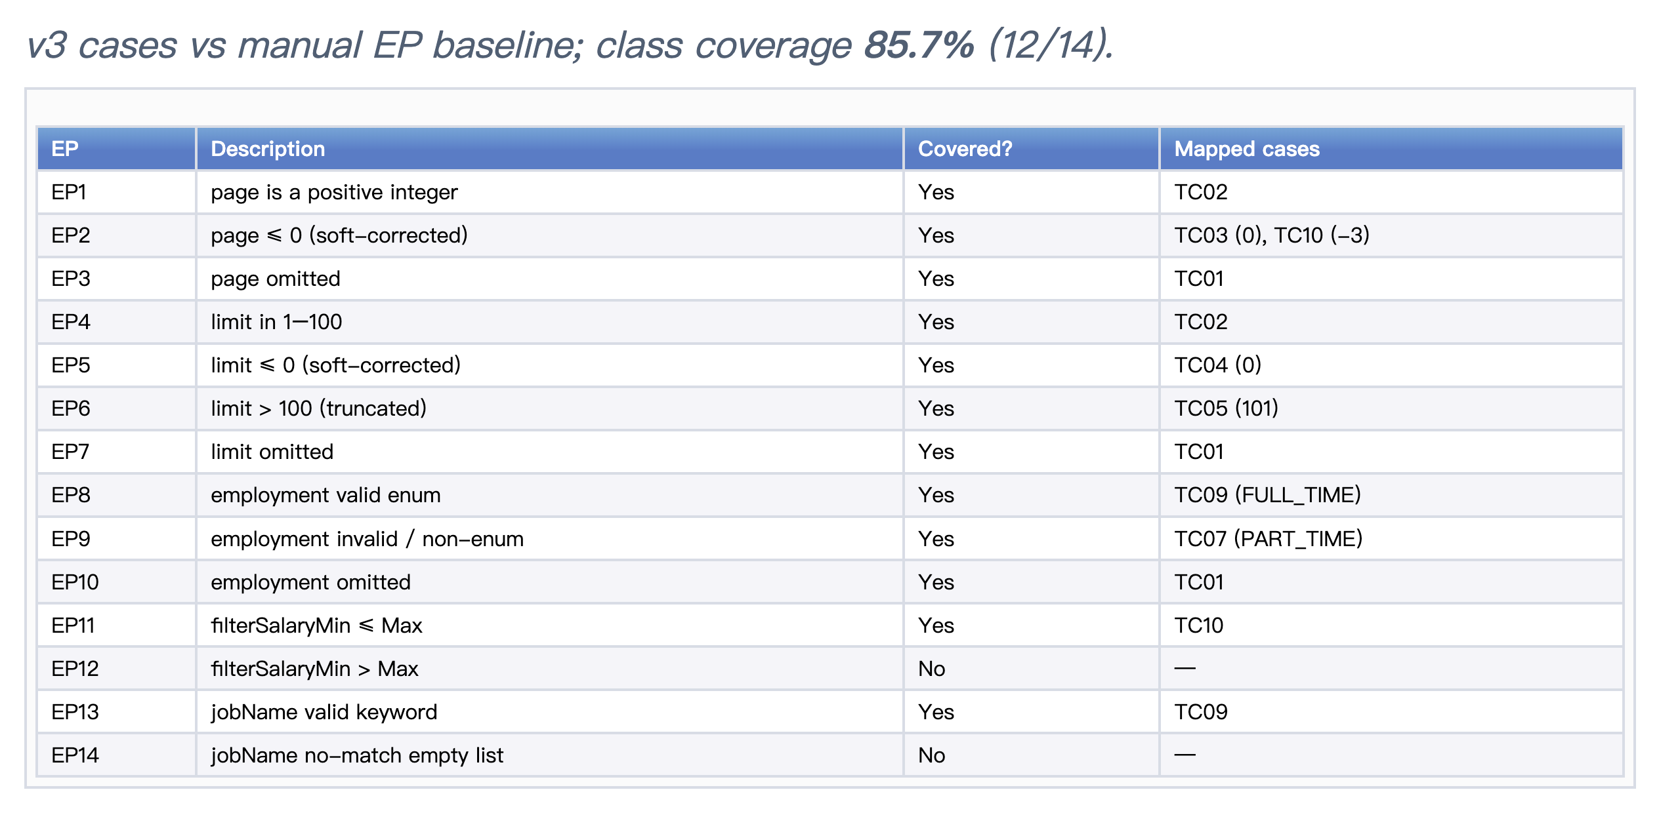
EP coverage ( )

Slide 16
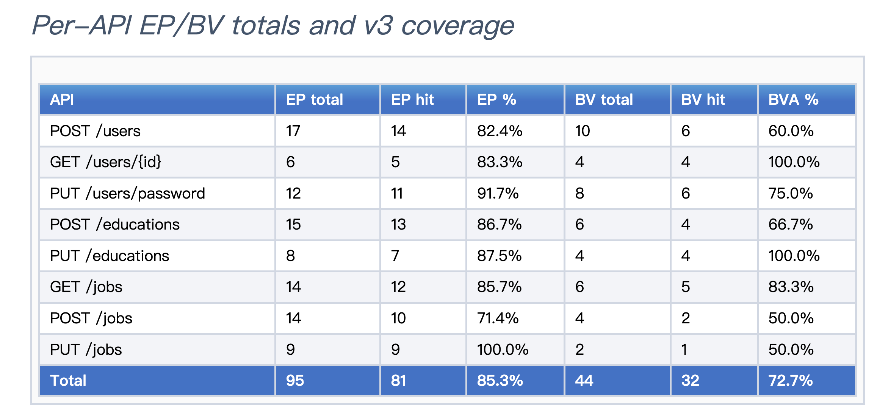
EP And BVA coverage (total)

Slide 17
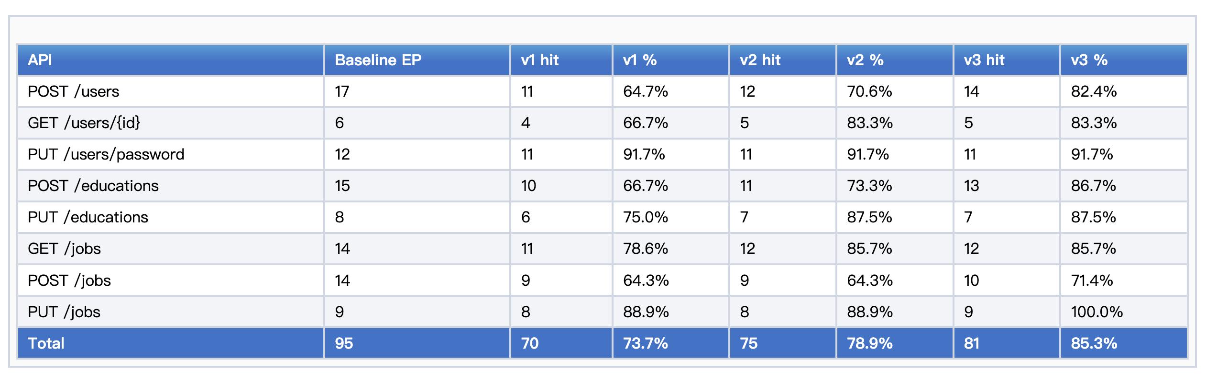
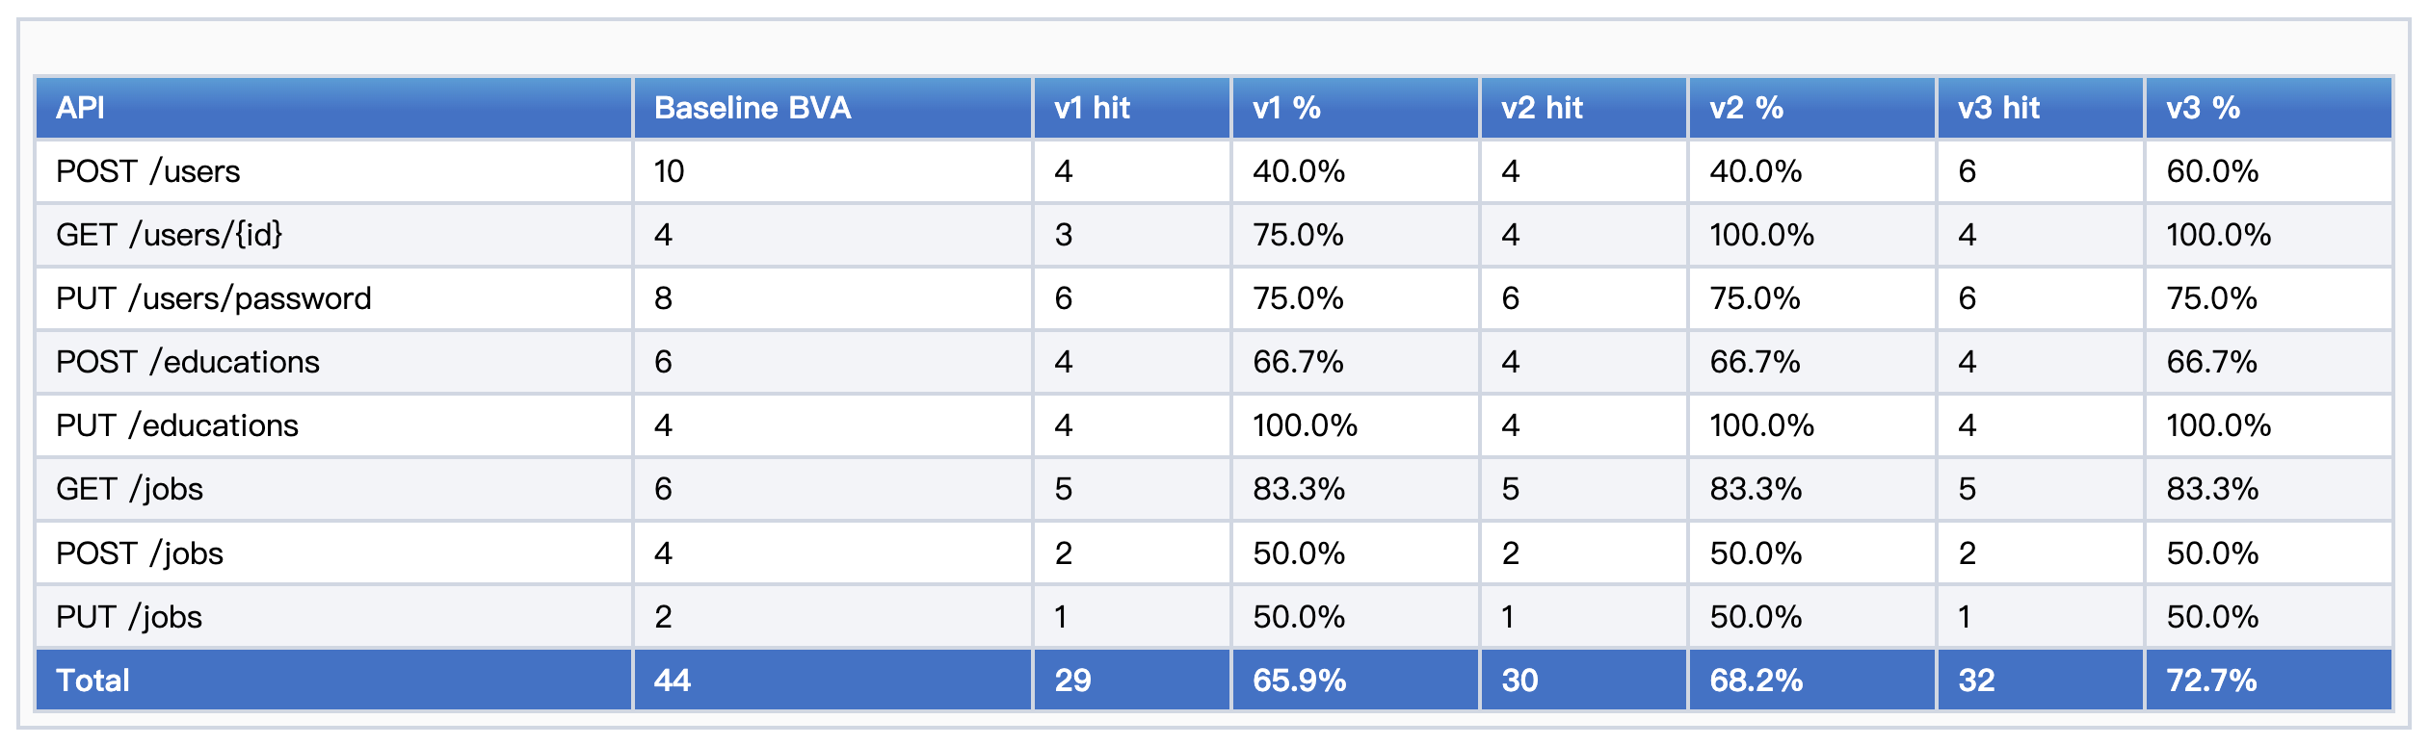
EP and BVA coverage (v1- v2- v3)
EP
BVA

Slide 18
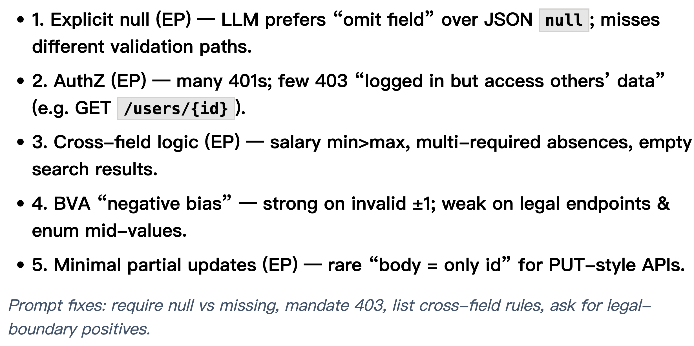
EP and BVA missing analysis

Slide 19
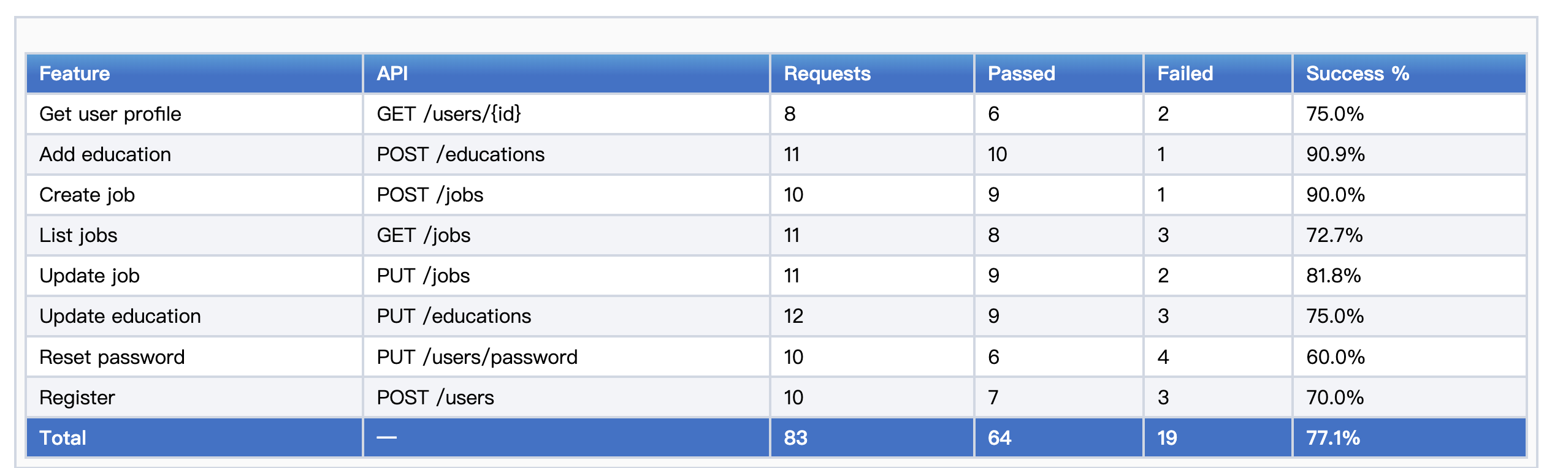
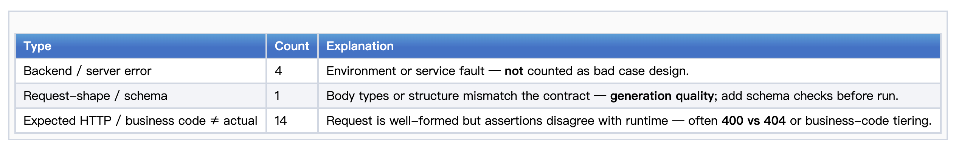
Apifox result (Sample test case)
Failure reason
Raw pass rate is 77.1%; effective pass rate is 81.0% after excluding four backend/environment failures.

Slide 20
Apifox result (Combination input test)
Failure reason
Raw pass rate is 77.1%; effective pass rate is 81.0% after excluding four backend/environment failures.

Slide 21
04
AI capability analysis

Slide 22
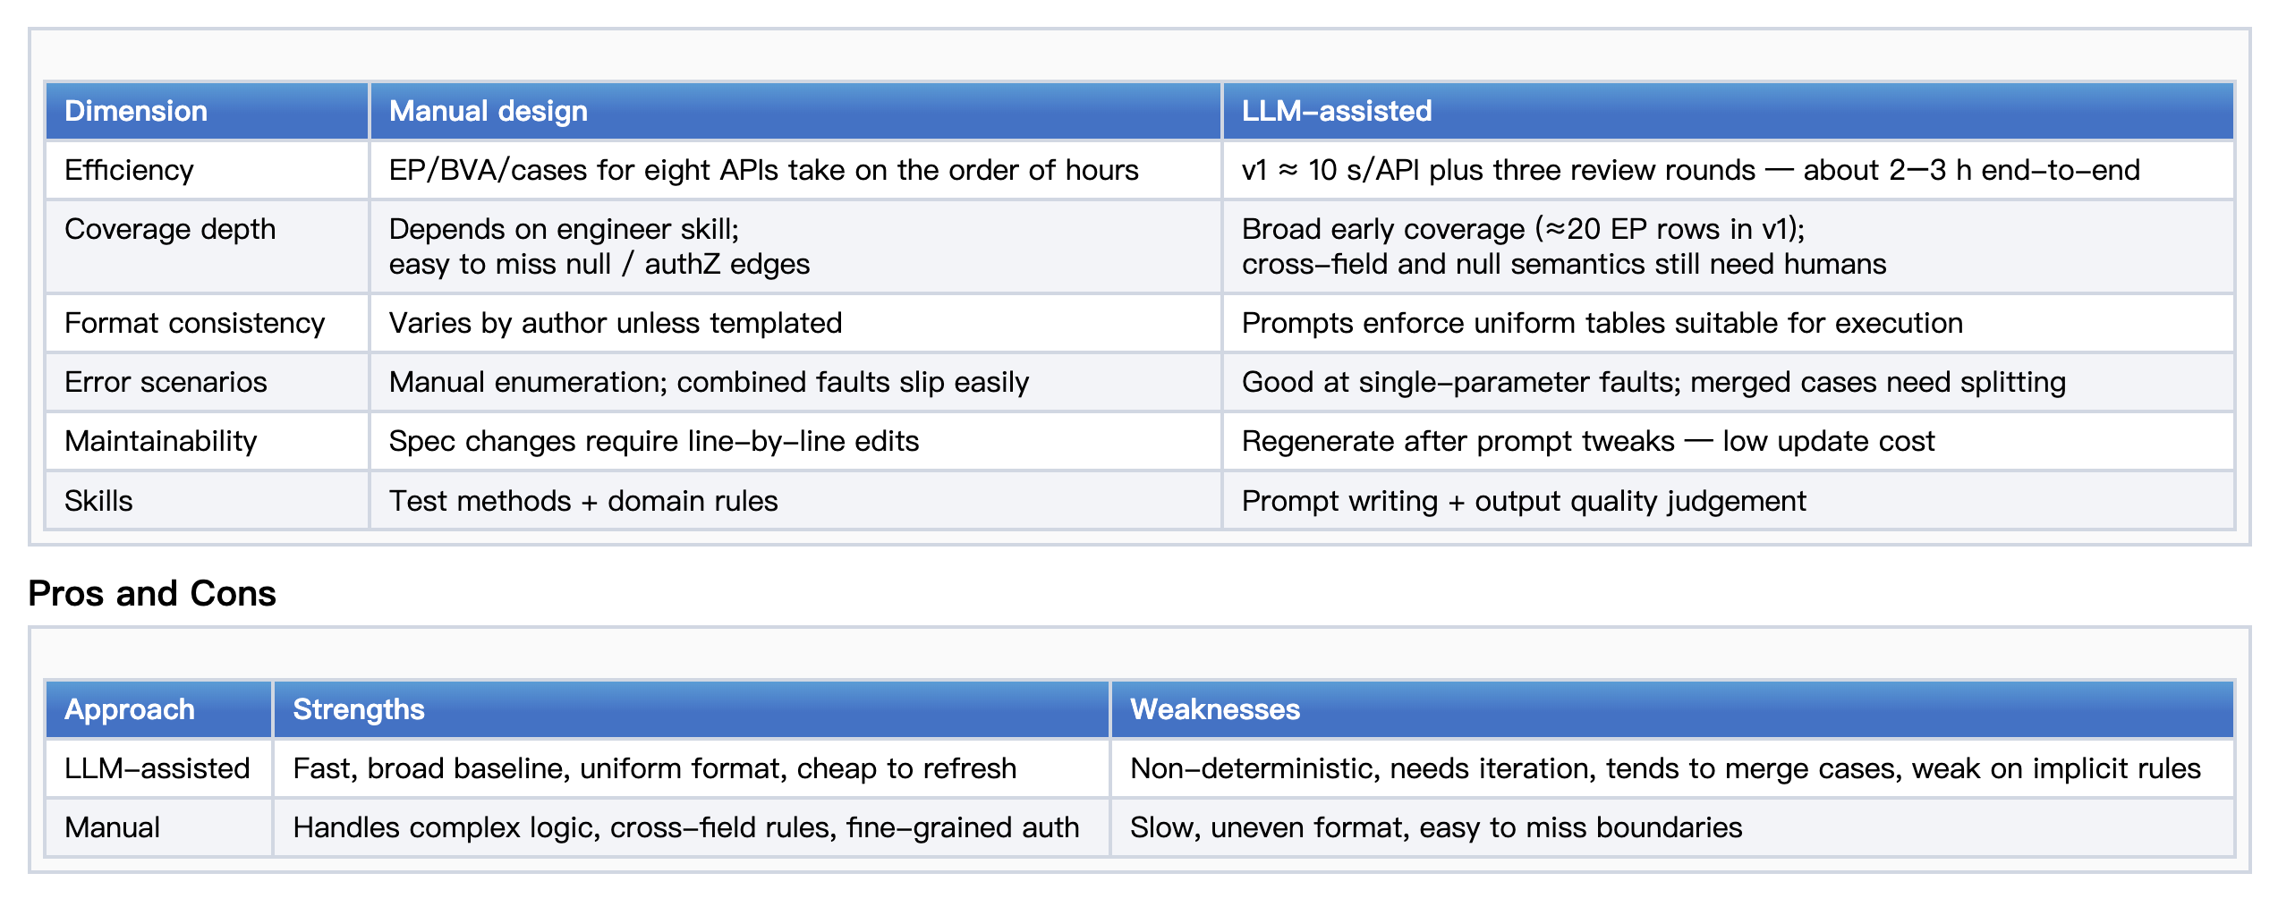
LLM- assisted vs Manual design

Slide 23
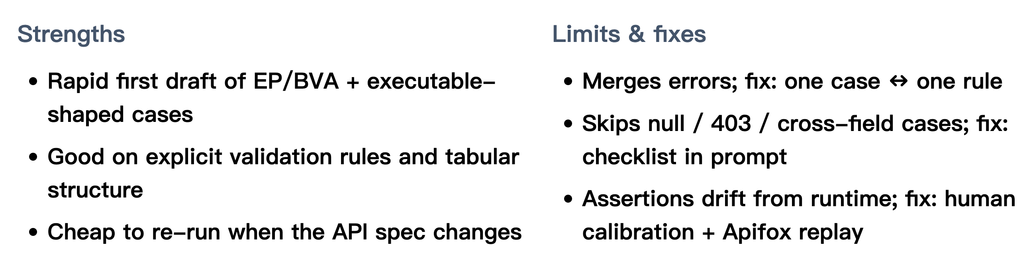
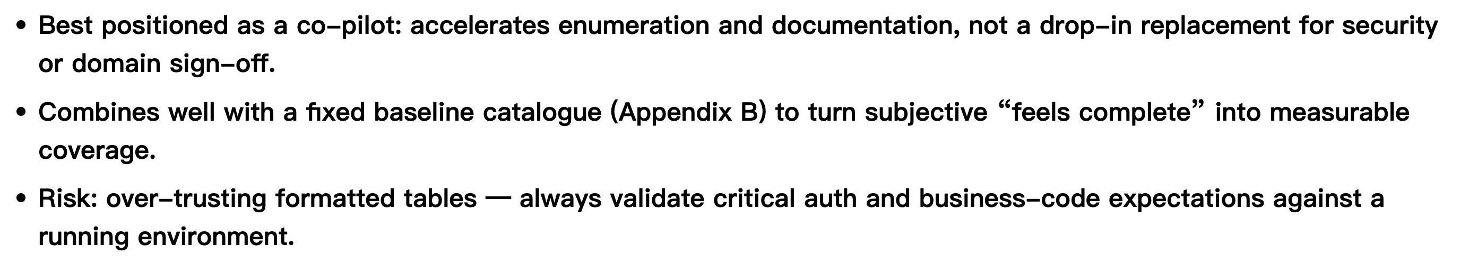
Strengths, Limits and Role in Black- Box Testing
Role

Slide 24
05
Conclusion

Slide 25
Conclusion
Key Findings
A complete workflow was established for the REST API: API specification input → LLM generation → Iterative hint optimization → Apifox execution
After iterations , the final version achieved an overall pass rate of 85.3% EP, 72.7% BVA, and 77.1% (excluding backend exceptions, the effective pass rate was 81.0%).
LLM performs well on explicit rules (required fields, format checks, enumerations, regular boundaries), but remains unstable on implicit or complex constraints.
Recommended Practices
Use LLM for initial draft generation, not as a complete replacement.
Adopt a hybrid workflow: hint constraints + iterative regeneration + manual review to balance speed and reliability.

Slide 26
Software Testing 2026
Thanks for Your Listening!
LLM- Based Black- Box Dynamic Testing of RESTful APIs
Members: Chengcheng Yin,Qingyi Lu,Yining Sun
Instructor:Kaifeng Huang
2026- 04- 23

