Slide 1
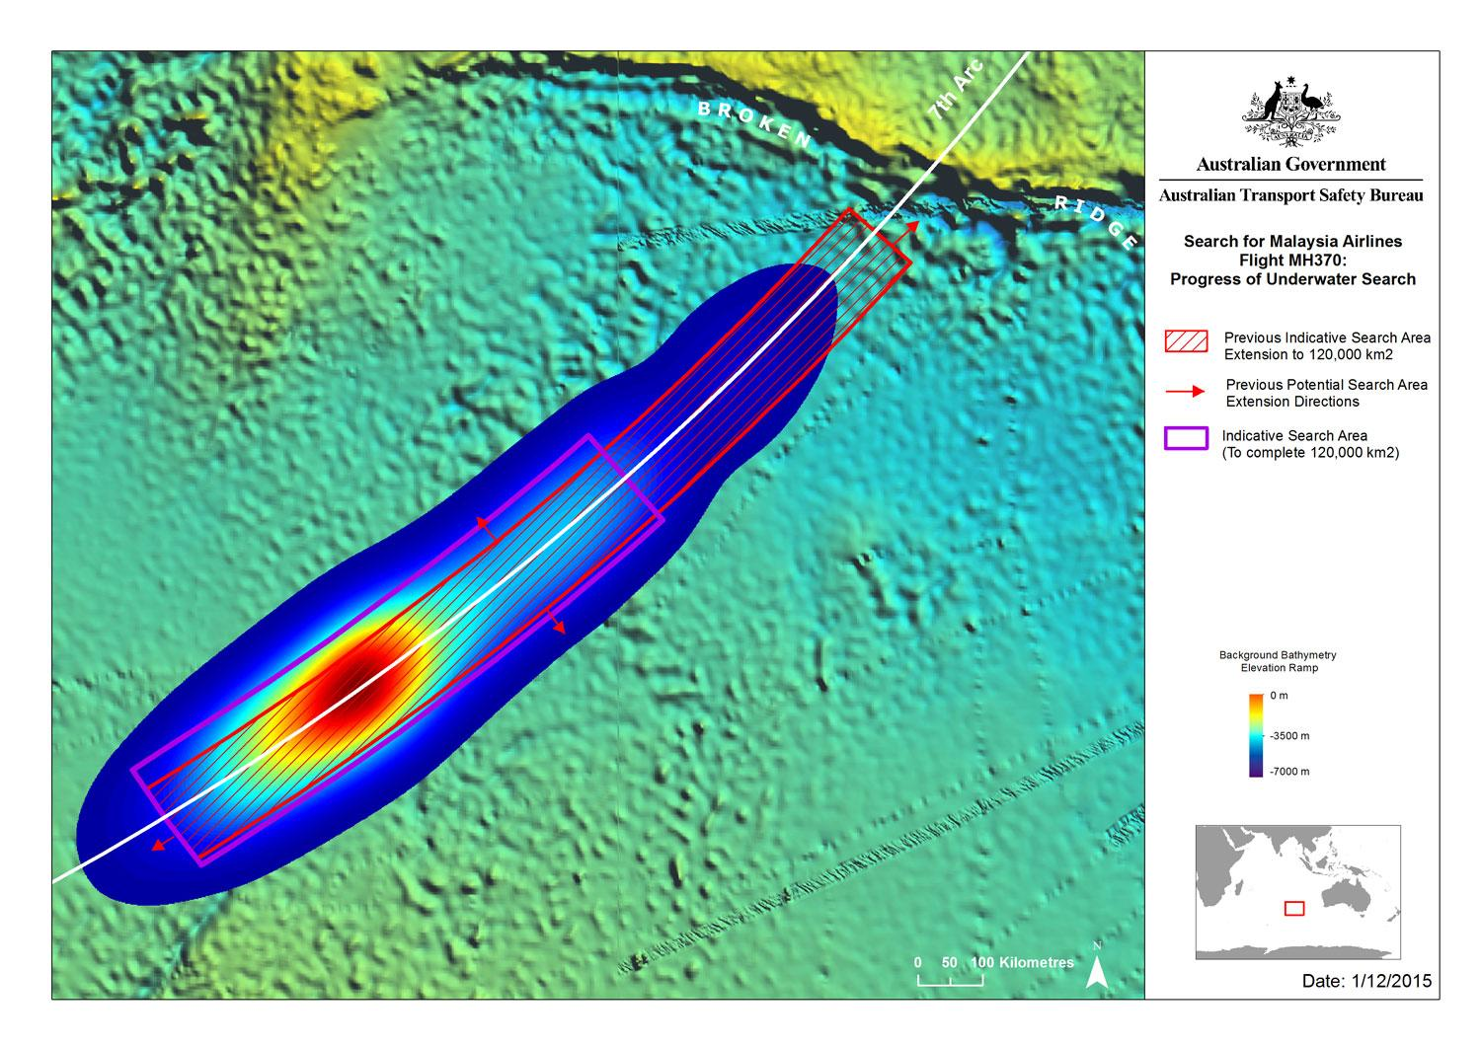
Notes:
Image of a heatmap that indicates the probable location of Malaysia Airlines Flight 370. In this image, a cold color like blue means low probability, and a warm color like red or yellow means high probability. There is a small amount of red and yellow surrounded by a larger amount of light blue and dark blue.
[source] Australian Transport Safety Bureau (2015). MH370 – Definition of Underwater Search Areas (Report). Retrieved February 17, 2017 from https://en.wikipedia.org/wiki/Heat_map#/media/File:MH370_location_probability_heat_map_per_DST_Group_analysis.jpg

Slide 2
Acknowledgements
Slide 1
Australian Transport Safety Bureau (2015). MH370 – Definition of Underwater Search Areas (Report). Retrieved February 17, 2017 from https://en.wikipedia.org/wiki/Heat_map#/media/File:MH370_location_probability_heat_map_per_DST_Group_analysis.jpg

