Slide 1
381 Revision 1
Week 1 to 6

Slide 2
NoSQL vs RDBMS
Relational databases were not designed to cope with the scale and agility challenges that face modern applications. They were not built to take advantage of the inexpensive storage and processing power available today.
NoSQL encompasses a wide variety of different database technologies that were developed in response to a rise in the volume of data stored about users, objects and products, the frequency in which this data is accessed, and performance and processing needs.

Slide 3
JSON
It is used when writing JavaScript based application, which includes browser extension and websites
JSON format is used for serializing & transmitting structured data over network connection
This is primarily used to transmit data between server and web application
Web Services (APIs) use JSON format to provide public data
It can be used with most modern programming languages

Slide 4
JSON
{ } means objects, in name/value pairs
[ ] means array
{"book":
[ {
"id":"01", "language": "Java",
"edition": "third", "author": "Herbert Schildt" },
{
"id":"07", "language": "C++",
"edition": "second" "author": "E.Balagurusamy"}
]
}

Slide 5
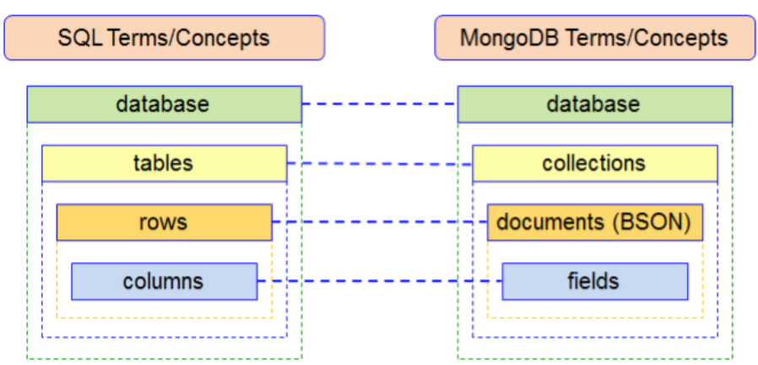
MongoDB

Slide 6
MongoDB CRUD
db.restaurants.insert( {name: value, name2: value2} )
db.restaurants.find( {criteria} )
db.restaurants.find( {criteria}, {projection} )
db.restaurants.aggregate([ {$group: {…} } ])
db.restaurants.aggregate([ {$unwind: __ }, {$group: {…} } ])
db.restaurants.aggregate([ {$unwind: __ }, {$group: {…} }, {$match: {…} } ])
db.restaurants.update( {criteria}, {$set: {name: newValue}} )
db.restaurants.update( {criteria}, {$push: {arrayName: {name : value, name : value, name: value} } } )
db.restaurants.remove( {criteria} )
db.restaurants.drop()

Slide 7
MongoDB Example Create (Insert)
db.restaurants.insert( {
borough : "Manhattan", cuisine : "Italian",
name : "Vella", restaurant_id : "41704620",
address : {
street : "2 Avenue", zipcode : "10075",
building : "1480",
coord : [ -73.9557413, 40.7720266 ] }
} )
INSERT INTO restaurants (borough, cuisine, name, restaurant_id) VALUES ("Manhattan", "Italian", "Vella", "41704620")

Slide 8
MongoDB Example Read (Find)
db.restaurants.find( {
borough: "Manhattan",
grades: {$elemMatch: {grade: "A"}}
} )
SELECT * FROM restaurants WHERE
borough = "Manhattan" AND grade = "A"

Slide 9
MongoDB Example Read (Find)
db.restaurants.find(
{$or: [ {cuisine: "Italian"}, {cuisine: "American"} ] },
{name: 1, borough: 1, _id: 0}
)
SELECT name, borough FROM restaurants WHERE
cuisine = "Italian" OR cuisine = "American"

Slide 10
MongoDB Example Update
db.restaurants.update(
{restaurant_id: "41704620"},
{$set: {'address.street': "East 31st Street",
borough: "Homantin"} }
)
UPDATE restaurants SET
address.street="East 31st Street", borough="Homantin" WHERE restaurant_id = "41704620"

Slide 11
MongoDB Example Update
db.restaurants.update(
{restaurant_id: "41704620"},
{$push: {grades: {
date:ISODate("2015-09-09T00:00:00Z"),
grade:"A", score:15
} } }
)

Slide 12
MongoDB Example Aggregate
db.restaurants.aggregate([
{$group: { _id: {borough: "$borough",
cuisine: "$cuisine"},
count: {$sum: 1} } }
] )
SELECT borough, cuisine, COUNT(*) FROM restaurants
GROUP BY borough, cuisine

Slide 13
MongoDB Example Aggregate (unwind)
{ "_id" : 1, "item" : "ABC1", sizes: [ "S", "M", "L"] }
db.inventory.aggregate( [ { $unwind : "$sizes" } ] )
{ "_id" : 1, "item" : "ABC1", "sizes" : "S" }
{ "_id" : 1, "item" : "ABC1", "sizes" : "M" }
{ "_id" : 1, "item" : "ABC1", "sizes" : "L" }

Slide 14
MongoDB Example Aggregate
db.restaurants.aggregate( [
{$unwind: "$grades"},
{$group: { _id: "$name",
max_score: {$max: "$grades.score"}}}
] )
SELECT name, MAX(grades.score)
FROM restaurants
GROUP BY name

Slide 15
MongoDB Example Aggregate
db.restaurants.aggregate([
{$unwind: "$grades"},
{$group: { _id: "$name",
avg_score: {$avg: "$grades.score"}}},
{$match: {avg_score: {$gt: 10}}}
])
SELECT name, AVG(grades.score)
FROM restaurants
GROUP BY name
HAVING scores > 10

Slide 16
MongoDB Example Delete
db.restaurants.remove({borough: "Queens"})
DELETE FROM restaurants
WHERE borough = "Queens"
db.restaurants.drop()
DROP TABLE restaurants

Slide 17
Clause in MongoDB
Operation | Symbols
Less than (<) | {name: {$lt : value} }
Less than or equals to (<=) | {name: {$lte : value} }
Greater than (>) | {name: {$gt : value} }
Greater than or equals to (>=) | {name: {$gte : value} }
Not (not a or b) | {$nor : [ {expression1}, {expression2}, …]
Not equal to (<>, !=) | {name: {$ne : value} }

Slide 18
Node.JS
NodeJS is JavaScript on the server
Fast and scalable
Designed for high concurrency (without threads or new processes)
Event-driven and non-blocking
Use event loop with a stack

Slide 19
HTTP
A client submits an HTTP request to the server; then the server returns a response to the client.
The response contains status information about the request and may also contain the requested content.
Two commonly used methods for a request-response between a client and server are:
GET - Requests data from a specified resource
POST - Submits data to be processed to a specified resource

Slide 20
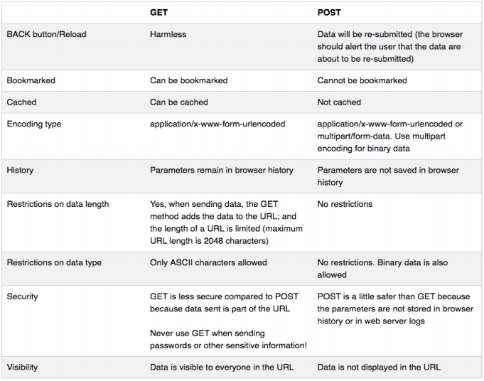
GET VS POST

Slide 21
Get data from online service
var http = require('http');
var options = { host: 'www.google.com.hk', port: 443,
path: '/search?q=ouhk', method: 'GET' };
var req = http.request(options, function(res){
res.setEncoding('utf8');
res.on('data', function (chunk){
//Respond (HTML code in this case) is stored on chunk
});
req.on('error', function(e) {
//Connection error handling
});
});
req.end();

Slide 22
BSON ←→ String
var string = JSON.stringify(obj);
var obj = JSON.parse(string);

Slide 23
A Typical Server app
Listen on a particular TCP port
Determine client’s request (what do clients want?)
Process the request
Respond to the client

Slide 24
1. Listen on a particular TCP port
var server = http.createServer(function (req,res) {
// Server code here…
});
server.listen(process.env.PORT || 8099);

Slide 25
2. Determine client’s request
var parsedURL = url.parse(req.url,true);
var queryAsObject = parsedURL.query;
if (parsedURL.pathname == '/sth' ||
parsedURL.pathname == '/sth2') { //Request ok
//Process the request
//Respond to client
} else { //Undefined request
res.writeHead(404, {"Content-Type": "text/plain"});
res.write("404 Not Found\n");
res.end();
}

Slide 26
4. Respond to the client
res.writeHead(200, {"Content-Type" : "text/html"}); res.write('<html><head><title>SimpleInterest</title></head>');
res.write('<body>');
//Continue your HTML code…
res.write(…);
res.end('</body></html>');

Slide 27
Content-type
Let browser know what to do on the received data
Commonly seen content-type:
text/html
text/plain
image/jpeg
image/gif
video/mpeg
application/pdf
application/json

Slide 28
MongoDB Driver & Mongoose (Connection)
MongoClient.connect(mongourl, function(err, db) {
assert.equal(err,null);
//Database Operation Here
});
mongoose.connect(mongourl);
var db = mongoose.connection;
db.on('error', function( /* error handling */));
db.once('open', function(callback){
//Database Operation Here
});

Slide 29
MongoDB Driver & Mongoose Create (Insert)
db.collection('restaurants')
.insertOne({ "name": " value", "name2": " value2"},
function(err, result) {
assert.true(err, null);
//Results handling (Objects array 'result')
});
var newRestaurant =
new Restaurnat ({ "name": " value", "name2": " value2"});
newRestaurant.save(function(err) {
assert.true(err, null)
//Results handling (Objects array 'result')
});

Slide 30
MongoDB Driver & Mongoose Read (Find)
var restaurants = [];
cursor = db.collection('restaurants').find({"borough": "Bronx"});
cursor.each(function(err, doc) {
assert.equal(err, null);
if (doc != null) { restaurants.push(doc); }
else { /*Results handling (Objects array 'result') */ }
});
Restaurant.find({"borough" : "Bronx"}, function(err, results) {
//Results handling (Objects array 'result')
} );

Slide 31
MongoDB Driver & Mongoose Read (Find distinct)
db.collection("restaurants").distinct('name',
function(err, result) {
//Results handling (array 'result')
});
Restaurant.find().distinct('name', function(error, result){
//Results handling (array 'result')
});

Slide 32
MongoDB Driver & Mongoose Update
*or updateMany
db.collection('restaurants').updateOne(
{ "restaurant_id" : "41156888" },
{ $set: { "address.street": "East 31st Street" } },
function(err, results) {
assert.true(err, null);
//Results handling
});
//Assume you have retrieve a restaurant from the collection
restaurant.save(function(err) {
assert.true(err, null);
//Results handling
});

Slide 33
MongoDB Driver & Mongoose Delete
*or deleteOne
db.collection('restaurants').deleteMany(
{ "borough": "Manhattan" },
function(err, results) {
assert.true(null, err);
//Results handling
});
//Assume you have retrieve a restaurant from the collection
restaurant.remove(function(err) {
assert.true(err, null);
//Results handling
});

Slide 34
Mongoose Delete (2)
Restaurants.remove(
{"borough": "Manhattan"} ,
function(err, results) {
assert.true(null, err);
//Results handling
});

Slide 35
MongoDB Client Aggregate
*same as in MongoDB
db.collection('restaurants').aggregate([
{ $group: {
"_id": "$borough", "count": { $sum: 1 }
} } ] ).toArray(function(err, result) {
assert.equal(err, null);
console.log(result);
//Results handling (Objects array 'result')
});

Slide 36
MongoDB Client GridFS
MongoClient.connect(uri, function(error, db) {
assert.true (error, null);
var bucket = new mongodb.GridFSBucket(db);
// Use bucket…
});

Slide 37
MongoDB Client GridFS
//Upload to DB
fs.createReadStream('./abc.mp3')
.pipe(bucket.openUploadStream(’abc.mp3'))
.on('error', function(error) { assert.ifError(error); })
.on('finish', function() { console.log('done!');});
//Download from DB
bucket.openDownloadStreamByName(’abc.mp3')
.pipe(fs.createWriteStream('./output.mp3'))
.on('error', function(error) { assert.ifError(error); })
.on('finish', function() { console.log('done!'); });

Slide 38
Mongoose Schema
var mongoose = require('mongoose');
var Schema = mongoose.Schema;
var blogSchema = new Schema({
title: String, author: String, body: String,
comments: [{ body: String, date: Date }], date: Date,
hidden: Boolean, meta: {
votes: Number, favs: Number }
});
module.exports = blogSchema;

Slide 39
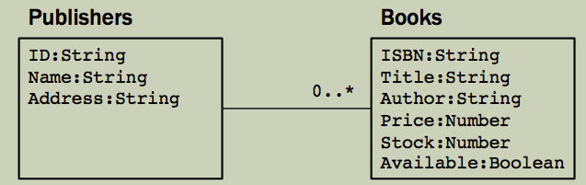
Mongoose Schema
var mongoose = require('mongoose');
var publisherSchema = mongoose.Schema({
id: mongoose.Schema.ObjectId,
name: String, address: String,
books: [ { isbn: String, title: String,
author: String, price: Number,
stock: Number, available: Boolean}]
});
module.exports = publisherSchema;

Slide 40
Mongoose Validation
var kittySchema = mongoose.Schema({
name: { type: String, required: true,
minlength: 1, maxlength: 50 },
age: { type: Number, min: 0, max: 20 },
sex: { type: String, enum: ['M', 'F'] },
birth: { type: Date, default: Date.now }
});
//When save to DB
fluffy.validate(function (err) { console.log(err); });

Slide 41
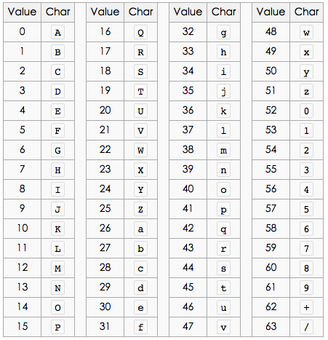
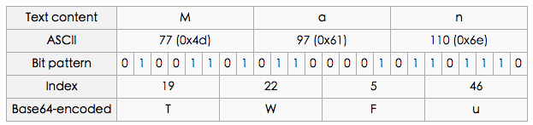
Base64
Convert Text content into ASCII code
Convert ASCII code into bit pattern
Six in a group, calculate indexes
Map the table
Pack 0s if not enough bits

Slide 42
Linux Command
cd <directory>
Change current directory
gedit <optional filename>
Fullscreen editor
ls
List a directory
npm start
Start server (configured in package.json)
npm install
Downlaod any dependency packages (stated in package.json)
curl –v –I <url>
Capture HTTP requests and responses to the url

Slide 43
Linux Command (git)
git clone <URL>
Clone a repository into a new directory
Download source codes from URL
git add [<file1> <file2> …]
Add file contents to the index
Tell which files are to be uploaded
git remote add <name> <URL>
Manage set of tracked repositories
Connect to GitHub

Slide 44
Linux Command (git)
git commit –m "comment”
Record changes to the repository
Commit the changes in the source codes
git push –u <name> master
Update remote refs along with associated objects
Upload the codes onto GitHub
git pull
Fetch from and integrate with another repository or a local branch
Download any updated codes from GitHub

