Slide 1
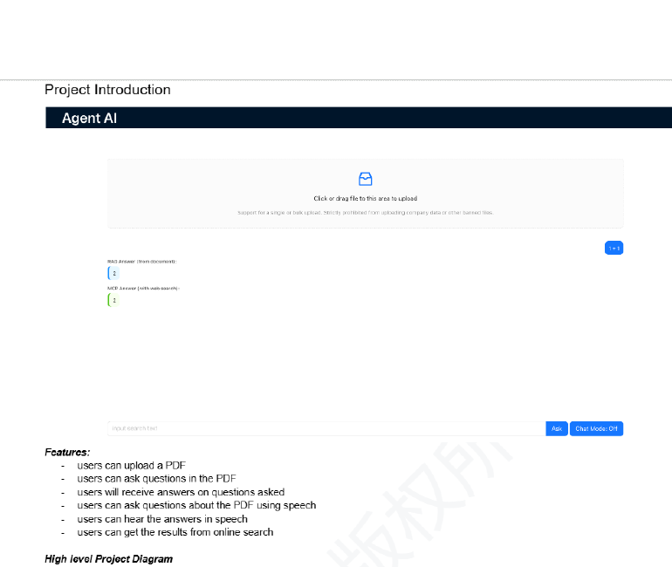
Master AI Course Project
AgentAI
A full-stack document Q&A agent that combines Retrieval-Augmented Generation, MCP-based web search, and voice interaction.
RAG
MCP Search
Speech I/O
Core stack
Frontend: React UI for file upload, chat, and voice controls
Backend: Node.js/Express endpoints for upload and /chat
AI layer: LangChain + OpenAI + vector retrieval
Tool use: MCP client/server with SerpAPI web search
1

Slide 2
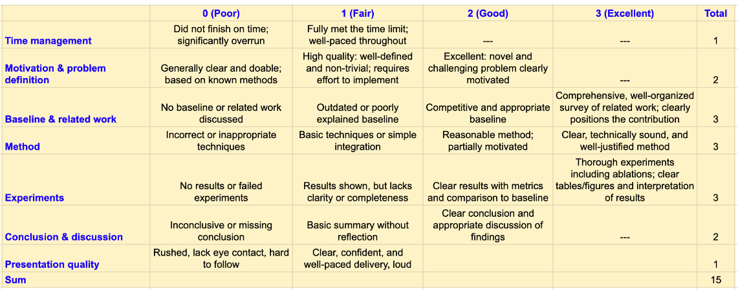
Presentation roadmap aligned to the rubric
The deck is organized to directly address motivation, baseline, method, experiments, and conclusion.
1
Motivation & problem
Why PDF-grounded + web-aware QA matters
2
Baseline & related work
Context, comparison, and project positioning
3
Method
RAG pipeline, retrieval path, and MCP tool use
4
Experiments
Validation cases and capability comparison
5
Conclusion & discussion
Strengths, limitations, and next steps
Time target
≈45–60 seconds per slide, 10 slides total.
Deck structure is guided by the uploaded course rubric screenshot.
2

Slide 3
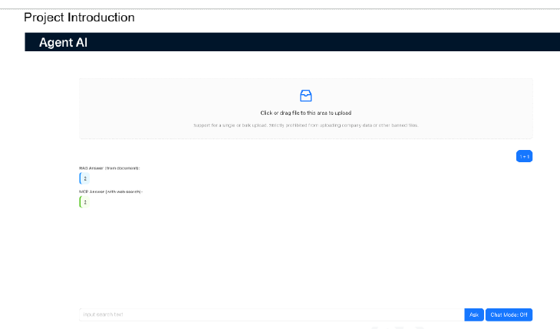
Motivation & problem definition
Why this problem matters
Long PDFs are hard to query; reading and locating specific evidence is time-consuming.
Pure LLM chat is not grounded
Without retrieval, answers depend on the model rather than the uploaded document.
Real questions often need more than one source
Some answers should combine private document context with fresh web information, plus hands-free interaction when needed.
AgentAI supports PDF upload, grounded answers, web search augmentation, and spoken interaction in one UI.
3

Slide 4
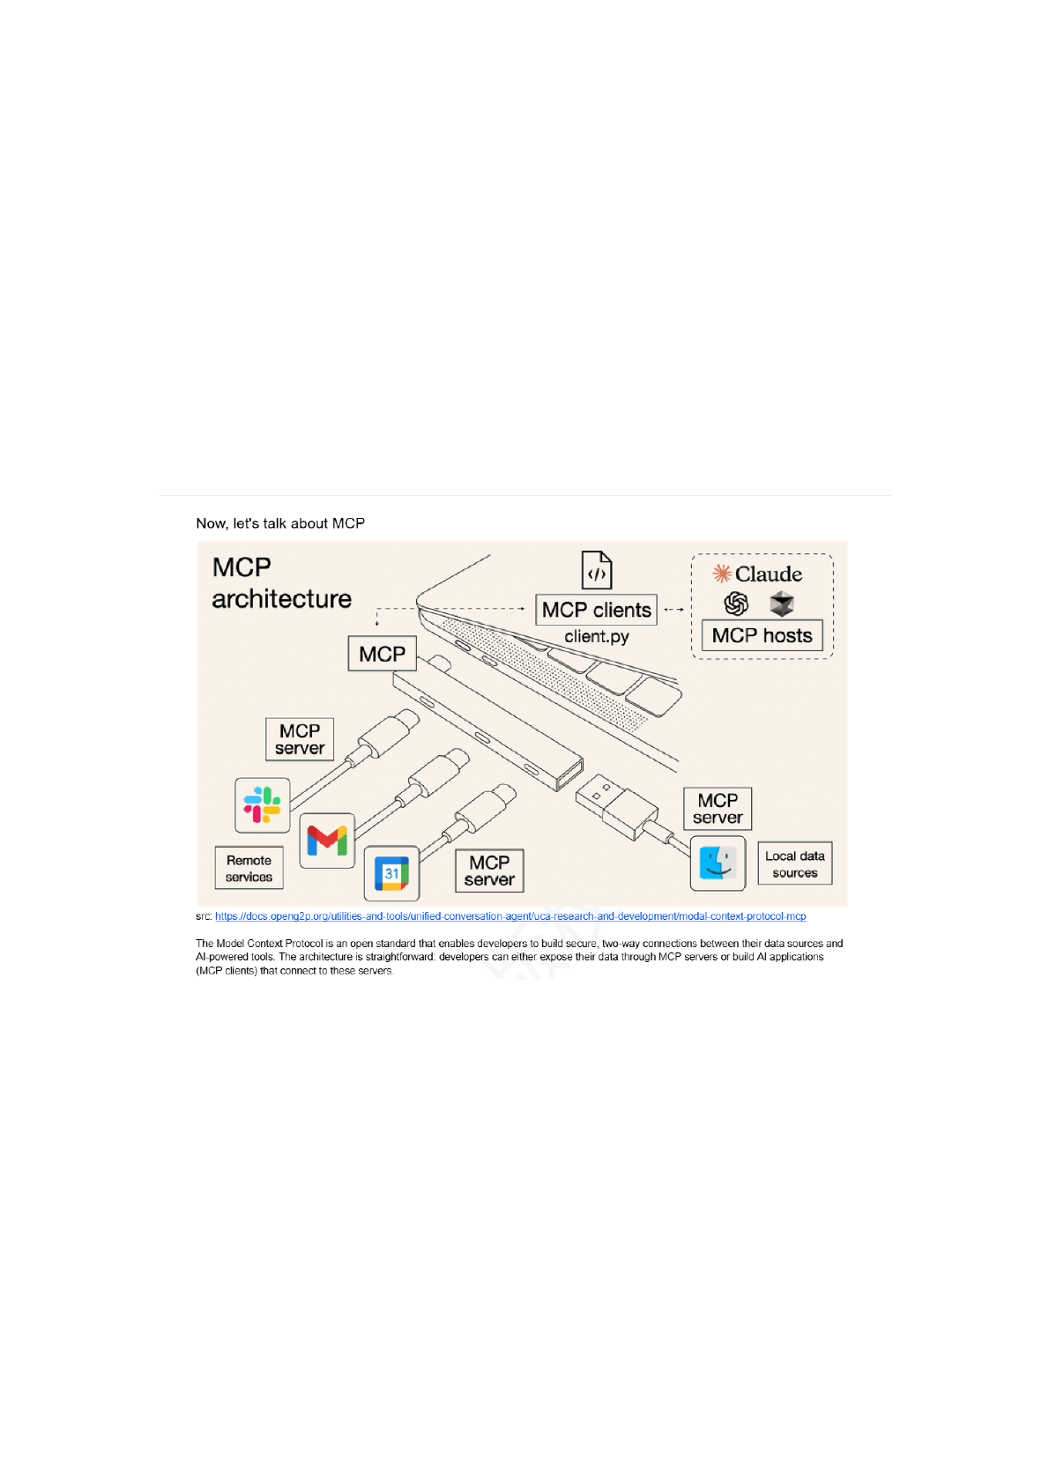
Baseline & related work
MCP as a standardized way to connect a model client to external tools and services
Approach | Strength | Main limitation | Role in this project
Direct LLM chat | Simple natural-language interface | No access to uploaded PDFs or live external context | Weak baseline
RAG on local documents | Grounded answers from PDF passages | Limited when the question needs fresh or external information | Core baseline
Agentic RAG + MCP | Grounded + tool-augmented answers with separate support | Higher system complexity and latency | Proposed method
Related ideas used in the project
LangChain for orchestration of retrieval, prompting, and model calls
MCP for standardized tool access to web search
Speech recognition and text-to-speech for multimodal interaction
This project adopts MCP to expose a search_web tool and call it from the backend chat flow.
4

Slide 5
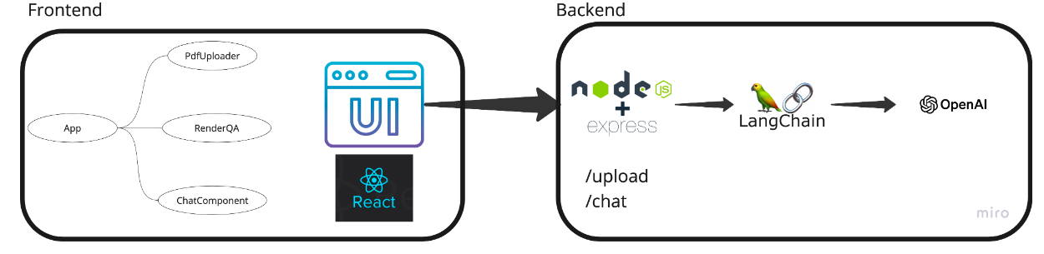
Overall system architecture
Outputs
D
RAG pipeline
A
ragAnswer
U
User ask / upload
R
React UI
E
Express backend
M
MCP search path
W
mcpAnswer
Server logic returns both answer paths so users can compare document-grounded and web-grounded responses in one conversation.
5

Slide 6
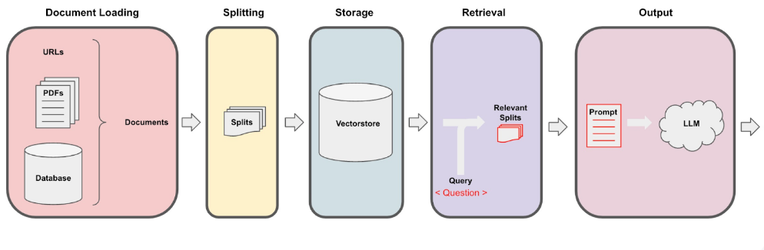
Method I: document-grounded RAG pipeline
1
Upload PDF
2
Parse & split it
3
Embed & store
4
Retrieve context
5
Generate answer
Design rationale
Retrieval grounds the answer in the uploaded file instead of asking the LLM to rely on general memory.
Chunking and embeddings make long PDFs searchable at semantic level.
The prompt asks for concise, context-aware answers.
6

Slide 7

Method II: MCP tool use + voice interaction
MCP search workflow
Voice interface
User query
MCP client
MCP server
Web snippet summary
A dedicated MCP server exposes a search_web tool backed by SerpAPI.
The chat path can call the tool, collect snippets, and summarize them with the model.
This complements or cross-checks the PDF-grounded answer when external context is useful.
Speech-to-text via react-speech-recognition
Text-to-speech via speak-tts
Supports chat mode toggling, recording, and spoken playback
7

Slide 8
Why this is more than API calling
Document ingestion
PDF upload endpoint
PDFLoader + chunking
Embeddings + vector retrieval
Standardized tool use
Dedicated MCP server
search_web tool via SerpAPI
stdio client/server transport
Full-stack UI
React upload + chat controls
Dual-answer rendering
Voice mode and loading states
Production thinking
AWS Amplify / App Runner path
NFR checklist in the project pad
Maintainability, security, usability
Key modules from the coding pad
server/chat.js
PDF retrieval + prompt-based RAG answer path
server/chat-mcp.js
MCP client that calls search_web and summarizes search results
server/mcp-server.js
MCP server that exposes the SerpAPI-backed tool
src/components/*.js
Uploader, chat controls, dual-answer renderer, and voice mode
8

Slide 9
Demo view & qualitative results
Observed interaction pattern
For one user question, the interface can show a document-grounded RAG answer and a web-grounded MCP answer side by side.
Result 1: uploaded-file specificity
The RAG path helps the system answer questions tied to the uploaded PDF instead of general background knowledge.
Result 2: external context
The MCP path can add fresh or broader context when the uploaded file alone is not enough.
Result 3: spoken loop
Voice mode allows speech input and spoken playback, making the demo feel like an interactive AI agent rather than a static web form.
Capability
Direct LLM
RAG
AgentAI
PDF-specific QA
No
Yes
Yes
Fresh web info
No
No
Yes
Voice I/O
No
No
Yes
9

Slide 10
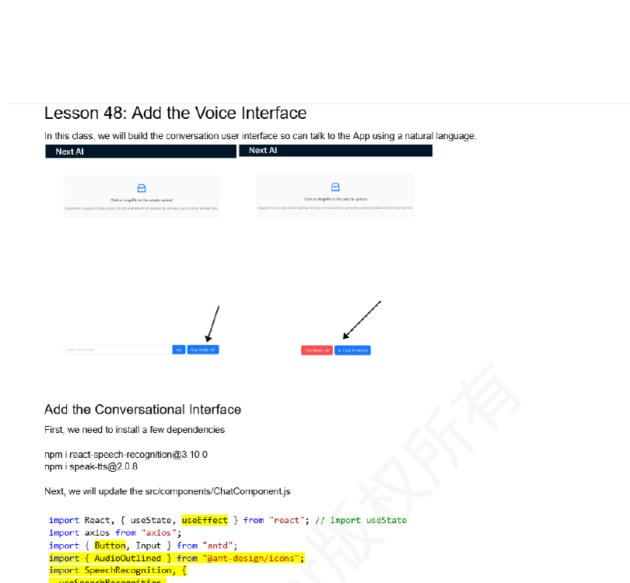
Experiments & validation
Because the project focuses on integration rather than model training, evaluation is presented as functional case studies plus baseline capability comparison.
Scenario | Baseline issue | Observed system behavior
Question about uploaded PDF | Direct LLM chat lacks access to the uploaded document | RAG path returns a grounded answer through the /chat endpoint
Need current or broader information | RAG is limited to local document context | MCP path can search the web and provide a second answer
Hands-free interaction | Text-only systems do not support spoken use | Voice mode supports STT for input and TTS for playback
Evidence from the local UI and the project record
This presentation deliberately avoids made-up quantitative numbers and instead frames the current validation honestly as implemented capability plus demo evidence.
Next evaluation step: add user-study metrics (accuracy, grounding quality, latency, and speech usability).
The experiments slide is designed to be credible: no fabricated metrics, but clear evaluation logic.
10

Slide 11
Conclusion & discussion
What worked well
Current limitations
Next-step improvements
Grounded QA over uploaded PDFs
MCP extends the system beyond closed-document retrieval
Dual-answer UI clearly separates private document and public web support
Full-stack integration, not just calling APIs
MemoryVectorStore is in-memory only
Current flow tracks a single active uploaded file
Web search is always called instead of selectively triggered
No displayed citations, auth, or rate limiting yet
Persistent vector DB and multi-document retrieval
Selective tool routing and better source citations
Cloud deployment with auth, logging, and monitoring
User feedback loop for demo and production use
End of presentation.
11

Slide 12
Appendix: implementation evidence & selected references
Backup slide for Q&A. Use only if the instructor asks for deeper technical details.
Representative code modules
Selected references / stack
server/chat.js
Loads PDF, splits into chunks, builds MemoryVectorStore, retrieves context, prompts the model.
React + Ant Design for frontend interaction design
Node.js + Express for backend service endpoints
LangChain for retrieval and prompting orchestration
OpenAI model + embeddings for generation and vectorization
Model Context Protocol (MCP) for standardized tool access
SerpAPI for Google search integration
server/server.js
Defines /upload and /chat endpoints and returns ragAnswer + mcpAnswer.
server/mcp-server.js
Registers the search_web tool backed by SerpAPI and exposes it over stdio.
server/chat-mcp.js
Keeps a reusable MCP client connection, calls search_web, and summarizes results.
Possible discussion questions
src/components/ChatComponent.js
Handles query input, voice mode, recording state, and spoken playback.
Why use MCP instead of calling search directly?
How would you scale from one PDF to many documents?
What metrics would you add in a next iteration?
src/components/PdfUploader.js + RenderQA.js
Handle file upload and dual-answer rendering in the UI.
Appendix slide: use only if needed during Q&A.
12

