Slide 1
INFINITY
Pramod kalidindi
Satish nandan reddy lakkam
Dixith kumar kurra
Chenchu Gowtham yerrapothu
Team 2-ser 502

Slide 2
AGENDA
Infinity Programming Language.
Design of the compiler and intermediate code generation.
Design of the runtime.
Demo of the language and a few examples.

Slide 3
INFINITY COMPONENTS
ANTLR Component
Scanning
Parsing
Intermediate code generation
JAVA – For Runtime

Slide 4
How Infinity Works
Compiler
Runtime
Source code indicated by .inf extension
Byte code file is indicated by .infb extension
Executable file for runtime
sourcecode.inf
sourcecode.inf.byte
Runtime

Slide 5
Supported Operations
Data Types
int- Integer type
bool- Boolean type
Assignment Operator
= - Assigns Value to a variable
Conditional Statements
< -Less than operator
> - Greater than operator
<= - Less than or equal to operator
>= - Greater than equal to operator
= - Equal to operator

Slide 6
Grammar
Our grammar was inspired from ”C”.
Our language is a list of statements.
These statements include assignment, loop, conditional statements, declaring a variable or a read statement which takes input from the user.
Our language prints both a value in a variable or can also print a string when given in parantheses.
The keyword scan takes input from the user.
Our program implements looping constructs using the while keyword and conditional constructs using the if-else keywords.

Slide 7
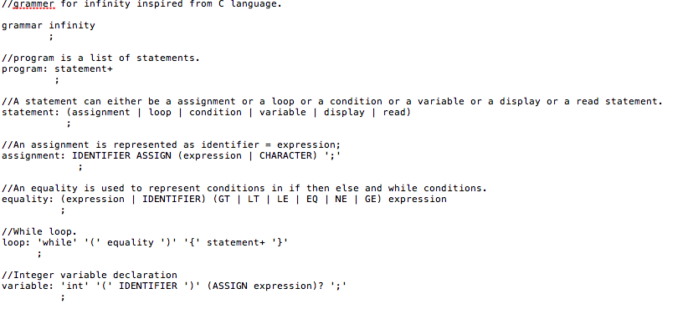
Grammar

Slide 8
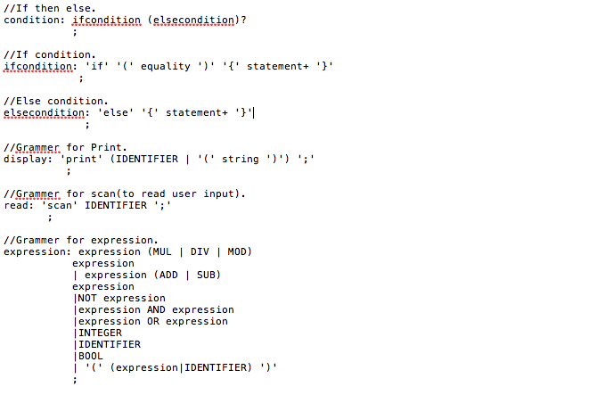
Grammar contd

Slide 9
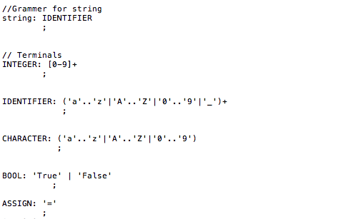
Grammar contd

Slide 10
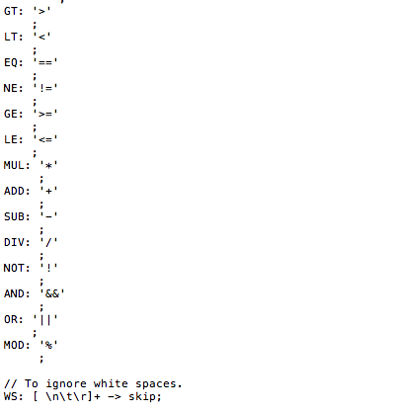
Grammar contd

Slide 11
Syntax Diagrams
Syntax diagrams (or railroad diagrams) are a way to represent a context-free-grammar. They represent a graphical alternative to Backus Naur Form or to Extended Backus Naur Form as metalanguages.

Slide 12
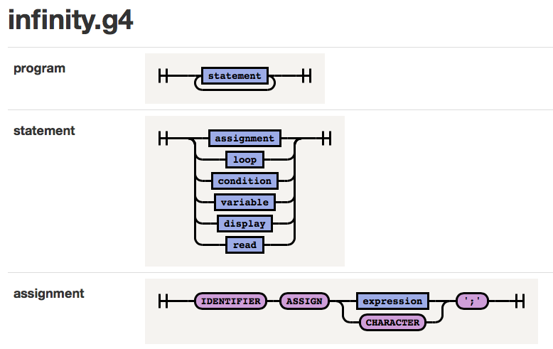
Syntax Diagrams

Slide 13
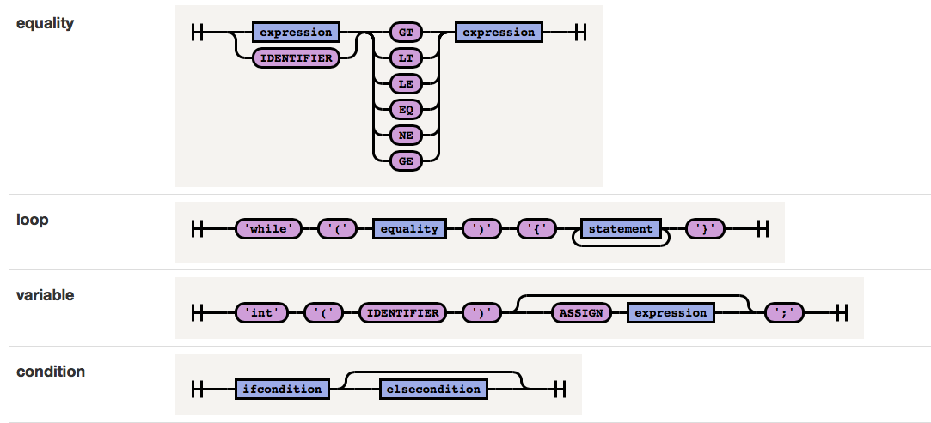
Syntax Diagrams

Slide 14
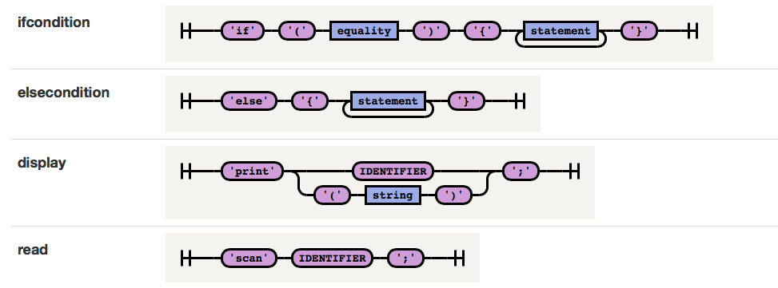
Syntax Diagrams

Slide 15
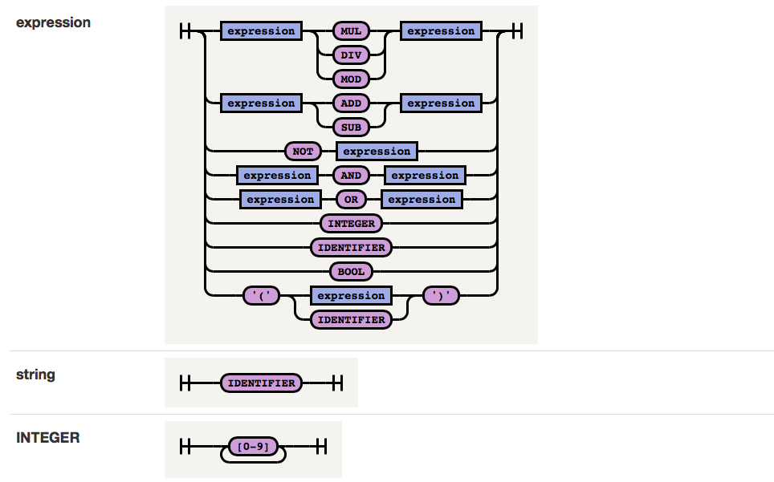
Syntax Diagrams

Slide 16
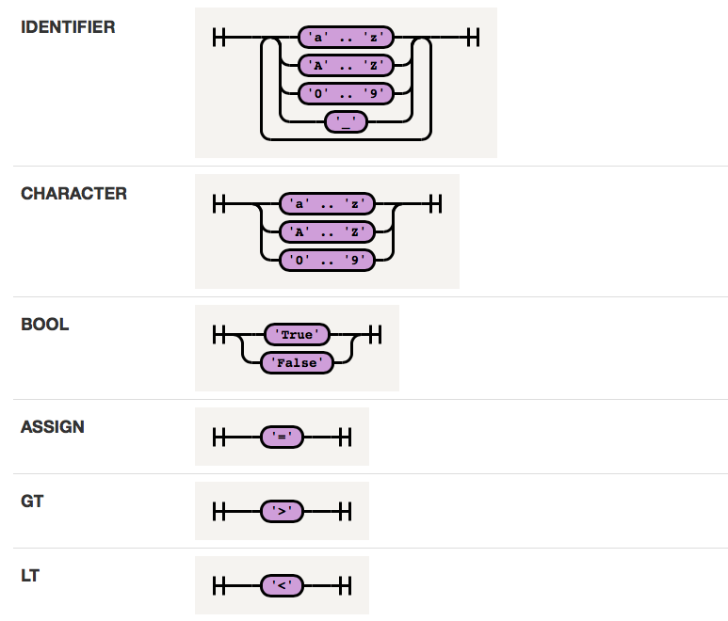
Syntax Diagrams

Slide 17
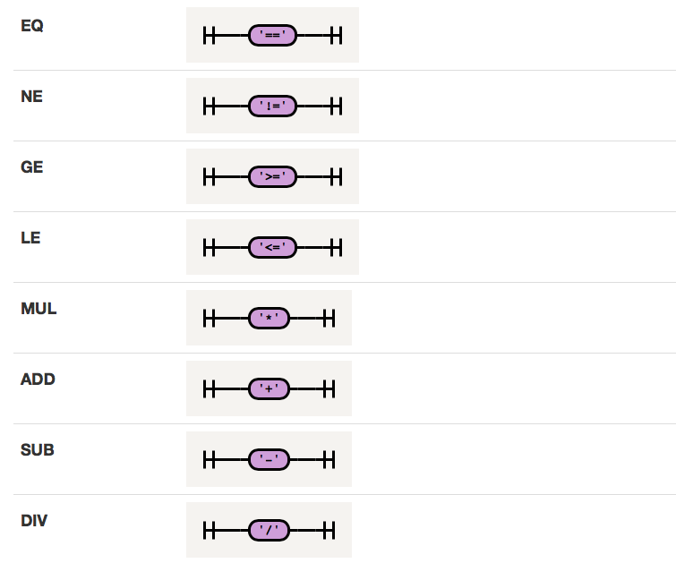
Syntax Diagrams

Slide 18
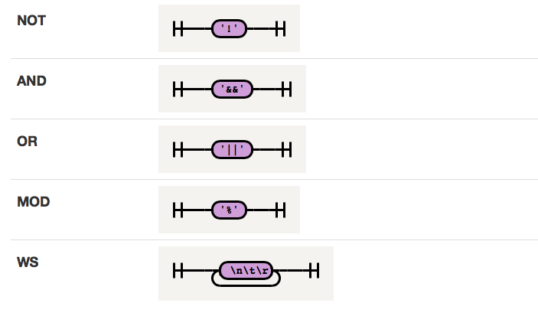
Syntax Diagrams

Slide 19
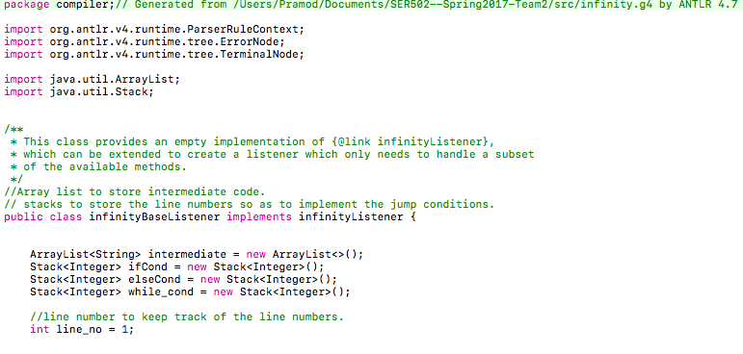
Compiler-Screenshots

Slide 20
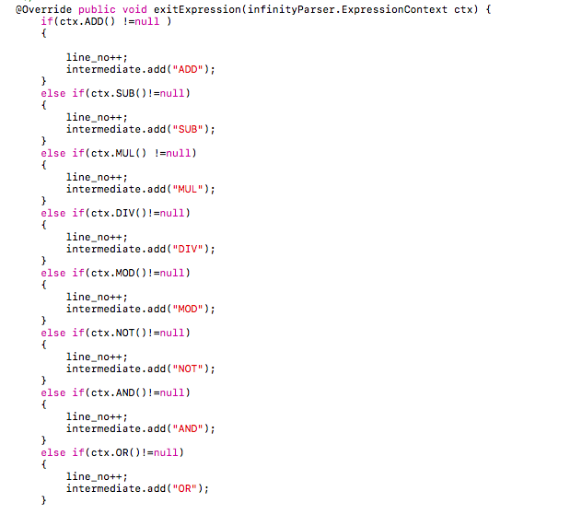
Compiler - Screenshots

Slide 21
Compiler
While walking through the parse tree in the base runner class we traverse through all the non terminals in the grammar.
At these point we use an array list and push our intermediate code into the array list and then we write it into a file.
Stacks are used to store the line numbers and then these numbers are used to implement the jump statements for if then else and while loops.
The generated intermediate code file is then passed to the run time environment to get the desired output.

Slide 22
Supported Operations
Mathematical operators
* Multiplication
- Subtraction
+ Addition
/ Division
% Modulus
Decision Constructs
If (condition) {……} else {……..}
Iterative Constructs
While (condition) {……….}

Slide 23
ANTLR V4
ANTLR (ANother Tool For Language Recognition) is a language tool that provides a frame work for constructing recognizers, Interpreters, compilers and translators from a given grammar input
It is essentially composed of three parts
Lexer
Parser
Abstract Syntax Tree (Parser)

Slide 24
ANTLR V4- Lexer and Parser
Lexer
Antlr reads a character stream and divides it into tokens using using the grammar pattern we input
The stream of tokens is then provided as output
Parser
Antlr takes the grammar token stream, generated out of lexer as an input to generate a parser
This parser is then used to generate a parse tree
Each node in the tree defines a non terminal
Abstract Syntax Tree
Each node in the tree is constructed from the source code based on the rules of the grammar input

Slide 25
Antlr Visualized
This representation shows the overall flow of Antlr Phases
Lexer
Tokens
Parser
Output
Visitor, Listener, symbol table, ancillary data structures
AST
Tree Walker

Slide 26
Infinity Runtime
implemented in Java
Follows same convention as __cdec__ calling convention
Data structures heavily used:
- Stack
- Symbol Table

Slide 27
Infinity Runtime cont..
Used cdec calling conventions for building Runtime for Infinity.
Runtime environment using Java with great importance to OOPS.
Runtime to support basic arithemtic, logical, conditional flows.
Basic error handling for incorrect byte code supplied.
Major data structures (stack, Symbol table) to support the language.

Slide 28
Some Examples
1. Fibonacci Series
Code:
int(a) = 0; int(b) = 1; int(n) = 100; int(nextTerm) =0; while(nextTerm <= n) { print nextTerm; a = b; b = nextTerm; nextTerm = a+b; }

Slide 29
The intermediate code generated for the above example
PUSH 0 STORE a PUSH 1 STORE b PUSH 100 STORE n PUSH 0 STORE nextTerm PUSH nextTerm PUSH n LESSEREQUAL TESTFGOTO 25 PUSH nextTerm PRINT PUSH b STORE a PUSH nextTerm STORE b PUSH a PUSH b ADD STORE nextTerm PUSH True TESTTGOTO 9 END

Slide 30
Another Example
2. Factorial of a number
Code:
int(x) = 5; int(fact) = 1; while(x > 1){ fact = fact * x; x = x - 1; } print fact;

Slide 31
The intermediate code generated for the above example
PUSH 5 STORE x PUSH 1 STORE fact PUSH x PUSH 1 GREATER TESTFGOTO 19 PUSH fact PUSH x MUL STORE fact PUSH x PUSH 1 SUB STORE x PUSH True TESTTGOTO 5 PUSH fact PRINT END

Slide 32
Thank you

