Slide 1
ISSO New York State
Tax Information Session
We are not tax experts, we are volunteers. If you have a complicated tax question, you may need to seek answers elsewhere!
Federal forms software: http://www.isso.cornell.edu/tax/tax.php

Slide 2
Session Summary
Review of Basic Tax Principles
State Tax Forms – tips and line-by-line information
Question/Answer Period

Slide 3
NY State Tax Filing
This session is for filing New York State forms
You should have ALREADY completed your U.S. Federal non-resident forms

Slide 4
DATES
DEADLINE for filing U.S. federal and state tax forms:
  April 15, 2013
U.S. 2012 Tax Year is:
  January 1, 2012 to December 31, 2012

Slide 5
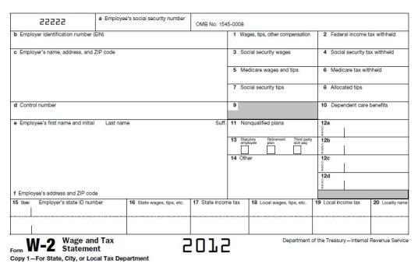
FORMS from your employer/school:
What Income Does a W-2 Report?
The W-2 reports wages (including the stipend portion of teaching assistantships) paid to employees (box 1).
It also reports the amount of federal and state taxes withheld by your employer (box 2) and paid to the IRS and State tax authority (box 17).

Slide 6
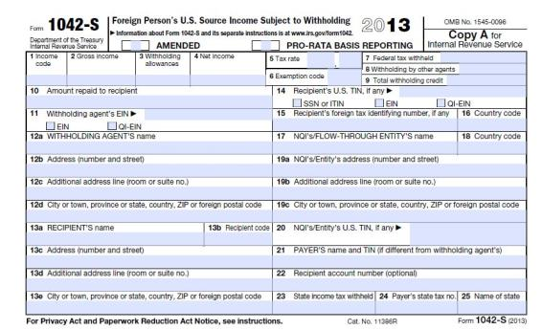
FORMS from your employer/school:
What Does a 1042S Report?
“non-wage” portions of scholarships, fellowships, grants, awards and any other payment made to an individual who is NOT an employee.
Income exempted from tax due to an income tax treaty
Note: “non-wage” refers to income received for which no service or work was provided, like a travel grant or fellowship.
Notes:
Income codes on the form define the nature of the income. Those that generally apply to students and scholars are:
15 = Scholarship, fellowship, grant
18 = Compensation for Teaching or Research
19 = Compensation during study or training
The “Exemption Code” (box 6) tells you why the income was exempt from tax

Slide 7
FORMS:
Other Forms You may have received
You also might have received:
1099-INT: For interest on a income producing bank account (not personal savings)
1098-T: Reporting tuition you paid

Slide 8
FORMS: A Note about the 1098-T
The 1098-T form is a tax document that reports to the student (and the IRS) tuition charges and financial aid for a calendar year.
The 1098-T is used by U.S. residents to claim educational credits such as the Hope Credit or Life Time Learning Credit. Unfortunately, any international who is filing tax returns as a NON-resident for U.S. federal tax purposes is NOT eligible for any of these educational credits.
THEREFORE: Internationals filing U.S. federal taxes as Non-Residents should IGNORE the 1098-T form when filing U.S. tax returns.
The parents of Canadian undergraduates MIGHT be able to use the 1098-T when filing Canadian taxes.

Slide 9
Other Forms
Report of State Tax refund:
1099-G: the state no longer sends out the form reporting your past year’s refund, so to get that information, you can:
get your form online,* using our 1099-G online service, which will be available in late January
call (518) 457-5181 (income taxpayers) or (518) 485-2392 (MCTMT taxpayers)

Slide 10
NY State Tax Status

Slide 11
NY State Tax Status
First, determine if you are a
RESIDENT or
NON-RESIDENT
for tax purposes in New York State. (This is not the same as your tax status for the U.S. federal tax forms.)

Slide 12
NY State Tax Status:
Undergraduates
Undergraduate students, whose permanent home is not New York, are considered NYS nonresidents for income tax purposes.

Slide 13
NY State Tax Status:
F-1 or J-1 Graduate Students and J-1 Researchers
Did you rent an apartment (not a dorm room) in New York State for 11 months or more of the year 2012?
  [NOTE: if you sublease your apartment but you still held the lease, this still counts as renting the apartment]
Did you spend more than 183 total days in New York state in 2012?
If you answered YES to BOTH of these questions, you are considered a resident for tax purposes in New York State. If you answered NO to either one of these questions, you are a nonresident for tax purposes in New York State.

Slide 14
NY State Tax Filing:
NON-resident
IF you are a NON-resident for New York State Tax purposes, then you are only required to file NY State forms IF:
  You want a refund for NY state tax withheld
  OR, received more than $7500 in 2012 and some of that income was from a New York source
If the above do NOT apply to you, you are NOT REQUIRED to file a New York State tax return!

Slide 15
NY State Tax Filing:
RESIDENT
IF you are a RESIDENT for New York State Tax purposes, then you are only required to file NY State forms IF:
  You want a refund for NY state tax withheld
  OR, received more than $4000 in 2012 and some of that income was from a New York source
If the above do NOT apply to you, you are NOT REQUIRED to file a New York State tax return!

Slide 16
General NYS Income Tax Filing Guidelines

Slide 17
NYS Conforms with Internal Revenue Service
Your Federal (IRS) Adjusted Gross Income is the starting point in computing your New York State income tax. The amount you include as income on the federal income tax return is transferred to the NYS income tax return.
New York State-source income for nonresidents is your Federal Income that you earned in New York State.
New York State income for residents is the TOTAL Federal Income that you earned.
  Note: If you earned income in any other state in the U.S., please consult that state for income tax filing requirements.
New York State (NYS) complies with ALL tax treaties that the Internal Revenue Service uses.

Slide 18
NOTEs on Treaty Exempt Income
If all of your income was exempt by treaty AND it was reported to you by Cornell on a 1042-S, then you do NOT have to file NEW YORK State tax forms at all
If all of your income was exempt by treaty (Glacier Tax Prep would show this on your federal form), but Cornell reported that income to you on a W-2, then you should file the New York State forms (instructions will follow)
If you have a mixture of some income exempt by treaty and some not, then you should fill in the New York State forms

Slide 19
Filing Status Guidelines
If you checked “single” on your federal (IRS) income tax return and are required to file a NYS income tax return, you MUST check “single” as your filing status on your NYS income tax return.
If you are married and filing federal Forms 1040-NR or 1040-NR-EZ, you must check “married filing separately” as your filing status on your NYS income tax return.
NOTE: Special rules apply for same sex married couples.

Slide 20
General Guidelines
Unlike the federal (IRS) income tax return, NO PERSONAL EXEMPTION is allowed for you or your spouse on the NYS income tax return.
You are allowed the SAME number of DEPENDENT EXEMPTIONS as claimed on your federal (IRS) income tax return. The New York Dependent Exemption is $1000.
You are not allowed to take any itemized deductions on the New York state form that you were not allowed to take on the federal form (e.g. moving expenses).

Slide 21
General Guidelines
Unlike the federal (IRS) income tax return, EVERYONE filing a NYS income tax return may claim a New York STANDARD DEDUCTION.
New General Guidelines
  Whole dollar amounts required on income tax forms - For tax years 2012 and after, taxpayers must enter whole dollar amounts on income tax forms (ie. no cents).
  Additional account information required on Form IT-201 - For direct deposit or electronic funds withdrawal, taxpayers must now designate whether the checking or savings account is a personal or business account.

Slide 22
NYS 2012 Standard Deduction Amount
General Guidelines
Unlike the federal (IRS) income tax return, EVERYONE filing a NYS income tax return may claim a New York STANDARD DEDUCTION.
Filing Status
Standard Deduction
Single
$7,500
Married Filing Separately
$7,500

Slide 23
New York State and Local Sales and Use Tax
You owe a sales and use tax if:
You purchase property or a service delivered to YOU in New York State without payment of sales and use tax (Ex. Internet, catalog purchases).
Most tangible personal property such as clothing, jewelry, furniture, computers, videos, etc. is subject to New York and Local Sales tax.
If you do not owe New York State sales and use tax, enter a ZERO on the sales tax line. DO NOT leave the line blank.

Slide 24
Who is entitled to a NYS household credit?
Individuals who:
Cannot be claimed on another person’s federal income tax return AND
Whose tax filing status and income on the NYS income tax return (either as a New York resident or nonresident):
  Single and federal adjusted gross income is $28,000 or less
  Married and federal adjusted gross income is $32,000 or less
The household credit is NOT refundable and will only reduce your NYS tax.
See instructions booklet for household credit chart.

Slide 25
New York State
Tax Filing
Notes:
Income codes on the form define the nature of the income. Those that generally apply to students and scholars are:
15 = Scholarship, fellowship, grant
18 = Compensation for Teaching or Research
19 = Compensation during study or training
The “Exemption Code” (box 6) tells you why the income was exempt from tax

Slide 26
New York State Tax Forms
Resident:
IT-201
NON-Resident:
IT-203
IT-203-B
Notes:
Income codes on the form define the nature of the income. Those that generally apply to students and scholars are:
15 = Scholarship, fellowship, grant
18 = Compensation for Teaching or Research
19 = Compensation during study or training
The “Exemption Code” (box 6) tells you why the income was exempt from tax

Slide 27
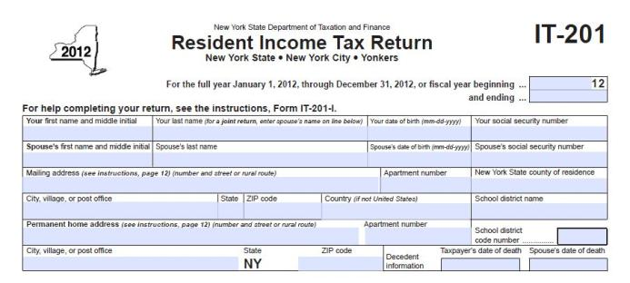
NYS Tax –IT-201 and IT-203
If you do NOT have a social security number, and you also do NOT have an ITIN, but when you filed your federal form, you filed a W-7 to apply for ITIN, write “ITIN Pending” in the social security box.

Slide 28

NYS Tax – Form IT-201
On the IT-201, you do need to fill in the county and school:
If you live in Ithaca, county of residence is Tompkins, School district name is Ithaca and the code number is 305. If you live elsewhere, look at the instruction booklet, page 44

Slide 29
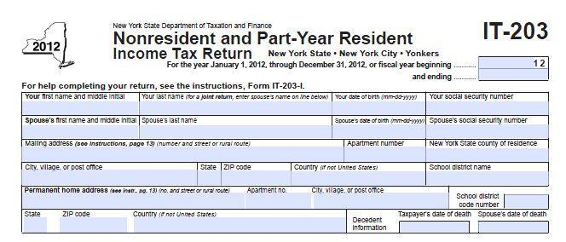
NYS Tax – Form IT-203
LEAVE BLANK
On the IT-203, you do NOT need to fill in county of residence and school district– leave blank

Slide 30
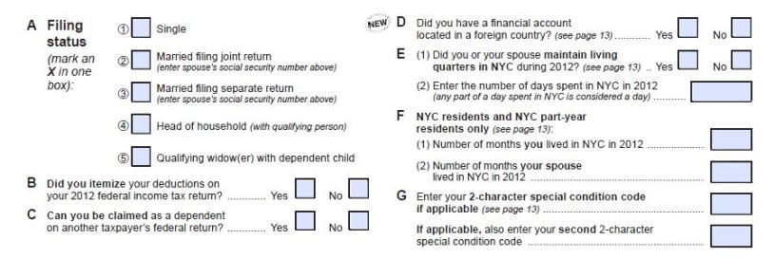
IT-201 and IT-203, Lines A-D
IT-201
Line A: You may ONLY choose either filing status 1 “single” or 3 “married filing separately”
Line B: Answer “yes” ONLY if the software allowed you to itemize deductions on your federal return (line 11 on 1040NRez OR line 35 on 1040NR)
Notes:
Income codes on the form define the nature of the income. Those that generally apply to students and scholars are:
15 = Scholarship, fellowship, grant
18 = Compensation for Teaching or Research
19 = Compensation during study or training
The “Exemption Code” (box 6) tells you why the income was exempt from tax

Slide 31
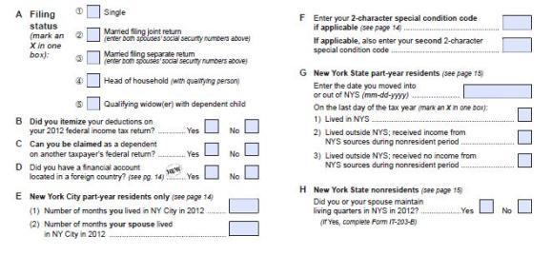
IT-201 and IT-203, Lines A-D
IT-203
Line C: For any internationals who are NON-residents for U.S. tax purposes, the answer should be “No”
Notes:
Income codes on the form define the nature of the income. Those that generally apply to students and scholars are:
15 = Scholarship, fellowship, grant
18 = Compensation for Teaching or Research
19 = Compensation during study or training
The “Exemption Code” (box 6) tells you why the income was exempt from tax

Slide 32
IT-201 and IT-203, Lines A-D
IT-203
  Line D: MOST internationals filing as non-residents for federal tax purposes should check “NO.” Check “yes” ONLY if you are carrying on a trade or business and are required to complete federal schedule B.
Notes:
Income codes on the form define the nature of the income. Those that generally apply to students and scholars are:
15 = Scholarship, fellowship, grant
18 = Compensation for Teaching or Research
19 = Compensation during study or training
The “Exemption Code” (box 6) tells you why the income was exempt from tax

Slide 33
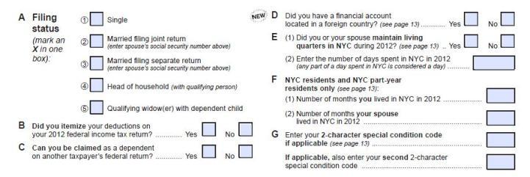
Page 1, IT-201 Lines E-G
IT-201
Line E: Complete only if you lived in New York City part of the year.
Line F: Complete only if you lived in New York City part of the year.
Line G: leave blank
Notes:
Income codes on the form define the nature of the income. Those that generally apply to students and scholars are:
15 = Scholarship, fellowship, grant
18 = Compensation for Teaching or Research
19 = Compensation during study or training
The “Exemption Code” (box 6) tells you why the income was exempt from tax

Slide 34
Page 1, IT-203 Lines E-G
IT-203
Line E: Complete this only if you lived part of the year in New York City.
Line F and G: leave blank.
Notes:
Income codes on the form define the nature of the income. Those that generally apply to students and scholars are:
15 = Scholarship, fellowship, grant
18 = Compensation for Teaching or Research
19 = Compensation during study or training
The “Exemption Code” (box 6) tells you why the income was exempt from tax

Slide 35
Page 1, IT-203 Line H
IT-203
Line H: Check “Yes” and fill out IT-203-B.
We will show the IT-203 later in this powerpoint
Notes:
Income codes on the form define the nature of the income. Those that generally apply to students and scholars are:
15 = Scholarship, fellowship, grant
18 = Compensation for Teaching or Research
19 = Compensation during study or training
The “Exemption Code” (box 6) tells you why the income was exempt from tax

Slide 36
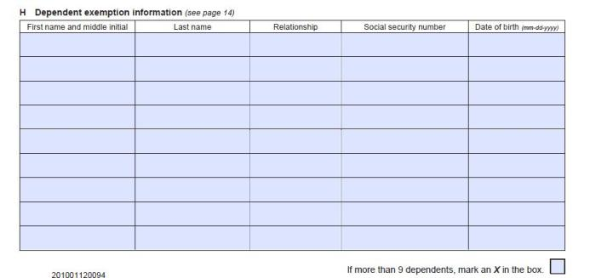
IT-201 Line H, IT-203 line I
IT-201
IT-201 Line H, IT-203 Line I: Dependent exemption information. ONLY fill this in if the GTP software allowed you to include dependents on your federal form—citizens of very few countries are allowed to claim dependents.
Notes:
Income codes on the form define the nature of the income. Those that generally apply to students and scholars are:
15 = Scholarship, fellowship, grant
18 = Compensation for Teaching or Research
19 = Compensation during study or training
The “Exemption Code” (box 6) tells you why the income was exempt from tax

Slide 37
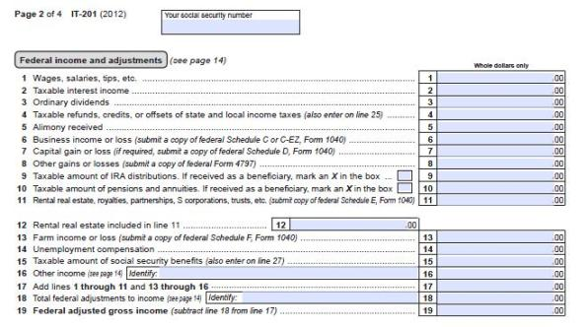
Line by Line instructions
IT-201
USE whole dollar amounts ONLY on your form.
We will go through the lines that need to have an amount entered… if the line is not relevant to you at all, you can leave it blank!
Notes:
Income codes on the form define the nature of the income. Those that generally apply to students and scholars are:
15 = Scholarship, fellowship, grant
18 = Compensation for Teaching or Research
19 = Compensation during study or training
The “Exemption Code” (box 6) tells you why the income was exempt from tax

Slide 38
Page 2, IT-201
IT-201
USE whole dollar amounts ONLY on your form.
LINE 1: Report wages from the wage line on your 1040NR line 8, or 1040NR-EZ line 3
LINE 4: If you reported your last year state refund on the federal form, enter it on line 4 (1040NR line 11; 1040NR-EZ line 4)
Notes:
Income codes on the form define the nature of the income. Those that generally apply to students and scholars are:
15 = Scholarship, fellowship, grant
18 = Compensation for Teaching or Research
19 = Compensation during study or training
The “Exemption Code” (box 6) tells you why the income was exempt from tax

Slide 39
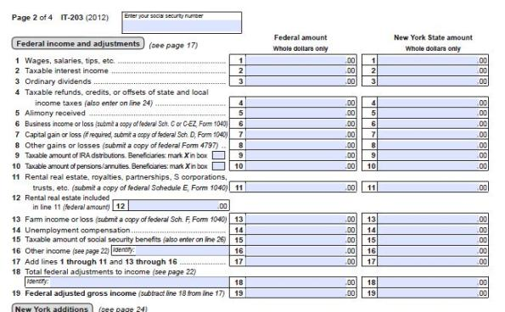
FORM IT-203 page 2
Two columns: federal and NY STATE
Federal uses numbers from federal form
New York State ONLY different if earned income in a different state

Slide 40

Page 2, IT-203
IT-203
USE whole dollar amounts ONLY on your form.
LINE 1: Report wages from the wage line on your 1040NR line 8, or 1040NR-EZ line 3
LINE 4: If you reported your last year state refund on the federal form, enter it on line 4 (1040NR line 11; 1040NR-EZ line 4)
Notes:
Income codes on the form define the nature of the income. Those that generally apply to students and scholars are:
15 = Scholarship, fellowship, grant
18 = Compensation for Teaching or Research
19 = Compensation during study or training
The “Exemption Code” (box 6) tells you why the income was exempt from tax

Slide 41

IT-201 & IT-203,
LINE 16 “other income”
IT-201
LINE 16 “other income”: Scholarships, fellowships and grants should be reported on Line 16.
Any treaty exempt income that is reported on a 1042-S should be included on Line 16
Treaty exempt income that was incorrectly included on your W-2 as taxable wage income, should also be included on line 16. (from federal form 1040NR-EZ line 6, or 1040NR line 22). In this situation, also send in a copy of your federal tax return with your state return.
Notes:
Income codes on the form define the nature of the income. Those that generally apply to students and scholars are:
15 = Scholarship, fellowship, grant
18 = Compensation for Teaching or Research
19 = Compensation during study or training
The “Exemption Code” (box 6) tells you why the income was exempt from tax

Slide 42
IT-201 & IT-203,
LINE 17 –total lines 1-16
IT-201
LINE 17: Add lines 1-11 and 13-16
Notes:
Income codes on the form define the nature of the income. Those that generally apply to students and scholars are:
15 = Scholarship, fellowship, grant
18 = Compensation for Teaching or Research
19 = Compensation during study or training
The “Exemption Code” (box 6) tells you why the income was exempt from tax

Slide 43
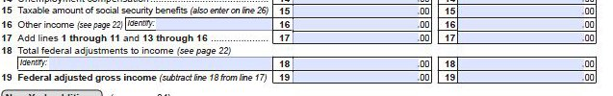
IT-201 / IT-203, LINE 18
“total federal adjustments to income”
IT-203
LINE 18 “total federal adjustments to income”:
include income exempt by treaty (from federal form 1040NR-EZ line 6, or 1040NR line 22)
Include any deductions the federal software allowed you to take on lines 6, 8 or 9 on 1040NR-EZ or lines 24-34 of the 1040NR (such as deductions for books or student loan interest)
Notes:
Income codes on the form define the nature of the income. Those that generally apply to students and scholars are:
15 = Scholarship, fellowship, grant
18 = Compensation for Teaching or Research
19 = Compensation during study or training
The “Exemption Code” (box 6) tells you why the income was exempt from tax

Slide 44
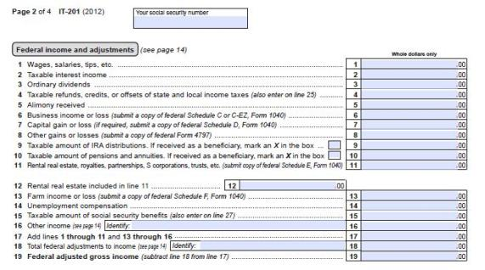
IT-201 & IT-203, line 19
IT-201
Line 19 of IT-201 & IT-203 should equal the federal adjusted gross income on Form 1040NR-EZ line 10 or 1040NR line 36.
Notes:
Income codes on the form define the nature of the income. Those that generally apply to students and scholars are:
15 = Scholarship, fellowship, grant
18 = Compensation for Teaching or Research
19 = Compensation during study or training
The “Exemption Code” (box 6) tells you why the income was exempt from tax

Slide 45
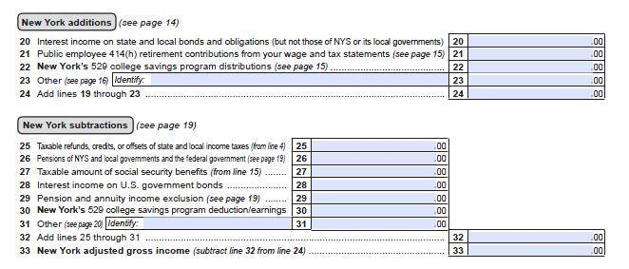
Page 2, IT-201
IT-201
Line 24, same amount as line 19
Line 25, if you entered your previous year NY state tax refund on line 4, enter that amount again here and on line 32
Line 33, subtract line 32 from line 24—this is your NY State adjusted gross income
Notes:
Income codes on the form define the nature of the income. Those that generally apply to students and scholars are:
15 = Scholarship, fellowship, grant
18 = Compensation for Teaching or Research
19 = Compensation during study or training
The “Exemption Code” (box 6) tells you why the income was exempt from tax

Slide 46
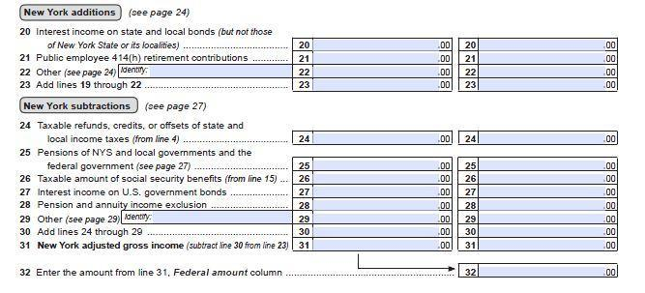
Page 2, IT-203
IT-203
Line 23, same amount as line 19
Line 24, if you entered your previous year NY state tax refund on line 4, enter that amount again here and on line 30
Line 31, subtract line 30 from line 23—this is your NY State adjusted gross income
Line 32, repeat the federal column line 31
Notes:
Income codes on the form define the nature of the income. Those that generally apply to students and scholars are:
15 = Scholarship, fellowship, grant
18 = Compensation for Teaching or Research
19 = Compensation during study or training
The “Exemption Code” (box 6) tells you why the income was exempt from tax

Slide 47
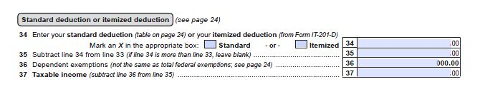
Page 2, IT-201
IT-201
Line 34: enter standard deduction = $7500
Line 35: subtract line 34 from line 33
Line 36, dependent exemptions – from Line H – internationals can NOT take personal exemptions for self or spouse; for NON-residents for U.S. federal tax purposes, only citizens of canada, mexico or south korea can claim dependent children (page 24 of instructions)
Line 37, subtract line 36 from line 35—this is your taxable income for NY State
Notes:
Income codes on the form define the nature of the income. Those that generally apply to students and scholars are:
15 = Scholarship, fellowship, grant
18 = Compensation for Teaching or Research
19 = Compensation during study or training
The “Exemption Code” (box 6) tells you why the income was exempt from tax

Slide 48
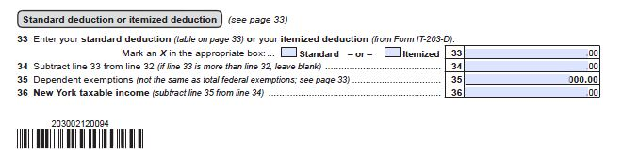
Page 2, IT-203
IT-203
Line 33, enter standard deduction = $7500
Line 34, subtract line 33 from line 32 (do not enter less than 0)
Line 35, dependent exemptions – from Line I – internationals can NOT take personal exemptions for self or spouse; for NON-residents for U.S. federal tax purposes, only citizens of canada, mexico or south korea can claim dependent children (page 33 of instructions)
Line 36, subtract line 35 from line 34 (do not enter less than 0) — this is your taxable income for NY State
Notes:
Income codes on the form define the nature of the income. Those that generally apply to students and scholars are:
15 = Scholarship, fellowship, grant
18 = Compensation for Teaching or Research
19 = Compensation during study or training
The “Exemption Code” (box 6) tells you why the income was exempt from tax

Slide 49
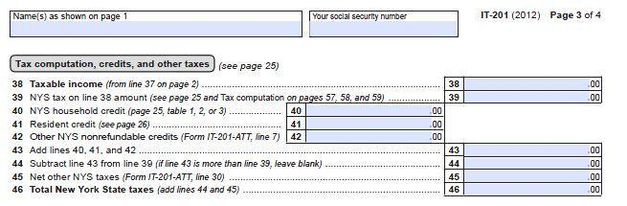
Page 3, IT-201
IT-201
Line 38, repeat amount from line 37
Line 39: Figure the tax on your taxable income from the tax table (instructions page 48).
Notes:
Income codes on the form define the nature of the income. Those that generally apply to students and scholars are:
15 = Scholarship, fellowship, grant
18 = Compensation for Teaching or Research
19 = Compensation during study or training
The “Exemption Code” (box 6) tells you why the income was exempt from tax

Slide 50
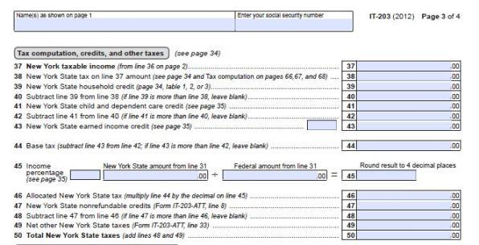
Page 3, IT-203
IT-203
Line 37, repeat amount from line 36
Line 38: Figure the tax on your taxable income from the tax table (instructions page 57).
Line 39: Household credit—most people CAN take this (instructions page 34).
Line 40: subtract line 39 from line 38
Line 44: same as line 40
Notes:
Income codes on the form define the nature of the income. Those that generally apply to students and scholars are:
15 = Scholarship, fellowship, grant
18 = Compensation for Teaching or Research
19 = Compensation during study or training
The “Exemption Code” (box 6) tells you why the income was exempt from tax

Slide 51
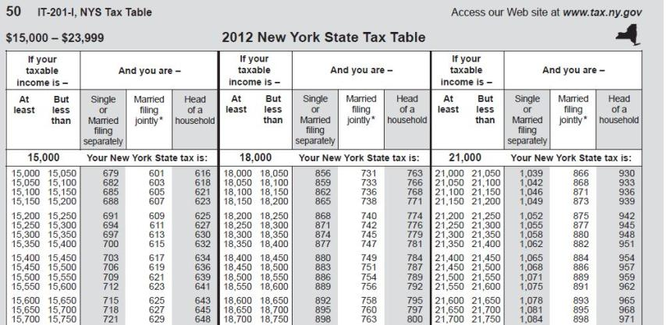
New York State Tax table
(pages 48-55 in the IT-201 instructions; pages 57-64 in the IT-203 instructions)

Slide 52
New York State Tax table
Find your income range and the tax on that, enter that amount on IT-201 line 39 or IT-203 line 38

Slide 53
Page 3, IT-201
IT-201
Line 40: Household credit—most people CAN take this (instructions page 25), enter here and line 43.
Notes:
Income codes on the form define the nature of the income. Those that generally apply to students and scholars are:
15 = Scholarship, fellowship, grant
18 = Compensation for Teaching or Research
19 = Compensation during study or training
The “Exemption Code” (box 6) tells you why the income was exempt from tax

Slide 54
Page 3, IT-203
IT-203
Line 39: Household credit—most people CAN take this (instructions page 34).
Notes:
Income codes on the form define the nature of the income. Those that generally apply to students and scholars are:
15 = Scholarship, fellowship, grant
18 = Compensation for Teaching or Research
19 = Compensation during study or training
The “Exemption Code” (box 6) tells you why the income was exempt from tax

Slide 55
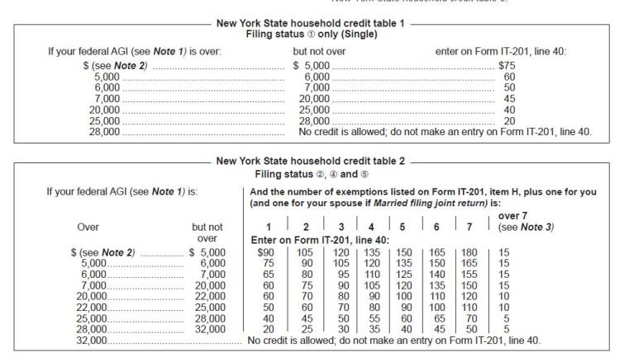
Household Credit
Find your income range and the household credit for that, enter that amount on IT-201 line 40 or IT-203 line 39
On the married table, use column “1” even if you had 0 exemptions

Slide 56
Page 3, IT-201
IT-201
Line 43: repeat the household credit amount
Line 44: subtract line 43 from line 39
Line 46: same as line 44
Notes:
Income codes on the form define the nature of the income. Those that generally apply to students and scholars are:
15 = Scholarship, fellowship, grant
18 = Compensation for Teaching or Research
19 = Compensation during study or training
The “Exemption Code” (box 6) tells you why the income was exempt from tax

Slide 57
Page 3, IT-203
IT-203
Line 40: subtract line 39 from line 38
Line 44: same as line 40
Notes:
Income codes on the form define the nature of the income. Those that generally apply to students and scholars are:
15 = Scholarship, fellowship, grant
18 = Compensation for Teaching or Research
19 = Compensation during study or training
The “Exemption Code” (box 6) tells you why the income was exempt from tax

Slide 58
Page 3, IT-203
IT-203
Line 45: If you only received income from a New York State source, Line 45 will equal 1.
If part of your income was from outside of NY, this will be less than 1.
Line 46: multiply line 44 by line 45
Line 48 and line 50: same as 46
Notes:
Income codes on the form define the nature of the income. Those that generally apply to students and scholars are:
15 = Scholarship, fellowship, grant
18 = Compensation for Teaching or Research
19 = Compensation during study or training
The “Exemption Code” (box 6) tells you why the income was exempt from tax

Slide 59
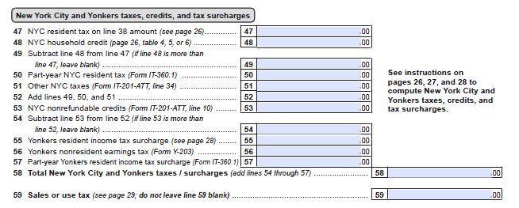
Page 3, IT-201
IT-201
Line 47-58: complete this only if you worked in New York City
Line 59: Sales and Use Tax (instructions page 29):
MUST ENTER SOMETHING-- CAN be “0” OR….
    Income up to 15,000: $8.
    Income 15,000 – 30,000: $16
    Income 30,000 – 50,000: $27
Notes:
Income codes on the form define the nature of the income. Those that generally apply to students and scholars are:
15 = Scholarship, fellowship, grant
18 = Compensation for Teaching or Research
19 = Compensation during study or training
The “Exemption Code” (box 6) tells you why the income was exempt from tax

Slide 60
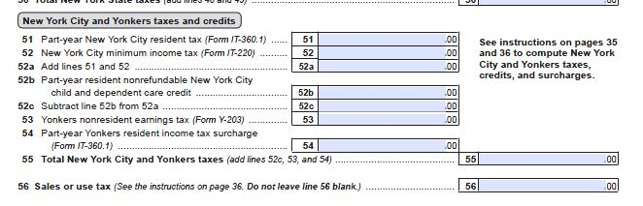
Page 3, IT-203
IT-203
Line 51-55: complete this only if you worked in New York City
Line 56: Sales and Use Tax (instructions page 36):
MUST ENTER SOMETHING--CAN be “0” OR….
    Income up to 15,000: $8.
    Income 15,000 – 30,000: $16
    Income 30,000 – 50,000: $27
Notes:
Income codes on the form define the nature of the income. Those that generally apply to students and scholars are:
15 = Scholarship, fellowship, grant
18 = Compensation for Teaching or Research
19 = Compensation during study or training
The “Exemption Code” (box 6) tells you why the income was exempt from tax

Slide 61
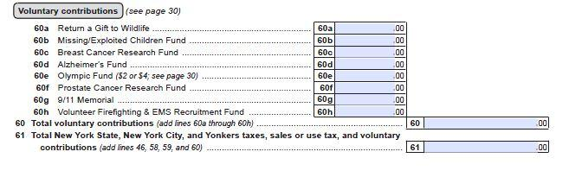
Page 3, IT-201
IT-201
Line 60: Totally “voluntary”
Line 61: Total of all your NY State taxes
Notes:
Income codes on the form define the nature of the income. Those that generally apply to students and scholars are:
15 = Scholarship, fellowship, grant
18 = Compensation for Teaching or Research
19 = Compensation during study or training
The “Exemption Code” (box 6) tells you why the income was exempt from tax

Slide 62
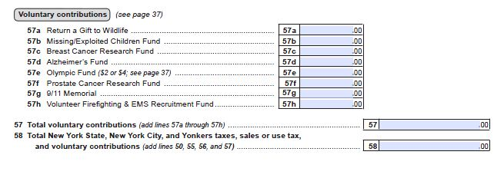
Page 3, IT-203
IT-203
Line 57: Totally “voluntary”
Line 58: Total of all your NY State taxes
Notes:
Income codes on the form define the nature of the income. Those that generally apply to students and scholars are:
15 = Scholarship, fellowship, grant
18 = Compensation for Teaching or Research
19 = Compensation during study or training
The “Exemption Code” (box 6) tells you why the income was exempt from tax

Slide 63
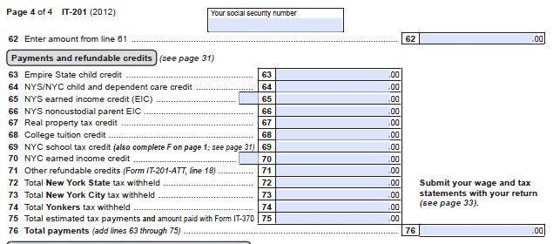
Page 4, IT-201
IT-201
line 62: Same as line 61 from the previous page
line 68: if you are a NON-resident for U.S. federal tax purposes, you can NOT take this tuition credit
line 72: NY State taxes withheld (W-2 box 17; 1042-S box 23)
Line 73: only if you worked in NY City
Line 76: total of lines 63-75
Notes:
Income codes on the form define the nature of the income. Those that generally apply to students and scholars are:
15 = Scholarship, fellowship, grant
18 = Compensation for Teaching or Research
19 = Compensation during study or training
The “Exemption Code” (box 6) tells you why the income was exempt from tax

Slide 64
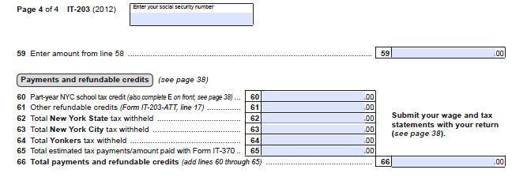
Page 4, IT-203
IT-203
line 59: Same as line 58 from the previous page
line 62: NY State taxes withheld (W-2 box 17; 1042-S box 23)
Line 63: only if you worked in NY City
Line 66: total of lines 60-65
Notes:
Income codes on the form define the nature of the income. Those that generally apply to students and scholars are:
15 = Scholarship, fellowship, grant
18 = Compensation for Teaching or Research
19 = Compensation during study or training
The “Exemption Code” (box 6) tells you why the income was exempt from tax

Slide 65
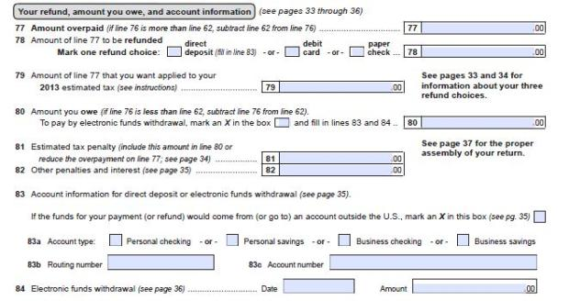
Page 4, IT-201
IT-201
line 77: If line 76 is more than 62, subtract 62 from 76
line 78: Enter amount from 77—this is your REFUND
line 80: If line 76 is less than 62, subtract 76 from 62, this is the amount you OWE
Line 83-84: account information if you want them to use it—leave it blank if you do NOT want them to
Notes:
Income codes on the form define the nature of the income. Those that generally apply to students and scholars are:
15 = Scholarship, fellowship, grant
18 = Compensation for Teaching or Research
19 = Compensation during study or training
The “Exemption Code” (box 6) tells you why the income was exempt from tax

Slide 66
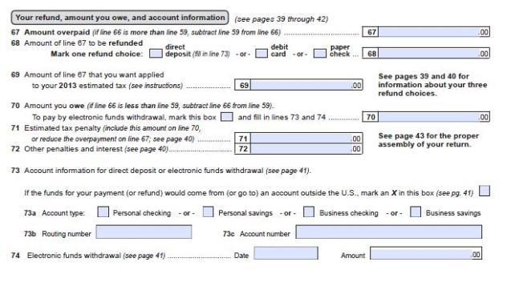
Page 4, IT-203
IT-203
line 67: If line 66 is > line 59, subtract line 59 from line 66
line 68: Enter amount from 67—this is your REFUND
line 70: If line 66 is < line 59, subtract line 66 from line 59, this is the amount you OWE
Line 73-74: account information if you want them to use it—leave it blank if you do NOT want them to
Notes:
Income codes on the form define the nature of the income. Those that generally apply to students and scholars are:
15 = Scholarship, fellowship, grant
18 = Compensation for Teaching or Research
19 = Compensation during study or training
The “Exemption Code” (box 6) tells you why the income was exempt from tax

Slide 67
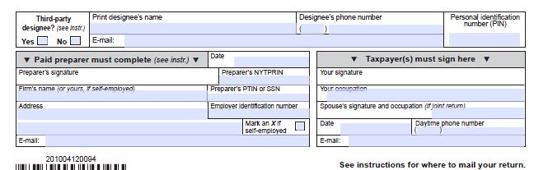
FORM IT-201 & IT-203
SIGN YOUR FORM!!!

Slide 68
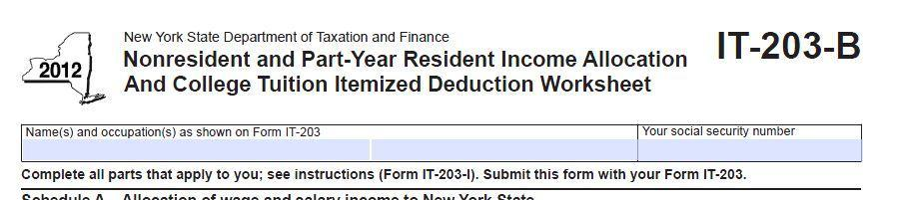
Form IT-203-B
Include your name on the top of the form
Complete only “Schedule B” of Form IT-203-B

Slide 69
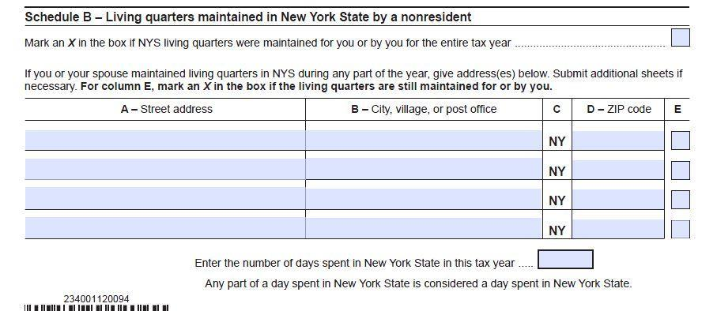
IT-203-B Schedule B
Include Address Here
U.S. Non-Resident
325
Include your name on the top of the form
Complete only “Schedule B” of Form IT-203-B
Fill in your address, the total days you were at that address, and write “U.S. Non-Resident”

Slide 70
Putting it All Together
Be sure you signed your return
Attach W-2 and/or 1042-S to NYS Tax forms.
Mail to NYS tax authorities, address listed in the directions, page 50.
  If you are enclosing a payment*:
        State Processing Center
        PO Box 15555
        Albany, NY 12212-5555
      *if you pay by check, make check payable to “New York State Income Tax”
  If you are NOT enclosing a payment:
        State Processing Center
        PO Box 61000
        Albany, NY 12261-0001

Slide 71
NYS residents who earned income in other states
If you are a New York State resident for income tax purposes, your total income, as reported to the IRS on your federal income tax return, is reported on your NYS resident income tax return.
However, if you are required to pay taxes to other states, you may be entitled to claim a resident tax credit by completing the other state return first and then completing Form IT-112R, NYS Resident Tax Credit.
The credit you calculate is entered on line 41 of Form IT-201 and you must attach Form IT-112R to your IT-201.
Note: There is a similar resident credit form for taxes paid to the Provence of Canada, Form IT-112C.

