Slide 1
C
Cleo
Cleo — the autonomous
product-feedback operator
Declarative intent, not static code.
Built on Google ADK · every connector speaks MCP · gemini-3.5-flash
01 / 09

Slide 2
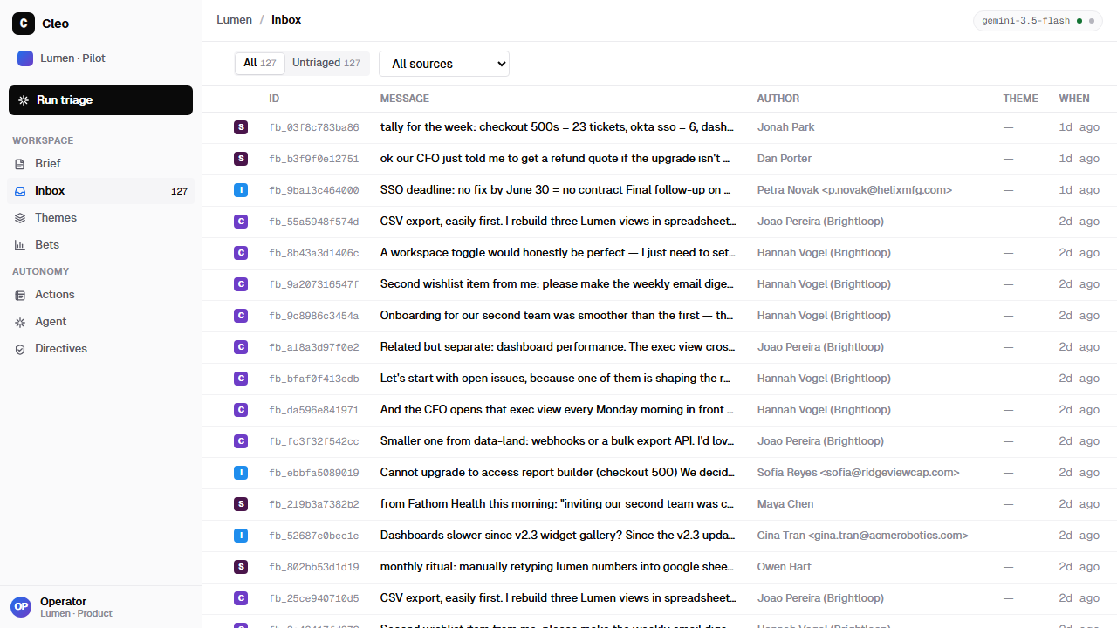
01 · THE PROBLEM
Feedback is everywhere. Insight is nowhere.
Scattered — across chats, tickets, sales calls, and docs.
Hand-read — founders and PMs read, tag, and guess.
Hidden — urgent issues sit unseen for days.
The raw inbox — 5 sources, untriaged
~90 raw signals/week · 5 sources · 0 read end-to-end
Cleo · Google Agent Hackathon
02 / 09

Slide 3
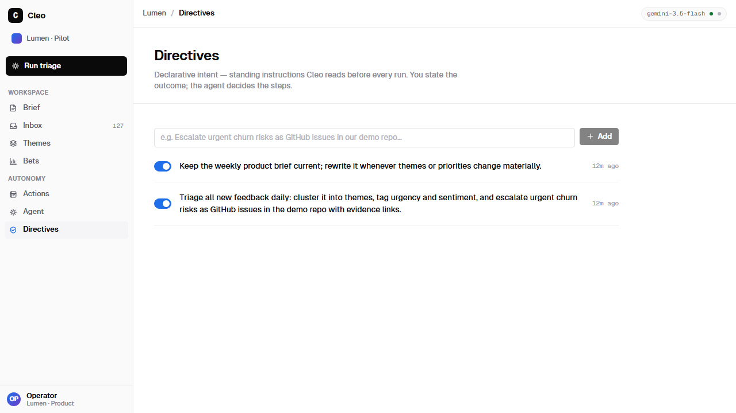
02 · WHAT CLEO DOES
One directive in. Accountable action out.
01
02
03
04
05
06
Directive
Gather
Synthesize
Bet
Act
Ledger
standing intent, not a script
MCP connectors, in parallel
themes · urgency · contradictions
evidence-backed, typed output
GitHub issues · weekly brief
every action audited
Autonomy with accountability.
A guardrail callback gates every external write; the ledger keeps the receipts.
Standing directives — declarative intent
Cleo · Google Agent Hackathon
03 / 09

Slide 4
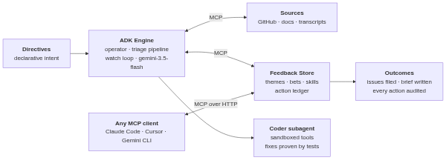
03 · ARCHITECTURE
An ADK engine that touches the world only through MCP.
The ADK engine orchestrates
MCP is the only world access
One engine, every surface
Sequential triage pipeline, parallel ingest, bounded watch loop, coder handoff.
Feedback store, GitHub, filesystem — each behind narrow tool allow-lists.
The same runner serves the Web UI, the cleo CLI, and any MCP client.
Cleo · Google Agent Hackathon
04 / 09

Slide 5
04 · BUILT ON ADK
The core concepts, not just the import.
LlmAgent · gemini-3.5-flash
every reasoning unit, operator through coder
Sequential · Parallel · Loop
staged pipeline · concurrent ingest · bounded autonomy
output_schema (Pydantic)
bets as typed JSON, not prose
callbacks as guardrails
action_guard gates writes; every run lands in the ledger
sub-agent transfer
operator hands work to a sandboxed coder agent
McpToolset · stdio + HTTP
the only world access — store, GitHub, filesystem
Runner + get_fast_api_app
one engine behind the UI, the CLI, and the API
Cleo · Google Agent Hackathon
05 / 09

Slide 6
05 · TWO CLOSED LOOPS
It learns, and it ships.
LOOP 01 — SKILLS
LOOP 02 — THE FIX
It writes its own runbooks.
It fixes the code it hears about.
Agents consult versioned skills before multi-step work — and after succeeding at uncovered work, write a new one via save_skill. Intelligence compounds across runs.
Feedback → bet → handoff → a coder subagent with its own context and sandboxed tools fixes real code, proven red → green by the target repo's test suite. Ledgered as code_fix.
Cleo · Google Agent Hackathon
06 / 09

Slide 7
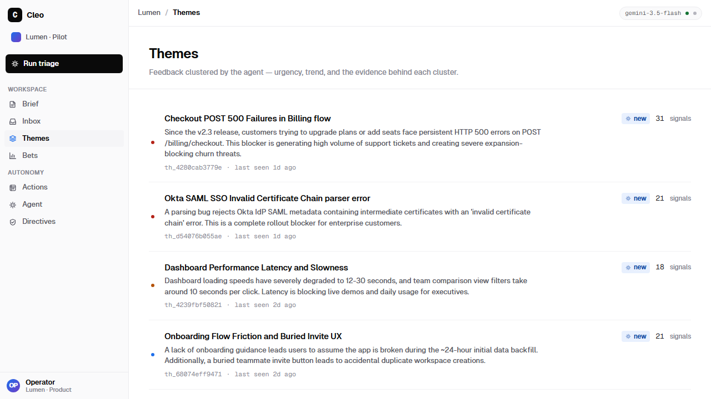
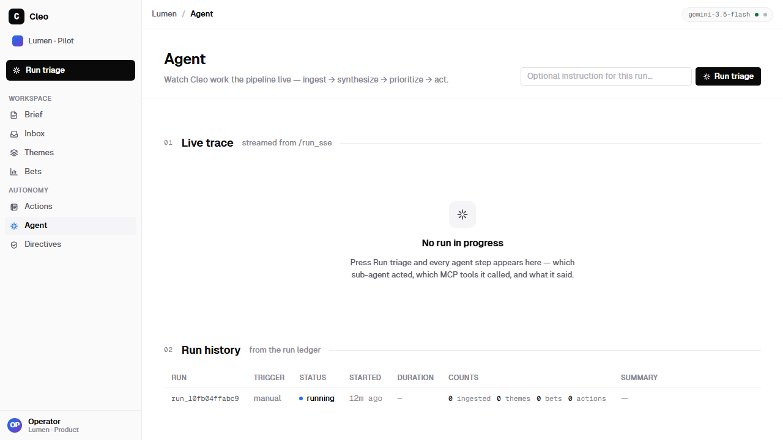
06 · LIVE OUTPUT
Real screenshots — the agent's work, not a mock.
Live trace view — runs streamed over SSE · 5 skills available
7
themes from one live run
31
Agent-synthesized themes from ~90 multi-source items — urgency flagged by the agent
signals behind the urgent checkout theme
Cleo · Google Agent Hackathon
07 / 09

Slide 8
07 · ADOPT IT TODAY
Not wired to demo data — sources are configuration.
cleo.config.json
cleo CLI
Standard MCP server
Point it at your repo and your docs — transcripts, support exports, notes.
init · triage · status · skills — every command takes --json for scripts and agents.
stdio + HTTP. Operate Cleo from Claude Code, Cursor, or Gemini CLI. Ships AGENTS.md + llms.txt.
151 automated tests · architecture docs · 15-minute setup
Cleo · Google Agent Hackathon
08 / 09

Slide 9
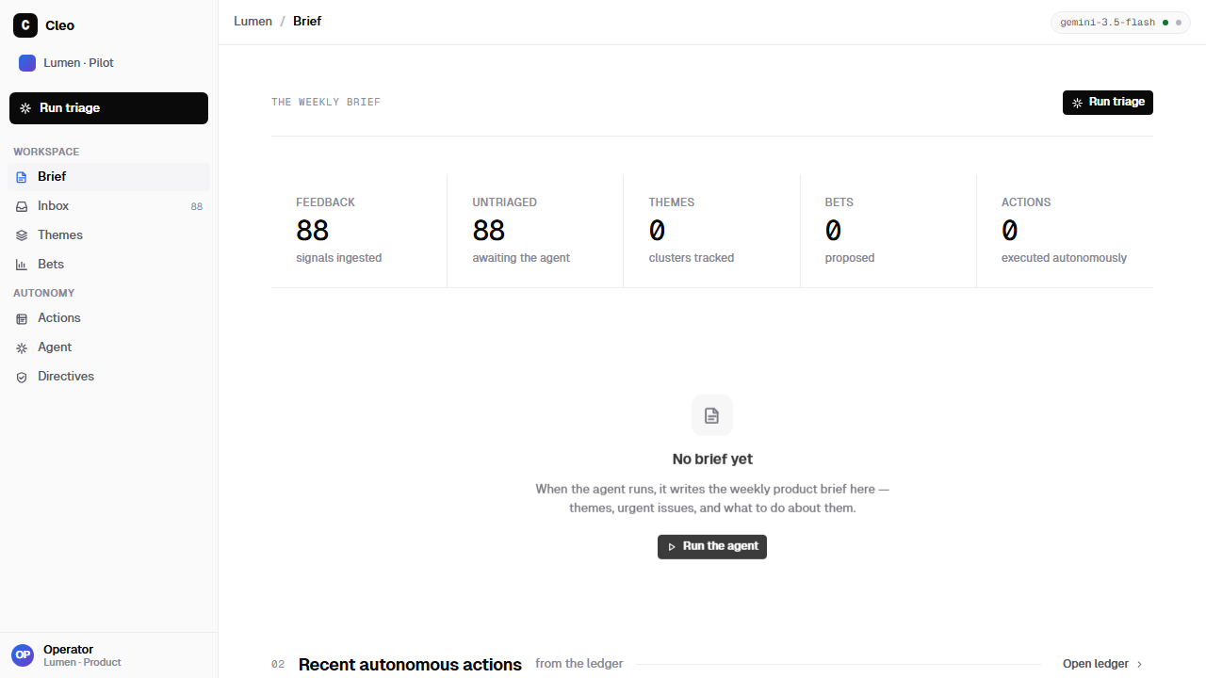
C
Cleo
From a Tuesday-night complaint to a test-proven fix —
one directive, full audit trail.
The weekly brief writes itself
github.com/ychampion/cleo-hack · 3-minute demo: docs/DEMO.md

