Slide 1
Research Proposal Implementing Cyber Security tools and/or techniques in Detecting medical misinformation on a social media platform of Twitter
Ying Chan
University of Essex
Research Methods and Professional Practice November 2022
Unit 10

Slide 2
Introduction
Propose a methodology for implementing blockchain on citations to ensure the medical information on Twitter is correct.
Respect Twitter's values of openness and transparency.
Enhancement of the human intervention Birdwatch rating system.
Instead of deciding whether the information is fake or not, Twitter provides additional information and rating.

Slide 3
Research Problem
Video analysis must be transformed to text or a picture using artificial intelligence (AI) or machine learning (ML) technology to determine if text content has been altered. Content, especially video, has shown to be reliable with blockchain technology.
There is a possibility that an organization will be prejudiced if a responsibility to verify accurate news is entrusted to it. Additionally, the company will be responsible for handling the entire validation responsibilities. The government could exert pressure on them in some severe circumstances. In contrast, we may provide a method for Blockchain where validate with the source video.

Slide 4
Research questionnaire SAMPLE
Do you agree or disagree with the following statements?
Much medical uncertainty information can be found on Twitter.
Most of the medical information is without citation.
I do fact-check the medical information detail from sources before believing it.
I feel convenient to find the source from the medical video.
I feel convenient if the medical video is able to show the citation.
I feel convenient if the medical video shows the percentage that matches the citation source.
Agree
Strongly disagree
Disagree
Strongly agree
Neutral

Slide 5
Research question
Strategies & Tactics
Issues & Constraints
Gaps
Proposed Methodology

Slide 6
Aims and Objectives
Provide real citations and source information to users.
Calculate the percentage that matches the source.
Avoid the pretended medical source video or incorrect citation.
Able to validate even if the source video or URL is unavailable.
Shorter the blockchain, reduce complexity, pointless to alter blockchain.
Comparison of the number of frames and storage size of the blockchain needs.
Comparison of the accuracy, efficiency, speed, and controllability by simulation.

Slide 7
Key literature related to the project Fake News Detection in Social Media using Blockchain (Paul et al., 2019)
The plan is to include social media in a blockchain so that ad hoc users, such as journalists, will serve as news verifiers. They can independently verify news freely because of their anonymity. Therefore, immune to bias and outside pressure from any group or individual.
The decentralized and anonymous system will make their verification more dependable and transparent.
Figure 1: Social media sharing in the blockchain
Notes:
S. Paul, J. I. Joy, S. Sarker, A. . -. A. . -. H. Shakib, S. Ahmed and A. K. Das, "Fake News Detection in Social Media using Blockchain," 2019 7th International Conference on Smart Computing & Communications (ICSCC), Sarawak, Malaysia, 2019, pp. 1-5, doi: 10.1109/ICSCC.2019.8843597.
Fake News Detection in Social Media using Blockchain DOI: https://doi.org/10.1109/ICSCC.2019.8843597

Slide 8
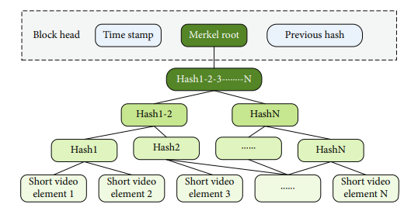
Key literature related to the project Short Video Copyright Storage Algorithm Based on Blockchain and Expression Recognition (Yang & Dingguo, 2022)
This article proposes a blockchain-based architecture for digital copyright storage for short videos.
The hash value of multiple keyframes in a video is used as the judgment basis when a suspected violating copyright video is detected in a hash collision.
The amount of keyframes is modified by establishing a threshold, and several keyframe selection bases are established based on various review standard processes, which enhances the storage architecture's resilience and effectiveness.
Figure 2: Calculating Merkel root value of elements
Notes:
Short Video Copyright Storage Algorithm Based on Blockchain and Expression Recognition
DOI:10.1155/2022/8827815

Slide 9
Key literature related to the project Blockchain Based Approach for tackling Deepfake videos (Patil & Chouragade, 2021)
The original artist, metadata, and video frames are the essential components of the suggested model.
An input video is made by the original creator, also known as the trustworthy owner. The original artist must complete the registration on the Distributed File System (IPFS) before the first video is used as input. On IPFS, the video frames and the associated metadata are kept, and a unique hash is generated for each video. After then, the hash value is kept on a blockchain.
Figure 3: The Signing Actors and Process
Notes:
Blockchain Based Approach for tackling Deepfake videos
DOI:10.32628/CSEIT217372

Slide 10
Proposed Methodology
Build special add-in for video editor to store blockchain when cited to medical video.
The solidity struct in Figure 4 shows the data stored in the blockchain and the function to get source data.
struct MedicalVideo{ uint256 UserId; string SourceURL; string Author; uint256 Datatime; } function get_MedicalVideo_by_id(uint256 _Id) public view returns(MedicalVideo data){ return MedicalVideo [_Id]; }
Figure 4: Blockchain data and function

Slide 11
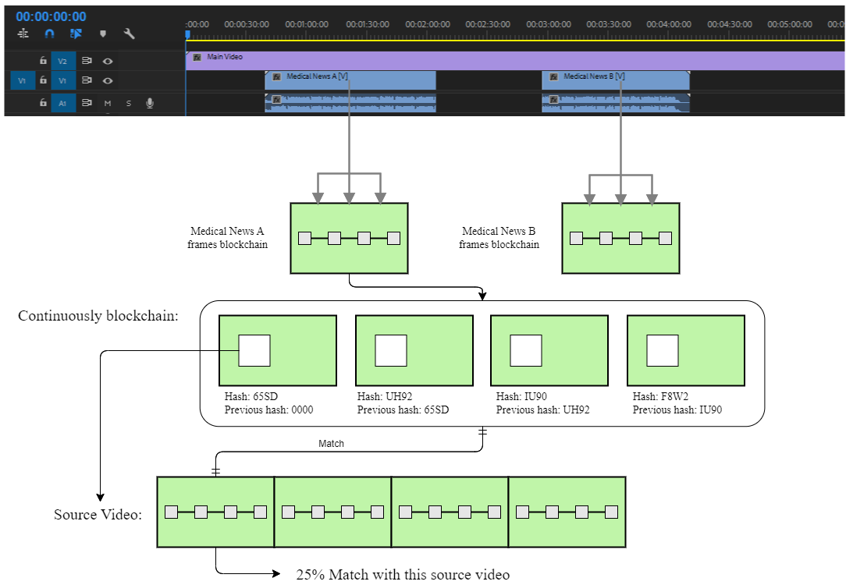
Proposed Methodology
Figure 5: Calculate the video blockchain that matches the source video

Slide 12

Proposed Methodology
Outcomes
Provide the citation information for the uploaded video (Figure 6)
Citation:
Medical News A
Author: Dr. A
URL: https://MedicalNewsA.com
Match: 25%
Medical News B
Author: Dr. B
URL: https://MedicalNewsB.com
Match: 20%
Figure 6: Sample of user view

Slide 13
Ethical considerations and risk assessment
Risk Level | Estimated detectability | Description
0 - 1 | Acceptable risk | Video adjustments impacts Data Accuracy
2 - 3 | Significant risk | Blockchain inefficient Data inaccuracy Video editor add-in compatible issue Blockchain unfixable bugs
4 - 5 | Unacceptable risk | Copyright issue of the citation Privacy data breach Legal issue

Slide 14
Description of artefacts that will be created
The special add-in for video editor
Generate the frames to blockchain with citation data.
Verification program
Verification continuously blockchain that match to the percentage of the source video

Slide 15
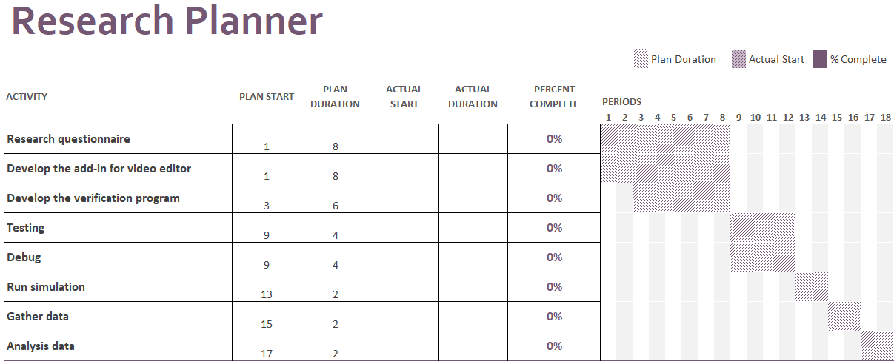
Timeline of proposed activities
Figure 7: Research timeline plan

Slide 16
references
Patil, U. & Chouragade, P. (2021) Blockchain Based Approach for tackling Deepfake videos. International Journal of Scientific Research in Computer Science, Engineering and Information Technology 342-347. DOI: https://doi.org/10.32628/CSEIT217372
Paul, S., Joy, J., Sarker, S., Shakib, A., Ahmed, S. & Das, A. (2019) Fake News Detection in Social Media using Blockchain. 2019 7th International Conference on Smart Computing & Communications (ICSCC) pp. 1-5. DOI: https://doi.org/10.1109/ICSCC.2019.8843597
Yang, Y. & Dingguo, Y. (2022) Short Video Copyright Storage Algorithm Based on Blockchain and Expression Recognition. International Journal of Digital Multimedia Broadcasting Vol. 2022, Article ID 8827815, 11 pages. DOI: https://doi.org/10.1155/2022/8827815

Slide 17
The End Thanks for watching

