Slide 1
Group 3 Seminar 3: Unit 6 Evaluation exercise
Jonathan, Ying & Haseeb
Friday 17th December 2021

Slide 2
Overall evaluation
13.3%
13.3%
13%
12%
Metasploit
Nessus
Nmap
Burp suite
14.1%
12.8%
13%
8.5%
OWASP ZAP
SQLmap
Kali Linux
Jawfish

Slide 3
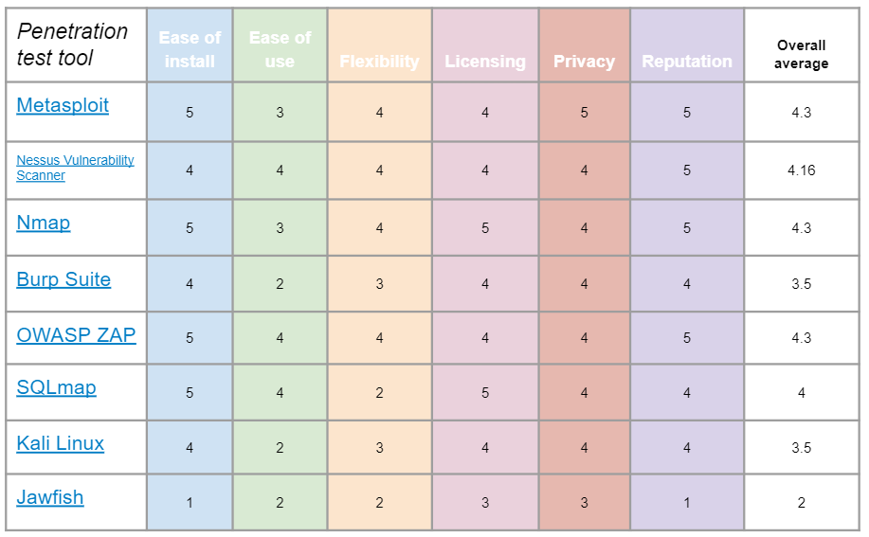
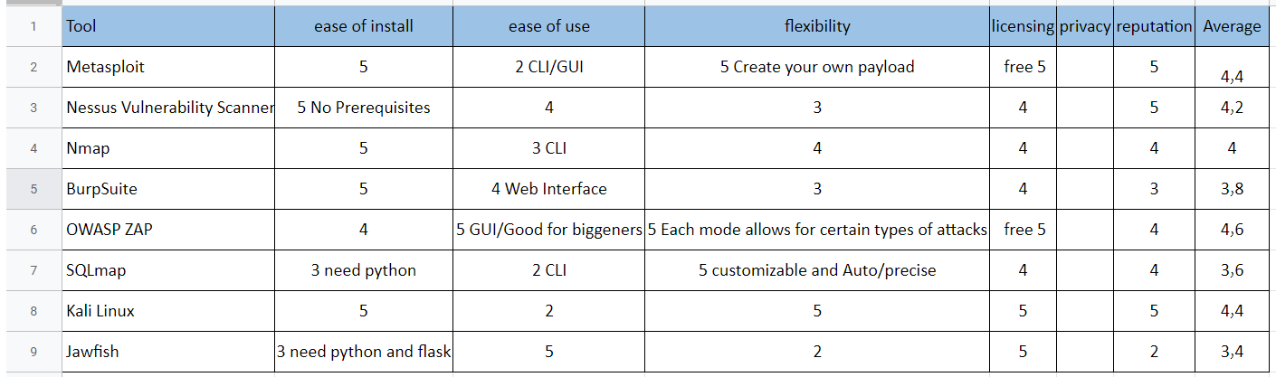
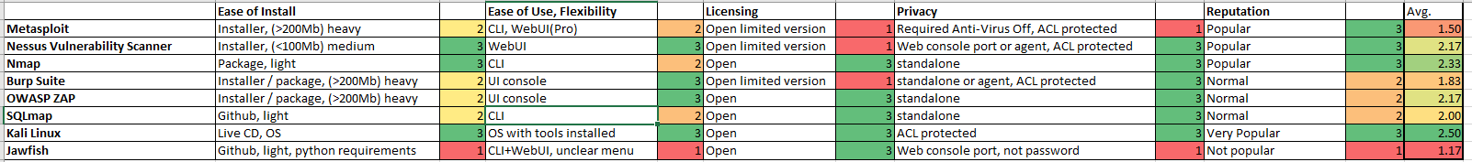
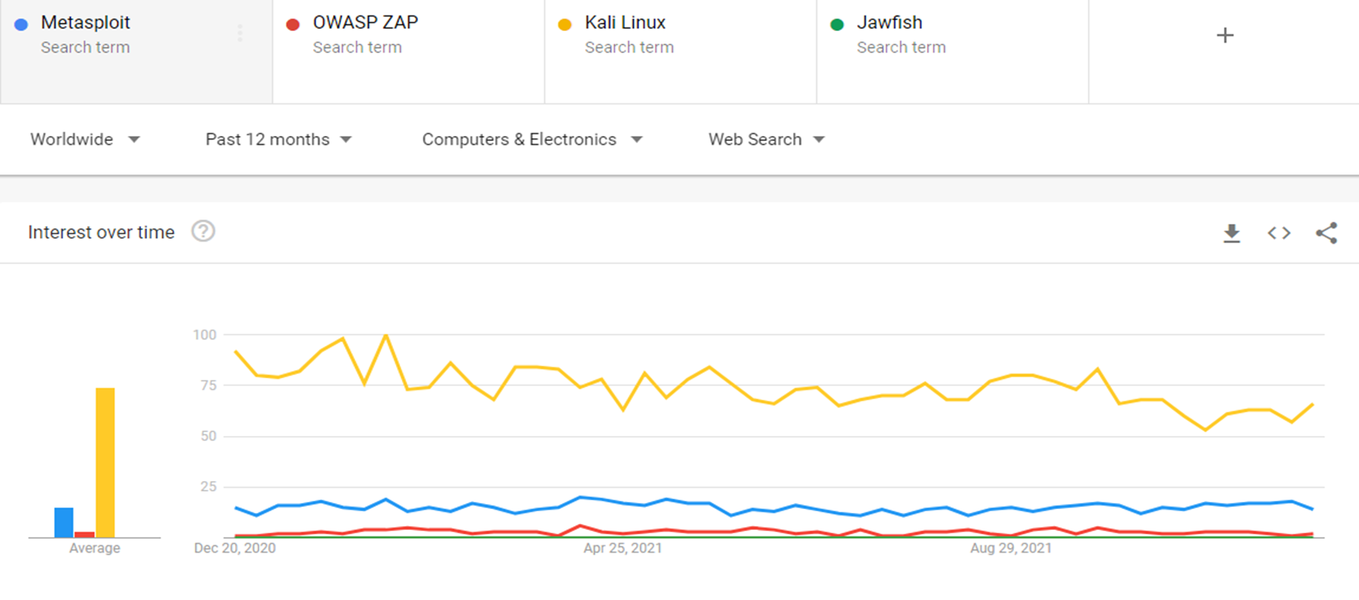
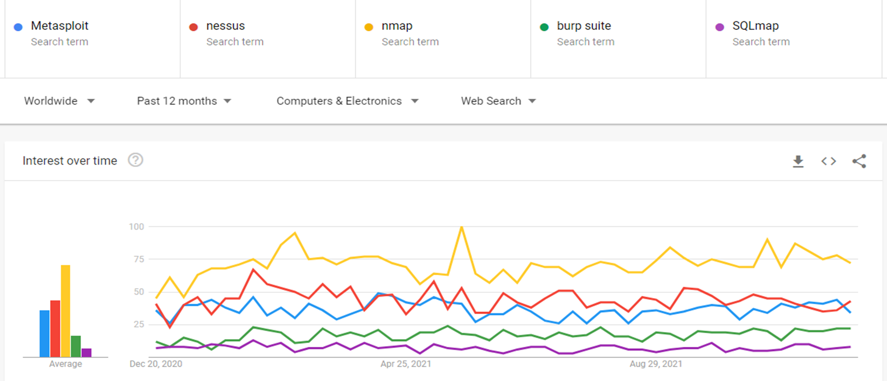
Group findings: How we got there…

Slide 4
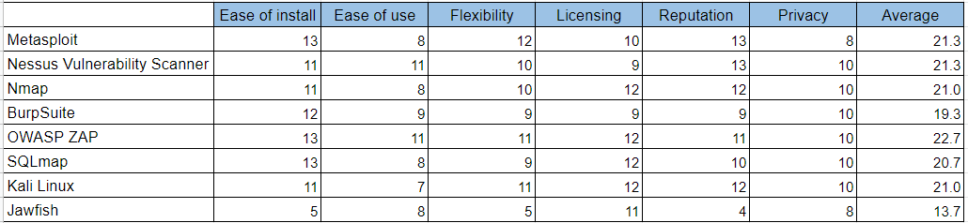
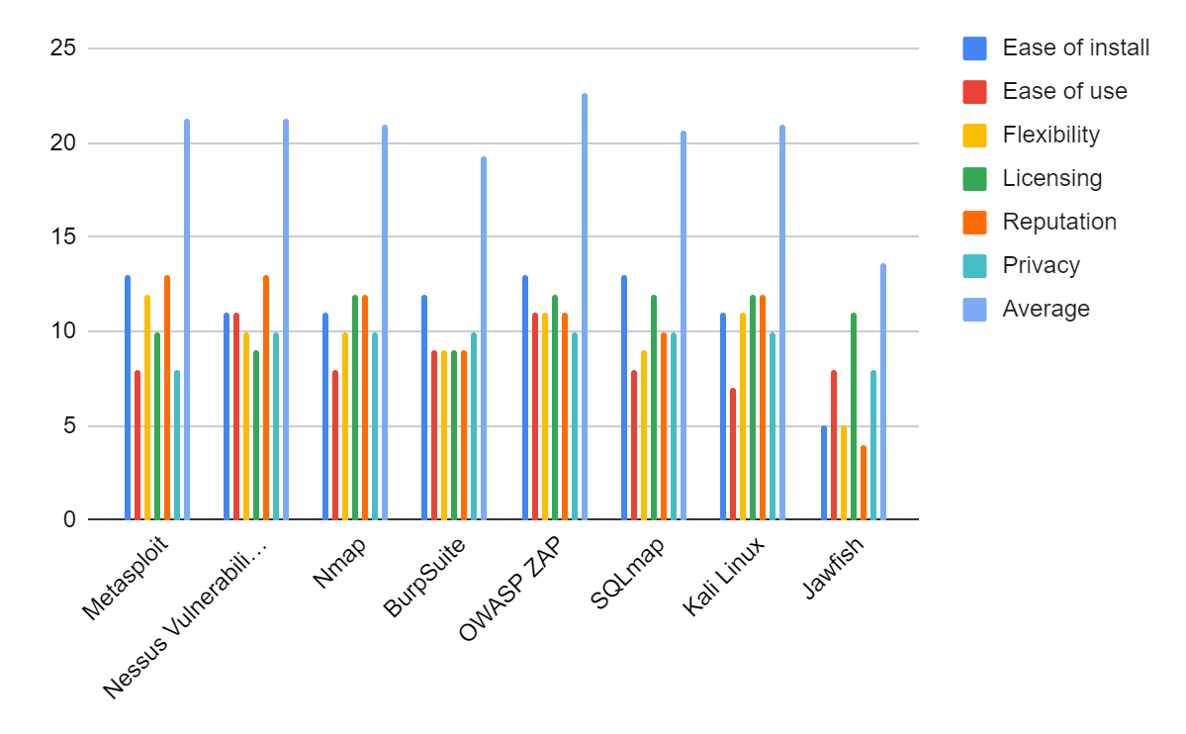
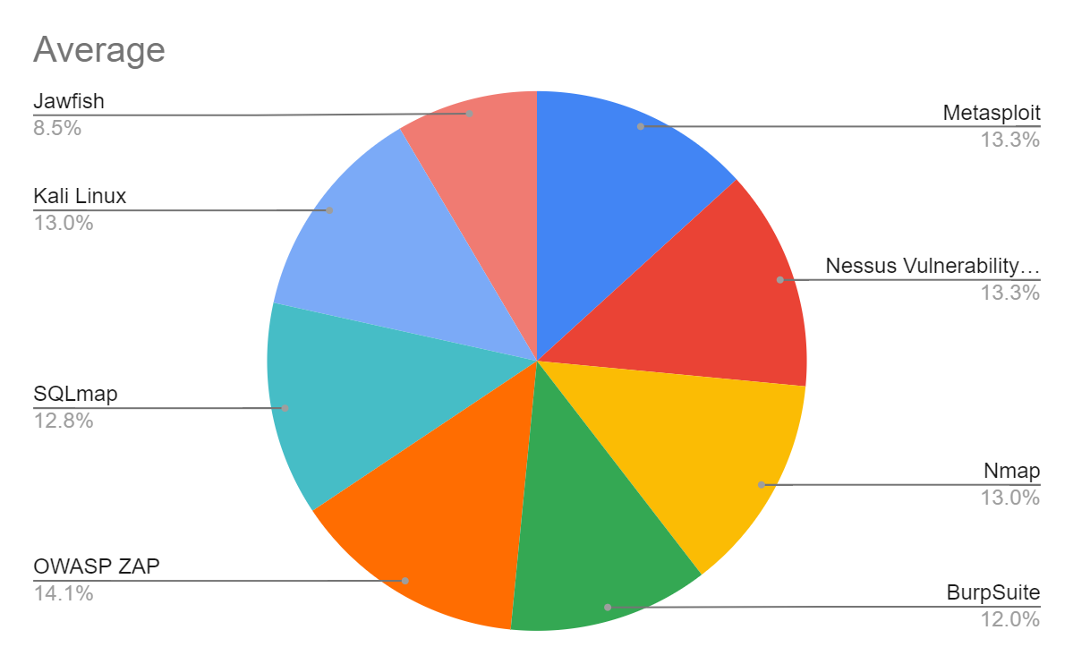

Slide 5
Penetration test tool | Advantages | Disadvantages
Metasploit | GUI environment, Easy install, Community edition is free Pro edition, Open source, Wide range of applications Listeners, Reliable, Use any language and platform Cleaner exits, CLI, Create your own payload | Can be challenging to learn to use but there are training course and an exam certification can be taken Knowledge of Ruby, GUI has limitations and CLI driven Can crash if not used safely, Antivirus can affect the use, installer/ package >200mb heavy. Techniques needed before using tools.
Nessus Vulnerability Scanner | Compares scans to known standards High success rate in accuracy, Free and paid version, Speed Training available, No prerequisites, installer/ package <100mb medium. Continuous scanning for your network and up to date. | Pro version is a yearly fee Cannot use with a Host based Intrusion Prevention System Training costs
Nmap | Open source, Many features for networking, Easy setup GUI and CLI, light | Give clear directions of scans will be time consuming Some platforms not all features Exporting information is not always that presentable Takes learning
Burp Suite | Can perform many scans, web interface Offers variability Cheaper price options | Takes time to learn, Time consuming GUI could be improved, installer/ package >200mb heavy Limited update compared to ZAP
OWASP ZAP | Beginners as well as more advanced users, GUI Open source, Automated and manual testing, Cross platform | Report output, installer/ package >200mb heavy
SQLmap | Database, Cost, Automates, Customizable, CLI, light, easy to use | GUI, Need python
Kali Linux | Languages supported, Customise, Cost, Powerful separate OS | Speed, Knowledge is required for use, Live CD, OS
Jawfish | Light, simplistic | Could not access the site, Had to search Github, Need python and flask, basic options, difficult to learn - lack of resources
Popularity:

Slide 6
Overall evaluation
13.3%
13.3%
13%
12%
Metasploit
Nessus
Nmap
Burp suite
14.1%
12.8%
13%
8.5%
OWASP ZAP
SQLmap
Kali Linux
Jawfish

Slide 7
Concluding remarks
Team expertise
2. Budget
3. Time management
4. Accuracy
5. Infrastructure
6. Features

