Slide 1
University of Essex Practical Activity - Scanning Exercise
Network and Information Security Management November 2021 A
Group 3

Slide 2
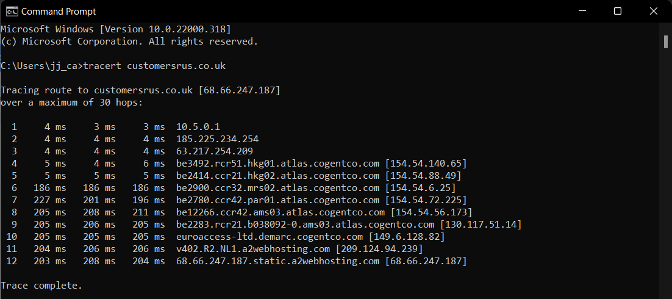
[customersrus.co.uk] tracert
Findings in tracert: After the local ISP, other country hop in atlas.cogentco.com domain (ISP: Cogentco) caused the biggest delay,
the average duration is 121.41ms.

Slide 3
[customersrus.co.uk] nameservers and Registered contact
A2 Hosting web hosting nameservers (nslookup)
Registered contact (whois)
Name servers: ns1.a2hosting.com ns2.a2hosting.com ns3.a2hosting.com ns4.a2hosting.com
Registrar: eNom LLC [Tag = ENOM] URL: http://www.enom.com
Results returned from whois.arin.net: OrgName: A2 Hosting, Inc. OrgId: A2HOS Address: P.O. Box 2998 City: Ann Arbor StateProv: MI PostalCode: 48106 Country: US RegDate: 2004-03-16 Updated: 2021-10-13 Comment: http://www.a2hosting.com Ref: https://rdap.arin.net/registry/entity/A2HOS
MX record (nslookup)
customersrus.co.uk. 5 IN MX 0 mail.customersrus.co.uk.
Based the IP ping result, showed that the mail server hosting in A2 Hosting

Slide 4
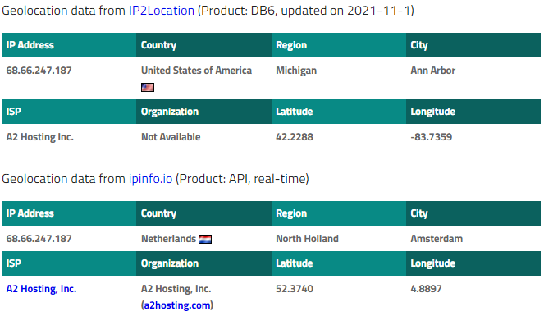
[customersrus.co.uk] website hosted
A2 Hosting, Inc.
United States of America (Ann Arbor)
Netherlands (Amsterdam)
Ref: https://www.iplocation.net/ip-lookup

Slide 5
Team activity
A2 Hosting, Inc. provided solutions to prevent attack and abuse:
Google reCAPTCHA - bot detection
Affect: Testing the website with lower level
Temporarily banned IP addresses
Affect: Unable to send too much request and require to change IP address if blocked
SSL
Affect: Packet or traffic capture may not able to get information
References:
https://www.a2hosting.com/kb/security/temporarily-banned-ip-addresses
https://www.a2hosting.com/kb/security

