Slide 1
Seminar 1 Preparation Intellectual Property Crime
University of Essex Principles of Digital Forensics and Cyber Law (Aug 22)
Ying Chan

Slide 2
Intellectual Property (IP) Crime
Case No. A28- 11930/2021 in the Arbitration Court of the Kirov Region (Arbitr, 2022)
Trademarks of Peppa Pig case

Slide 3
Description and Explanation of the crime
In September 2021, Entertainment One sued a Russian entrepreneur, Ivan (Кожевникову Ивану Владимировичу), for copyright infringement based on the unauthorized trademarks of the Peppa characters in his artwork.
In March 2022, Judge Andrei subsequently dismissed the case, citing the “Unfriendly actions of the United States of America and affiliated foreign countries.” Andrei noted that Russians were free to use the Peppa Pig characters as they pleased.
In Jun 2022, the Court of Appeal reversed the decision. Claimed that the location of the plaintiff in an unfriendly country is not a reason to refuse judicial protection of the right. (Arbitr, 2022)

Slide 4
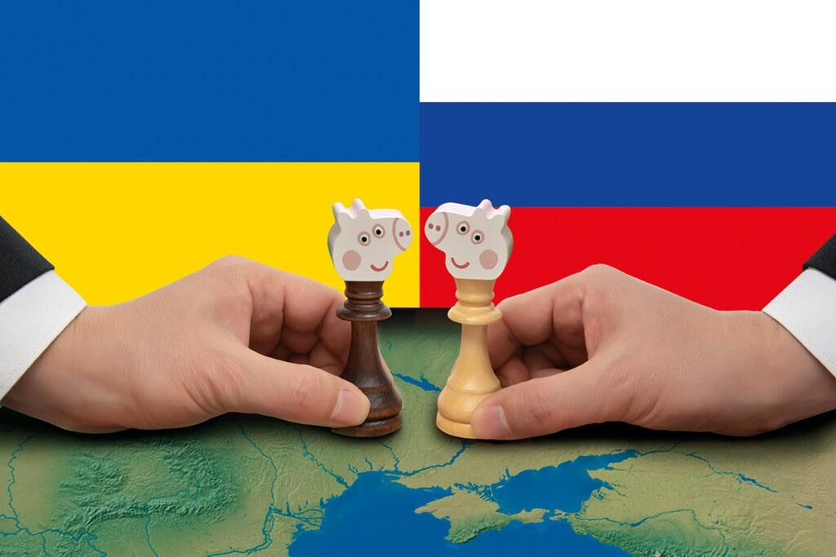
Identify its unique characteristics
Due to the economic sanctions of the Russo-Ukrainian War, the Russian government has issued a decree that allows patented inventions and industrial designs from "unfriendly countries" to be used without permission or compensation.
Russia's intellectual property treaties might be affected, including the “Paris Convention”, the “Agreement on TradeRelated Aspects of Intellectual Property Rights” and the “Hague Agreement”.
Lawyers believe that the approach proposed by the trial court could advance an uncontrolled growth in the volume of counterfeit products on the Russian market.
“Offering items, either billed as genuine, or clearly fake, for sale through online shops and auction sites, or on social networking sites” (CPS, 2019)
(Latha, 2022)

Slide 5
Evaluate the extent of which this cybercrime is different than its off-line version
Besides the awareness of the artwork from YouTube or trading websites, there is no difference in copyright infringement based on using the unauthorized character's trademarks for the physical or visual artwork in this case.

Slide 6
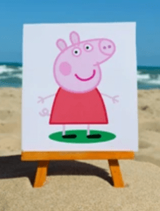
Identify and assess issues concerning laws
Peppa Pig is a British animated television series about Peppa, her family, and friends.
In December 2019, Hasbro, Inc. acquired Entertainment One, the television studio that owns rights to the Peppa Pig franchise, for $3.8 billion, and renewed the series for additional seasons until 2027 (Dorsey & Whitney LLP, 2022).
(Dorsey & Whitney LLP, 2022)

Slide 7
Identify and assess issues concerning burden of proof, standards of proof and admissibility.
Burden of proof
Entertainment One
Standards of Proof
Trademarks owner
Intellectual property violation
YouTube video
Trading website
Admissibility
Reputation impact
Financial loss

Slide 8
References
CPS. (September, 26 2019) Cybercrime - prosecution guidance. Legal Guidance, Cyber / online crime. Available from: https://www.cps.gov.uk/legal-guidance/cybercrime-prosecution-guidance [Accessed 16 August 2022].
Arbitr. (June 27, 2022) А28-11930/2021. SECOND ARBITRATION COURT OF APPEALS. Available from: https://kad.arbitr.ru/Document/Pdf/a45fa186-05bb-43b5-87d9-1f0d3b640142/10d923f8-6f76-45fc-879b-154629e75647/A28-11930-2021_20220627_Postanovlenie_apelljacionnoj_instancii.pdf?isAddStamp=True [Accessed 16 August 2022].
Dorsey & Whitney LLP. (April 25, 2022) Peppa Pig: Intellectual Property Infringement as a Form of Retaliatory Sanction. Legal News. Available from: https://www.jdsupra.com/legalnews/peppa-pig-intellectual-property-1376654/ [Accessed 16 August 2022].
Cynthia, M. (July 27, 2022) War and Peace at Rospatent: Protecting Trademarks in Russia. Volume XII, Number 228. Available from: https://www.natlawreview.com/article/war-and-peace-rospatent-protecting-trademarks-russia [Accessed 16 August 2022].
Zuykov. (June, 29 2022) The Court of Appeal reversed the decision in the Peppa Pig case. News. Available from: https://zuykov.com/en/about/cases/the-court-of-appeal-reversed-the-decision-in-the-peppa-pig-case/ [Accessed 16 August 2022].
Latha, J. (July, 27 2022) A tool of war?. Opinion. Available from: http://www.millenniumpost.in/opinion/a-tool-of-war-487422 [Accessed 16 August 2022].

