Slide 1
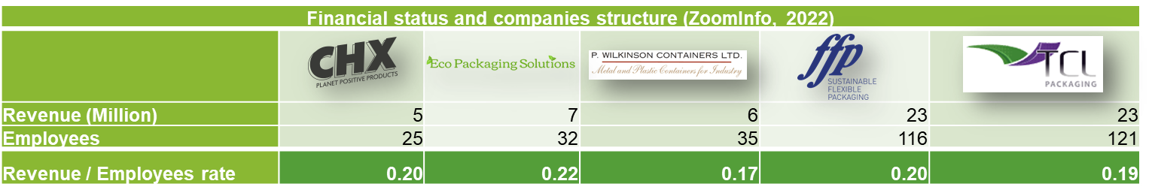
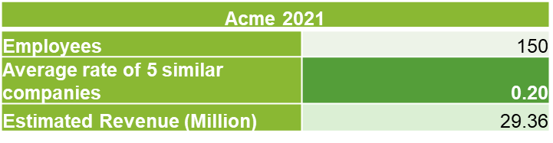
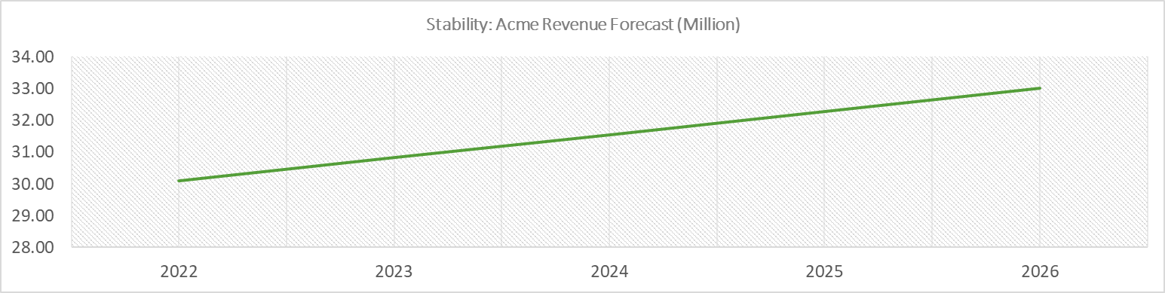
Team Project: Status Report
Research Companies
Estimation
Manufacturing Production in the United Kingdom is expected to grow at a rate of 2.50% in 2022, 2.50% in 2023, and 2.30% in 2024 (Trading Economics, 2022).

Slide 2
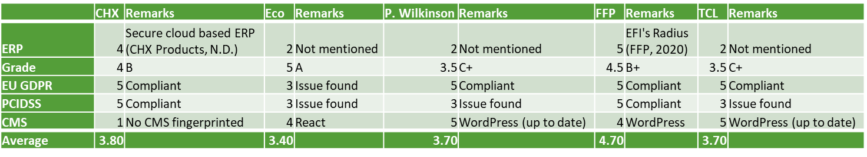
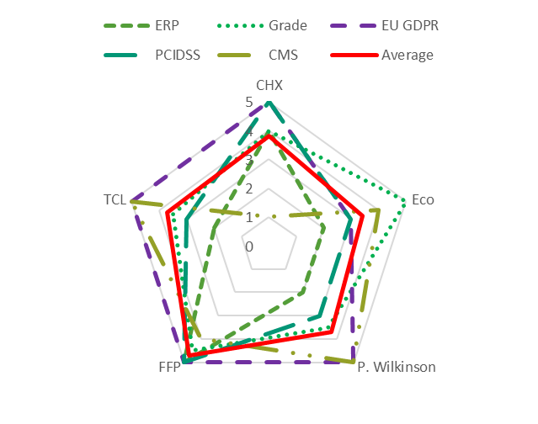
IT capabilities (ImmuniWeb, 2022)
Risk appetite
Theft of intellectual property (Jason Miller, 2021)
Issues with data integrity/customer specs being changed prior to manufacture
Attacks against manufacturing facilities or goods
Productivity loss caused by downtime
Malware in the supply chain compromises the manufacturing process's integrity (Jason Miller, 2021)
Products lose their dependability and integrity
Based on the similar structure (>100 employees) of disposable cutlery companies Website Security Test showed that the IT capabilities are above average.

Slide 3
Key Business Risks
Business Continuity
Human error, whether internal or external staff or vendor negligence or malicious activity.
Third-party vendor disruption: Vendors should comply with regulations to minimise exposure or reputational damage.
Business process re-engineering.
Consumer purchase behaviour or potential dissatisfaction.
Productivity loss during the transition period to ERP.
Forming a solid project team with executive-level members is required to integrate and align business and IT needs.
Environmental factors
Climate change and natural disasters can affect IT infrastructure, reducing capacity, readiness procedures and impaired security controls.
Social awareness of waste disposable or accidents may affect the company’s reputation.
Global financial crises can reduce workforces, ventures and increase inflation.
Technological factors
Internet of Things – data-gathering devices may need to be secure.
Social Engineering, Phishing, Malware and Denial-of-Service attacks; Securing and protecting personal (GDPR), payment (PCI compliance) and sensitive data.
Recruiting ERP trained developers or retraining IT professionals / internal expertise.
Automation can reduce the workforce that challenges small to medium-sized enterprises.

Slide 4
Technical, Business risks and Assumptions
Risk No. | Risk | Description | Potential Effect
COTS (Commercial Off the Shelf) solution
1 | Inadequate support of COTS vendor | The COTS vendor may stop providing support or provide inadequate support either due to incompetency or bankruptcy | Inadequate service quality
 |  |  | Security breaches and incidents
 |  |  | Non-compliance with regulatory authority
 |  |  | Financial loss and reputational damage
2 | Process risk | The COTS application may require more time than required to understand and integrate business processes | Sustainability of application leading to service degradation
3 | SLAs not meeting agreed-on metrics | Depending on the support model agreed, the vendor could breach the SLA | Not able to provide the agreed-on RTO and RPO
4 | Product obsolescence | Lack of product enhancements and/or product development may get dropped | Inadequate service quality
 |  |  | Security breaches and incidents
 |  |  | Financial loss and reputational damage
 |  |  | Not able to meet organisations strategic objectives
Open-Source solution supported by Internal IT department
1 | Software quality | Open source projects are community-oriented, developed and supported through collaboration. However with insufficient resources, quality will suffer. | Inadequate service quality
 |  |  | Not able to meet strategic objectives
2 | Sustainability over longer time period | As open-source projects relies on community contributions, if the contributors are not able to keep the commitment, it will lead to a product that is no longer sustainable | Inadequate service quality
 |  |  | Security breaches and incidents
 |  |  | Not able to meet organisations strategic objectives
3 | Copyright infringement | Negligence from coder can potentially allow proprietary code in the product. | Financial loss and reputational damage
4 | Software security risks | Open-source vulnerabilities and exploits are made public to everyone once discovered. If there is a vulnerable open-source library used in the code, there is a risk of malicious attack. | Security breaches and incidents
 |  |  | Financial loss and reputational damage
In-house developed solution built by a student and supported by Internal IT department
1 | Unrealistic estimated schedule | The solution developed by the student may have unrealistic deadline for completion | Not able to meet organisations strategic objectives
2 | Lack of adequate skill set | The solution may suffer quality issues and/or not meet the expectations due to a lack of required skill set | Not able to meet organisations strategic objectives
 |  |  | Security breaches and incidents
 |  |  | Inadequate service quality
3 | Incomplete solution | There is a risk of an incomplete solution if the student discontinues the course | Not able to meet organisations strategic objectives
4 | Lack of upper management involvement | Risk of upper management not being involved with the student | Not able to meet organisations strategic objectives
5 | Insufficient testing | There is a risk of the solution not being tested sufficiently either due to project timelines or inadequate skillset | Security breaches and incidents
 |  |  | Inadequate service quality

Slide 5
Appendixes: GANTT Chart

Slide 6
References
Aloini, D., Dulmin, R. & Mininno, V. (2007). Risk management in ERP project introduction: Review of the literature. Information & Management, 44, 547-567.
Asgary, A., Ozdemir, A. I. & Özyürek, H. (2020). Small and Medium Enterprises and Global Risks: Evidence from Manufacturing SMEs in Turkey. International Journal of Disaster Risk Science, 11, (1): 59-73.
Costello, L. (2022). Benefits of ERP. Available: https://terillium.com/benefits-of-erp/ [Accessed 23 March 2022].
Decesare, J. (2020). Top 4 Types of Risk Impacting Manufacturing Companies. Available: https://www.ispartnersllc.com/blog/common-risk-facing-manufacturing-companies/ [Accessed 25 March 2022].
Dey, P., Clegg, B. & Cheffi, W. (2011). Risk management in enterprise resource planning implementation: A new risk assessment framework. Production Planning & Control - PRODUCTION PLANNING CONTROL, 24, 1-14.
Puzhevich, V. (2019). How to Implement an ERP System Effectively. Available: https://scand.com/company/blog/implementing-erp-system-advantages-and-disadvantages/ [Accessed 23 March 2022].
Spears, J. L. & Barki, H. (2010). User Participation in Information Systems Security Risk Management. MIS Quarterly, 34, (3): 503-522.
Software Engineering Authority. (2017). Understanding the Risks of Commercial off-the-shelf software (COTS). [online] Available at: https://ao.ms/understanding-the-risks-of-commercial-off-the-shelf-software-cots/ [Accessed 22 Mar. 2022].
snyk.io. (2021). 5 Risks of Open Source Software | Snyk. [online] Available at: https://snyk.io/learn/risks-of-open-source-software/ [Accessed 22 Mar. 2022].
WhiteSource. (n.d.). Top 3 Open Source Risks and How to Beat Them. [online] Available at: https://www.whitesourcesoftware.com/resources/blog/top-3-open-source-risks-and-how-to-beat-them/ [Accessed 23 Mar. 2022].
ResearchGate. (n.d.). Table 5 . Top ten risks factors in inhouse & outsourced software projects. [online] Available at: https://www.researchgate.net/figure/Top-ten-risks-factors-in-inhouse-outsourced-software-projects_tbl2_319643465 [Accessed 24 Mar. 2022].
Information Systems Audit And Control Association (2013). CRISC review manual 2014. Rolling Meadows, Ill.: Isaca.

Slide 7
References
CHX Products (N.D.) Where we store your data. Privacy policy. Available from: https://www.chxproducts.co.uk/privacy-policy/ [Accessed 25 March 2022].
FFP (2020) Factory investments. News from FFP - Spring 2020. Available from: https://www.ffppkg.co.uk/wp-content/uploads/FFP-Newsletter-Spring-2020.pdf [Accessed 25 March 2022].
ImmuniWeb. (2022) Summary. Website Security Test. Available from: https://www.immuniweb.com/websec/www.chxproducts.co.uk/XP5AdDxf/ [Accessed 25 March 2022].
ImmuniWeb. (2022) Summary. Website Security Test. Available from: https://www.immuniweb.com/websec/www.ecopackagingsolutions.co.uk/ah6PUYAa/ [Accessed 25 March 2022].
ImmuniWeb. (2022) Summary. Website Security Test. Available from: https://www.immuniweb.com/websec/pwcon.co.uk/FuR765gV/ [Accessed 25 March 2022].
ImmuniWeb. (2022) Summary. Website Security Test. Available from: https://www.immuniweb.com/websec/www.ffppkg.co.uk/DZUrz0P3/ [Accessed 25 March 2022].
ImmuniWeb. (2022) Summary. Website Security Test. Available from: https://www.immuniweb.com/websec/www.tcl-packaging.com/xhrVQbcH/ [Accessed 25 March 2022].
Trading Economics. (2022) Forecast. United Kingdom Manufacturing Production. Available from: https://tradingeconomics.com/united-kingdom/manufacturing-production#forecast [Accessed 25 March 2022].
ZoomInfo. (N.D) Who is CHX Products. CHX Products. Available from: https://www.zoominfo.com/c/chx-products-ltd/368790596 [Accessed 25 March 2022].
ZoomInfo. (N.D) Who is P. Wilkinson Containers. P. Wilkinson Containers. Available from: https://www.zoominfo.com/c/p-wilkinson-containers-ltd/347689607 [Accessed 25 March 2022].
ZoomInfo. (N.D) Who is FFP Packaging. FFP Packaging. Available from: https://www.zoominfo.com/c/ffp-packaging-ltd-company/25921955 [Accessed 25 March 2022].
ZoomInfo. (N.D) Who is Eco-Packaging. Eco-Packaging. Available from: https://www.zoominfo.com/c/eco--packaging-inc/348126347 [Accessed 25 March 2022].
ZoomInfo. (N.D) Who is TCL Packaging. TCL Packaging. Available from: https://www.zoominfo.com/c/tcl-packaging-ltd/170459373 [Accessed 25 March 2022].

