Slide 1

Clustering in Alzheimer’s Disease Neuroimaging Initiative Data
Insights from Longitudinal Metabolomics Data
Yao Chen
Dec 7, 2023

Slide 2
Introduction
Alzheimer's Disease (AD) is a brain disorder that gets worse over time, and the most common cause of dementia.
Increasing Age: The majority of people with Alzheimer’s are 65 and older.
Genetics: Certain genes have been linked to Alzheimer's, making it more likely in some families.
Brain Changes: Alzheimer's leads to the buildup of abnormal proteins in and around brain cells, causes the brain to shrink and brain cells to eventually die.
Symptoms: Characterized by memory loss and cognitive decline.
Data Source
The Alzheimer’s Disease Neuroimaging Initiative (ADNI) dataset is a rich collection of multi-dimensional data designed to study the progression of Alzheimer's. It includes neuroimaging, genetic, clinical, and, importantly, longitudinal metabolomics data, providing insights into the disease's trajectory.
Objective
Our analysis aims to uncover patterns in longitudinal metabolomics data. By exploring these datasets, we seek to identify AD progression trends and potential targets for therapeutic intervention.
This is not just an analytical challenge but a step towards unraveling the complexities of Alzheimer's Disease.
Notes:
The early signs of the disease include forgetting recent events or conversations.
Over time, it progresses to serious memory problems and loss of the ability to perform everyday tasks.

Slide 3
Data Overview
1524 patients, 13 time points, 4841 rows in ADNI data
ADNI data for clustering:
patient ID, visit time (in months), metabolomics abundance
Other variables used in analysis:
age, gender, years of education,
CDRSB, ADAS11, ADAS13, MMSE, DX
Manually imputed incomplete follow-up time for 37 patients
Excluded:
follow-up visits >= 48 months
n= 600
1524 patients, 6 time points, 4241 rows with follow-up visits < 48 months
Excluded: patients with only 1 visit
n=65
Table of follow-up visit time (in months)
Months | 0 | 6 | 12 | 18 | 24 | 36
Count | 1418 | 158 | 1220 | 101 | 1118 | 226
1458 patients, 6 time points, 4176 rows final data for analysis
Flowchart of data pre-processing

Slide 4
Data Overview
Baseline characteristics and cognitive performance
Characteristics | CN 443, 30.4% | MCI 757, 51.9% | Dementia 258, 17.7%
Age mean(SD) | 74.2 (5.95) | 72.8 (7.43) | 75.2 (7.60)
Gender Female N(%) | 226 (51.0) | 312 (41.2) | 111 (43.0)
Male N(%) | 217 (49.0) | 445 (58.8) | 147 (57.0)
Years of education mean(SD) | 16.4 (2.67) | 16.0 (2.79) | 15.2 (2.94)
CDRSB mean(SD) | 0.04 (0.14) | 1.53 (0.90) | 4.30 (1.62)
ADAS11 mean(SD) | 5.79 (2.87) | 10.2 (4.56) | 18.9 (6.45)
ADAS13 mean(SD) | 9.00 (4.27) | 29.1 (7.72) | 29.1 (7.72)
MMSE mean(SD) | 29.0 (1.14) | 27.6 (1.81) | 23.4 (1.98)

Slide 5
Generalized Estimating Equations (GEE)
Adjusting for Age, Gender, Years of Education to control for confounding effects :
Time-Variant Factor (Age):
Age in this dataset does not change over time but coded to be time variant.
Time-Invariant Factors (Gender, Years of Education):
may significantly influence metabolomics abundance
Metabolomics Abundance ~ Age + Gender + Years of Education
The residuals from GEE models are used for clustering.

Slide 6
K-Means for Joint Longitudinal Data
Traditional k-means clustering
Partition a dataset into 'k' clusters in which each observation belongs to the cluster with the nearest mean.
This mean is typically a point in a multidimensional space.
Longitudinal data
Measurements are taken over multiple time points for each subject.
Implementation with `kml3d`
Trajectories as Features: Each individual's data is considered as a trajectory over time, rather than as a single point in multidimensional space.
Cluster Centroids: The centroid of a cluster in longitudinal k-means is also a trajectory, representing the average path taken by all trajectories in that cluster.
Distance Measures: The distance measure used to assign trajectories to clusters must account for the temporal nature of the data. This often involves measures that can handle time series data, like dynamic time warping.
Handling Missing Data and Time Points: Longitudinal data often has missing values or differing time points across individuals. kml3d is designed to handle such irregularities, making it suitable for real-world longitudinal datasets.

Slide 7
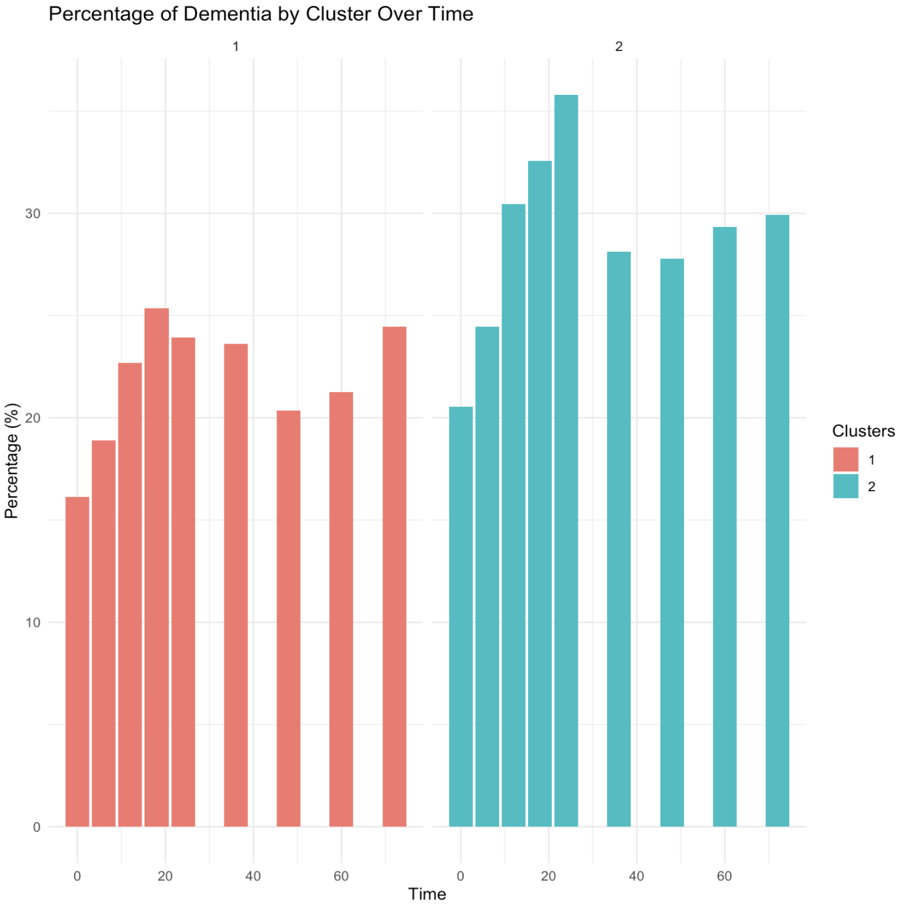
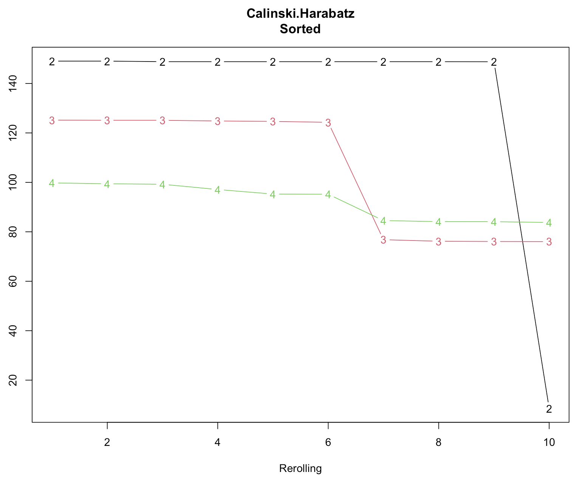
Clustering Results
Best clustering: 2 clusters (64%, 36%)
Cluster 2 consistently shows a higher percentage of dementia across all time points when compared to Cluster 1
Notes:
Percentage of Dementia by Cluster Over Time: Cluster 2 consistently shows a higher percentage of dementia across all time points when compared to Cluster 1. This indicates that individuals in Cluster 2 are more likely to progress to dementia, which could be due to a variety of factors including environmental factors, or other comorbidities that are not specified in the cluster data.

Slide 8
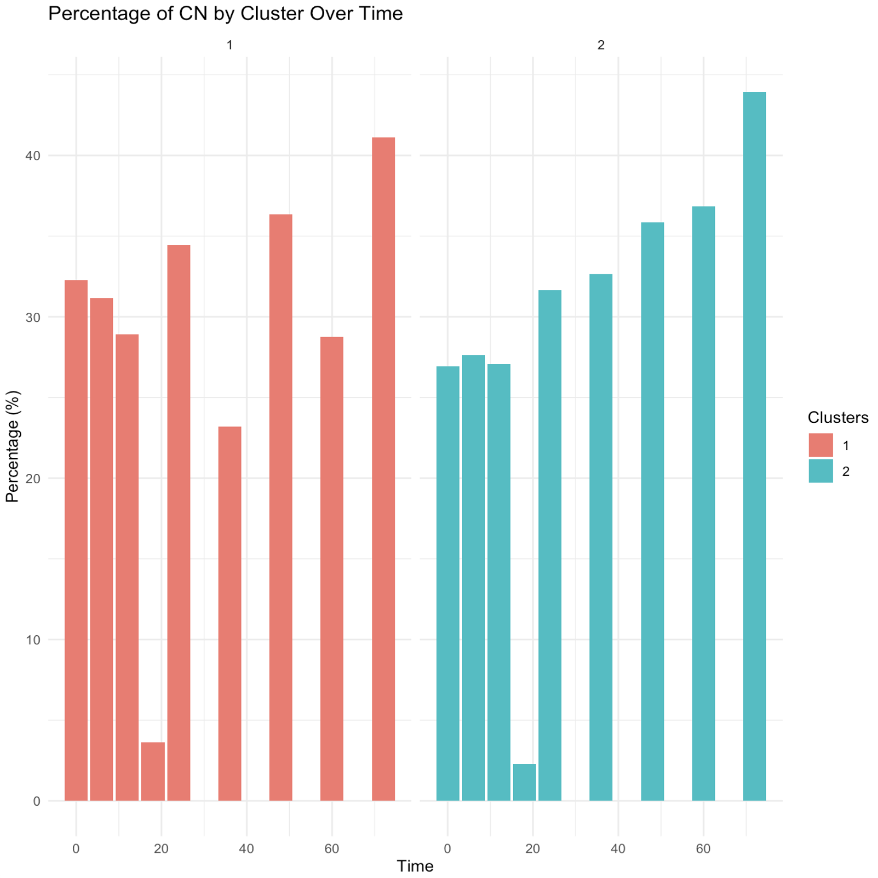
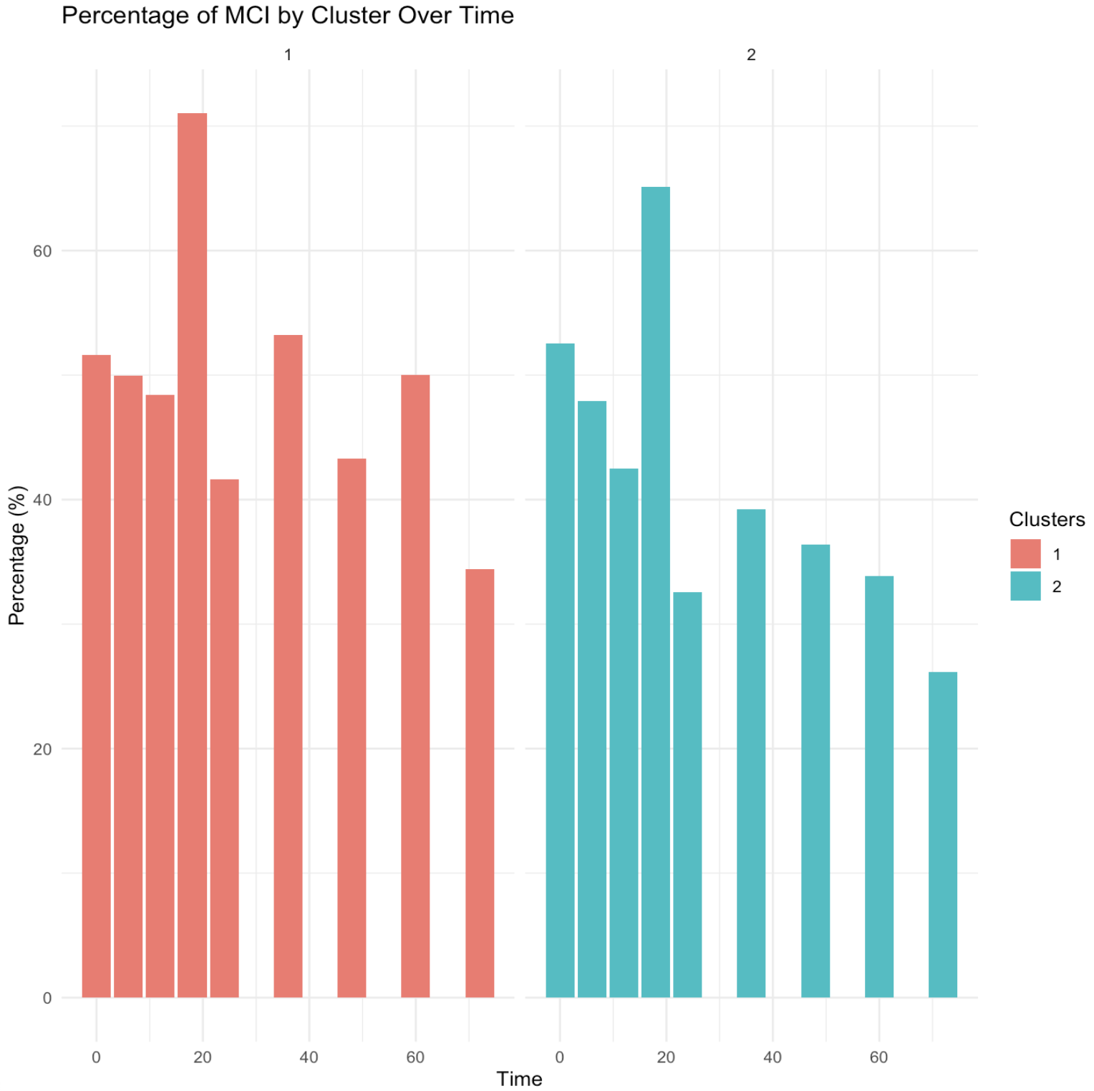
Notes:
Percentage of CN (Cognitively Normal) by Cluster Over Time: In the first year of follow up, there is a noticeable decline in the percentage of cognitively normal individuals in Cluster 1 over time, but they both increase over time. Could be attribution bias that participants who retain in study could be due to their cognitive conditions. 2. Percentage of MCI (Mild Cognitive Impairment) by Cluster Over Time: It appears that the percentage of MCI is initially higher in Cluster 1 but decreases over time and is inversely proportional to the trend in CN in cluster 1. This could indicate a transition from CN to MCI, especially in Cluster 1.

Slide 9
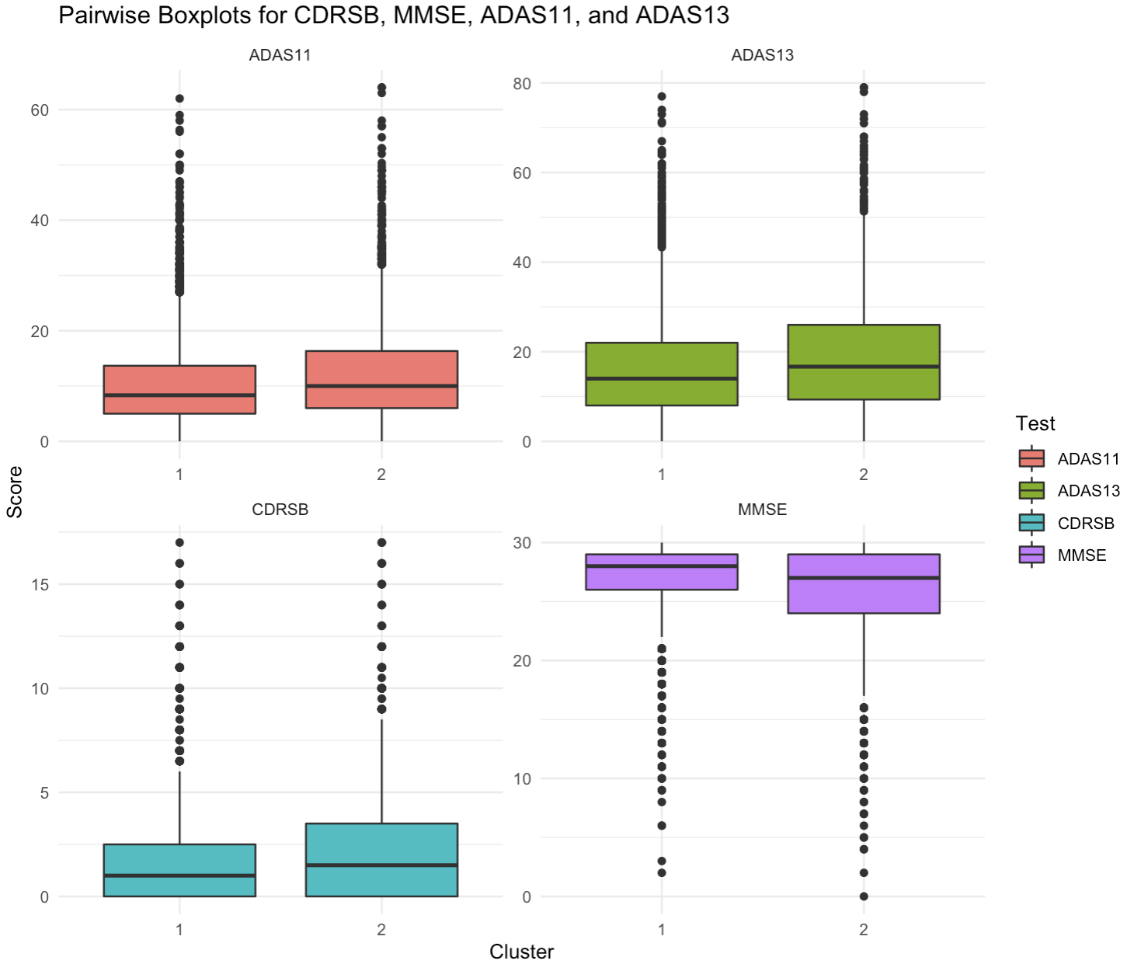
Cluster 2 has higher scores on ADAS11, ADAS13, CDRSB, and lower scores on MMSE
Significant p-values in Chi-sq test for all measurements
Diagnosis Stage | ADAS11 | ADAS13 | CDRSB | MMSE
Cognitively Normal (CN) | Higher score is worse performance. | Higher score is worse performance. | 0 – 1.0 | 27 - 30
Mild Cognitive Impairment (MCI) | 9 - 18 | 13 - 21 | 1.0 – 2.5 | 20 - 26
Dementia | > 18 | > 21 | > 2.5 | < 20
Notes:
Pairwise Boxplots for Clinical Measures: The boxplots demonstrate that Cluster 2 has higher scores on ADAS11 and ADAS13 and higher CDRSB scores but lower scores on MMSE compared to Cluster 1. Higher scores on ADAS11 and ADAS13, as well as CDRSB, indicate more pronounced cognitive deficits, while lower MMSE scores suggest more severe cognitive impairment. These measurements correlate with the higher prevalence of dementia in Cluster 2.

Slide 10
Key Findings
Summary of Clusters:
When compared to Cluster 1,
Cluster 2 consistently shows a higher percentage of dementia across all time points.
Cluster 2 has higher scores on ADAS11 and ADAS13 and higher CDRSB scores but lower scores on MMSE compared to Cluster 1.
The significant p-values from the chi-squared tests for all measurements suggest that the differences in cognitive scores between the clusters are statistically significant.
Cluster 2 is evidently associated with a higher risk and faster progression of cognitive decline leading to dementia.
Impact of the Study: These results underscore the potential of using cluster analysis in identifying subgroups within the AD spectrum, which could be crucial for targeted therapeutic interventions and personalized patient management.

Slide 11
Challenges and Considerations
Data Limitations
Loss of follow up
Unbalanced data: Different participants have different numbers of follow-up visits.
Methodological Challenges
Dimension Reduction
Tried Furry’s Common PCA, Functional PCA, Longitudinal Functional PCA but are computationally intensive and time-consuming.
Longitudinal Multivariate Clustering Methods
Methods such as k-means for longitudinal data (kml3d) are used, but selecting the number of clusters also requires long execution time.
Interpreting Clusters
Individual trajectories comparison
Notes:
Data Limitations
Loss of Follow-Up: Participants may drop out of the study over time, potentially leading to attrition bias. The reasons behind dropout may be related to the severity of the condition, which needs to be accounted for in the analysis.
Unbalanced Data: Different participants have different numbers of observations, which complicates the analysis. Especially when we originally had 13 time points from baseline to 120 months (10 years), this is extremely unbalanced dataset. Techniques such as imputation might be used to address this, but we have to be they also introduce to bias to the results.
Methodological Challenges
and ensuring the clusters are meaningful and not artifacts of the method are not small challenges.

Slide 12

Thank you for listening

