Slide 1
Penalized Generalized Estimating Equations for High-Dimensional Longitudinal Data Analysis
Authors: Lan Wang, Jianhui Zhou, Annie Qu
DOI: https://doi.org/10.1111/j.1541-0420.2011.01678.x
Presented by: Yao Chen

Slide 2
Introduction
Penalized generalized estimating equations (GEE) for high-dimensional longitudinal data analysis
Traditional GEE
Penalty functions
Theoretical properties
Evaluation
Monte Carlo simulations
Real world dataset application
Notes:
This is the flow of today’s presentation. We will present a thorough overview of the method and its theoretical theorems. If you find it interesting, or helpful with your research, you are welcome to discuss the details in QA session and after class.
- Penalized generalized estimating equations, or Penalized-GEE, is an innovative statistical approach to analyze high-dimensional longitudinal data.
- Traditional GEE models may not be able to handle the large number of covariates present in high-dimensional data, but the addition of penalty functions in Penalized-GEE can help address this issue.
- These penalty functions are mathematical functions that shrink the coefficients of irrelevant covariates, leading to more accurate and efficient results.
- The theoretical properties of P-GEE are also impressive, as they are consistent and asymptotically normal under certain conditions.
- To evaluate the effectiveness of P-GEE, Monte Carlo simulations and real-world dataset applications have been conducted. These studies have shown that P-GEE performs well in identifying relevant covariates and improving prediction accuracy.

Slide 3
Longitudinal Data Analysis – Challenges
High-dimensional longitudinal data
Repeated measurements on a large number of covariates over time
The number of variables (p) is much larger than the number of observations (n) , p>>n
Large-scale long-term health studies, gene expression experiments…
Traditional Generalized Estimating Equations in high-dimensional settings
Variable selection
Parameter estimation
Notes:
Longitudinal data analysis poses several challenges, especially when dealing with high-dimensional data. This type of data involves repeated measurements on a large number of covariates over time, with the number of variables much larger than the number of observations.
And it is commonly seen in Large-scale long-term health studies, gene expression experiments…
Traditional Generalized Estimating Equations, or GEE, may struggle in this setting with variable selection and parameter estimation due to the large number of covariates compared to the number of observations. This can lead to Overfitting: GEE models may overfit the high-dimensional data by including too many irrelevant covariates, which can result in poor generalization and low prediction accuracy.

Slide 4
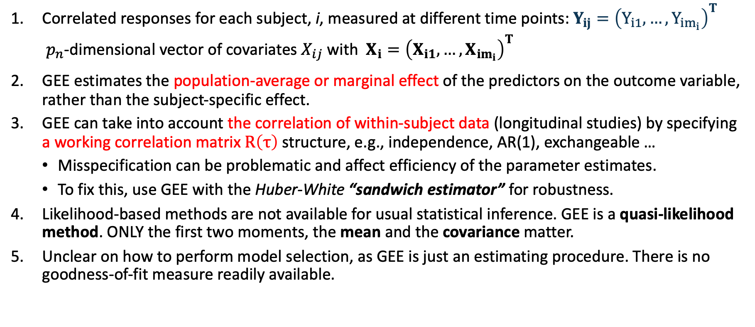
Generalized Estimating Equations (GEE)
Correlated responses for each subject, i, measured at different time points: $Y_{ij}={\left(Y_{i1}, …, Y_{im_{i}}\right)}^{T}$
$p_{n}$-dimensional vector of covariates $X_{ij}$ with $X_{i}={\left(X_{i1},…, X_{im_{i}}\right)}^{T}$
GEE estimates the population-average or marginal effect of the predictors on the outcome variable, rather than the subject-specific effect.
GEE can take into account the correlation of within-subject data (longitudinal studies) by specifying a working correlation matrix $R\left(τ\right)$structure, e.g., independence, AR(1), exchangeable …
Misspecification can be problematic and affect efficiency of the parameter estimates.
To fix this, use GEE with the Huber-White “sandwich estimator” for robustness.
Likelihood-based methods are not available for usual statistical inference. GEE is a quasi-likelihood method. ONLY the first two moments, the mean and the covariance matter.
Unclear on how to perform model selection, as GEE is just an estimating procedure. There is no goodness-of-fit measure readily available.
Notes:
Before introducing the penalized GEE method, let’s review the generalized estimating equations and here are some take-home messages:
GEE, is a statistical method used to analyze correlated data from longitudinal studies or clustered data.
GEE estimates the population-average or marginal effect of the predictors on the outcome variable, rather than the subject-specific effect.
To account for the correlation of within-subject data, GEE specifies a working correlation matrix structure, such as independence, AR(1), or exchangeable.
However, misspecification can be problematic and affect the efficiency of the parameter estimates. To fix this, GEE can be used with the Huber-White “sandwich estimator” for robustness.
Unlike likelihood-based methods, GEE is a quasi-likelihood method, which means only the first two moments, the mean and the covariance, matter. However, there is no readily available goodness-of-fit measure for GEE, making model selection unclear.
Overall, GEE is a powerful tool for analyzing longitudinal data.

Slide 5
GEE with Diverging Number of Covariates
Wang (2011) in paper “GEE Analysis of Clustered Binary Data with Diverging Number of Covariates,” developed an asymptotic theory for GEE analysis of clustered binary data when the number of covariates grows to infinity with the number of clusters (”large n, diverging p” framework).
The existence, consistency, and asymptotic normality of the GEE estimator under appropriate regularity conditions
When the working correlation matrix is misspecified, the sandwich variance formula remains valid.
An asymptotically valid confidence interval and Wald test for an estimable linear combination of the unknown parameters
The accuracy of the asymptotic approximation is examined via numerical simulations.
Notes:
Dr. Wang, the first and corresponding author of this methodology paper, also developed the asymptotic theory for GEE analysis when the number of covariates grows to infinity with the number of clusters. -----
This also provided us theoretical background for dimension reduction by variable selection when we work with high-dimensional longitudinal data

Slide 6
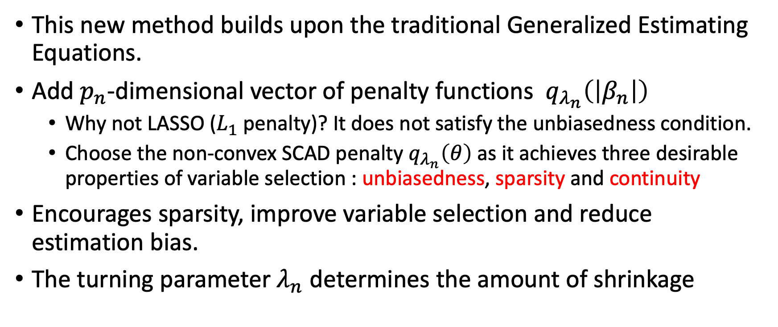
The Penalized GEE Method – Overview
This new method builds upon the traditional Generalized Estimating Equations.
Add $p_{n}$-dimensional vector of penalty functions $q_{λ_{n}}\left(\left|β_{n}\right|\right)$
Why not LASSO ($L_{1}$penalty)? It does not satisfy the unbiasedness condition.
Choose the non-convex SCAD penalty $q_{λ_{n}}\left(θ\right)$ as it achieves three desirable properties of variable selection : unbiasedness, sparsity and continuity
Encourages sparsity, improve variable selection and reduce estimation bias.
The turning parameter $λ_{n}$ determines the amount of shrinkage
Notes:
The Penalized GEE approach adds penalty functions to the GEE model, shrinking the coefficients of irrelevant covariates and producing more accurate and efficient results. ---
Overall, P-GEE is a powerful tool that can help researchers better understand the dynamics of high-dimensional longitudinal data, and has the potential to advance research in fields such as genetics, epidemiology, and biomedical sciences.

Slide 7
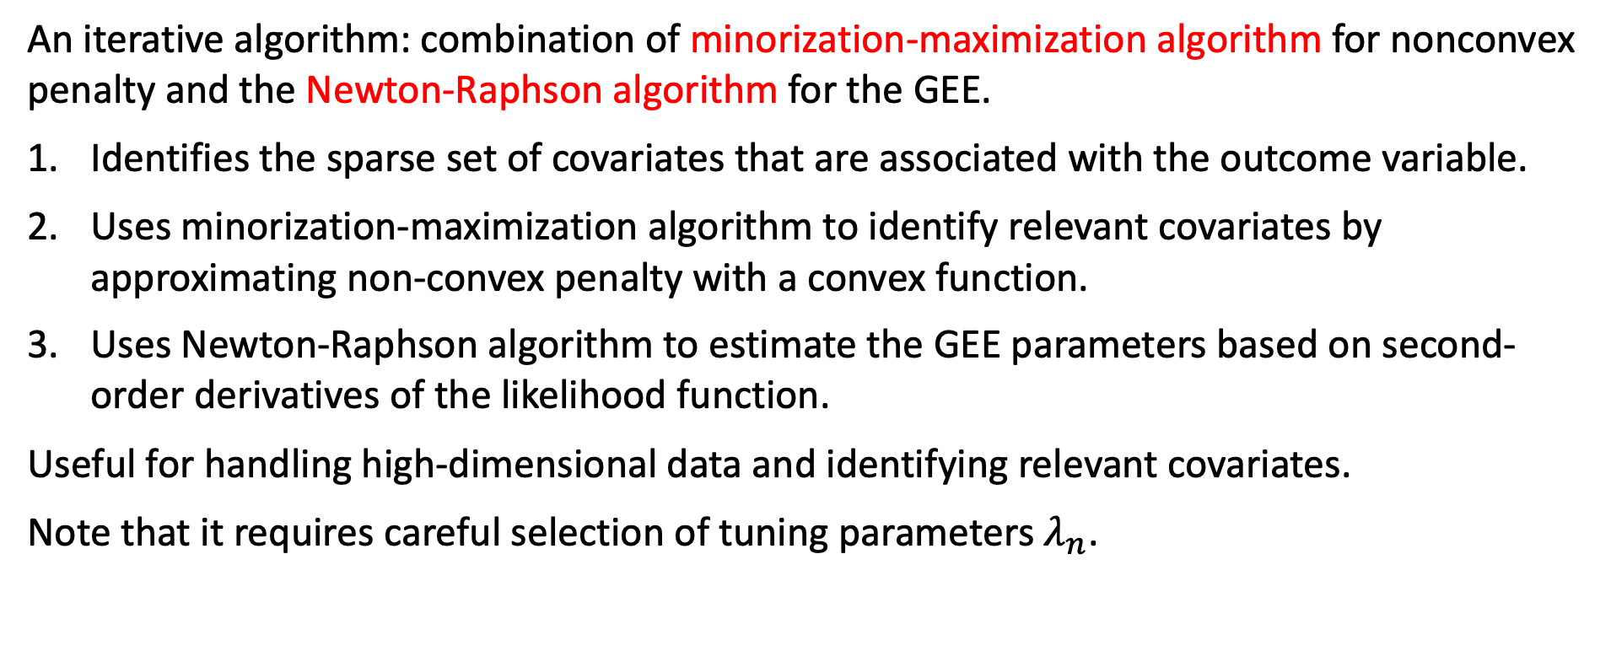
The Penalized GEE Method – Algorithm
An iterative algorithm: combination of minorization-maximization algorithm for nonconvex penalty and the Newton-Raphson algorithm for the GEE.
Identifies the sparse set of covariates that are associated with the outcome variable.
Uses minorization-maximization algorithm to identify relevant covariates by approximating non-convex penalty with a convex function.
Uses Newton-Raphson algorithm to estimate the GEE parameters based on second-order derivatives of the likelihood function.
Useful for handling high-dimensional data and identifying relevant covariates.
Note that it requires careful selection of tuning parameters $λ_{n}$.

Slide 8
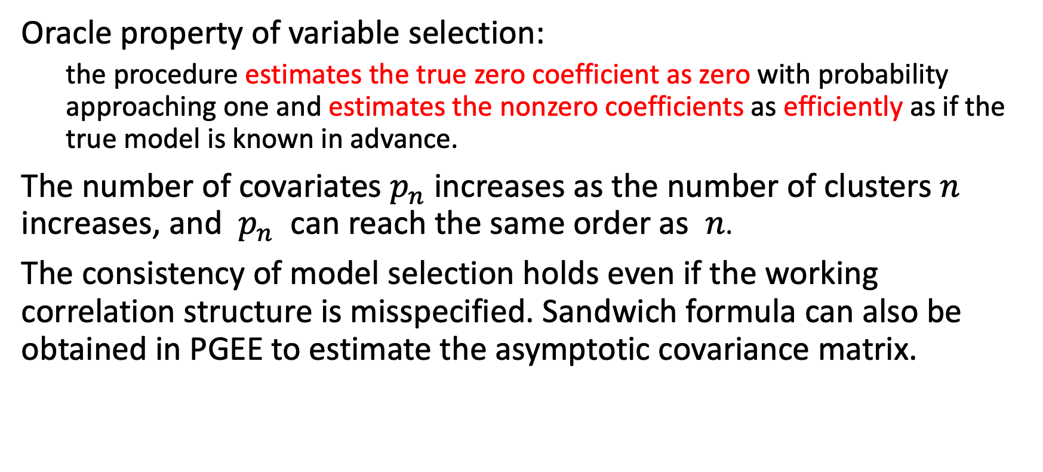
Asymptotic Theory - Theorem
Oracle property of variable selection:
the procedure estimates the true zero coefficient as zero with probability approaching one and estimates the nonzero coefficients as efficiently as if the true model is known in advance.
The number of covariates $p_{n}$ increases as the number of clusters $n$ increases, and $p_{n}$ can reach the same order as $n$.
The consistency of model selection holds even if the working correlation structure is misspecified. Sandwich formula can also be obtained in PGEE to estimate the asymptotic covariance matrix.

Slide 9
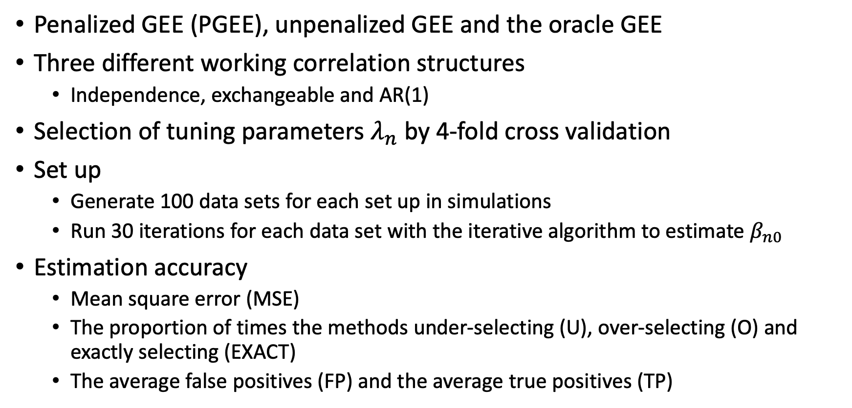
Monte Carlo Simulations – Design
Penalized GEE (PGEE), unpenalized GEE and the oracle GEE
Three different working correlation structures
Independence, exchangeable and AR(1)
Selection of tuning parameters $λ_{n}$ by 4-fold cross validation
Set up
Generate 100 data sets for each set up in simulations
Run 30 iterations for each data set with the iterative algorithm to estimate $β_{n0}$
Estimation accuracy
Mean square error (MSE)
The proportion of times the methods under-selecting (U), over-selecting (O) and exactly selecting (EXACT)
The average false positives (FP) and the average true positives (TP)
Notes:
Three models : Penalized GEE (PGEE) with all zeros as initial beta values, unpenalized GEE with all zeros as initial beta values and the oracle GEE, which is the ideal model with the true beta values
For each model, we also applied three working correlations structures: Independence, exchangeable and AR(1)
First we need to select the tunning parameter lambda_n in penalty function by a forth fold cross validation. Note that this step actually took a long time to process, and my simulation only calculated the accuracy of 0.1, not 0.01 due to the limited time.
Set up & estimation

Slide 10
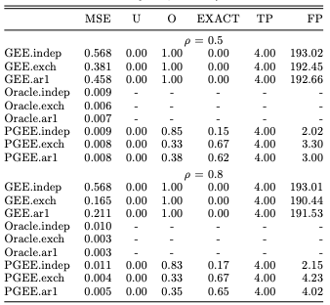

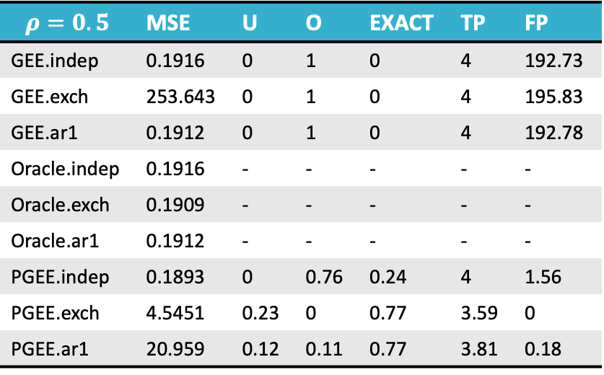
Monte Carlo Simulations – Results
Example 1 : correlated normal responses ($n=200$, $p_{n}=200$)
$$Y_{ij}=X_{ij}^{T}β+ε_{ij}$$
The penalized GEE successfully reduces MSE, selects all covariates with nonzero coefficients and has a fairly small number of FPs.
$$ρ=0.5$$ | MSE | U | O | EXACT | TP | FP
GEE.indep | 0.1916 | 0 | 1 | 0 | 4 | 192.73
GEE.exch | 253.643 | 0 | 1 | 0 | 4 | 195.83
GEE.ar1 | 0.1912 | 0 | 1 | 0 | 4 | 192.78
Oracle.indep | 0.1916 | - | - | - | - | -
Oracle.exch | 0.1909 | - | - | - | - | -
Oracle.ar1 | 0.1912 | - | - | - | - | -
PGEE.indep | 0.1893 | 0 | 0.76 | 0.24 | 4 | 1.56
PGEE.exch | 4.5451 | 0.23 | 0 | 0.77 | 3.59 | 0
PGEE.ar1 | 20.959 | 0.12 | 0.11 | 0.77 | 3.81 | 0.18
Notes:
The correlated normal responses are generated from this model, with 200 subjects, 4 timepoints, and 200 covariates.
we generate xij from the multivariate normal distribution with mean 0 and an AR(1) covariance matrix with marginal variance 1 and auto-correlation coefficient 0.5.
The random errors are also generated from the multivariate normal distribution with marginal mean 0, marginal variance 1 and an exchangeable correlation matrix with parameter ρ.
We consider ρ = 0.5 and 0.8 to represent different strength of within cluster correlation
The results of Table on the right hand side, summarize the estimation accuracy and model selection properties of the penalized GEE, the unpenalized GEE and the oracle GEE for three different working correlation matrices and two different values of ρ.
We observe that in terms of estimation accuracy the penalized GEE procedure performs closely to the oracle GEE, and significantly reduces the MSE of the unpenalized GEE estimator.
Using the true correlation structure (exchangeable) in penalized GEE gives the smallest MSE, with greater gain when the within cluster association is stronger.
Furthermore, we observe that the unpenalized GEE generally does not lead to a sparse model. The penalized GEE successfully selects all covariates with nonzero coefficients and has a fairly small number of false positives.

Slide 11

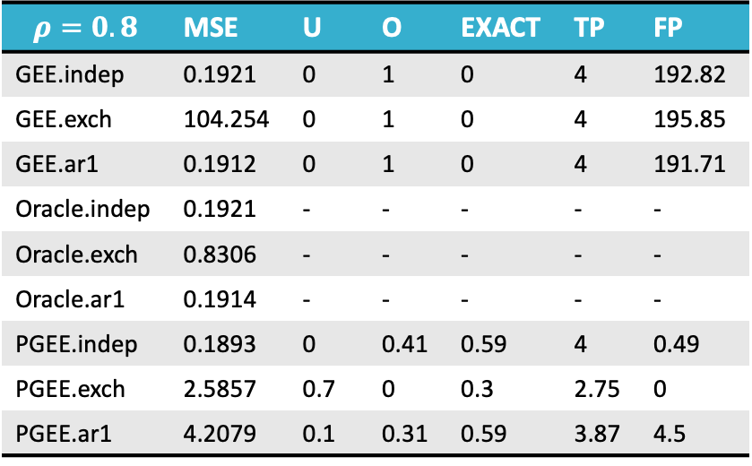
Monte Carlo Simulations – Results
Example 1 : correlated normal responses ($n=200$, $p_{n}=200$)
$$Y_{ij}=X_{ij}^{T}β+ε_{ij}$$
The penalized GEE successfully reduces MSE, selects all covariates with nonzero coefficients and has a fairly small number of FPs.
$$ρ=0.8$$ | MSE | U | O | EXACT | TP | FP
GEE.indep | 0.1921 | 0 | 1 | 0 | 4 | 192.82
GEE.exch | 104.254 | 0 | 1 | 0 | 4 | 195.85
GEE.ar1 | 0.1912 | 0 | 1 | 0 | 4 | 191.71
Oracle.indep | 0.1921 | - | - | - | - | -
Oracle.exch | 0.8306 | - | - | - | - | -
Oracle.ar1 | 0.1914 | - | - | - | - | -
PGEE.indep | 0.1893 | 0 | 0.41 | 0.59 | 4 | 0.49
PGEE.exch | 2.5857 | 0.7 | 0 | 0.3 | 2.75 | 0
PGEE.ar1 | 4.2079 | 0.1 | 0.31 | 0.59 | 3.87 | 4.5
Example 2 for correlated binary responses is not replicated because the R package used was removed from CRAN repository.
Notes:
The correlated normal responses are generated from this model, with 200 subjects, 4 timepoints, and 200 covariates.
we generate xij from the multivariate normal distribution with mean 0 and an AR(1) covariance matrix with marginal variance 1 and auto-correlation coefficient 0.5.
The random errors are also generated from the multivariate normal distribution with marginal mean 0, marginal variance 1 and an exchangeable correlation matrix with parameter ρ.
We consider ρ = 0.5 and 0.8 to represent different strength of within cluster correlation
The results of Table on the right hand side, summarize the estimation accuracy and model selection properties of the penalized GEE, the unpenalized GEE and the oracle GEE for three different working correlation matrices and two different values of ρ.
We observe that in terms of estimation accuracy the penalized GEE procedure performs closely to the oracle GEE, and significantly reduces the MSE of the unpenalized GEE estimator.
Using the true correlation structure (exchangeable) in penalized GEE gives the smallest MSE, with greater gain when the within cluster association is stronger.
Furthermore, we observe that the unpenalized GEE generally does not lead to a sparse model. The penalized GEE successfully selects all covariates with nonzero coefficients and has a fairly small number of false positives.

Slide 12

Real Data Application – Results
Data: yeast cell-cycle gene expression data Genome-wide mRNA levels for 6178 yeast ORFs at 7-minute intervals for 119 minutes, which covers two cell-cycle periods for a total of 18 time points.
Goal: Identify transcription factors (TFs) that influence gene expression levels at each stage of the cell process.
At each of the five stages, the selected TFs were not sensitive to the choice of working correlation structure.
Some of these selected TFs have already been confirmed by biological experiments using genome-wide binding method.
Different TFs play important roles at different stages of the cell-cycle process, which has also been observed by the biologists.
The sets of TFs selected at different stages have only small overlaps.
Table: Number of TFs selected for each stage in the yeast cell-cycle
process with the penalized GEE procedure.

Slide 13
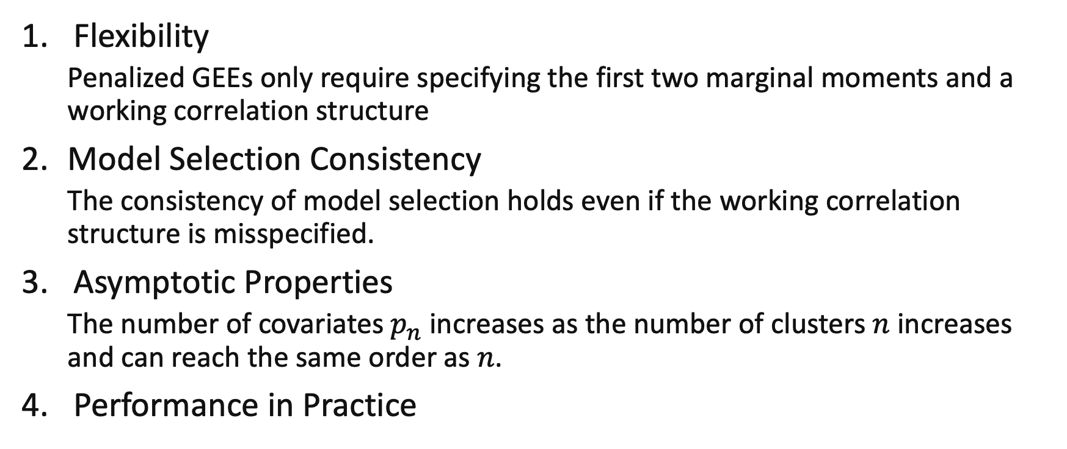
Advantages of Penalized GEE
Flexibility
Penalized GEEs only require specifying the first two marginal moments and a working correlation structure
Model Selection Consistency
The consistency of model selection holds even if the working correlation structure is misspecified.
Asymptotic Properties
The number of covariates $p_{n}$ increases as the number of clusters $n$ increases and can reach the same order as $n$.
Performance in Practice

Slide 14
Concluding Remarks – Potential Limitations
Assumptions about working correlation structure
Tendency to select an overfitted model in cross validation
The tuning parameter selection may influence the practical performance
Computational complexity with larger datasets (took me 18+ hours to only run R codes to replicate the simulations and real-world data analysis)

Slide 15

Thank you and questions?

