Slide 1
DOWN2GO
6.170 Initial project pitch
Lucy Yu, Chongyuan Xiang, Yang Chen, Andre Mroz

Slide 2
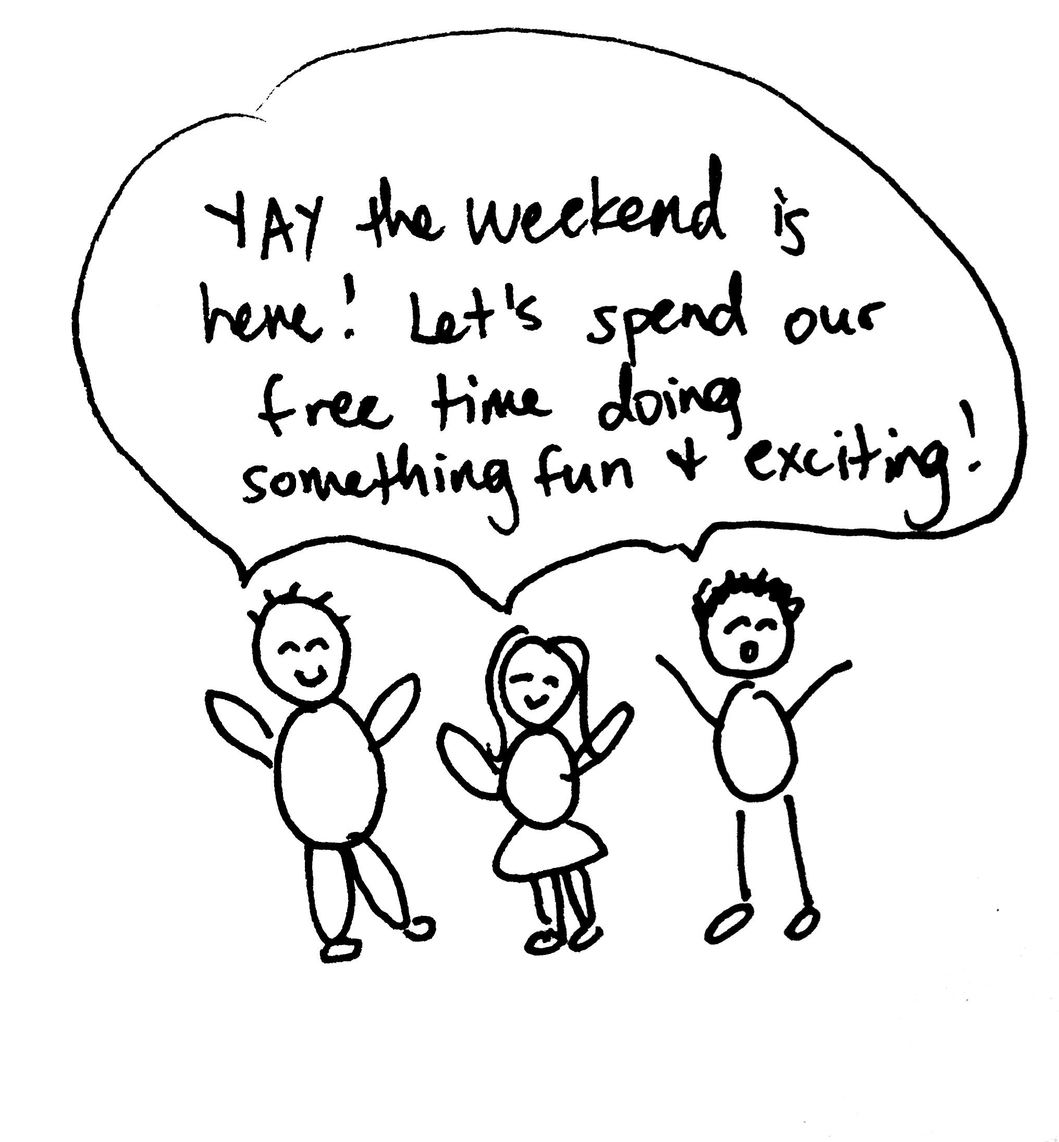
Problem: A group of friends is deciding what to do on the weekend

Slide 3
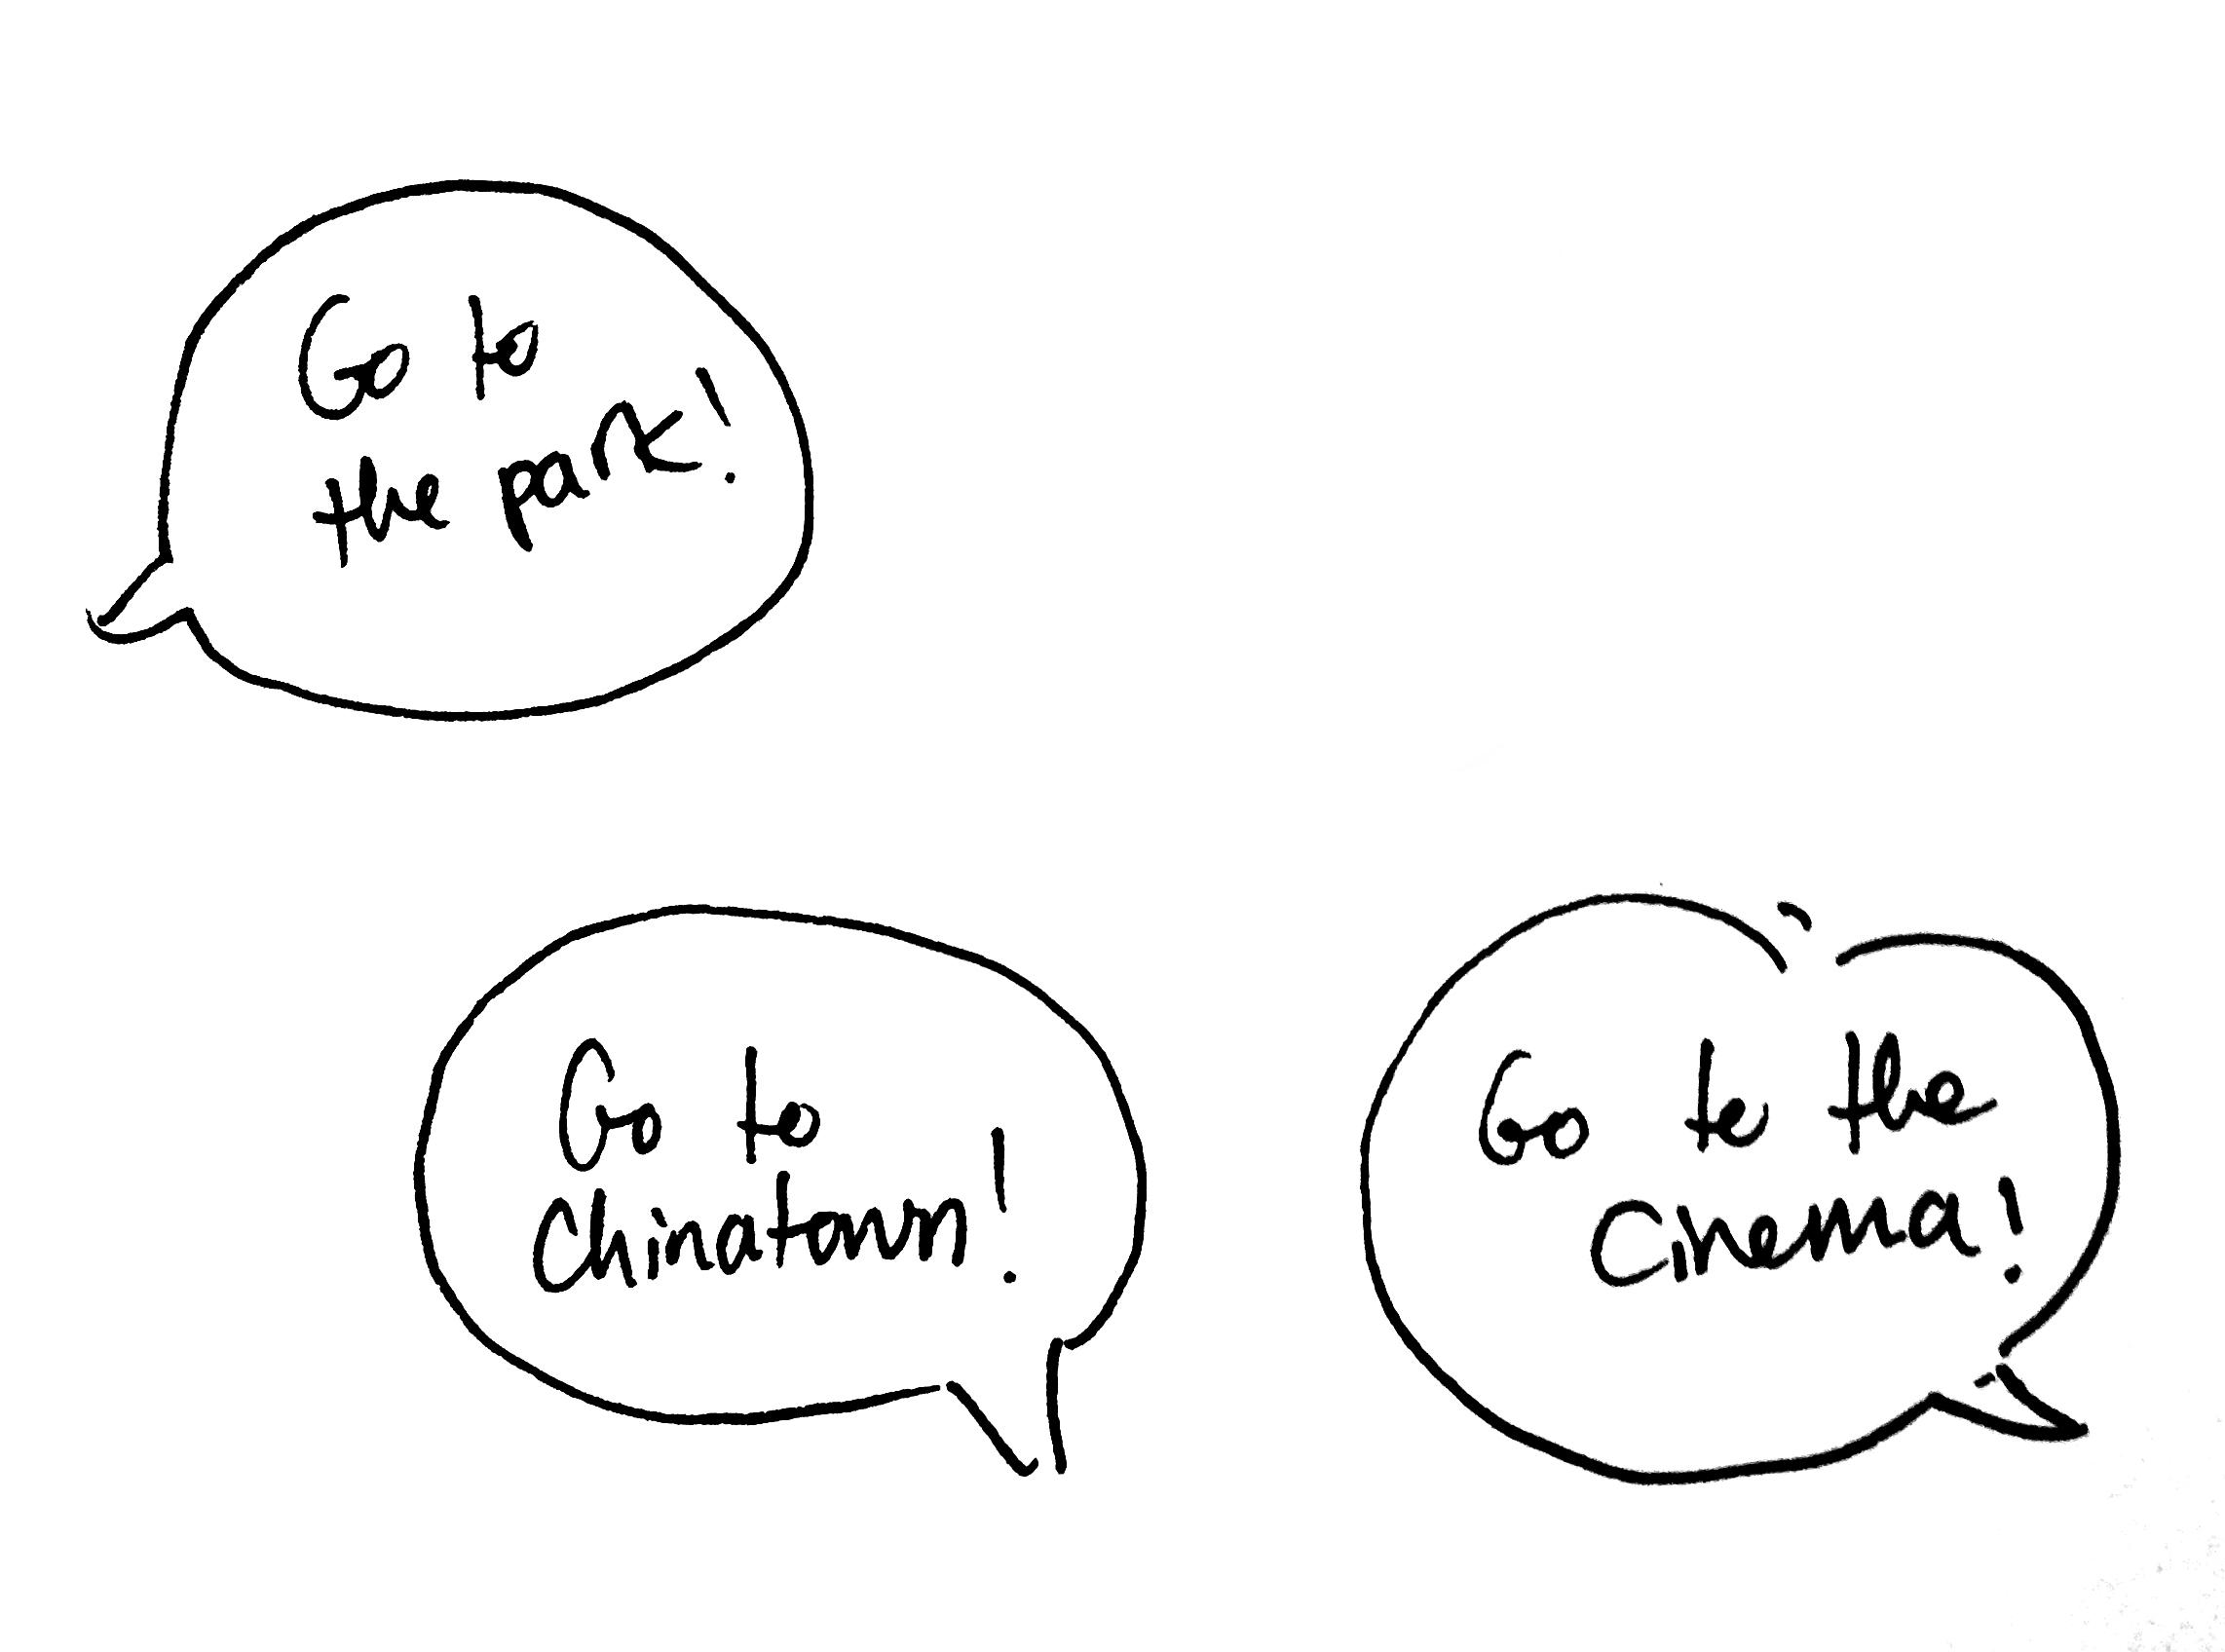
Problem: A group of friends is deciding what to do on the weekend

Slide 4
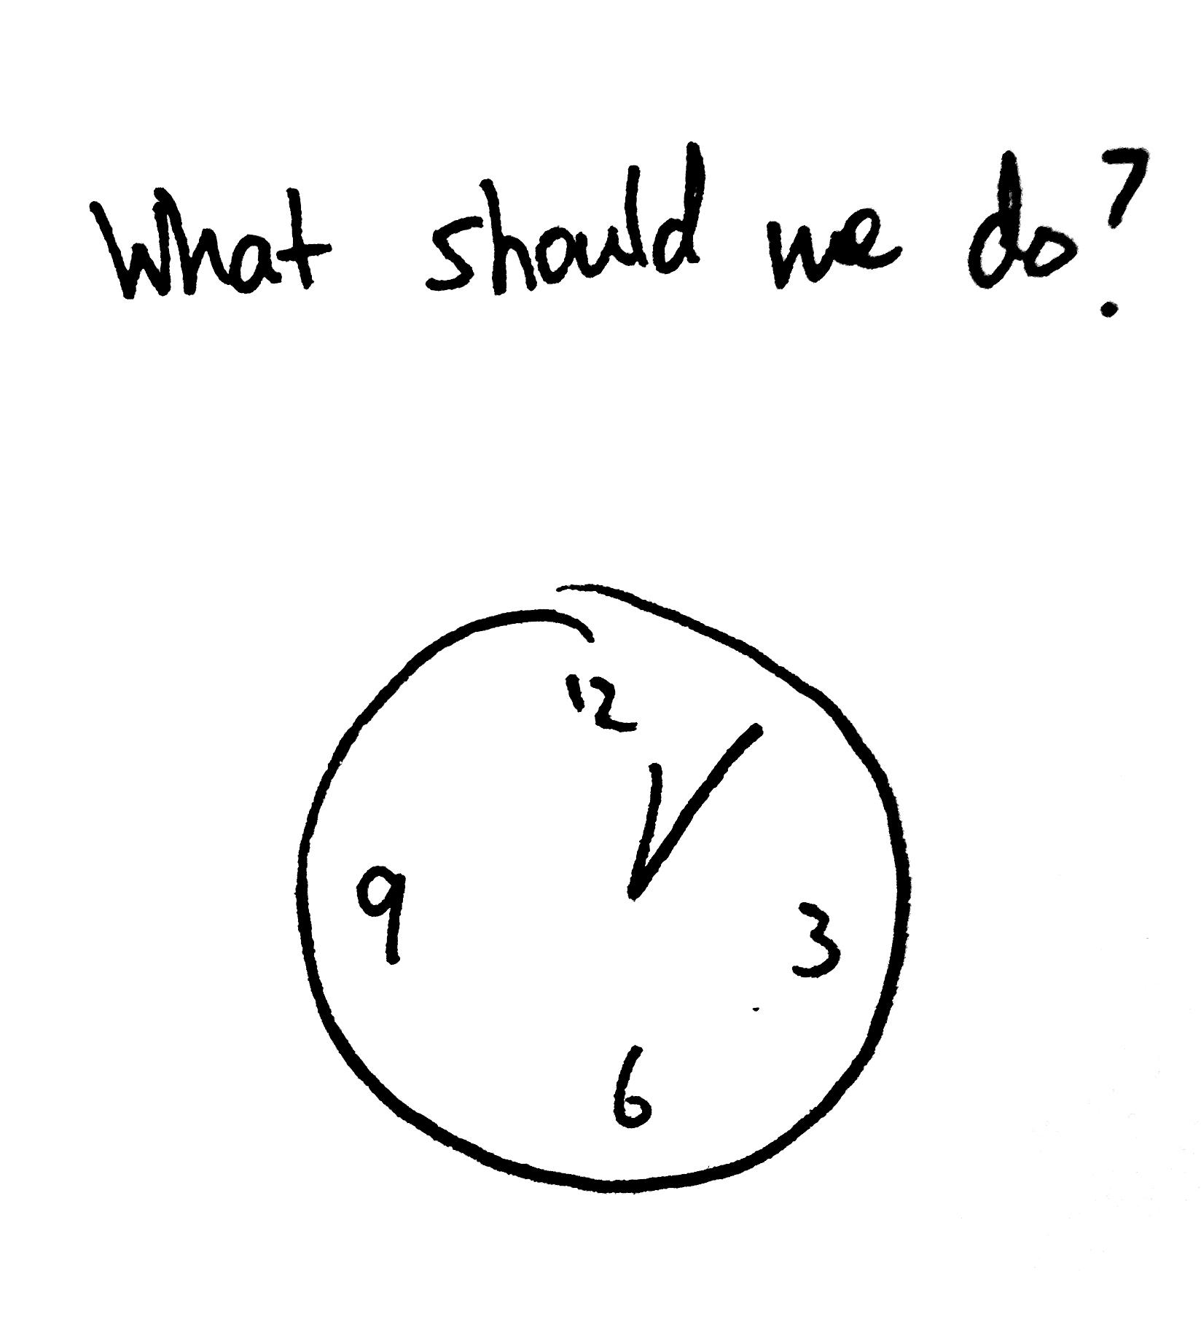
Problem: A group of friends is deciding what to do on the weekend

Slide 5
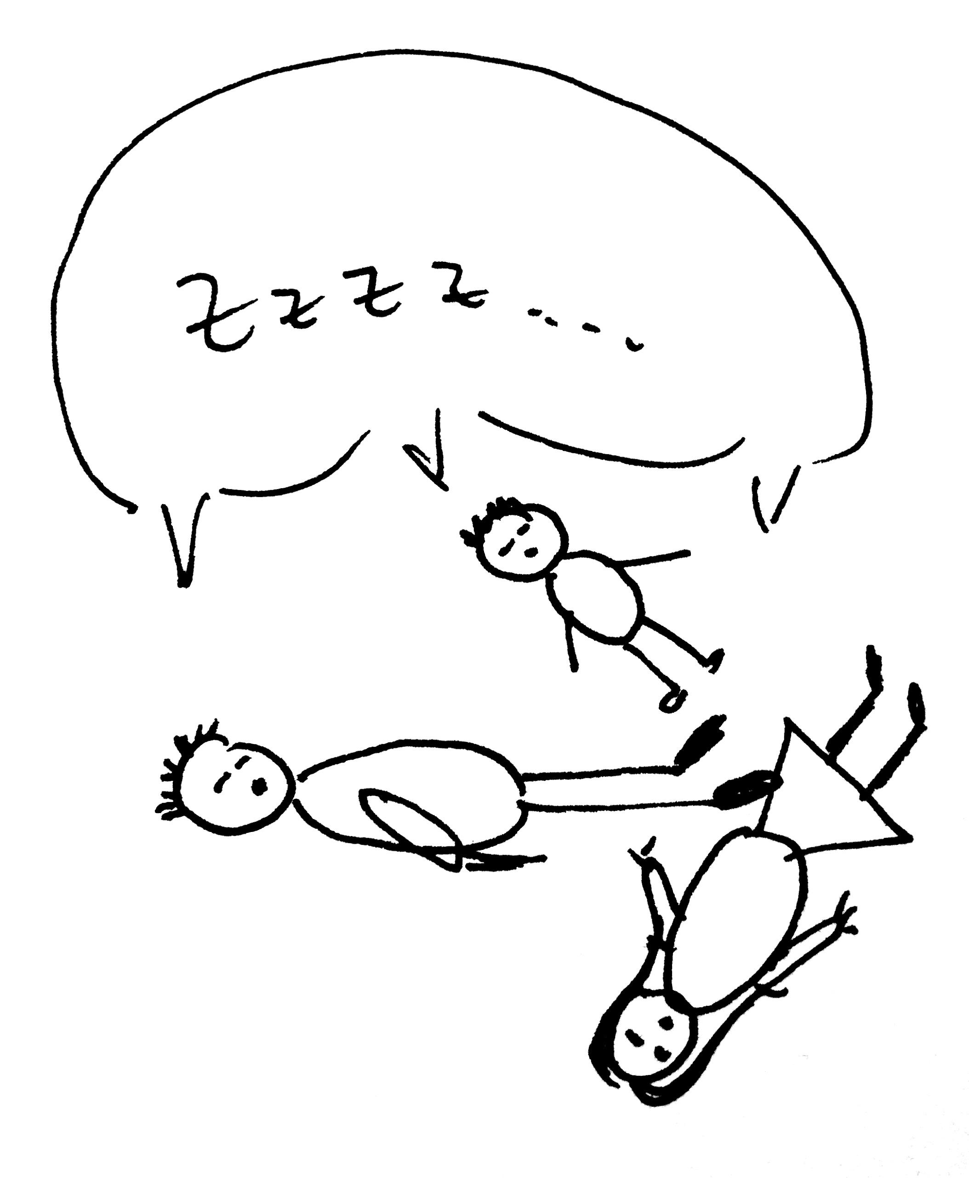
Problem: A group of friends is deciding what to do on the weekend

Slide 6
Problem: A group of friends is deciding what to do on the weekend
OPPORTUNITY WASTED!

Slide 7
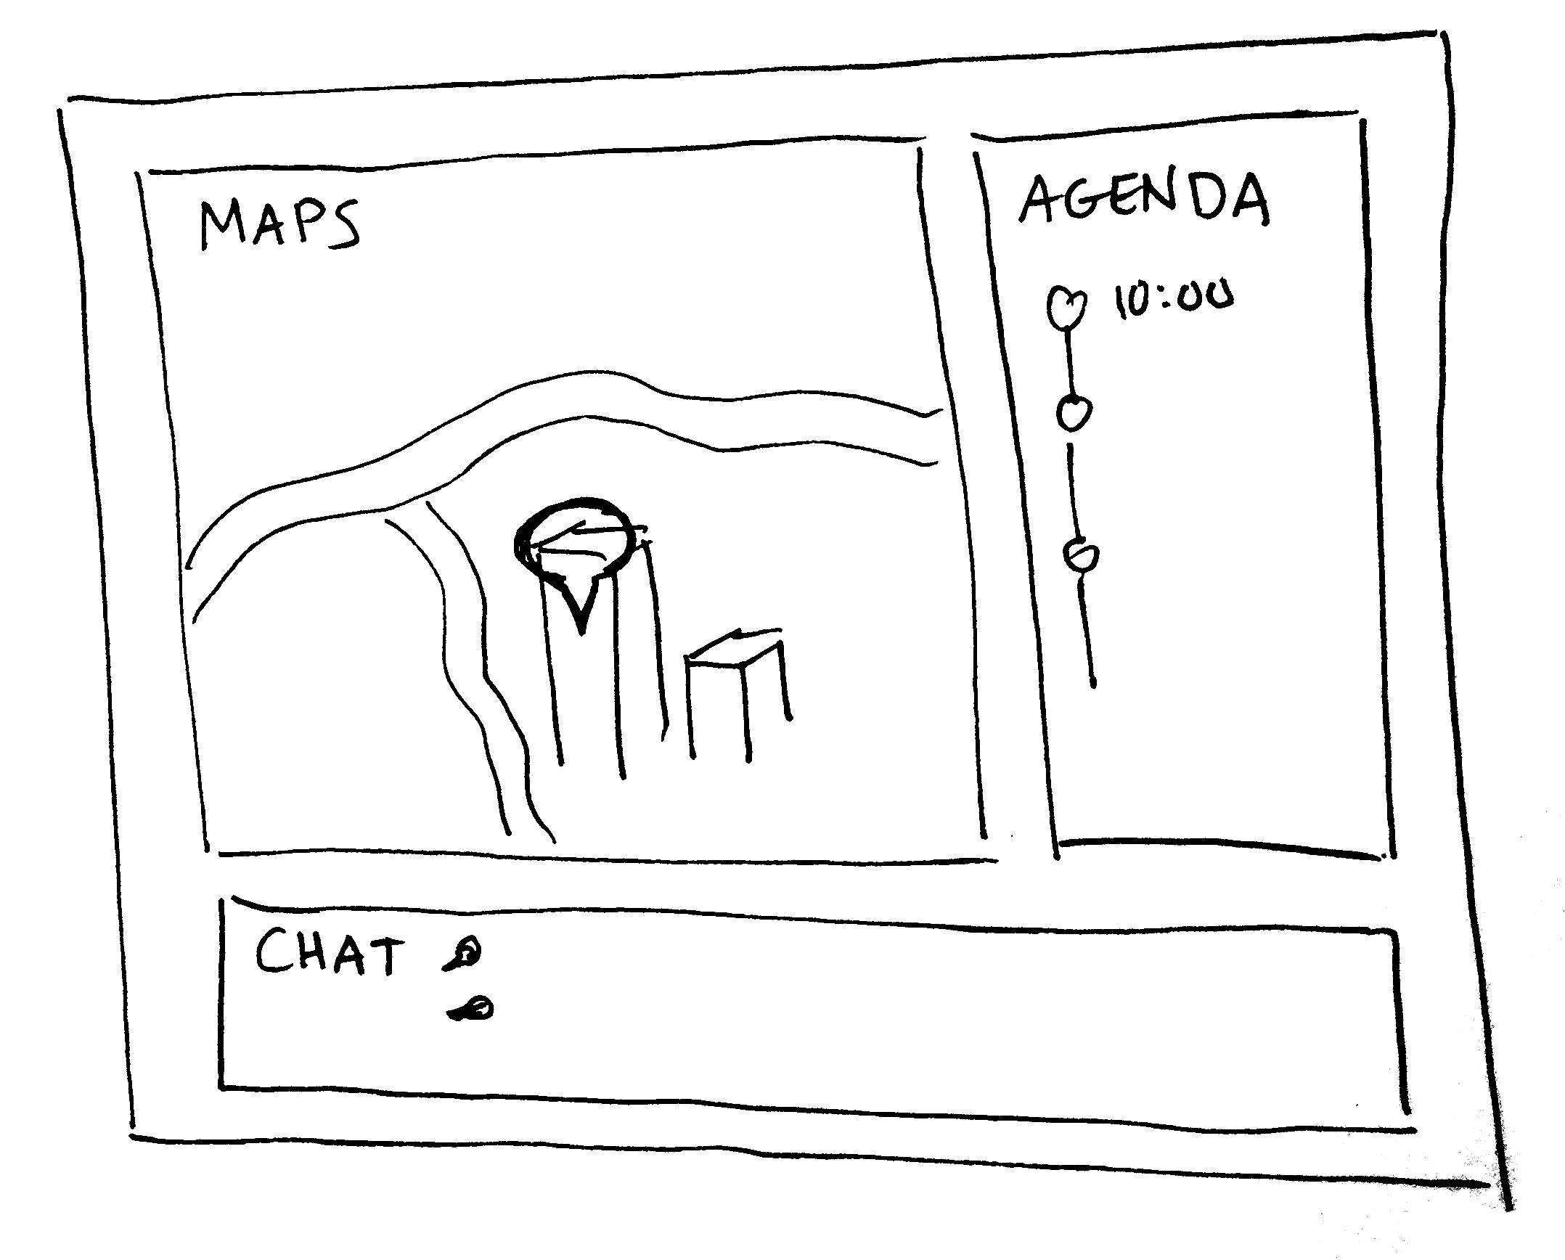
SAY HELLO TO DOWN2GO!

Slide 8




Features
Real time chat
Google Maps Integration
Mark your activities
Create an agenda

Slide 9
Concepts
MAP/PINPOINT visual representation of activity/ idea
AGENDA schedule to follow
GROUP group of friends with common goal (to have fun together!)

Slide 10
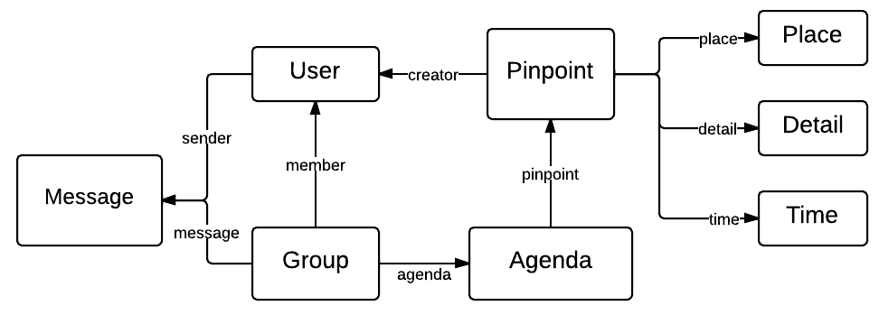
Data Model

Slide 11
Challenges and Risks
Displaying a map and allowing users to interact with it
Google Maps API
People averse to using another app to deal with a real life problem
Very minimalistic, flat UI design
Easy to sign up (login by MIT certification?)
Make our system real-time
Pick up a plug-in, for example, Pusher

Slide 12
Challenges and Risks cont.
Concurrency: people may edit the same marker at the same time, or send chat messages at the same time
Implement a lock for the marker on the server that allows only one user to work on a marker at once. For chat, we will implement a versioning record that keeps the order of messages according to when they arrived on the server

