Slide 2
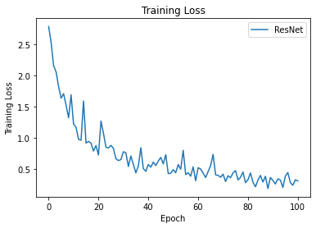
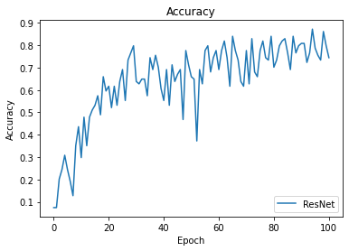
Classification: ResNet
ResNet:
Kernel (1, 16, 32, 32, 64, 64)
Highest accuracy: 87.2%
Time used: 63 min 43 sec

Slide 3
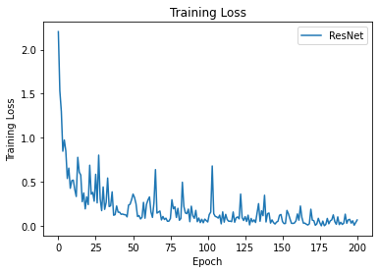
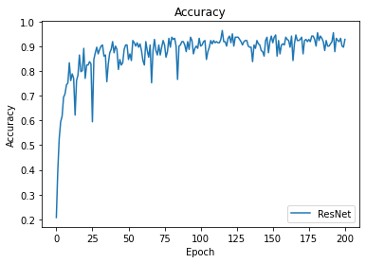
Classification: ResNet 02
ResNet: (with normalize)
Kernel (1, 16, 32, 32, 64, 64)
Highest accuracy: 96.4%
Time used: 137 min 16 sec (200 epochs)
Data description:
- #Class (id): 50
- 1 ground signal + 99 labeled signals per id
- Signal Length: 2556 samples (fs = 0.1 ns)
- Total data: 4950
- Train: 80% (3960) & Test: 20% (990)

Slide 4
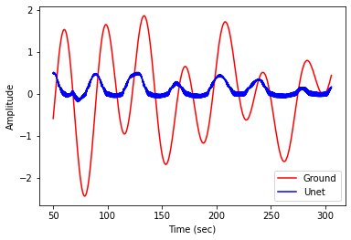
Denoise: Unet (without normalized)

