Slide 1
LULCC_toy 流程圖
fun_lulcc_toy function start
Default parameters: ld_plot=TRUE, nx=50,
ny=50, y=100, p=10, l=30, w=10, k=3,
q=80, v=20, c_value=200, f_top=0.01, geo_city=data.frame(x=c(10,35,40), y=c(10,35,10)
nx=10, ny=10,
y=100, p=10,
l=50, w=5,
k=5, q=25,
v=20, c_value=250.0,
geo_city = data.frame (x=c(1,8,3),y=c(5,1,2))
L25 - L41
Y
ld_go <- TRUE?
N
remain default parameters
#n_city = total number of cities
n_city <- nrow(geo_city)
#create empty topology array
topo <- array(NA, dim=c(nx,ny))
# to create topology based on x y index
L48 – L54
for loop – j loop
i=1nx; j=1:ny
for loop – i loop
#create topology based on x y index
id <- id +1
topo[i,j] <- i*j
L55 – L60
#create lu_arr array with default value 3 (forest) to hold lu type
lu_arr <- array(3, dim=c(nx,ny))
#create dis_n empty array to hold values of distance between points and cities
dis_n <- array(NA, dim=c(nx,ny,n_city))
#create rent_n empty array to hold values of rent
rent_n <- array(NA,dim=c(nx,ny,n_city))

Slide 2
L63 – L77
for loop – k loop
#i j k loop to assign lu type to study area +
calculate distance of points to cities and
rent based on the distance calculated
#assign city with lu type 1 (city)
lu_arr[c(geo_city$x[k]), c(geo_city$y[k])] <- 1
i=1, j=1,k=1
for loop – j loop
for loop – i loop
#calculate distance from city
del_xy <- sqrt(abs(i- geo_city$x[k])**2. + abs(j- geo_city$y[k])**2.)
#store value of del_xy into dis_n array
dis_n[i,j,k] <- del_xy
#store calculated rent values into rent_n array
rent_n[i,j,k] <- (p*y) - (l*w) - (k*q) - v* ( topo[i,j]*f_top + dis_n[i,j,k] )
sqrt(2) >= del_xy >= 1.0 ?
Y
#assign areas with proximity >= 1 and <= sqrt(2) to lu type 2 (agri)
lu_arr[i,j] <- 2
L78 – L82
# create rent_final array for storing maximum rent through comparison among different cities
rent_final <- array(NA, dim=c(nx,ny))
#copy lu_arr array containing original lu type data to new_lu_arr array
new_lu_arr <- lu_arr

Slide 3
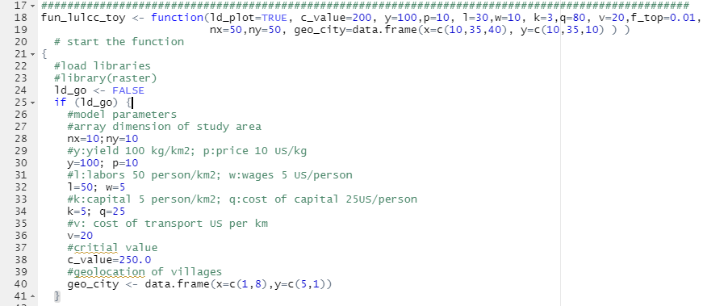
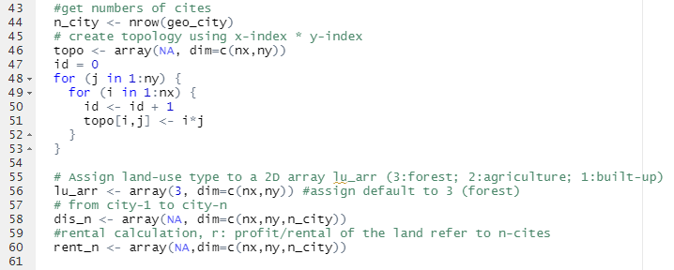
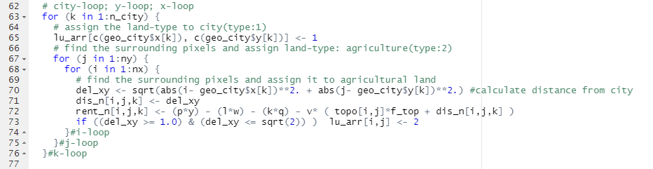

Slide 5
#i j k loop to finalize final rent assign new lu type based on c_value
L83 – L100
for loop – j loop
i=1,nx; j=1,ny; k=1, n_city
for loop – i loop
#set initial tmp value as -999.99
tmp <- -999.99
for loop – k loop
rent_n[i,j,k] >= tmp ?
N
Do nothings
Y
#assign rent value to tmp when rent >= temp
tmp <- rent_n[i,j,k]
#store final maximum rent value to rent_final array
rent_final[i,j] <- tmp
(rent_final[i,j] >= c_value) & (lu_arr[i,j] == 3)
N
Do nothings
Y
#assign lu type 2 (agri) to land originally marked as lu type 3 (forest) and has final rent >= c_value
new_lu_arr[i,j] <- 2

Slide 6
ld_plot <- TRUE
L102 – L119
if statement
ld_go <- TRUE?
#plotting
N
No plotting
Y
#plot of distance from city 1
par(mfrow=c(1,2))
image.plot(dis_n[,,1],col=terrain.colors(10), main="distance of city 1 ")
#plot of land rent over study area
image.plot(rent_final,col=terrain.colors(10), main="land rent")
#plot of original land use type
dev.new()
par(mfrow=c(1,2))
image.plot(lu_arr, col=rev(terrain.colors(10)), zlim=c(1,3), main="original land use type")
contour(topo, add=TRUE)
#plot of new land use type
image.plot(new_lu_arr, col=rev(terrain.colors(10)), zlim=c(1,3), main="new land use type")
contour(topo, add=TRUE)
fun_lulcc_toy function end

Slide 7
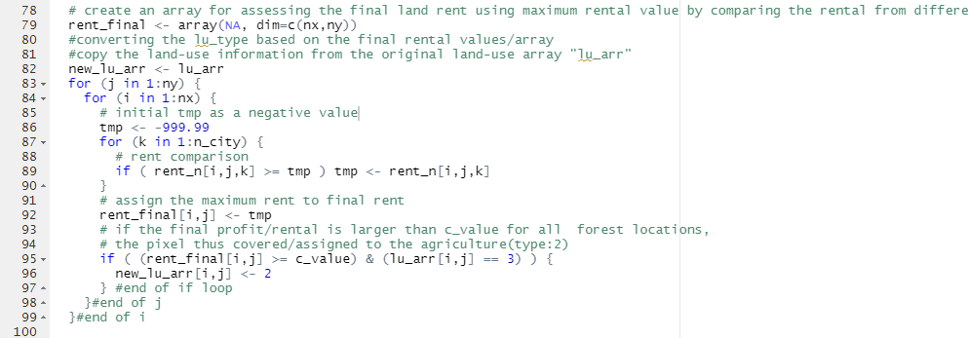
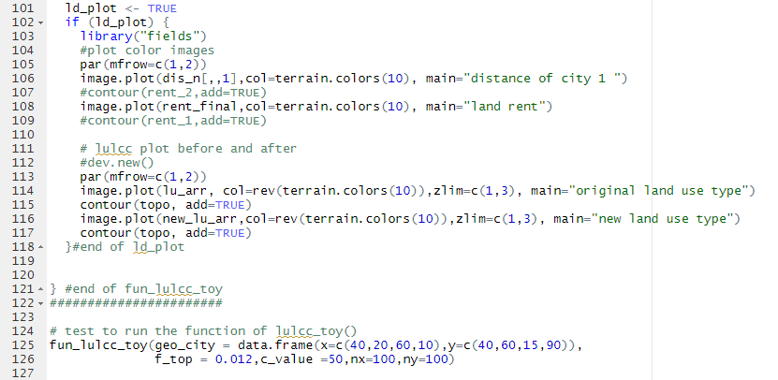

Slide 8
Fun_lulcc_toy() 程式執行結果
運送里程(City 1)
淨收益
原始土地使用空間位置圖
未來可能的土地使用變化空間圖

