Slide 1
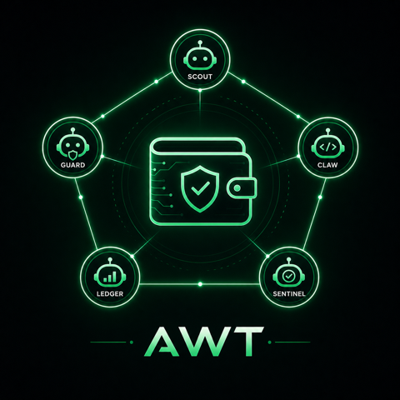
Agentic Wallet Treasury
Five ERC-8004 agents coordinate treasury decisions on Mantle: proposal, risk approval, execution, validation, and reputation.
Scout: proposal
Guard: EIP-712 approval
Claw: execution
Ledger: reputation
Sentinel: validation
Dashboard: ychenfen.github.io/agentic-wallet-treasury
GitHub: github.com/ychenfen/agentic-wallet-treasury

Slide 2
Problem
Mantle Turing Test Hackathon 2026
Agent wallets need accountability before they can manage capital.
Most demos stop too early
Treasury automation raises the stakes
Web3 has the right substrate
They show an AI suggesting or clicking an action, but skip durable identity, permissioning, replay safety, validation, and long-term reputation.
If agents can move assets, judges and users need to know who approved the action, why it was allowed, and whether the result matched policy.
Mantle + ERC-8004 lets agent decisions become verifiable artifacts instead of screenshots or unverifiable logs.

Slide 3
Solution
Mantle Turing Test Hackathon 2026
A full agent economy loop, not a single bot.
Scout proposes a bounded treasury action.
Guard checks policy and signs an EIP-712 ApprovedAction.
Claw executes through AgenticTreasury on Mantle Sepolia.
Ledger writes structured ERC-8004 reputation feedback.
Sentinel independently validates and posts the response.
IdentityRegistry
5 real agent IDs
ReputationRegistry
feedback events
ValidationRegistry
request + response
AgenticTreasury
EIP-712 execution

Slide 4
Architecture
Mantle Turing Test Hackathon 2026
The control loop is explicit, replay-safe, and inspectable.
Sentinel
validate
Scout
Guard
Claw
Treasury
proposal
policy + signature
execute
contract
Ledger
EIP-712 approval
reputation
ERC-8004 identity + reputation + validation

Slide 5
On-Chain Evidence
Mantle Turing Test Hackathon 2026
Every core claim is independently verifiable on Mantle Sepolia.
AgenticTreasury
Validation
0x739862c3cf9b5f9fe6a8ecd95e75714a20116fe9
Deploy tx: 0x649656b3...d2f190
request tx 0x652b7154...c448b6
response tx 0xe4897d7e...2cca8d
Five ERC-8004 identities
Scout #26, Guard #27, Claw #28, Ledger #29, Sentinel #30
Evidence report
SUBMISSION_HASHES.md lists all registry, reputation, validation, and treasury links.
Latest execution
Full evidence report
mantle-sepolia adapter submitted tx 0xa3d26423...a4ca8a

Slide 6
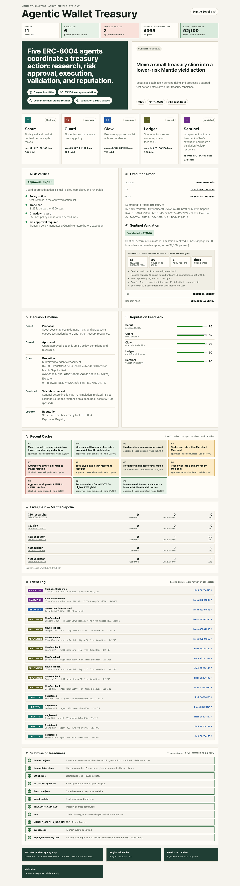
Live Dashboard
Mantle Turing Test Hackathon 2026
A judge-facing interface backed by real event data.
What to click
Execution proof links to Mantlescan.
Live Chain shows agent feedback and validation counts.
Event Log backfills Identity, Reputation, Validation, and Treasury events.
Current public state
Preflight: 11 pass / 0 warn / 0 fail
Events: 16 chain events
Latest validation: 92/100 passed

Slide 7
Why It Can Win
Mantle Turing Test Hackathon 2026
Track fit: Agentic Wallets & Economy.
ERC-8004 depth
Verifiable execution
Replayable demo
Uses all three surfaces: IdentityRegistry, ReputationRegistry, ValidationRegistry.
EIP-712 risk approval plus real AgenticTreasury execution on Mantle Sepolia.
Open-source scripts regenerate the dashboard, chain snapshots, event logs, and submission report.
Not overclaimed
Extensible
This is a control-plane primitive for agent wallets, not a profitability claim or paper trading leaderboard.
Same loop can serve RWA allocation, DeFi rebalancing, treasury ops, and validator reputation markets.

Slide 8
Roadmap
Mantle Turing Test Hackathon 2026
From hackathon proof to reusable agent wallet infrastructure.
Host agent metadata instead of data URIs for richer identity pages.
Add Mantle-specific Byreal Skills when released for this track.
Expand Sentinel adapters for quotes, slippage, gas, and policy proofs.
Package Guard policies as reusable wallet risk modules.
Move from demo treasury to account abstraction wallet integration.
Submission links
GitHub:
https://github.com/ychenfen/agentic-wallet-treasury
Dashboard:
https://ychenfen.github.io/agentic-wallet-treasury/
Evidence:
SUBMISSION_HASHES.md
Agentic Wallet Treasury gives Mantle a verifiable benchmark for autonomous wallet agents.

