Slide 1
banknote authentication, part ii:
A survey of models, attacks, and defenses
Alice chang, yu chen, Karthik umashankar

Slide 2
outline
Previous work done
Background
Processing raw data
Our contribution
Experimenting with other models
Attacking the model
Next steps

Slide 3
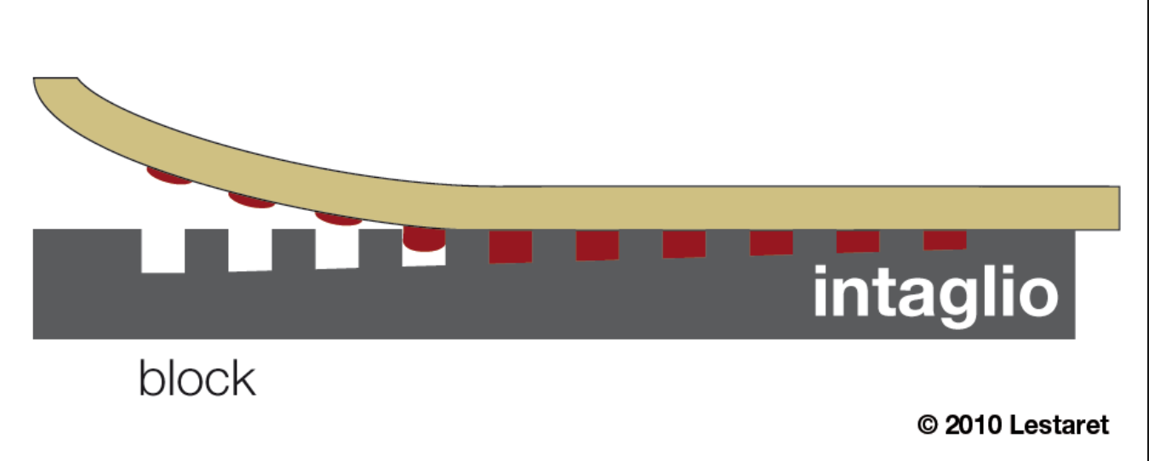
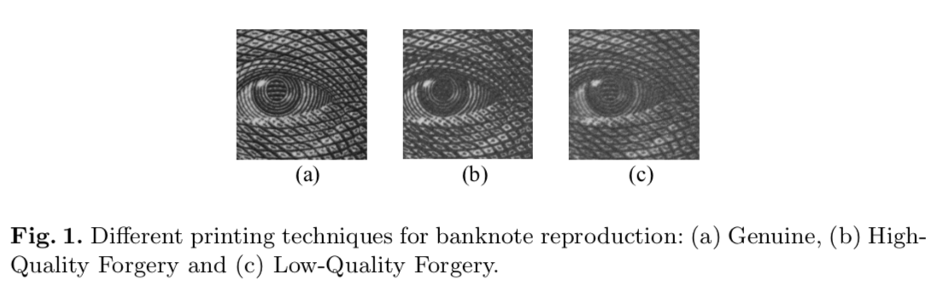
background
Basic premise: use the properties of Intaglio printing to differentiate between genuine bills from high-quality and low-quality forgeries.
The fine-grain detail is difficult to emulate, and is thus a good authentication feature.
several tons/cm² presses a feelable relief into the paper
ink

Slide 4
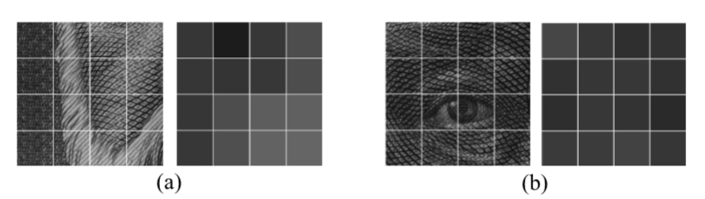
MACHINE LEARNING FOR FORGERY DETECTION
Pioneered by two researchers – Eugen Gillich and Volker Lohweg:
Leveraged Shift Invariant Wavelet Transform (SWT) + Support Vector Machine
Yielded 100% accuracy rate (threw out two outliers due to them being incomplete data points).
Took pictures of Regions of Interest (picked based on domain knowledge).
Averaged their mean gray values, and threw out non-homogeneous areas.
Homogeneity implied level of detail in original print.

Slide 5
Feature processing (INCOMPLETE)
Banknote image > Vector of RGB pixel values >

Slide 6
Our research (INCOMPLETE)
Comparison of models (KNN Classifier and Neural Network multi-layer perceptron classifier)
Performance metrics
Finding bias variance curve
Boiling Frog attack (and other drifting attacks)

Slide 7
FUTURE WORK (INCOMPLETE)

