Slide 1
banknote authentication, part ii:
A survey of models, attacks, and defenses
Alice chang, yu chen, Karthik umashankar

Slide 2
outline
Previous work done
Background
Processing raw data
Our contribution
Experimenting with other models
Attacking the model
Next steps

Slide 3
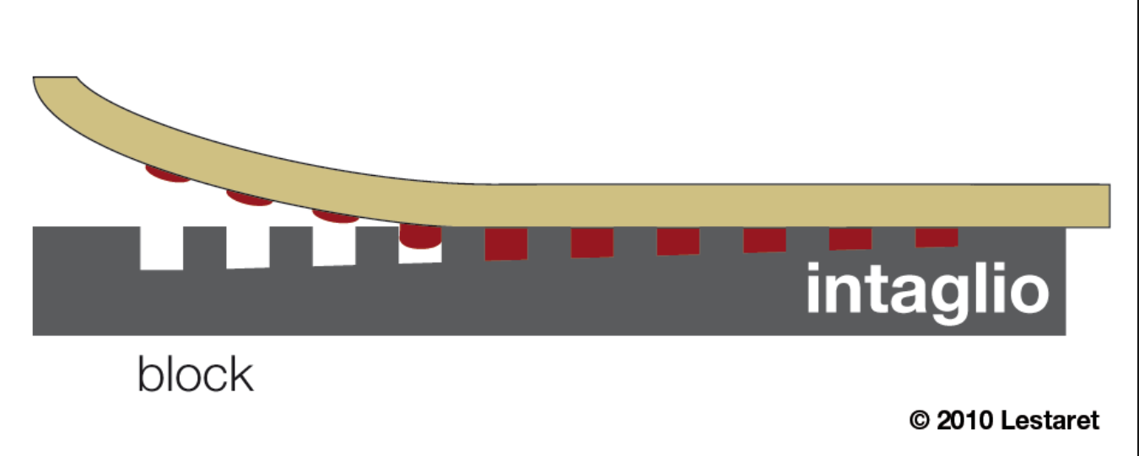
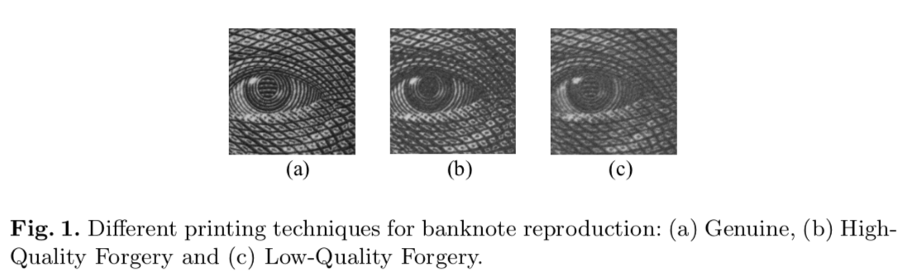
background
Basic premise: use the properties of Intaglio printing to differentiate between genuine bills from high-quality and low-quality forgeries.
The level of fine-grain detail is difficult to emulate, and is thus a good authentication feature.
several tons/cm² presses a feelable relief into the paper
ink

Slide 4
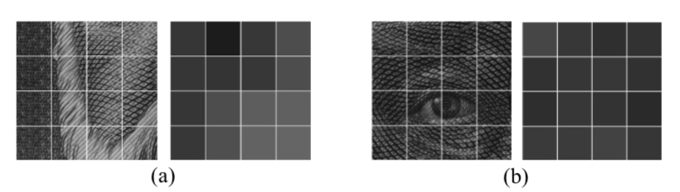
MACHINE LEARNING FOR FORGERY DETECTION
Pioneered by two researchers – Eugen Gillich and Volker Lohweg:
Leveraged Shift Invariant Wavelet Transform (SWT) + Support Vector Machine
Yielded 100% accuracy rate (threw out two outliers due to them being incomplete data points).
Four step process:
Image digitization using areas of homogeneous grayscale mean.
Preprocessing
Feature extraction
Classification

Slide 5
Feature processing (INCOMPLETE)

Slide 6
THEIR FINDINGS (INCOMPLETE)

Slide 7
Our FINDINGS: COMPARING CLASSIFIER MODELS
Comparison of models (KNN Classifier and Neural Network multi-layer perceptron classifier)
Performance metrics
Bias variance curves

Slide 8
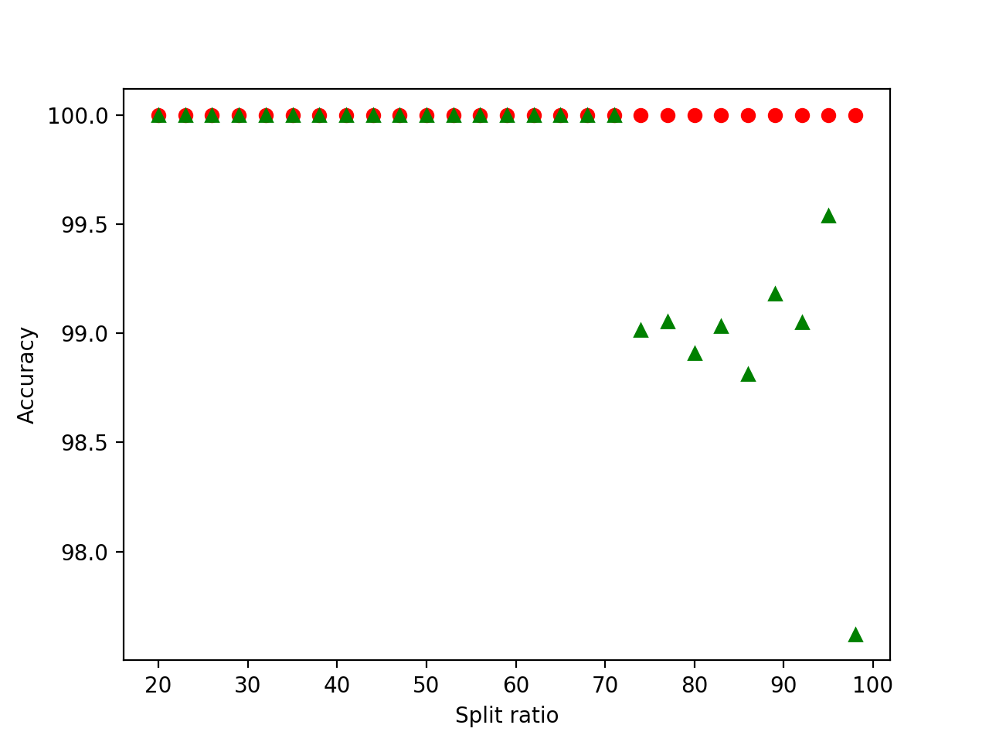
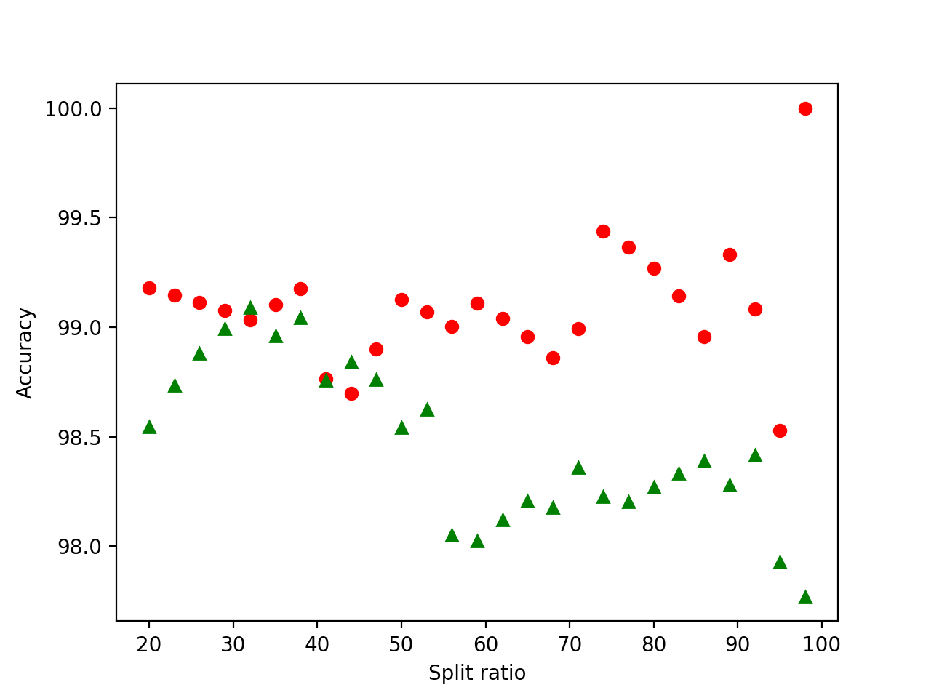
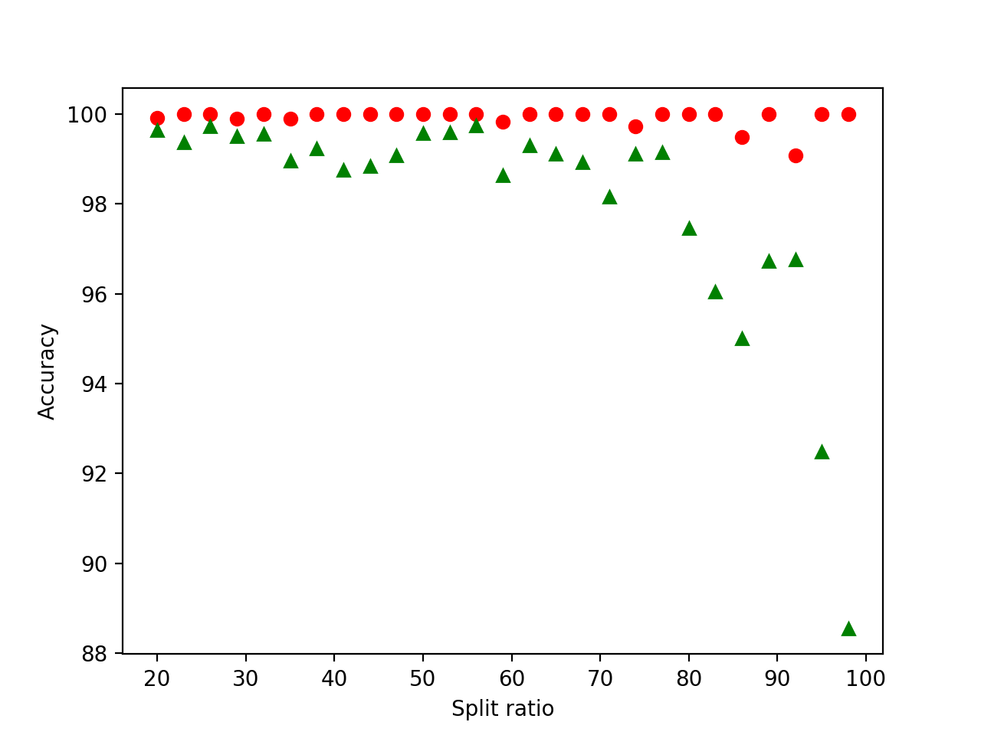
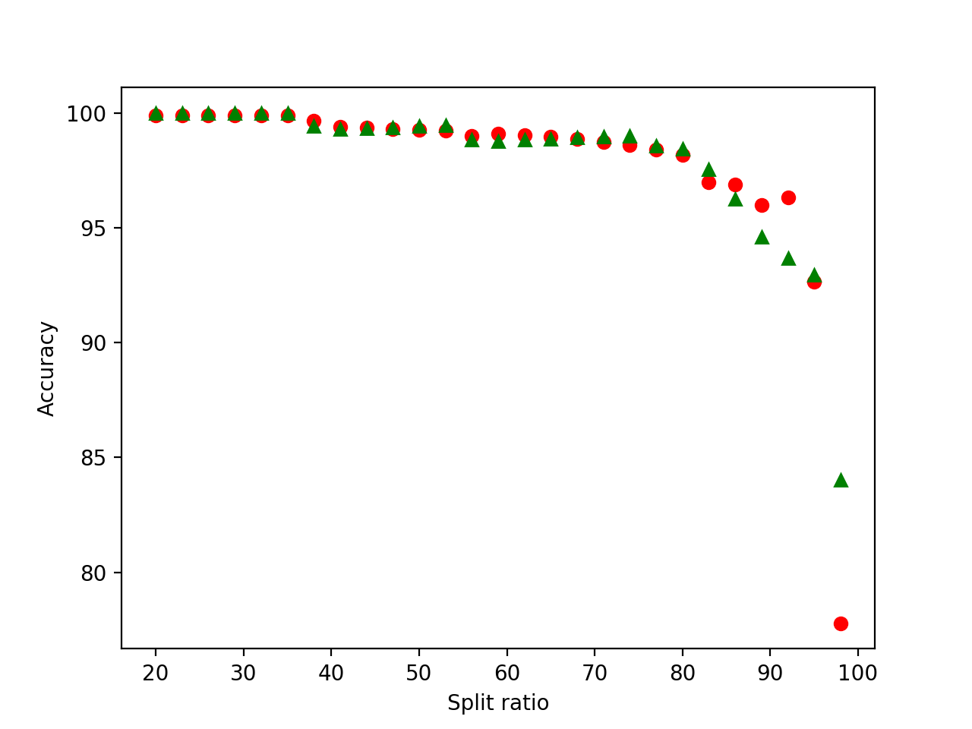
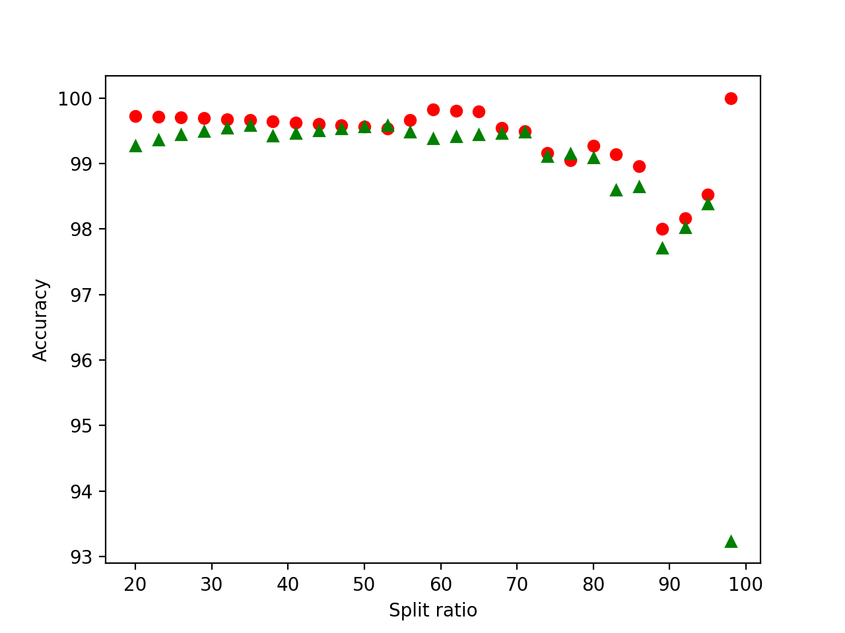
Bias Variance Curve
Training set
Test set
Neural network
Linear
Random forest
K-nearest neighbors
Gaussian

Slide 9
FROG BOILING ATTACK (FBA)
Only feasible when model is adaptive.
Works on concept of template drift.
F_{new} = F_{old} + (i − 1)δ(x)

Slide 10
FBA – Our implementation
Split dataset into training and test.
Over N iterations
Calculate new corrupt data record.
Insert into training set.
Fit training data.
Classify the corrupt record.
If detected, stop. Else continue
Classify test set, and find differences.

Slide 11
Classifier accuracies post attack
Notes:
KNN & NN only misclassified the data point closest to the centroid we drifted towards.
Linear SVC & Gaussian misclassified several data points around the centroid.
Random Forest thwarted the attack at each stage.

Slide 12
The random forest anomaly
Our FBA didn’t work when we chose Random Forest
In fact
Accuracy increased.
Didn’t complete full iteration count.
Why?
Notes:
Why is Random forest immune to FBA? Possibly because Random forest constructs a bunch of decision trees at training time, and the output classification is the mean prediction of individual trees. Since we started with a data point that was furthest out from the centroid of the positive mean, it didn’t take the decision trees based on feature values closer to the positive centroid to weigh in against the tree on the edge.

Slide 13
Counter-measures to fba
Freeze online training
Autocorrelation detection
Batched model updates

Slide 14
FUTURE WORK (INCOMPLETE)
Ability to reproduce using iPhone / mobile device?
Would the accuracy of classifiers improve with additional feature detection?

Slide 15
References

